Slide 1
Tic-Tac-Toe Game Using Python and Tkinter
Exploring Game Logic, AI Integration, and User Interface
Prudvikar Donthagani
Deepika Thiramdasu
Saiteja Dharmaram

Slide 2
Introduction
This presentation will cover the implementation of a Tic-Tac-Toe game in Python using Tkinter for the graphical user interface (GUI).
-Board
- Game Logic
- AI Integration (Minimax Algorithm)
- User Interface Design

Slide 3

Requirements and Libraries
Libraries Used:
- tkinter: For creating the graphical user interface (GUI).
- itertools.cycle: For cycling between players in the game.
- random: For random moves in AI.
- typing.NamedTuple: For creating immutable player and move data structures.
Key Concept: Tkinter is used for GUI, and other libraries help manage game logic and AI behavior.

Slide 4

Game Setup
Constants:
BOARD_SIZE = 3: 3x3 board for Tic-Tac-Toe.
DEFAULT_PLAYERS: X (Blue) and O (Green) players.
Explanation: The board size is 3, and there are two players, each with a label and color.

Slide 5
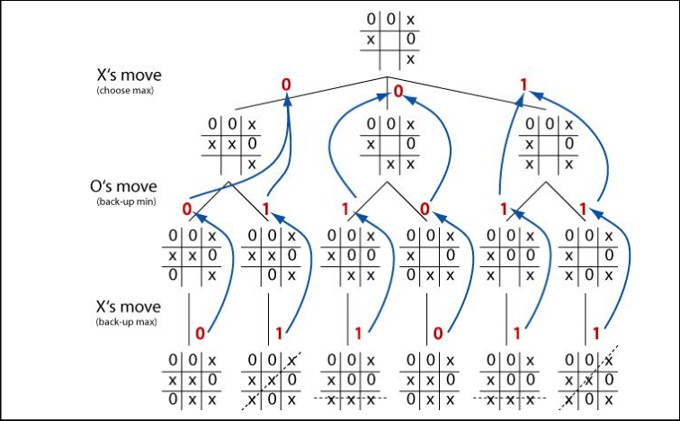
The Player and Move Classes
Player Class:
Contains two attributes: label (X or O) and color.
Move Class:
Represents each cell in the board with row, col, and label (either X or O).

Slide 6
The Tic-Tac-Toe Game Class
Purpose: Manages the game logic (turns, checking for winners, etc.).
Important Methods:
- toggle_player(): Switches between players after each move.
- is_valid_move(): Checks if a move is valid (e.g., cell is empty, no winner yet).
- process_move(): Applies the move and checks for a winner.

Slide 7
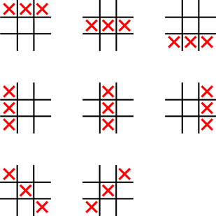
Winning Combinations
Winning Logic: The game checks for any horizontal, vertical, or diagonal combination of 3 identical labels (either X or O).
Method Used: _get_winning_combos(), which returns all possible winning combinations for rows, columns, and diagonals.

Slide 8

AI Integration Overview
Play with AI: The game can be played against AI, with difficulty levels: Easy, Medium, and Hard.
AI Move Decision:
- Easy: Random move.
- Medium: A strategic move based on blocking or winning.
- Hard: Uses the Minimax algorithm for optimal play.

Slide 9
The Minimax Algorithm
Explanation: The Minimax algorithm helps the AI decide the best possible move by simulating all possible future moves.
- Evaluate the board recursively to determine the best score.
- AI tries to maximize its chances (maximize score).
- Opponent tries to minimize AI’s score (minimize score).
Used in: The get_ai_move_with_difficulty() and _minimax() methods.

Slide 10
User Interface – The TicTacToeApp Class
Purpose: Initializes the game window and handles user input.
Key Methods:
- create_start_screen(): Displays the main menu.
- choose_difficulty(): Prompts user for difficulty level (if playing against AI).
- start_game(): Starts the game by initializing the TicTacToeGame class.

Slide 11
User Interface – The Game Board
TicTacToeBoard Class:
Displays the game board and updates it after every move.
Handles user clicks for player moves and AI moves.
- Visual display of the Tic-Tac-Toe grid using buttons.
- Updates turn display after each move.
- Highlights the winning combination.

Slide 12
Game Flow – Two Player Mode
Explanation of Two-Player Mode:
- Players take turns clicking on the grid.
- The game continues until there’s a winner or a tie.
- The display updates after each move (current player’s turn).
User Interaction: Each player can click on the empty grid cells.

Slide 13
Game Flow – AI Mode
AI Behavior:
- In AI mode, the game alternates between the human player (X) and AI (O).
- AI makes a move based on the selected difficulty level.
- The game logic automatically checks for a win or tie after every move.
AI Difficulties:
- Easy: Random move.
- Medium: Block or win if possible.
- Hard: Minimax algorithm for optimal strategy.

Slide 14
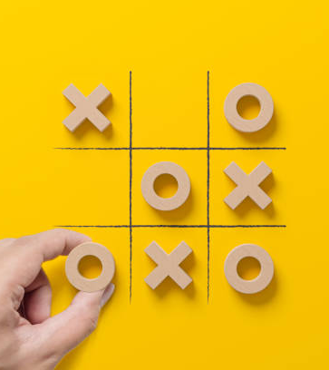
Reset and Quit Game
Resetting the Game:
- Clicking the ‘Reset Game’ button reloads the main menu.
- All data is cleared, and the game starts from scratch.
Exiting the Game:
- The quit button allows the user to close the application.

Slide 15
Conclusion and Key Takeaways
Recap: The presentation covered the implementation of a Tic-Tac-Toe game with AI using Python’s Tkinter library.
-Board
- Game Logic (turns, checks for winner, etc.)
- AI (Minimax algorithm, difficulty levels)
- GUI using Tkinter
- Adding multiplayer over the network, custom difficulty settings, animations, etc.

