Slide 1
Digital Communication Protocols
Name : Parmar TIRth
Company : ECO paradigm
Date : 23-02-2024

Slide 2
Outline
UART
USART
SPI
I2C
CAN
TWAI

Slide 3
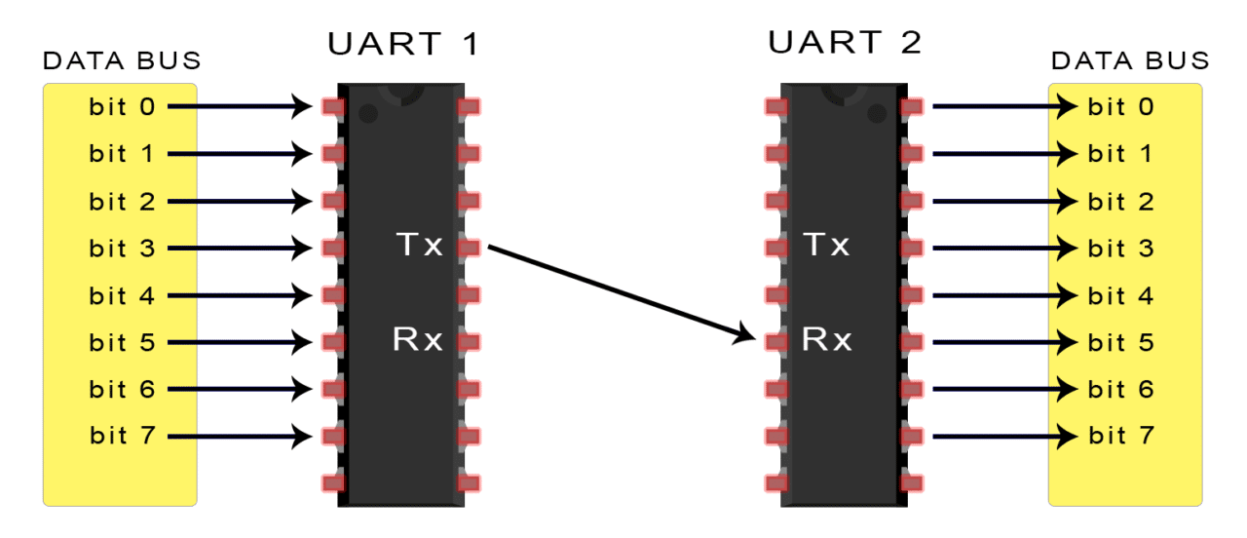
UART

Slide 4
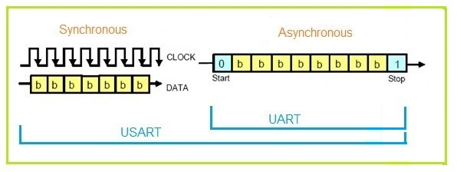
USART

Slide 5
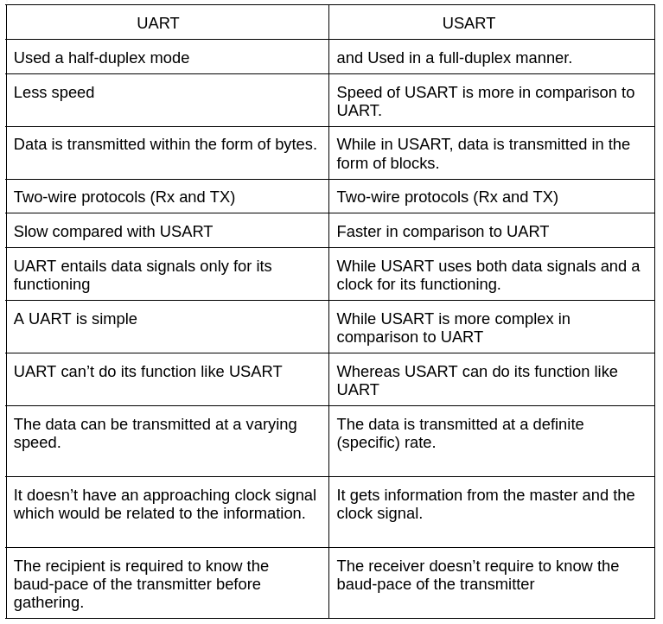
UART vs USART

Slide 6
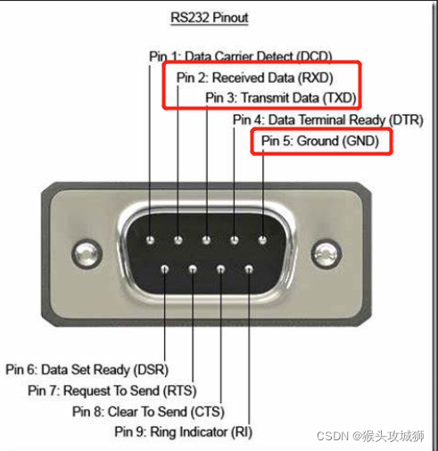
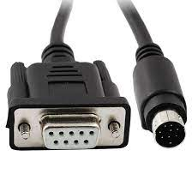
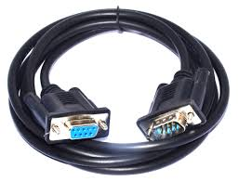
RS232

Slide 7
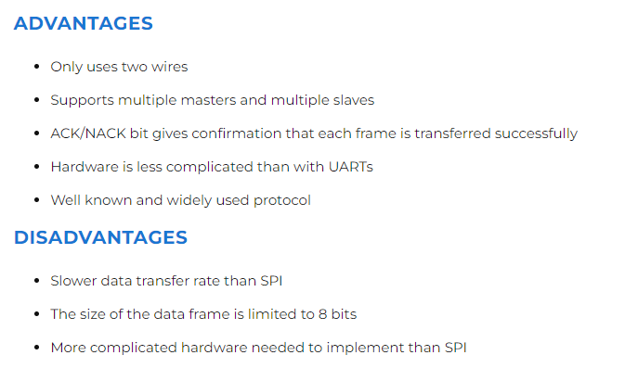
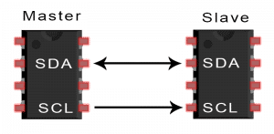
I2C

Slide 8
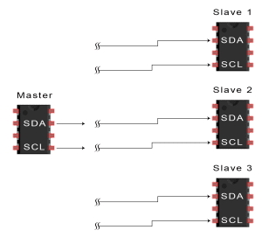
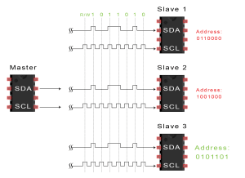
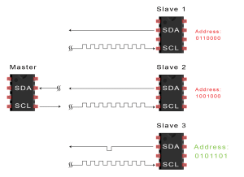
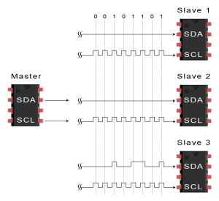
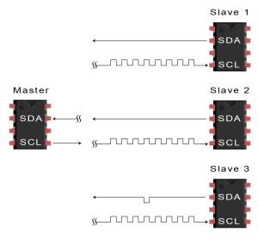
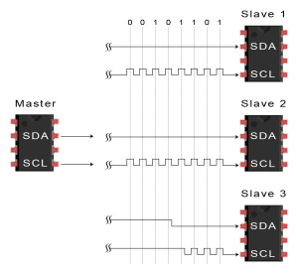
How it works??

Slide 9
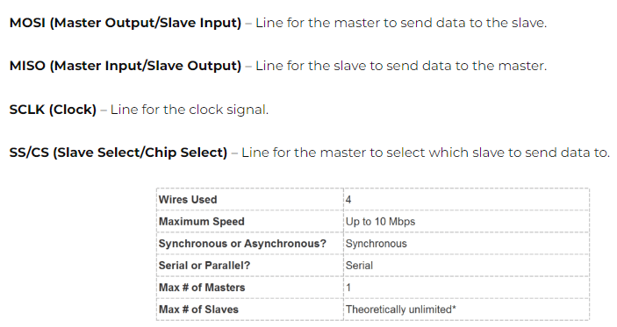
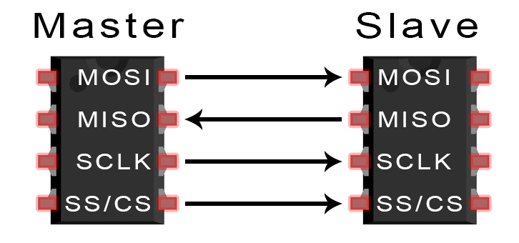
SPI

Slide 10




How it works??

Slide 11
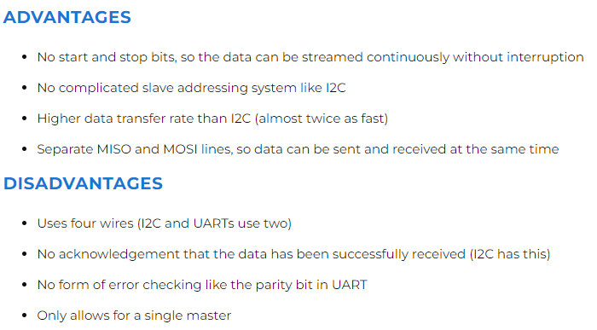
Pros & Cons

Slide 12
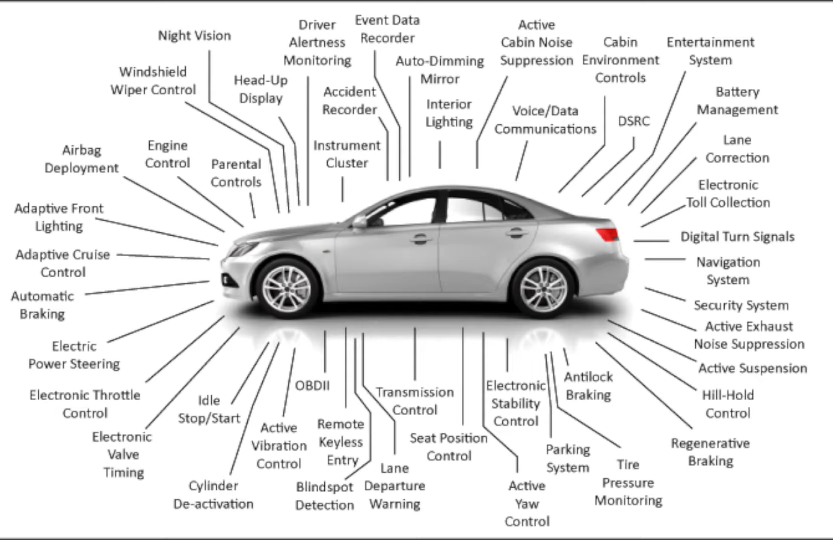
CAN

Slide 13
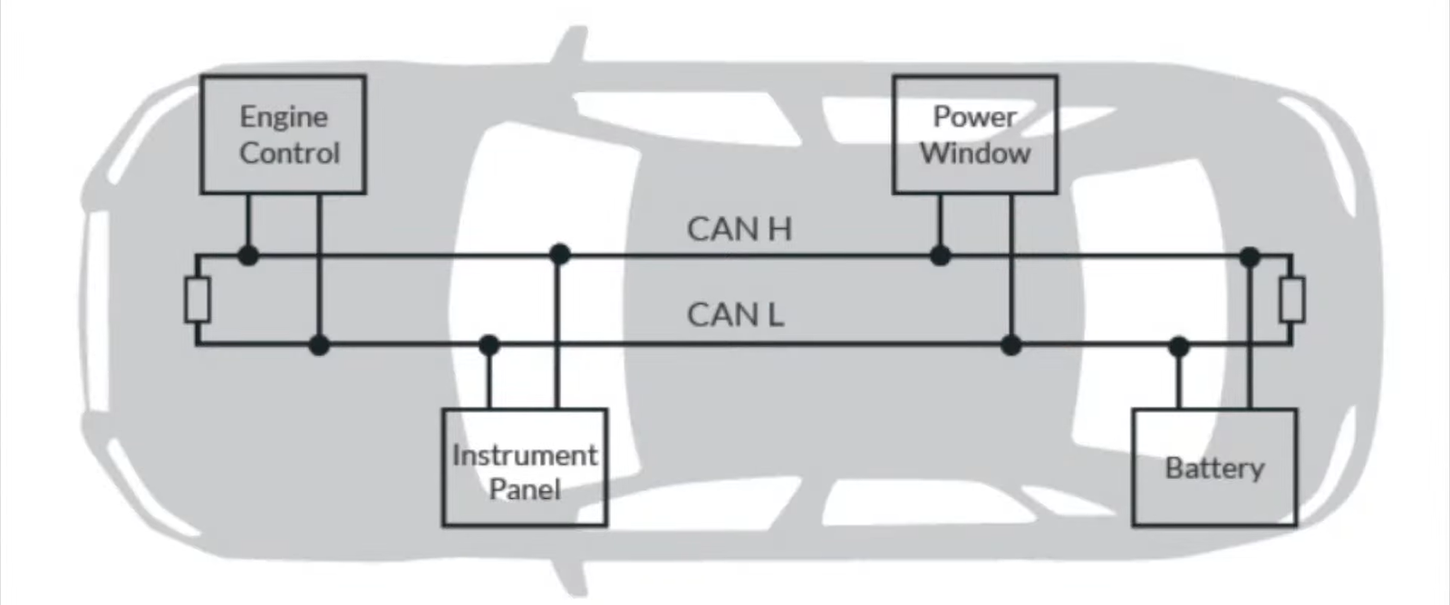

Slide 14
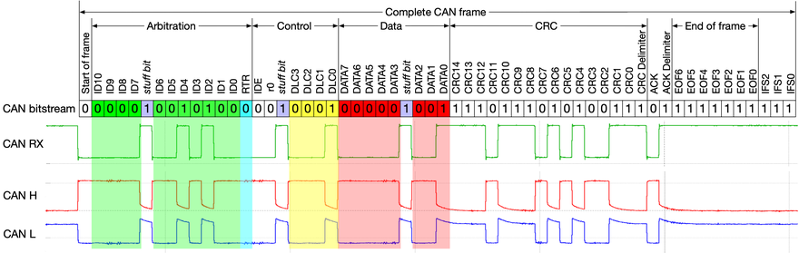
How it works??

Slide 15
TWAI
TWAI
CAN
LIN
SENT
CAN high
CAN low
LIN GROUND
Signal
Ground
LIN bus

Slide 16
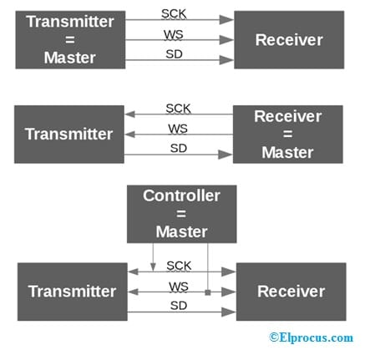
I2S
The protocol which is used to transmit digital audio data from one device to another device is known as I2S or Inter-IC Sound protocol.

Slide 17
Difference between Protocols
Parameters | UART | USART | SPI | I2C | I2S | CAN | RS232
Speed | slower | Fast than UART | fastest | Slower than SPI | Faster than I2C | moderate | slowest
Complexity | simple | moderate | Most complex | Less complex than I2C | More complex than I2S | Moderate | Simple
Number of wires | 2 | 4 | 4 | 2 | 3 | 2 | 9(4)
Duplex | Full duplex | Half/Full duplex | Full duplex | Half duplex | Full duplex | Half duplex | Full duplex

Slide 18
Communication type | Serial communication | Serial communication | Serial communication | Serial communication | Serial communication | Serial communication with multi-master capability. | Serial communication
Applications | In telecommunications, GPS modules, personal computers, Sim cards | embedded systems, communication between microcontrollers and peripherals. | Touchscreen, video game controller, RTC, SD Card, Temperature and Pressure sensors | Ports, LCD displays, LED driver, Motor controllers | Connecting digital audio devices, audio codec to play audio, connecting digital audio devices together | Automotive (passenger vehicles, trucks, buses) , Elevator and escalators, Electronic equipment for aviation and navigation | serial communication between computers and peripherals.
Baud rate | Can support a range of baud rates | Can support high baud rates | Can support high baud rates | up to 400 kbps (standard mode) or 3.4 Mbps (high-speed mode). | Can vary depending on the audio application. | Standard baud rates range from 10 kbps to 1 Mbps | up to 115,200bps
Cost | Low | Higher than UART | Higher than UART and I2C | Higher than UART | Higher than UART,I2C | Higher than SPI | Moderate
Synchronous/Asynchronous | Asynchronous | Both | Synchronous | Synchronous | Synchronous | Synchronous | Asynchronous

