Slide 1
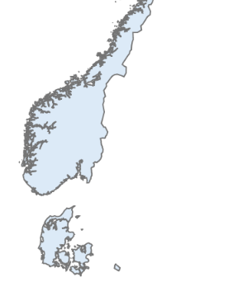
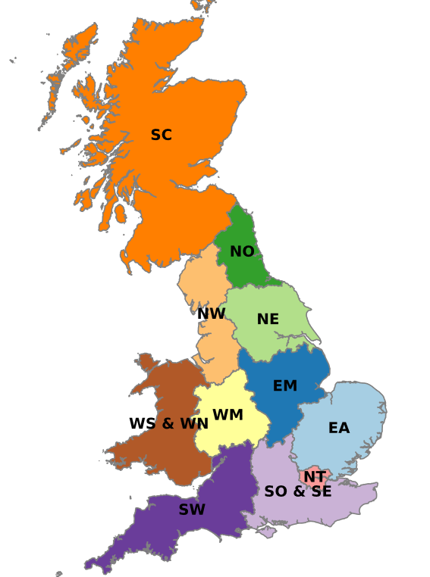
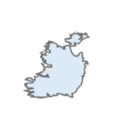
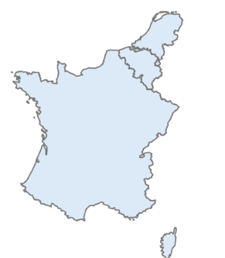
NO
0
3.5
0.15
DK
2
IE
0.15
0
4
5
NL
0
2.5
BE
FR

Slide 2
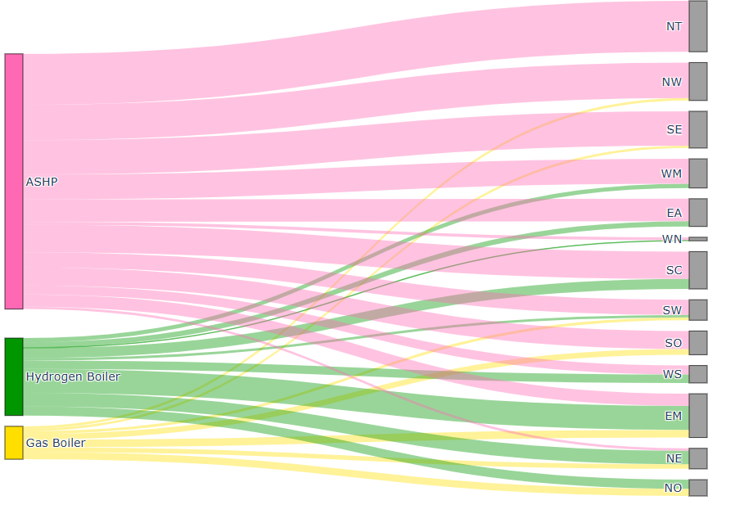
47
32
2
31
2
23
237 GW
4
21
5
2
0.5
26
10
14
2
17
5
72 GW
8
8
11
22
30 GW
7
12
4
6
8

Slide 3
