Slide 1

Presentation
By Tunde Olokun & Piyush Rana

Slide 2



Introduction referencing Proposal
- To overcome the problem of the voice recognition, we will be providing user with the feedback on success and failure of the activity.
We will be providing user on how to use the app/device in efficient way with different test plans and guide. To backup the user data, we will be creating the copy of database for the users.
This is an opportunity to integrate the knowledge and skills developed in our program to create a collaborative IoT capstone project demonstrating my ability to learn how to support projects such as the initiative described by [3].

Slide 3

- No new purchases made
- Amazon accounts made no charge.

Slide 4
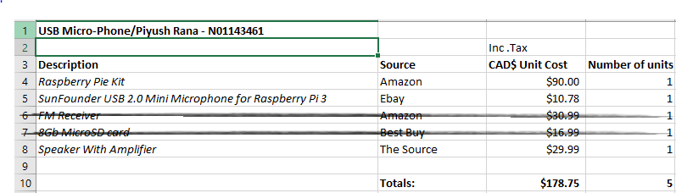
Budget for hardware

Slide 5

Project Schedule
Accomplished task date before deadline

Slide 6

Course knowledge utilized from previous courses
Java Docs from CENG 212 Programming Techniques In Java,
Construction of circuits from CENG 215 Digital And Interfacing Systems,
Rapid application development and Gantt charts from CENG 216 Intro to Software Engineering,
Micro computing from CENG 252 Embedded Systems,
SQL from CENG 254 Database With Java,
Web access of databases from CENG 256 Internet Scripting; and,
Wireless protocols such as 802.11 from TECH152 Telecom Networks.

Slide 7
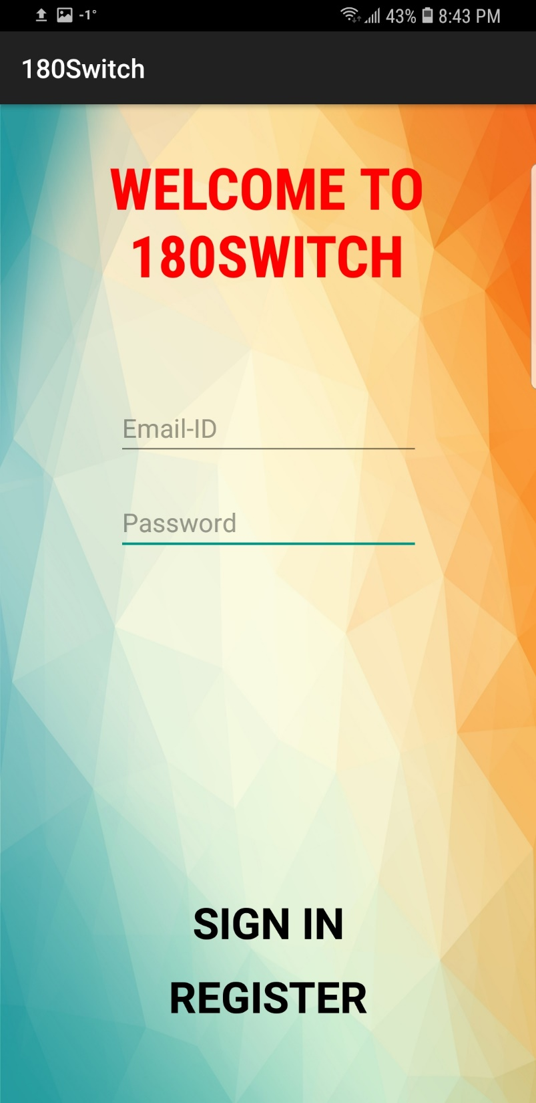
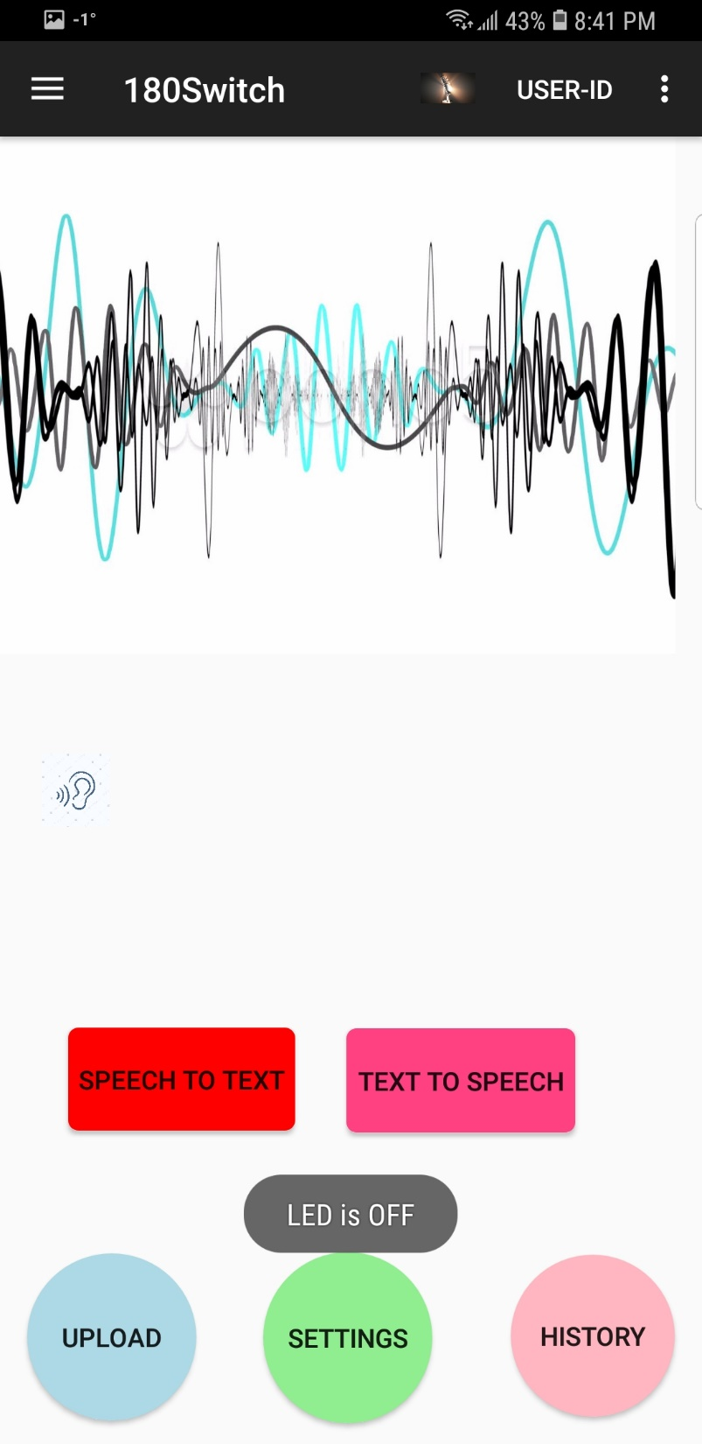
180 Switch

Slide 8
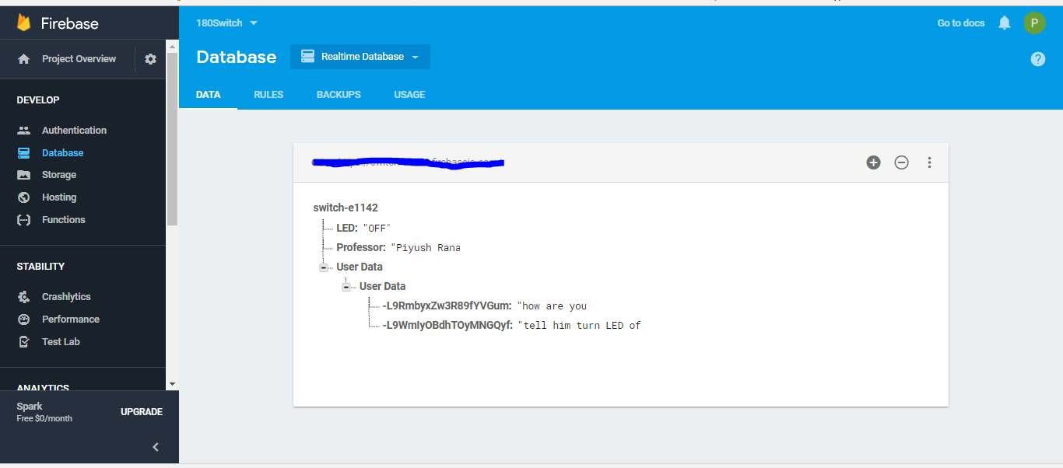
Firebase Database layout

Slide 9
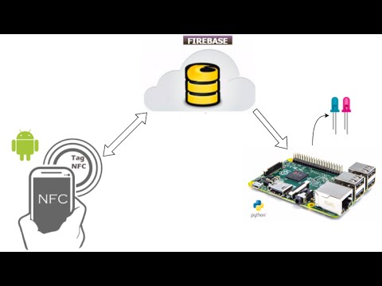
Integration of hardware and software using Firebase database
Two ways to connect Amazon Alexa to the firebase database.
External service using https connection.
Using AWS lambda.

Slide 10


Slide 11

So what makes this project interesting?
-Benefits of this app
-Its possibilities

Slide 12

This Project is based on the idea of providing efficient and user friendly environment to the people for latest news feed and some household control.

