Slide 1
HEA Fellowship in Maths
AFHEA / FHEA / SFHEA
Notes:
This is a presentation to cover some of the requirements for HEA fellowship applications.

Slide 2
HEA Fellowship Terminology
Bath Course
UKPSF
Pathways to Higher Education Academy Fellowship (PHEAF)
PSF23
Notes:
This is some of the old and new terminology used:
What was known as the “Bath Course” is now the “PHEAF”
The UKPSF (published in 2011) is now the “PSF23” (published in 2023 and will be implemented starting January 2025)

Slide 3

“Typical” Timeline
AFHEA
Associate Fellowship
SFHEA Senior Fellowship
PFHEA Principal Fellowship
FHEA Fellowship
Notes:
Depending on your experience and qualification, you can apply for any of these at any point, you do not have to follow this exact timeline.
I will not be discussing the PFHEA because the university does not have a scheme to support that. I will have to be done directly through Advance HE.

Slide 4
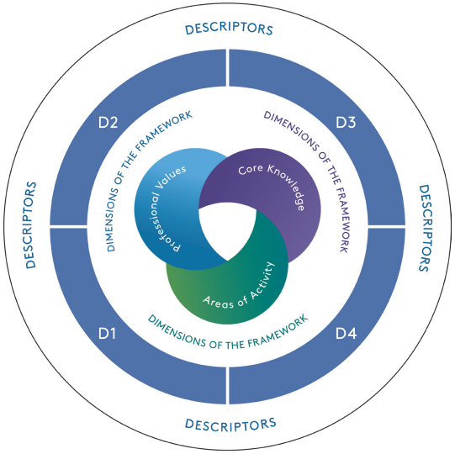
Professional Standards Framework
Notes:
This is the general view of the HEA application that fall into 4 descriptors, each following 3 dimensions.

Slide 5
Descriptors
FHEA
SFHEA
Fellowship
Category
Tool
AFHEA
PFHEA
Notes:
The descriptors are the different application routes:
D1: AFHEA
D2: FHEA
D3: SFHEA
D4: PFEA
If you want to see which one you should apply for, it is worth going to the “Fellowship Category Tool”. This page will ask some questions and determine which is the best one to apply for. Alternatively, you can speak to your Champion about that.

Slide 6
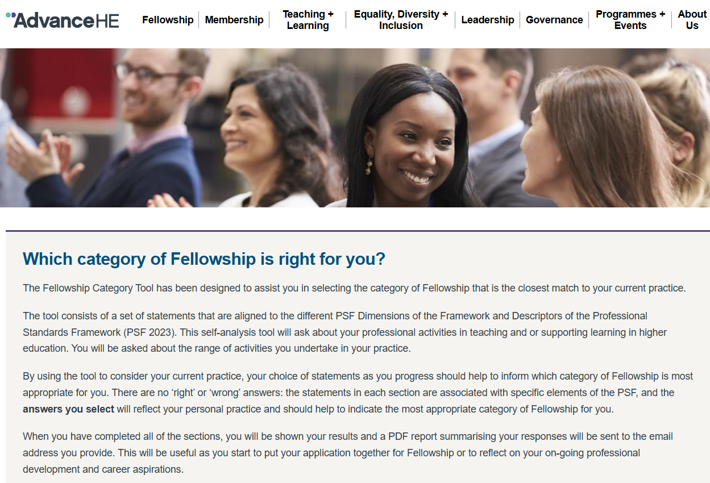
Fellowship Category Tool

Slide 7
Which One to Apply For?
AFHEA
Effectiveness of practice in teaching and/or support of learning.
FHEA
Effectiveness of practice in teaching and/or support of high-quality learning.
SFHEA
Comprehensive understanding and effective practice.
Lead or influence those who teach and/or support high-quality learning.
New GTA’s, new lecturers, anyone tutors, involved in teaching but not planning.
Student feedback.
Student feedback.
Innovative teaching practices.
Experienced GTA’s, lecturers, student-facing roles, teaching and planning.
Mentoring new staff.
Leading teaching initiatives.
Senior lecturers, staff-facing roles, committee members, collaborative boards.
Notes:
This is the general idea of who would be able to apply for which descriptor.
D1: Talk about your direct teaching practices, what you have done, what experiences you have undergone and how you have conducted your teaching.
D2: Talk about your general teaching approach in a wider context. Talk about your general preparation of material, your advice to tutors, your collaboration with others to build a unit that aligns with the ILOs.
D3: Focus on your influence on others. How have you helped your colleagues to run their lectures and teaching. How have you influenced their work and teaching, what have you done to improve your teaching and their teaching. Have you run any sessions or seminars or workshops for development of your fellow colleagues. You can talk about your teaching experience with students but make sure you expand on that and see what you have done afterwards and of others have adopted it with their students. Focus on a wider influence and leadership role. Ask yourself, what would happen if I was not there.

Slide 8
Emphasis
D3
Your colleagues’ teaching
D2
Your overall teaching
D1
Your own teaching
Notes:
From the way these are generally built, it might seem that they are hierarchical, but they are not. They can all be treated as independent from one another.

Slide 9
Emphasis
D1
Your own teaching
D2
Your overall teaching
D3
Your colleagues’ teaching

Slide 10
Emphasis
D1: AFHEA
Your teaching.
Your teaching.
D2: FHEA
Your practice.
Your general conduct.
Your ethos.
Your experience.
Your alignment.
Your assessment practices.
Notes:
The general emphasis of the applications depends on what you are trying to convey.

Slide 11
Emphasis
D3: SFHEA
Your influence on others through mentoring (including GTAs).
Your leadership role.
Your effect on the teaching and conduct of others.
How your learners get their learners to learn.
Coordination of L&T committees, initiatives and projects.
Develop L&T resources used by others.
Peer review of colleagues.
Contribution to L&T accreditations.
Notes:
The general emphasis of the applications depends on what you are trying to convey.

Slide 12
Professional Standards Framework

Slide 13
Dimensions
Notes:
The building blocks of the application will be the dimensions.

Slide 14
Areas of Activity
PSF23 | Descriptor
A1 | Design and plan learning activities and/or programs
A2 | Teach and/or support learning through appropriate approaches and environments
A3 | Assess and give feedback for learning
A4 | Support and guide learners
A5 | Enhance practice through own continuing professional development
Notes:
The application will revolve around these 5 Areas of Activity. You will need to focus on 2 of these if applying for an AFHEA and all 5 otherwise.

Slide 15
Areas of Activity
A1
Design and plan learning activities and/or programs
AFHEA
Comprehensive planning for diverse learning environments (e.g. tutorials vs lectures, online vs in-person, etc.).
Focus on skill development and support (e.g. technical skills).
FHEA
Curriculum development and customization (e.g. learning activities and materials).
Inclusive and industry-relevant learning experiences (relevant curriculum with long-term view).
SFHEA
Leadership in curriculum development.
Mentoring less experienced educators and supervisors (e.g. through observations).
Enhance learning outcomes through collaboration.
Notes:
A1: In your context:
Creating accessible material, have content delivered in a way appropriate to the context, build tutorial exercises that complement the lecture material.
AFHEA:
Comprehensive Planning for Diverse Learning Environments: You create inclusive lesson plans and individual learning plans, while also designing activities for one-on-one tuition, group sessions, and various educational contexts, including online and practical settings.
Focus on Skill Development and Support: Your planning emphasizes the development of learners’ technical skills and research capabilities, ensuring they receive tailored support to enhance their learning experience and engagement with the curriculum
FHEA:
Curriculum Development and Customization: You focus on designing and redesigning programs of study, creating new learning activities, and developing customized support materials to enhance student learning and professional development.
Inclusive and Industry-Relevant Learning Experiences: Your work emphasizes designing inclusive and accessible learning activities that foster a sense of belonging, while also ensuring that curricula remain current and responsive to industry demands and regulatory standards.
SFHEA:
Leadership in Curriculum Development and Support: You actively support and guide colleagues in designing and updating programs of study, mentoring less experienced supervisors, and coordinating the development of doctoral programs, ensuring alignment with institutional policies and industry standards.
Enhancing Learning Outcomes through Collaboration: Your efforts focus on influencing the design of learning activities and induction processes, fostering the effective use of digital technologies, and contributing to accreditation processes, all aimed at enabling colleagues to provide robust support for students to achieve challenging learning outcomes.

Slide 16
Areas of Activity
A2
Teach and/or support learning through appropriate approaches and environments
AFHEA
Facilitation of diverse learning experiences (e.g. running tutorials, MASH or outreach events).
Development of skills and resources (supporting development of academic and research skills).
FHEA
Adaptation and facilitation of learning in different environments.
Development of skills and supportive technologies.
SFHEA
Leadership and mentorship in teaching through mentoring.
Innovation and development of learning environments (lead initiatives to improve learning environments).
Notes:
A2: In your context
Support learners through other means, like in AA meetings, running training sessions with others that will influence the students’ practices (like tutorial training).
AFHEA:
Facilitation of Diverse Learning Experiences: You engage in running seminars, tutorials, and practical sessions, both individually and in teams, to enhance student learning across various contexts, including fieldwork and community events.
Development of Skills and Resources: You focus on supporting the development of academic and research skills through workshops and customized resources, while also creating digital learning opportunities tailored to specific disciplines and learner needs.
FHEA:
Adaptation and Facilitation of Learning: You effectively work with learners in various settings—individually, in groups, online, or in person—tailoring your teaching approaches to meet diverse learning goals and enhancing professional practice across different environments.
Development of Skills and Supportive Technologies: You focus on developing learners’ research and practical skills while also creating tools and technologies that support virtual learning environments, ensuring that educational experiences are relevant and accessible in various contexts, including work-based and online learning.
SFHEA:
Leadership and Mentorship in Teaching Practices: You actively coach and mentor both new and established staff in teaching and learner support, enhancing their practices through observation, guidance, and training, while also developing research students as effective educators.
Innovation and Development of Learning Environments: You lead initiatives to improve learning environments and support systems, collaborating with senior teams to implement innovative pedagogies and resource allocation strategies that enhance the quality of education across various settings.

Slide 17
Areas of Activity
A3
Assess and give feedback for learning
AFHEA
Comprehensive assessment and feedback (e.g. providing timely, constructive feedback).
Support for learner development (e.g. facilitating self- and peer-assessment for independent learning).
FHEA
Adapt assessment approaches to enhance specific skills (e.g. critical thinking, digital literacy, etc.).
Provide support for students preparing for summative assessments (e.g. practice opportunities, feedback).
SFHEA
Development of assessment practices.
Support and professional development for educators (e.g. mentoring and developmental feedback).
Notes:
A3: In your context
Build assessment in a way that tests the students appropriately, building on the ILOs and the material they have learned in the past. Formative vs Summative assessment and feedback, types of feedback to students or responding to their feedback.
AFHEA:
Comprehensive Assessment and Feedback: You focus on familiarizing learners with assessment criteria and providing timely, constructive feedback across various tasks, including formative assessments, online quizzes, and oral feedback in practical settings, all aimed at enhancing the quality of their work.
Support for Learner Development and Well-Being: You design formative tasks to prepare learners for summative assessments, promote academic integrity, and create a supportive environment that reduces anxiety around assessments, while also facilitating self- and peer-assessment to foster independent learning.
FHEA:
Tailored Assessment Strategies and Academic Integrity: You develop and adapt assessment approaches to enhance specific skills such as critical thinking and digital literacy, while ensuring adherence to academic integrity and quality assurance standards relevant to your field.
Comprehensive Support for Learner Development: You provide robust support for students preparing for summative assessments, including practice opportunities and feedback mechanisms, while also advising on revisions and fostering learner autonomy through diverse assessment tasks.
SFHEA:
Coordination and Development of Assessment Practices: You manage and coordinate assessment and feedback approaches across various programs, developing support materials and practices while supervising assessment panels and leading initiatives to enhance these processes.
Support and Professional Development for Educators: You provide mentoring and developmental feedback to both new and experienced teachers, facilitating staff development activities focused on assessment, and ensuring the effective use of technology to uphold academic integrity and improve learner feedback.

Slide 18
Areas of Activity
A4
Support and guide learners
AFHEA
Engagement with administrative and support services (MASH, MAST, etc.).
Development of inclusive learning resources to ensuring that all students understand and engage with the material.
FHEA
Promotion and engagement with administrative and support services (MASH, MAST, SSLC, DLTQC).
Holistic support and guidance (e.g. support students in their academic journey).
SFHEA
Leadership in developing learning support (collaborating with other teams to enhance learning support).
Mentoring colleagues.
Facilitation of student engagement.
Notes:
A4: In your context
Providing resources or signposting.
AFHEA:
Promotion and Engagement with Support Services: You raise awareness of academic and well-being support services, guiding learners to access resources that address their individual needs, including emotional well-being, mental health, and academic skills development.
Development of Inclusive Learning Resources: You provide tailored resources and support to enhance learners’ skills—such as research, writing, and presentation—while modeling inclusive practices and ensuring that all students understand the importance of academic integrity and can effectively engage in online learning environments.
FHEA:
Promotion and Engagement with Support Services: You ensure that students are aware of available support services and develop strategies to encourage positive engagement with these resources, including library, learner support, and career services. You also facilitate community-building activities that foster social engagement and a sense of belonging.
Holistic Support and Guidance: You provide tailored support to help students navigate their academic journey, integrating diverse perspectives into learning experiences, guiding them in using digital technologies effectively, and addressing individual needs through collaboration with specialists. This includes organizing revision sessions and responding to student feedback and concerns to enhance their learning experience.
SFHEA:
Leadership in Developing Learning Support Services: You take a proactive role in collaborating with senior teams to design and enhance learning support services, mentoring colleagues to recognize when to refer students to specialized support and promoting inclusive practices that foster a sense of belonging among diverse learners.
Facilitation of Student Engagement and Digital Experience: You ensure that your teaching and support teams develop strategies to encourage proactive student engagement, while also leading initiatives to improve the digital learning experience, making resources accessible and tailored to meet the needs of all students, especially during critical transition periods.

Slide 19
Areas of Activity
A5
Enhance practice through own continuing professional development
AFHEA
Actively participate in staff development events (e.g. CLT, doctoral college).
Responsive and inclusive teaching practices (through published research).
FHEA
Actively engage in role-specific training (e.g. peer observation, teaching-based courses, iTrent, CLT, L&T Hub).
Disseminate findings through seminars, publications, working groups, etc..
SFHEA
Influence through leadership and mentorship by engaging in professional development.
Commitment to professional growth.
Notes:
A5: In your context
Being aware of else is out there, like attending sessions run by CLT, L&T Hub, Doctoral college, iTrent, PRiME, workshops, etc..
AFHEA:
Commitment to Professional Development and Collaboration: You actively participate in staff development events and engage in credit-bearing programs, while also observing colleagues and inviting feedback on your own teaching practices to foster a culture of continuous improvement.
Responsive and Inclusive Teaching Practices: You utilize published research to inform your teaching, adapt your methods based on learner feedback, and focus on meeting the diverse needs of students, enhancing accessibility and inclusion in the learning environment.
FHEA:
Commitment to Continuous Improvement: You actively engage in role-specific training, peer observation, and professional associations to refine your teaching practices, implementing evidence-informed approaches and seeking advice from colleagues to address challenges effectively.
Research and Resource Development: You conduct action research and disseminate findings through conferences or publications, while also creating resources to support learners, particularly those with learning difficulties, thereby enhancing the overall educational experience.
SFHEA:
Influence Through Leadership and Mentorship: You actively engage in professional development related to academic leadership, using your experiences in roles such as curriculum redesign and external examining to mentor staff and enhance their practices, thereby positively influencing the work of others.
Commitment to Professional Growth and Community Engagement: You leverage your learning from professional development to support new educators and contribute to professional associations, demonstrating the impact of your work and enriching the overall quality of teaching and learning within your institution.

Slide 20
Professional Values
PSF23 | Descriptor
V1 | Respect individual learners and diverse groups of learners
V2 | Promote engagement in learning and equity of opportunity for all to reach their potential
V3 | Use scholarship, or research, or professional learning, or other evidence-informed approaches as a basis for effective practice
V4 | Respond to the wider context in which higher education operates, recognising implications for practice
V5 | Collaborate with others to enhance practice
Notes:
The first one is Core Values which is the foundation for professional practice:
V1
Creating an inclusive learning environment by fostering collaboration among learners, setting clear expectations and accommodating diverse needs.
V2
Actively identify and address the challenges faced by learners by collaborating with colleagues to implement supportive adaptations, ensuring material is widely accessible that accommodates for diverse needs while promoting proactive engagement and monitoring learner progress.
V3
Employ effective learning strategies and insights gained from professional development and experience to adapt your teaching practices and integrate workplace-relevant activities. Drawing on your professional experiences to inform resource recommendations and program design.
V4
Actively enhance learner engagement by identifying challenges and integrating real-life examples into the curriculum. Developing skills crucial for critical thinking and employment.
V5
Enhance your teaching practice by actively collaborating with colleagues and professional networks, seeking and applying feedback to address challenges, participating in team-based initiatives to develop resources.

Slide 21
Core Knowledge
PSF23 | Descriptor
K1 | How learners learn, generally and within specific subjects
K2 | Approaches to teaching and/or supporting learning, appropriate for subjects and level of study
K3 | Critical evaluation as a basis for effective practice
K4 | Appropriate use of digital and/or other technologies, and resources for learning
K5 | Requirements for quality assurance and enhancement, and their implications for practice
Notes:
The there are the aspects of the Core Knowledge:
K1
Incorporating learning theories and professional knowledge to emphasise active learner engagement through effective feedback.
K2
Use of different pedagogical methods and support to enhance teaching effectiveness and learner engagement. Reflecting on professional development and collaboration with colleagues to continuously improve educational practices.
K3
Comprehensive evaluation of teaching effectiveness while incorporating learner feedback, personal observations, colleague discussions, data from university systems and formal assessments.
K4
Incorporation of technology and resources in teaching (for example, to ensure accessibility or for visualization of abstract concepts).
K5
Active involvement in enhancing learner experiences through feedback (through Week 4 feedback or OUEs for example), quality assurance of the curriculum (through DLTQC) and assessments (possibly through working groups and tutorial setting), alignment of learning activities with ILOs, engage and promote practices across the department (e.g. consistency, fairness and continuous improvement in educational quality).

Slide 22
Professional Standards Framework

Slide 23
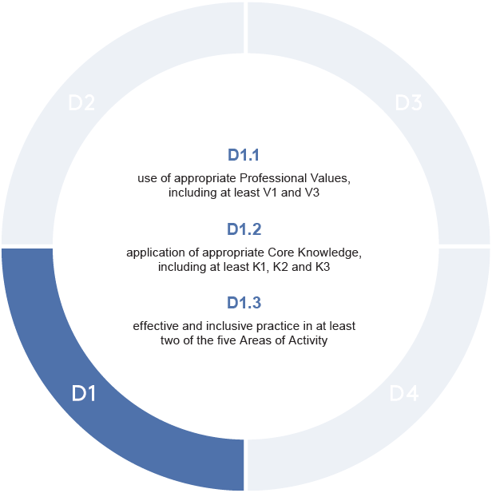
D1: AFHEA
Descriptor D1
Suitable for individuals whose practice enables them to evidence some Dimensions.
Emphasis: Effectiveness of practice in teaching and/or support of learning.
Notes:
V1: Respect individual learners and diverse groups of learners
V3: Use scholarship, or research, or professional learning, or other evidence-informed approaches as a basis for effective practice
K1: How learners learn, generally and within specific subjects
K2: Approaches to teaching and/or supporting learning, appropriate for subjects and level of study
K3: Critical evaluation as a basis for effective practice

Slide 24
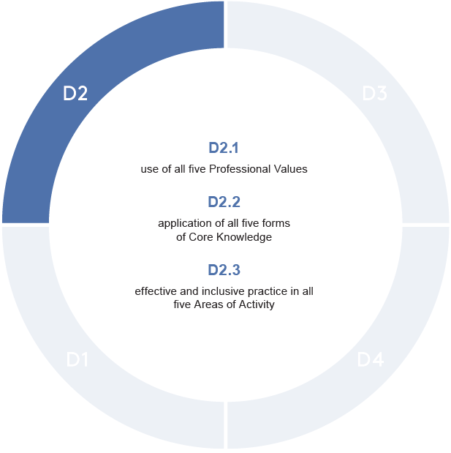
D2: FHEA
Descriptor D2
Suitable for individuals whose practice with learners has breadth and depth, enabling them to evidence all Dimensions.
Emphasis: Effectiveness of practice in teaching and/or support of high quality learning.

Slide 25
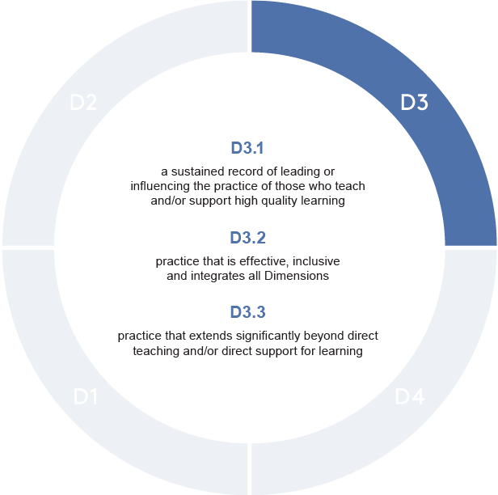
D3: SFHEA
Descriptor D3
Suitable for individuals whose comprehensive understanding and effective practice provides a basis from which they lead or influence those who teach and/or support high-quality learning.

Slide 26

Areas of Activity
PSF23 | Descriptor
A1 | Design and plan learning activities and/or programs
A2 | Teach and/or support learning through appropriate approaches and environments
A3 | Assess and give feedback for learning
A4 | Support and guide learners
A5 | Enhance practice through own continuing professional development
$${}_{}^{5}{C_{2}}$$
Notes:
For AFHEA, you need to talk about 2 out of the 5 areas of activity depending on what you have done.
The others require all 5.

Slide 27
Professional Values
PSF23 | Descriptor
V1 | Respect individual learners and diverse groups of learners
V2 | Promote engagement in learning and equity of opportunity for all to reach their potential
V3 | Use scholarship, or research, or professional learning, or other evidence-informed approaches as a basis for effective practice
V4 | Respond to the wider context in which higher education operates, recognising implications for practice
V5 | Collaborate with others to enhance practice
Notes:
For AFHEA, you need to include at least V1 and V3.
The others require all 5.

Slide 28
Core Knowledge
PSF23 | Descriptor
K1 | How learners learn, generally and within specific subjects
K2 | Approaches to teaching and/or supporting learning, appropriate for subjects and level of study
K3 | Critical evaluation as a basis for effective practice
K4 | Appropriate use of digital and/or other technologies, and resources for learning
K5 | Requirements for quality assurance and enhancement, and their implications for practice
Notes:
For AFHEA, you need to include at least K1, K2 and K3.
The others require all 5.

Slide 29
Submission Requirements
Requirements | AFHEA | FHEA | SFHEA
Background & Context | 300 words | 300 words | 300 words
Reflective Accounts | 1,400 words | 3,000 words | 3,000 words + 2 case studies (3,000 words)
References | 200 words | 500 words | 500 words
Dimensions | 2 A’s K1, K2, K3 + V1, V3 + | A1 – A5 K1 – K5 V1 – V5 | A1 – A5 K1 – K5 V1 – V5
Notes:
Summary of application requirements.

Slide 30
Advocates
AFHEA
Advocate
FHEA (Probation)
Advocate
Senior Observer
FHEA (Non-Probation)
Advocate
Advocate
SFHEA
Internal Advocate
External Advocate
Notes:
You will also be required to have people advocate for your practice.
Senior observer for probationers will be arranged centrally by the Pathways team.
For SFHEA, external advocates have to be sought out personally, it is not arranged centrally. They do not need to hold an SFHEA.

Slide 31
Advocates
An advocate should:
have observed your teaching/practice;
be able to provide first-hand accounts;
be able to authenticate your teaching practice;
have read through your application and can verify your teaching practices in the areas of activity;
give a personalised advocate statement about your teaching.
Being an advocate counts towards your small jobs allocation (2hrs)
Notes:
Advocates can be reached out to personally. Being an HEA advocate also counts towards the small jobs allocation (2 hours).
An advocate does not need to hold an FHEA.

Slide 32
SFHEA Case Studies
Title that reflects the SFHEA focus on leadership.
Provide context for each case study.
Explain your aims (what were you trying to achieve and why).
Discuss what you did and why you did it that way (include evidence base).
Outline the timescale and who you worked with (and why these people).
Explain the approaches you took (including any problems and how you managed them).
Discuss the outcome (what happened).
Explain the impact (what was achieved and was it effective).
Identify what would be do differently next time.
How you have adapted your approach in subsequent work.
Notes:
SFHEA requires two case studies.
Allows for more in-depth exploration of two examples from two different aspects.

Slide 33
Questions to Ask Yourself
What did I do?
Why did I do it that way?
How did I do it?
What underpinned that?
Was it effective?
So what?
Now what?
Notes:
What did I do?
Think about what you have done in terms of some of the practices.
Why did I do it that way?
Was there a reason you did this in a certain way? Was it because of peer comments, student feedback, or was it ineffective?
How did I do it?
How did you do it? Was someone else involved?
What underpinned that?
What made you do it this way, did you experience something that lead you to run it this way?
Was it effective?
Did it work? If not, then do not write about it.
Now what?
Will you continue to do it? Will you let others follow the same steps?

Slide 34
Reflection Cycle
Concrete Example
Kolb, David (1984). Experiential Learning: Experience As The Source Of Learning And Development.
Active Experimentation
Reflective Observation
Abstract Conceptualisation
Notes:
Concrete Example: Encounter the actual experience. Look at the situation around you.
Reflective Observation: Review and reflect on the experience. Did it work? Did it not work? What do you think made it not work?
Abstract Conceptualisation: Learning from the experience. What do you think you could have done differently? Can you improve on that?
Active Experimentation: Plan. What will you do differently next time?

Slide 35
Types of Evidence
OUE statistics.
Week 4 questionnaires.
Peer observations.
Personal communication.
Student comments.
Comments from other staff.
Department Policy.
Make stuff up.
Notes:
There is no way the reviewers can check if this is true or not

Slide 36
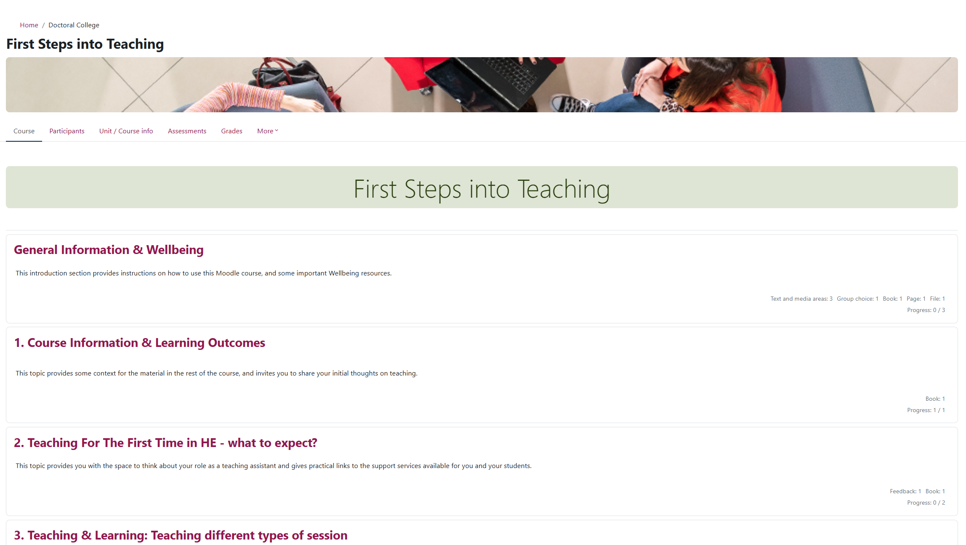
HEA Application Steps
0. Enrol and complete First Steps into Teaching.
Notes:
For those who are new to teaching and would like a quick guide to teaching, enrol on First Steps into Teaching.

Slide 37
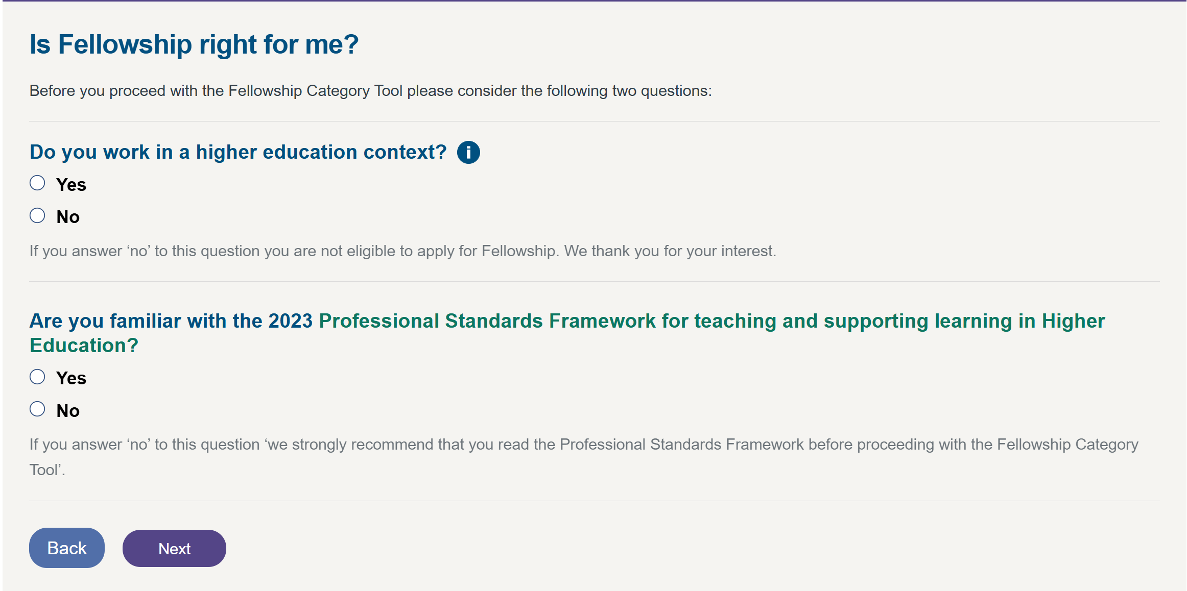
HEA Application Steps
Check the appropriate level of application using the Fellowship Category Tool.

Slide 38
HEA Application Steps
Non-Probationers: Sign up for and attend “20 - Introduction to Fellowship (Associate Fellow, Fellow & Senior Fellow)” through L&T Hub Pathways Events:
Date | Day | Time | Location | Link
21/11/2024 | Thursday | 13:30 – 14:45 | CB 3.11 | Link
21/01/2025 | Tuesday | 13:30 – 14:45 | 1W 3.107 | Link
27/02/2025 | Thursday | 13:30 – 14:45 | CB 3.16 | Link
11/03/2025 | Tuesday | 9:30 – 10:45 | CB 4.5 | Link
15/04/2025 | Tuesday | 9:30 – 10:45 | CB 3.16 | Link

Slide 39
HEA Application Steps
Probationers: Sign up for and attend “01 – Introduction to Probation Pathway to Fellowships (Pathways)” through L&T Hub Pathways Events:
Date | Day | Time | Location | Link
28/01/2025 | Tuesday | 9:30 – 13:00 | CB 5.12 | Link

Slide 40
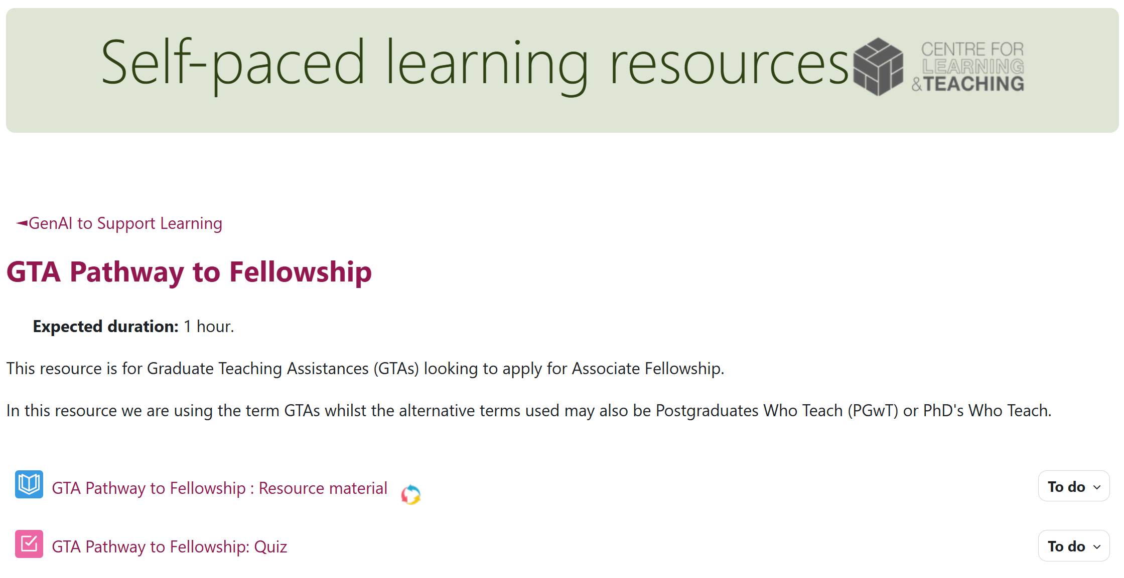
HEA Application Steps
GTAs: Enrol onto GTA Pathway to Fellowship and pass with a score of 80%.

Slide 41
HEA Application Steps
Sign up for and attend “21 - Reflective Writing Support (Associate Fellow, Fellow and Senior Fellow)” through L&T Hub Pathways Events:
Date | Day | Time | Location | Link
21/01/2025 | Tuesday | 14:45 – 16:00 | 1W 3.107 | Link
27/02/2025 | Thursday | 14:45 – 16:00 | CB 3.16 | Link
11/03/2025 | Tuesday | 10:45 – 12:00 | CB 4.5 | Link
15/04/2025 | Tuesday | 10:45 – 12:00 | TBC | Link
13/05/2025 | Tuesday | 10:30 – 11:45 | TBC | Link
Notes:
These events follow directly from “20 - Introduction”

Slide 42
HEA Application Steps
Make sure you are enrolled on (through Champion or Academic Development acdev@bath.ac.uk):
Pathways to Fellowship
Probationer Pathway;
Experiential Pathway;
GTA Pathway to Fellowship.
Gateway to Fellowship Submission.
Work with your fellowship champion to draft a fellowship application: Chris Budd, Sandipan Roy, Waleed Ali.

Slide 43
HEA Application Steps
Identify advocates.
Write and receive feedback on your application from the Champions.
Act on feedback, finalise application and pass to advocates to complete their statements.
Submit application before the deadline:
Day | Date | Time
Friday | 14/2/2024 | Noon
Friday | 16/5/2024 | Noon

Slide 44
HEA Application Forms
AFHEA
A1
A3
FHEA
A1
A2
SFHEA
A1 – A5
Case Study 1
A2
A4
A5
A3
A4
A5
Case Study 2
V1, V2, V3, V4, V5, K1, K2, K3, K4, K5

Slide 45
Key Principles
Personal Claim
Use 1st person.
Sufficient evidence for corresponding Descriptor.
Current
Past 3-5 years.
Sufficient
Individual contribution to group effort.
Appropriate Evidence
Appropriate evidence for context.
Lived experience of authentic practice.
Contextual AA’s, V’s, K’s and case studies in Higher Education.
Quotes from colleagues, students, feedback, etc..
Evidence-based approaches.
2 examples per AA.

Slide 46
Key Principles
Effective Practice
Talk about things that worked.
Make sure the claim is aligned with the principles outlined in the PSF23.
Reflection & Critical Evaluation
More reflective, less descriptive.
Aligned with PSF23
Commitment
Show commitment to high quality teaching in higher education.
IN YOUR CONTEXT.
Narrative.
Talk about rationale, outcomes and impact.

Slide 47

General Advice: Don’t
Don’t talk about (unless relevant):
Explain unit content.
Explain teaching hours.
Talk about who you teach with.
Talk about ideas that were ineffective.

Slide 48



Applicant Packs

Slide 49
Contacts
Centre for Learning & Teaching:
Lenka Bavnovcova
Jo Charles
Nadine Grimmett
Maths Department Champions:
Chris Budd
Sandipan Roy
Waleed Ali

Slide 50
Possible Citations
Biggs, J. and Tang, C., 2010, February. Applying constructive alignment to outcomes-based teaching and learning. In Training material for “quality teaching for learning in higher education” workshop for master trainers, Ministry of Higher Education, Kuala Lumpur (Vol. 53, No. 9, pp. 23-25). Link
Biggs, J., Tang, C. and Kennedy, G., 2022. Teaching for quality learning at university 5e. McGraw-hill education (UK).
Geraniou, E. and Mavrikis, M., 2015. Building bridges to algebra through a constructionist learning environment. Constructivist Foundations, 10(3), pp.321-330. Link
Rasmussen, C. and Marrongelle, K., 2006. Pedagogical content tools: Integrating student reasoning and mathematics in instruction. Journal for research in mathematics education, 37(5), pp.388-420. Link
Labuhn, A.S., Zimmerman, B.J. and Hasselhorn, M., 2010. Enhancing students’ self-regulation and mathematics performance: The influence of feedback and self-evaluative standards. Metacognition and learning, 5, pp.173-194. Link
QAA Subject Benchmarks Statements. Link

