Slide 2
Today you will learn:
What is GEO?
Locate data listed in a research paper
Navigate through GEO and SRA
Make sense of the accession numbers, the data they hold, and how they fit together
How to download data from SRA

Slide 3
Sequence data repositories
Host Organization | Repository Name
National Center for Biotechnology Information (NCBI) | Sequence Read Archive (SRA)
European Molecular Biology Laboratory – European Bioinformatics Institute (EMBL-EBI) | European Nucleotide Archive (ENA)
DNA Data Bank of Japan (DDBJ) | DDBJ Sequence Read Archive (DRA)

Slide 4
What is GEO?
GEO (Gene Expression Omnibus) is an international public repository that archives and freely distributes microarray, next-generation sequencing, and other forms of high-throughput functional genomics data submitted by the research community
User-friendly
100’s of organisms and thousands of different expression analysis platforms

Slide 5
Submitting to GEO
Is a pre-requisite for publication of peer-reviewed research articles
Step-by-step process that requires sample data spreadsheets, raw data, and other submission forms

Slide 6
MIAME Compliant
Minimum information about a microarray experiment
Effort to standardize publicly available data
MAIME Checklist
Experimental Design
Samples used, extract preparation, and labeling
Measurement data and specifications

Slide 7
GEO Architecture
There are three types of GEO submitter records:
A Platform record describes an array or sequencer and, for array-based platforms, a data table defining the array template.
A Sample record describes the sample source, the protocols used in its analysis, and the expression data derived from it.
A Series record links together a group of related Samples and describes a whole study.
Together, this information makes up a GEO record that is assembled by the GEO staff. These records provide a coherent synopsis about the experiment and data collected.

Slide 8
GEO data retrieval
GEO data can be retrieved and analyzed in several ways:
To look at a particular GEO record for which you have the accession number, use the GEO accession box located on the GEO homepage or at the top of each GEO record.
To download data, see the various options described on the Download GEO data page.
To quickly locate data relevant to your interests, search GEO DataSets and GEO Profiles

Slide 9
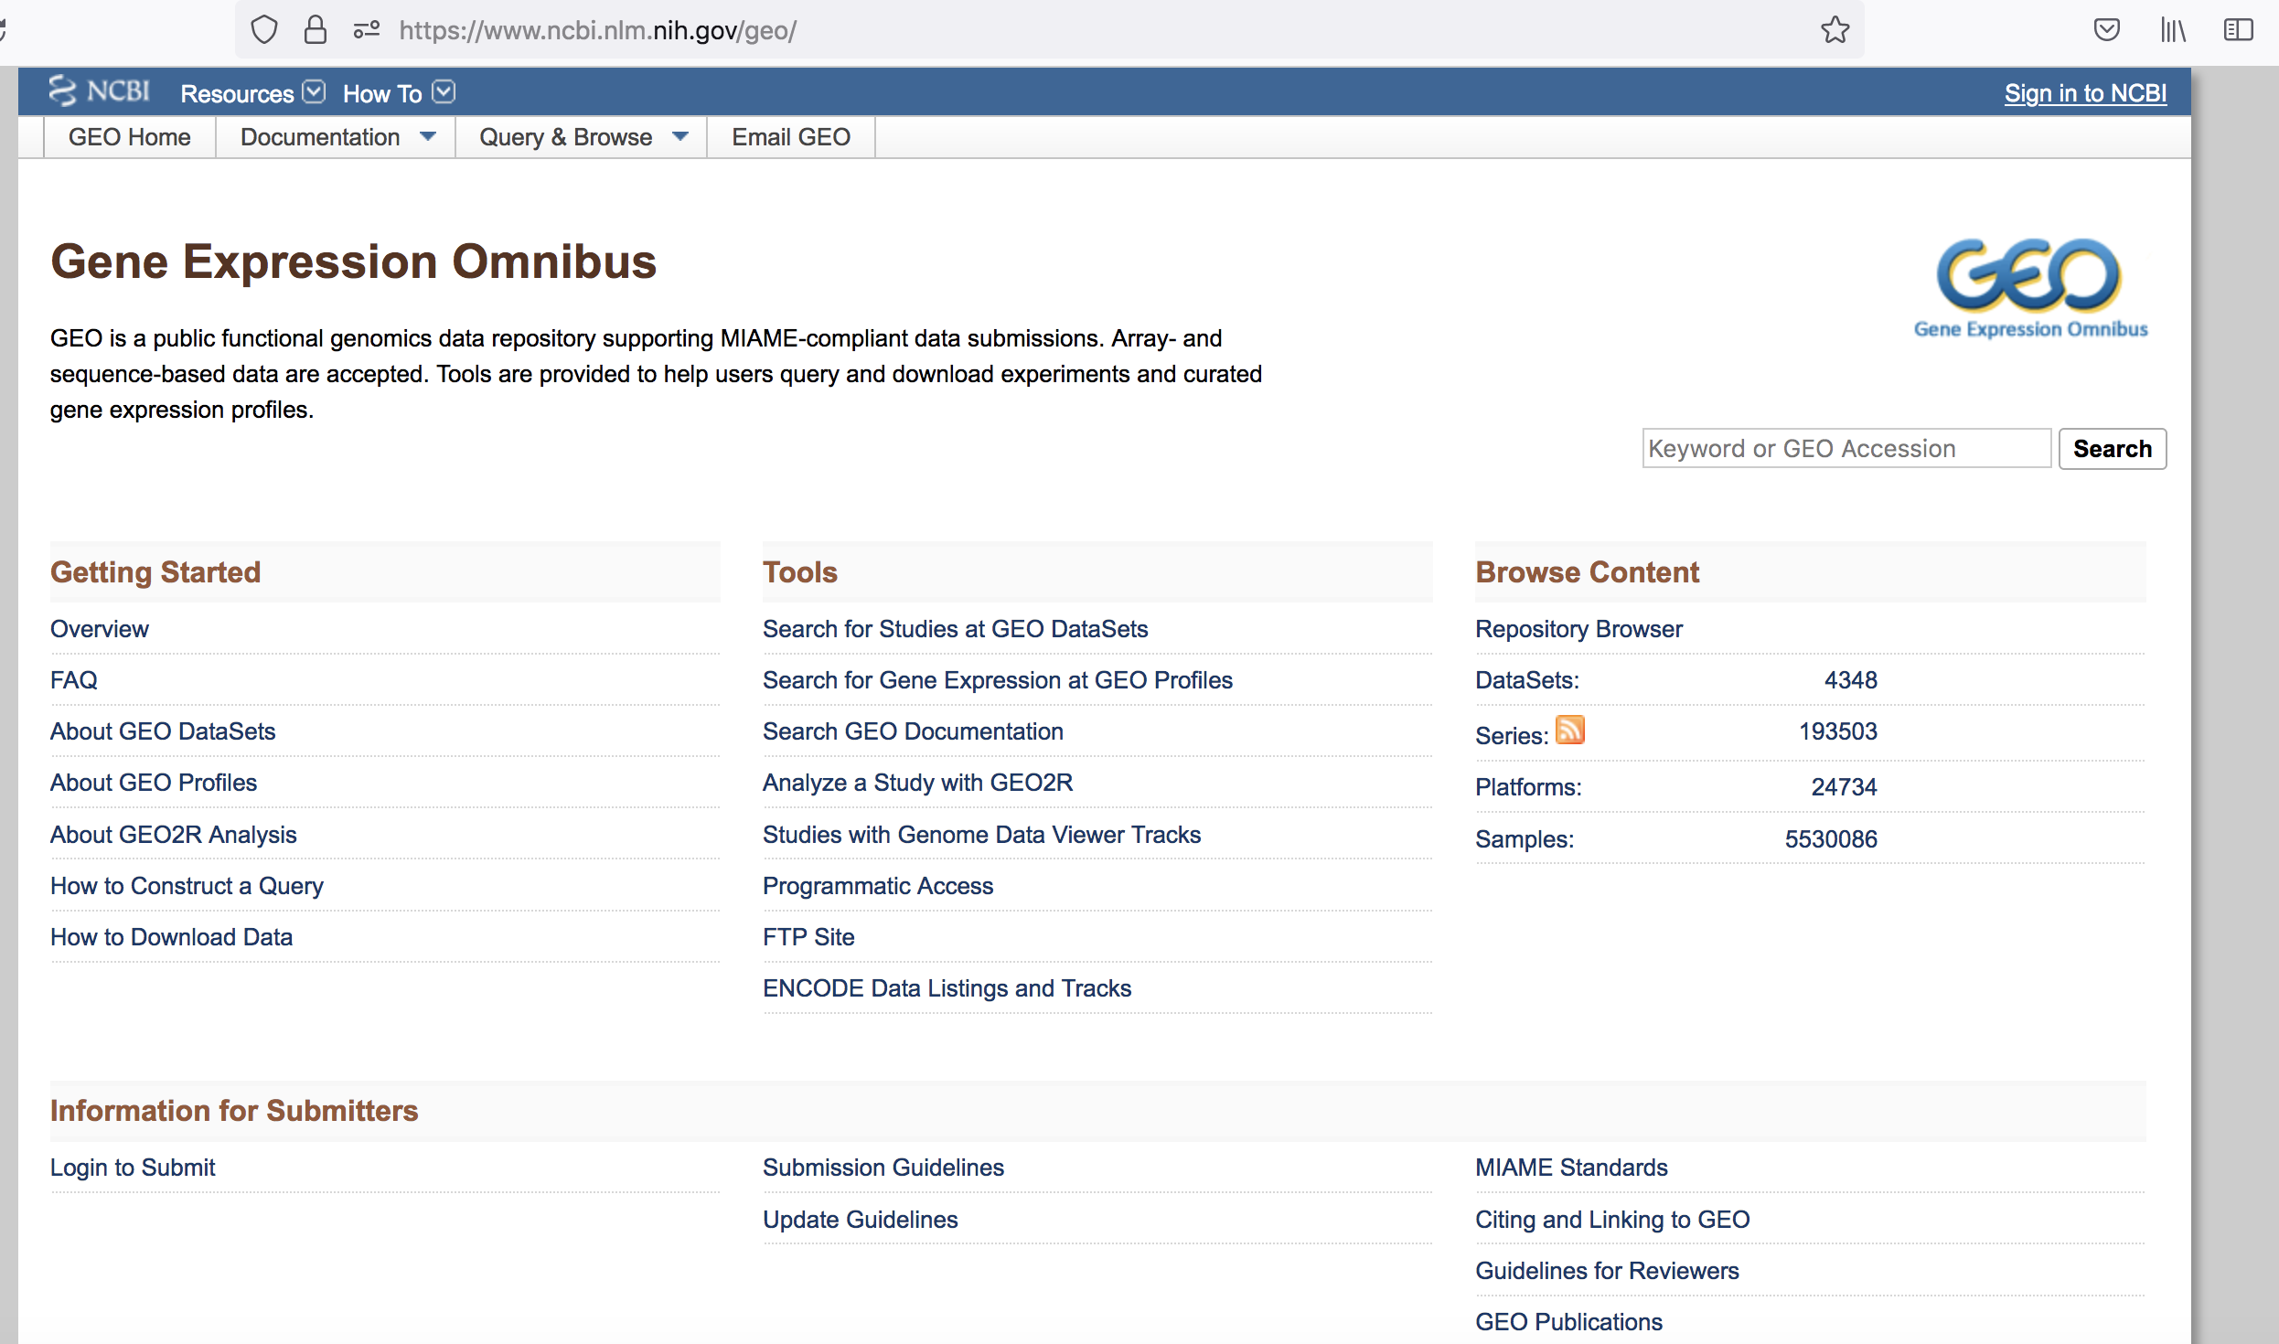
https://www.ncbi.nlm.nih.gov/geo/

Slide 10
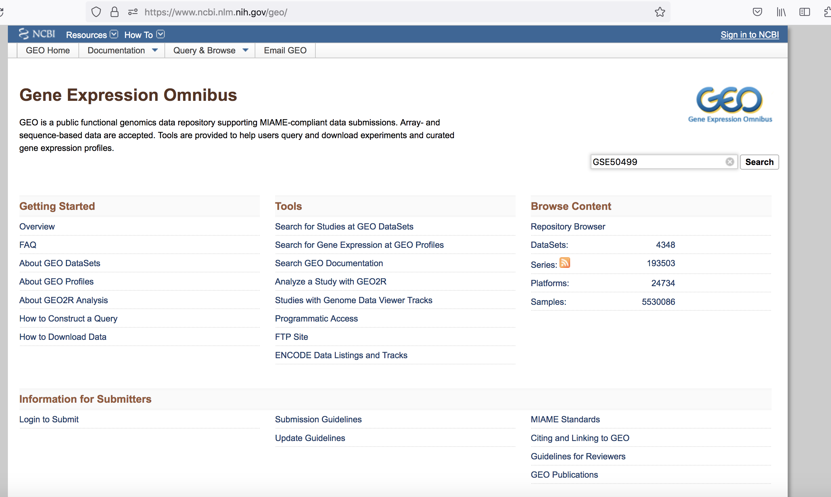

Slide 11
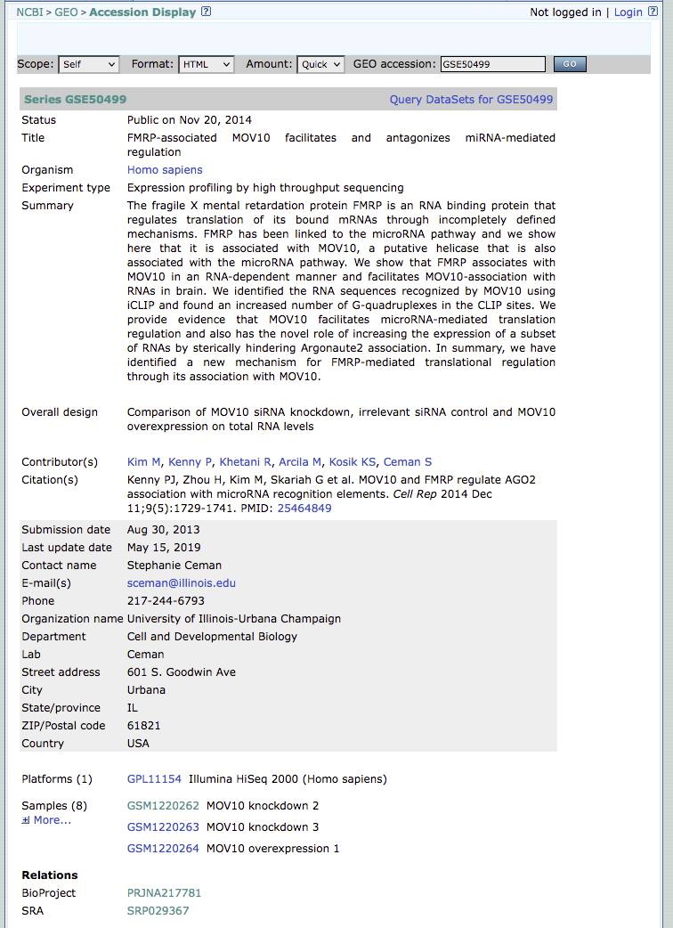

Slide 12
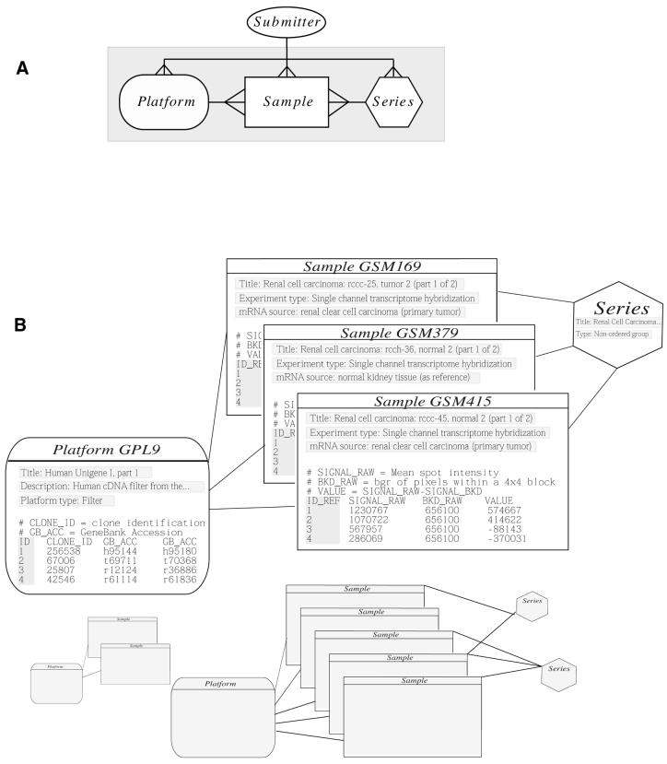
many
1
1
GSEXXXXX
GSMXXXXX
GPLXXXXX

Slide 13
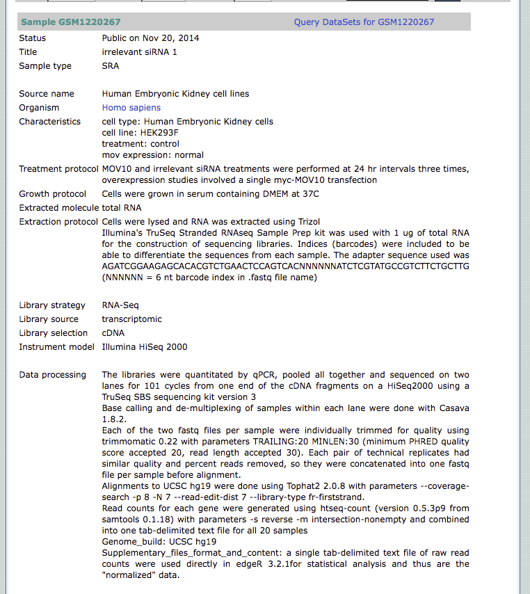

Slide 14
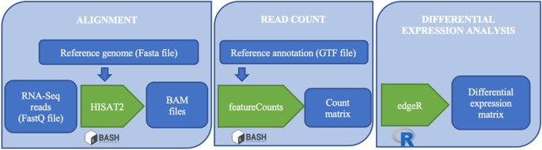

Slide 15
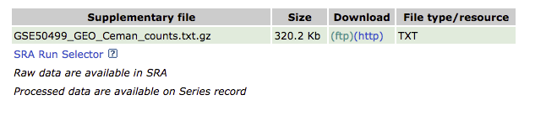
This assumes you completely understand the bioinformatic pipeline used and that it is still acceptable to current standards
Was the latest reference genome used?
Some aligners are outdated (ex. TopHat)

Slide 16
Research paper
(PUBMED)
SRA
(SRR, SRP)
GEO
(GSE, GSM, GPL)
NCBI

Slide 17
What is SRA?
The Sequence Read Archive (SRA) is an archive for high throughput sequencing data, publicly accessible, for the purpose of enhancing reproducibility in the scientific community.

Slide 18
There are levels of SRA entities and their accessions:
STUDY with accessions in the form of SRP, ERP, or DRP
SAMPLE with accessions in the form of SRS, ERS, or DRS
EXPERIMENT with accessions in the form of SRX, ERX, or DRX
RUN with accessions in the form of SRR, ERR, or DRR

Slide 19
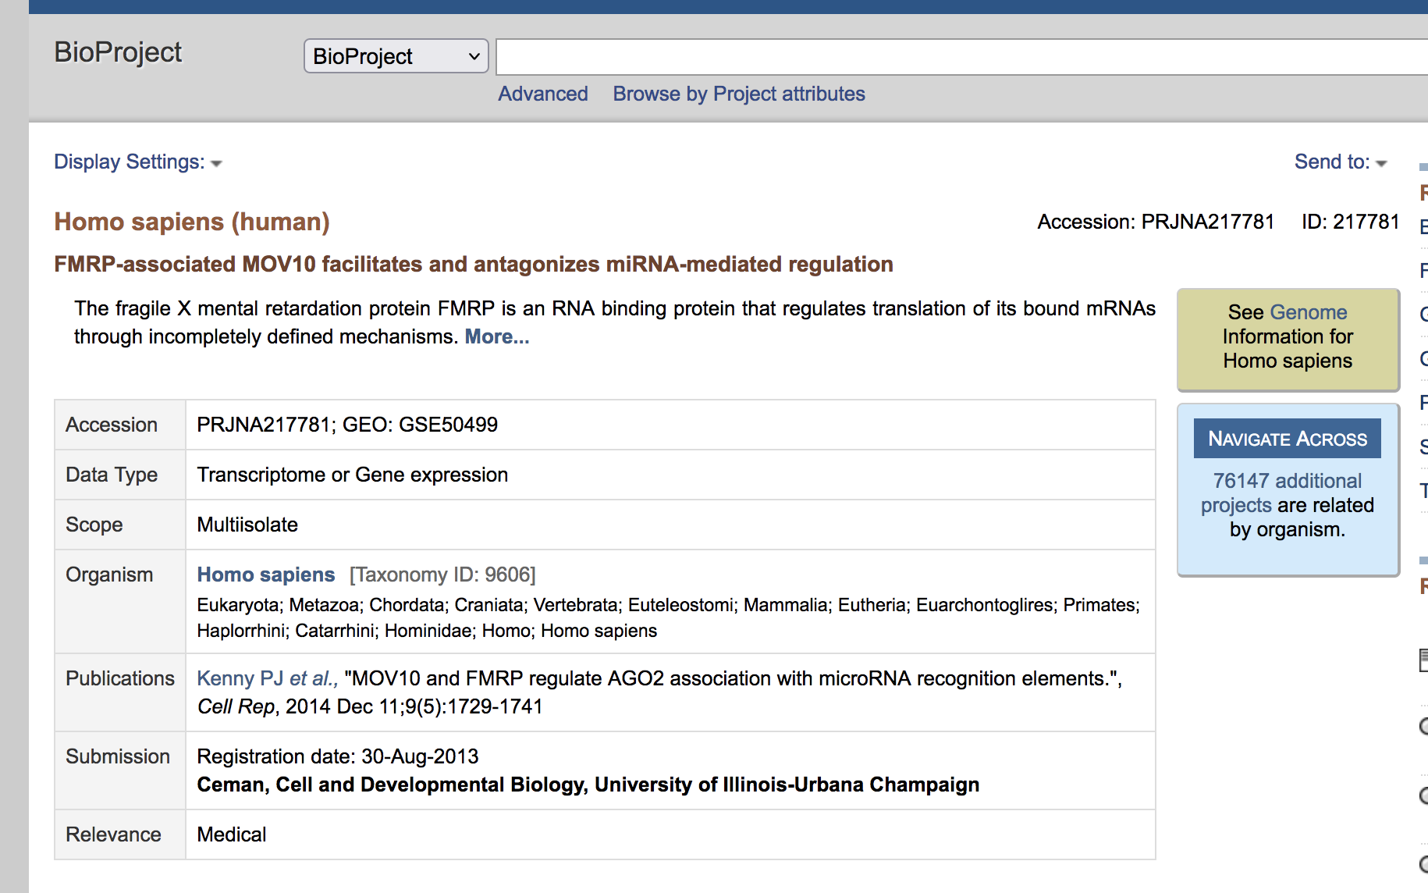
Sra HIERARCHY
Stands for | NCBI Prefix
BioProject | PRJNA123456
Notes:
Bioproject is a collection of biological data thats related to a single initiative. So you can think of the bioproject as a parent directory that’s going to hold all of the metadata, all of the sequencing information, and any information that may be related to the project.

Slide 20
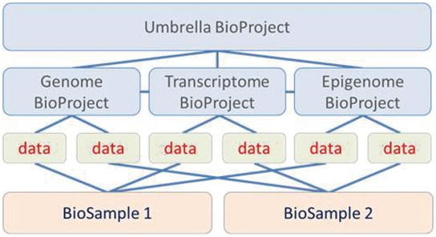

Slide 21
Sra HIERARCHY
Stands for | NCBI Prefix
BioProject | PRJNA123456
Sequence Read Archive Study | SRP123456
Sequence Read Archive Experiment | SRX123456
Sequence Read Archive Run | SRR123456
Notes:
Then within the bioproject you have a single study, then within the study you could have multiple experiments.

Slide 22
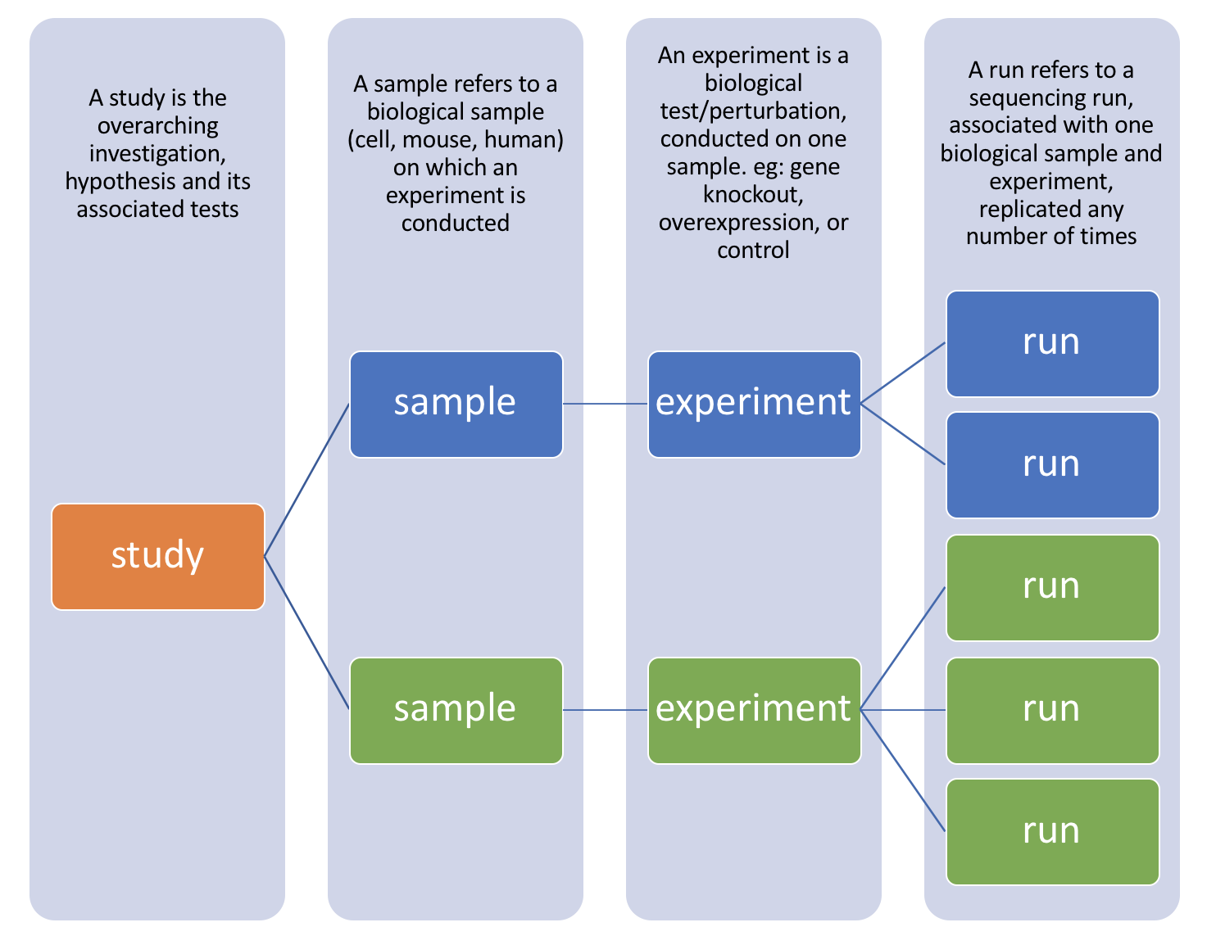
SRR1
SRR2
SRR3
SRR4
SRR5
Notes:
Most studies include multiple samples and a high number of replicates, it is useful to know how to download all the sequencing runs from all samples in a study, without having to hunt down and type in individual SRR numbers one by one.

Slide 23
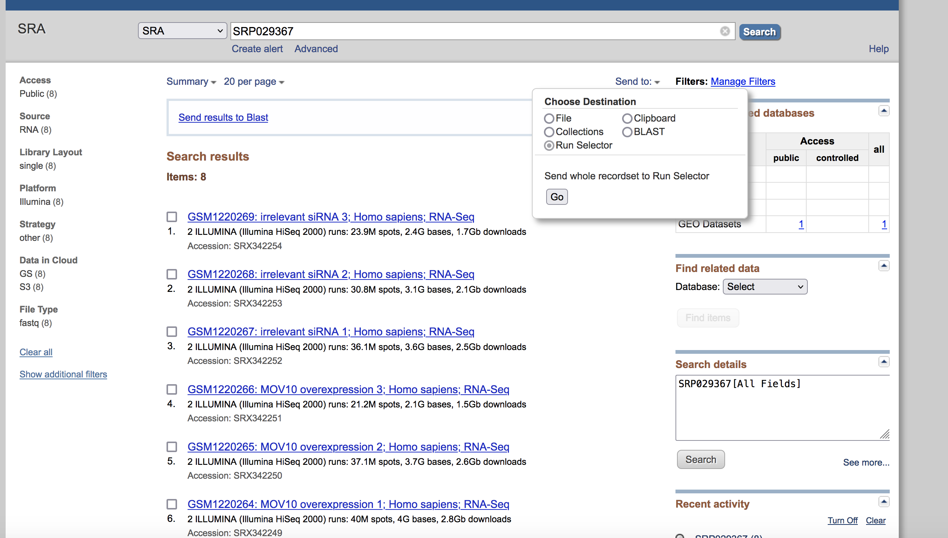
Step 1: Collect srr numbers USING RUN SELECTOR

Slide 24
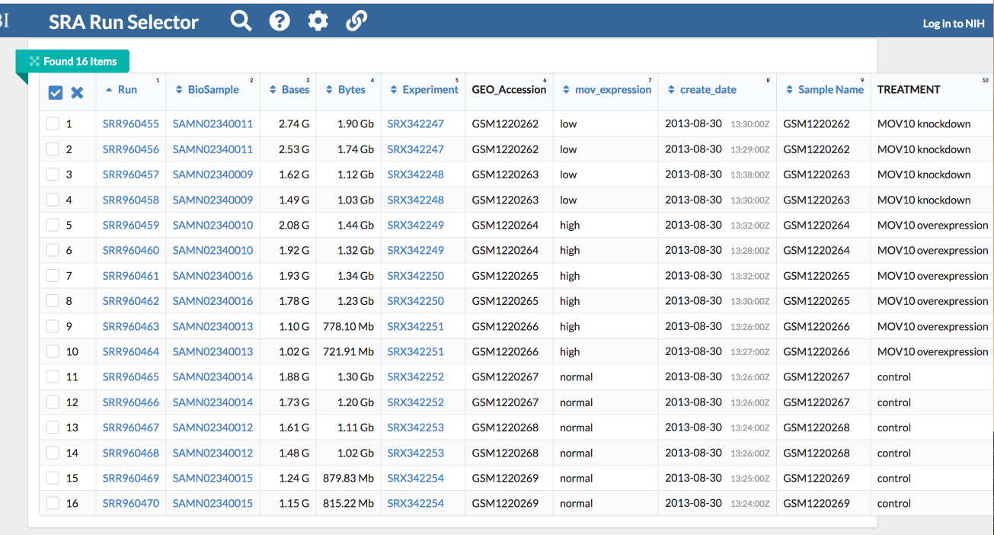
Notice, there are 8 samples however for each sample there were (2) runs making the final total 16

Slide 25
SRX342247
SRR960455
SRR960456

Slide 26
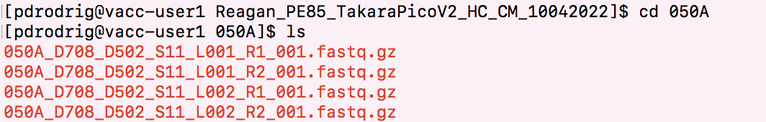
This is per sample!
Why so many files?

Slide 27


Inputs
Reads R1
Control
FastQ
Treatment
Reads R1
FastQ
SE – single end dataset -> Read 1 only
PE – paired end dataset -> Read 1 and 2
Sequenced over 2 lanes

Slide 28
Inputs
Inputs
Reads R1
Reads R2
Reads R1
Reads R2
Control
Control
4 files
FastQ
FastQ
FastQ
FastQ
Treatment
Reads R1
Reads R2
Treatment
Reads R1
Reads R2
4 files
FastQ
FastQ
FastQ
FastQ
LANE 1
LANE 2
4 files X 4 biological replicates = 16 files per treatment
16 FASTQ files for Control
16 FASTQ files for Treatment

Slide 29


What is a FASTQ?
@NS500177:196:HFTTTAFXX:1:11101:10916:1458 2:N:0:CGCGGCTG ACACGACGATGAGGTGACAGTCACGGAGGATAAGATCAATGCCCTCATTAAAGCAGCCGGTGTAA
+ AAAAAEEEEEEEEEEE//AEEEAEEEEEEEEEEE/EE/<<EE/AAEEAEE///EEEEAEEEAEA<
1
2
3
4
Each sequencing “read” consists of 4 lines of data :
1. The first line (which always starts with ‘@’) is a unique ID for the sequence that follows
2. The second line contains the bases called for the sequenced fragment
3. . The third line is always a “+” character
4. The fourth line contains the quality scores for each base in the sequenced fragment

Slide 30
FASTQ files are huge!
zipped-up
Notice, its fastq.gz
No need to decompress it
Any programs can use the .gz file as input
We need to merge these files by lane – not by read

Slide 31
cat command
Cat(concatenate) command is frequently used in Linux
One major function is to merge the contents of multiple files
cat filename1 filename2 > merged_file
Merge read1
Merge read 2
From 4 files to 2 files
Check size with disk usage command

Slide 32
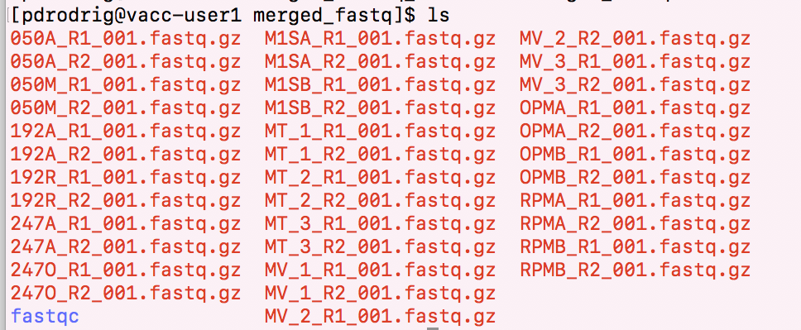
results of cat

Slide 33
How would you run a program on the VACC?
Install it in your personal VACC account and then be able to call it
Or load it from the shared computing cluster using module package

Slide 34
Running batch jobs

Slide 35
Important to know about VACC
Once you feel confident about programs being installed and/or your scripts, you may want to ‘submit a job’
For example, it may be annoying to do this one by one:
htseq-count -f bam -s yes -i gene_name -m union sample1.bam annotation.gtf > sample1.count.txt
htseq-count -f bam -s yes -i gene_name -m union sample2.bam annotation.gtf > sample2.count.txt
Also, some programs take very long to run!

Slide 36
In order to submit a job, need to use the job scheduler Slurm
Some common slurm directive
#!/bin/bash
#SBATCH --partition=bluemoon
#SBATCH --nodes=1
#SBATCH --ntasks=4
#SBATCH --mem=50G
#SBATCH --time=30:00:00
#SBATCH --job-name=RNAseq
# %x=job-name %j=jobid
#SBATCH --output=%x_%j.out

Slide 37
In order to submit a job, need to use the job scheduler Slurm
Some common slurm directive
shebang = used to tell the linux OS which interpreter to use
#!/bin/bash
#SBATCH --partition=bluemoon
#SBATCH --nodes=1
#SBATCH --ntasks=4
#SBATCH --mem=50G
#SBATCH --time=30:00:00
#SBATCH --job-name=RNAseq
# %x=job-name %j=jobid
#SBATCH --output=%x_%j.out

Slide 38
In order to submit a job, need to use the job scheduler Slurm
Some common slurm directive
partition = default is bluemoon if not specified
Other partitions are available and this is important if you are running a “job” that will take longer than 3 days
#!/bin/bash
#SBATCH --partition=bluemoon
#SBATCH --nodes=1
#SBATCH --ntasks=4
#SBATCH --mem=50G
#SBATCH --time=30:00:00
#SBATCH --job-name=RNAseq
# %x=job-name %j=jobid
#SBATCH --output=%x_%j.out

Slide 39
In order to submit a job, need to use the job scheduler Slurm
Some common slurm directive
Node: A “node” is a server in the cluster. Each node has is configured with a certain number of cores (CPUs).
Task: A “task” is a process sent to a core. By default, 1 core is assigned per 1 task
Recommend that you begin with 1 node and 2 processes
#!/bin/bash
#SBATCH --partition=bluemoon
#SBATCH --nodes=1
#SBATCH --ntasks=4
#SBATCH --mem=50G
#SBATCH --time=30:00:00
#SBATCH --job-name=RNAseq
# %x=job-name %j=jobid
#SBATCH --output=%x_%j.out

Slide 40
In order to submit a job, need to use the job scheduler Slurm
Some common slurm directive
#!/bin/bash
#SBATCH --partition=bluemoon
#SBATCH --nodes=1
#SBATCH --ntasks=4
#SBATCH --mem=50G
#SBATCH --time=30:00:00
#SBATCH --job-name=RNAseq
# %x=job-name %j=jobid
#SBATCH --output=%x_%j.out
If your job requires more than 1G of memory – need to specify this

Slide 41
In order to submit a job, need to use the job scheduler Slurm
Some common slurm directive
#!/bin/bash
#SBATCH --partition=bluemoon
#SBATCH --nodes=1
#SBATCH --ntasks=4
#SBATCH --mem=50G
#SBATCH --time=30:00:00
#SBATCH --job-name=RNAseq
# %x=job-name %j=jobid
#SBATCH --output=%x_%j.out
Walltime is the maximum amount of time your job will run.

