Slide 2
Today you will learn:
What is GEO?
Locate data listed in a research paper
Navigate through GEO and SRA
Make sense of the accession numbers, the data they hold, and how they fit together
How to download data from SRA

Slide 3
Sequence data repositories
Host Organization | Repository Name
National Center for Biotechnology Information (NCBI) | Sequence Read Archive (SRA)
European Molecular Biology Laboratory – European Bioinformatics Institute (EMBL-EBI) | European Nucleotide Archive (ENA)
DNA Data Bank of Japan (DDBJ) | DDBJ Sequence Read Archive (DRA)

Slide 4
What is GEO?
GEO (Gene Expression Omnibus) is an international public repository that archives and freely distributes microarray, next-generation sequencing, and other forms of high-throughput functional genomics data submitted by the research community
User-friendly
100’s of organisms and thousands of different expression analysis platforms

Slide 5
Submitting to GEO
Is a pre-requisite for publication of peer-reviewed research articles
Step-by-step process that requires sample data spreadsheets, raw data, and other submission forms

Slide 6
MIAME Compliant
Minimum information about a microarray experiment
Effort to standardize publicly available data
MAIME Checklist
Experimental Design
Samples used, extract preparation, and labeling
Measurement data and specifications

Slide 7
GEO Architecture
There are three types of GEO submitter records:
A Platform record describes an array or sequencer and, for array-based platforms, a data table defining the array template.
A Sample record describes the sample source, the protocols used in its analysis, and the expression data derived from it.
A Series record links together a group of related Samples and describes a whole study.
Together, this information makes up a GEO record that is assembled by the GEO staff. These records provide a coherent synopsis about the experiment and data collected.

Slide 8
GEO data retrieval
GEO data can be retrieved and analyzed in several ways:
To look at a particular GEO record for which you have the accession number, use the GEO accession box located on the GEO homepage or at the top of each GEO record.
To download data, see the various options described on the Download GEO data page.
To quickly locate data relevant to your interests, search GEO DataSets and GEO Profiles

Slide 9
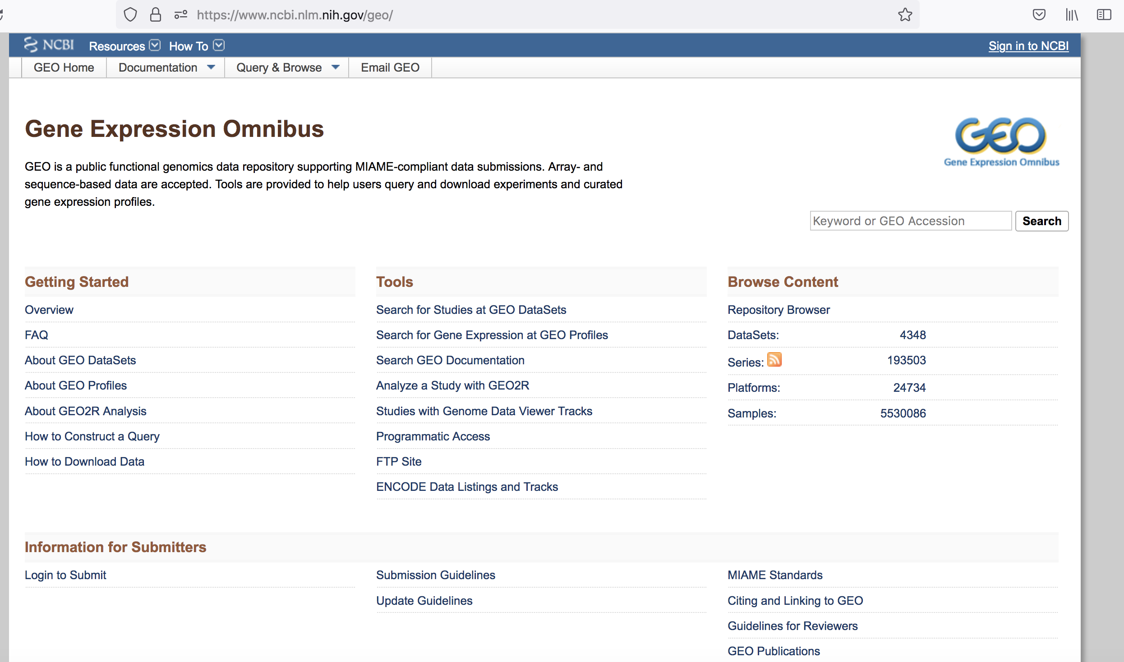
https://www.ncbi.nlm.nih.gov/geo/

Slide 10
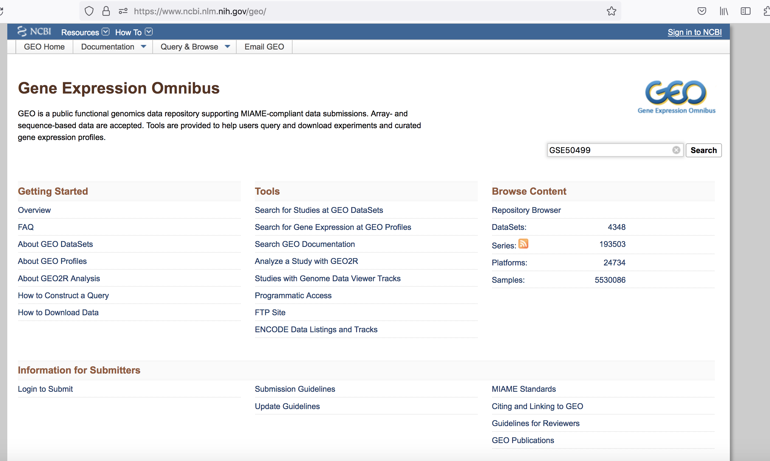

Slide 11
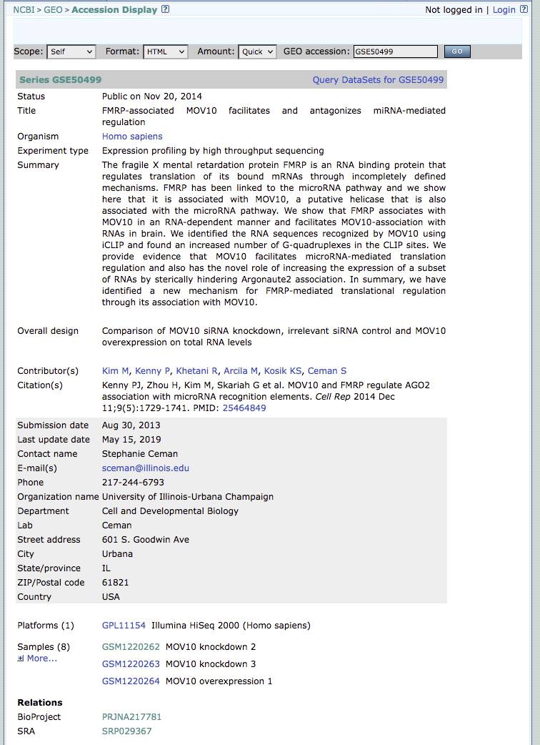

Slide 12
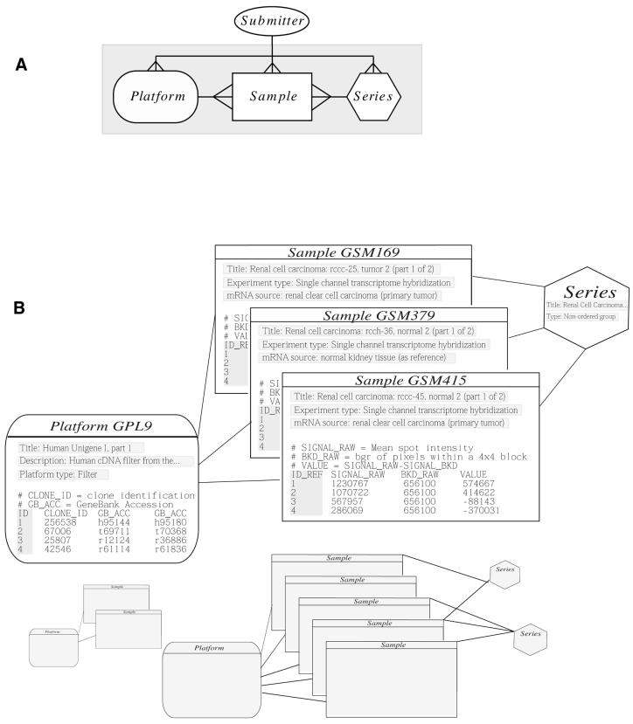
many
1
1
GSEXXXXX
GSMXXXXX
GPLXXXXX

Slide 13
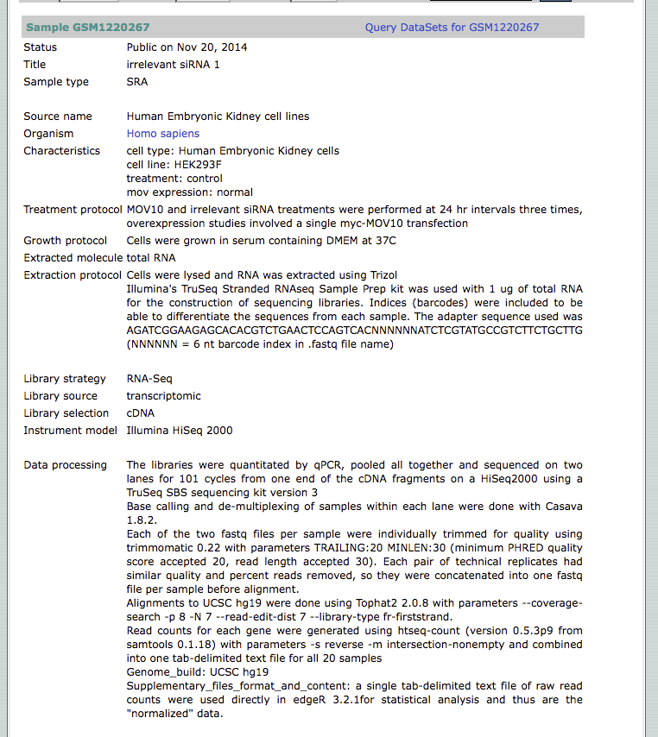

Slide 14
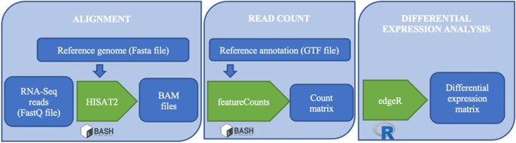

Slide 15
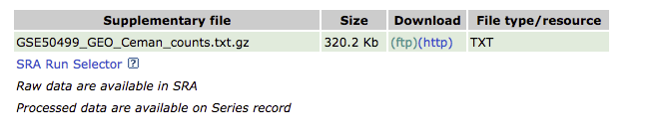
This assumes you completely understand the bioinformatic pipeline used and that it is still acceptable to current standards
Was the latest reference genome used?
Some aligners are outdated (ex. TopHat)

Slide 16
Research paper
(PUBMED)
SRA
(SRR, SRP)
GEO
(GSE, GSM, GPL)
NCBI

Slide 17
What is SRA?
The Sequence Read Archive (SRA) is an archive for high throughput sequencing data, publicly accessible, for the purpose of enhancing reproducibility in the scientific community.

Slide 18
There are levels of SRA entities and their accessions:
STUDY with accessions in the form of SRP, ERP, or DRP
SAMPLE with accessions in the form of SRS, ERS, or DRS
EXPERIMENT with accessions in the form of SRX, ERX, or DRX
RUN with accessions in the form of SRR, ERR, or DRR

Slide 19
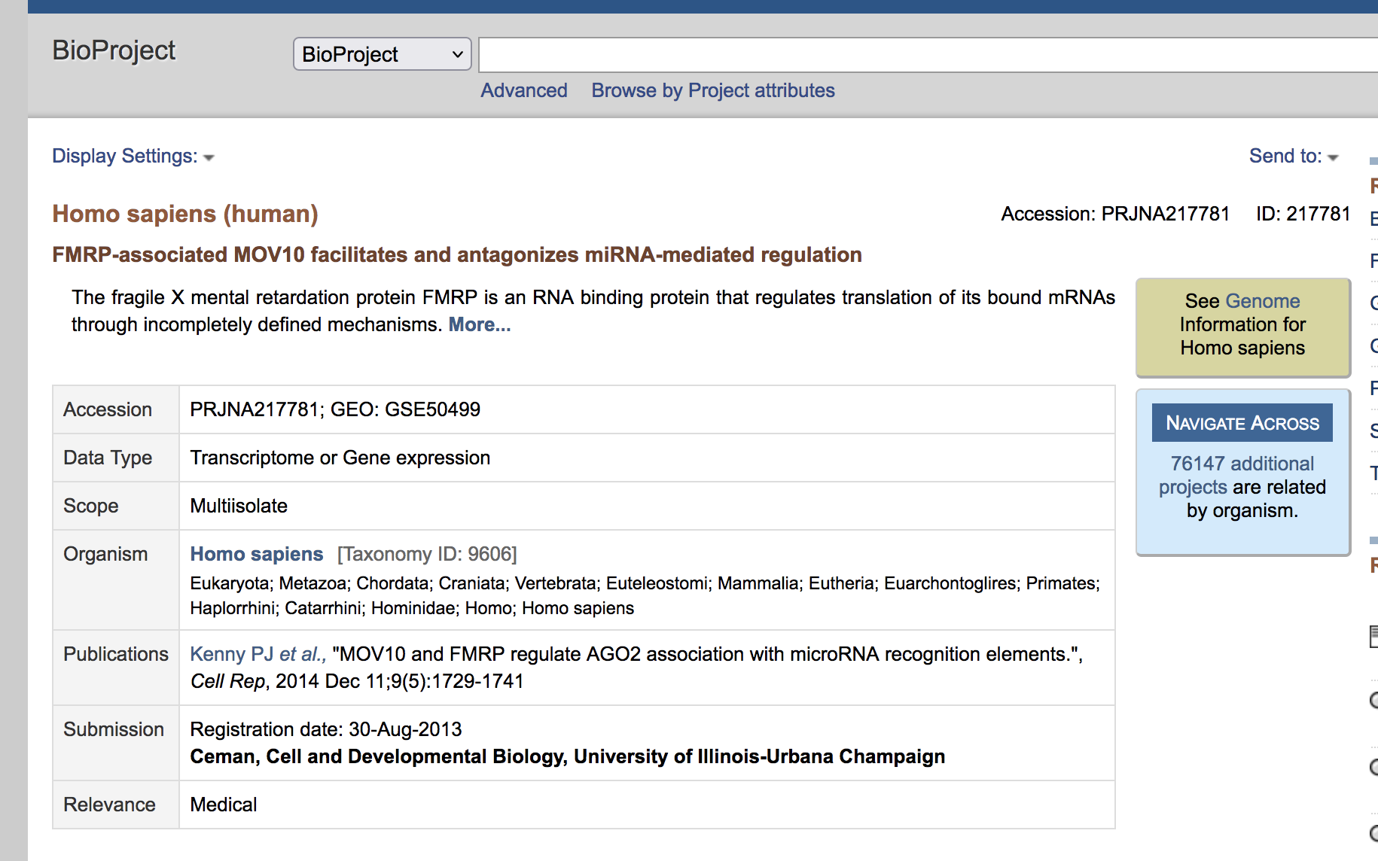
Sra HIERARCHY
Stands for | NCBI Prefix
BioProject | PRJNA123456
Notes:
Bioproject is a collection of biological data thats related to a single initiative. So you can think of the bioproject as a parent directory that’s going to hold all of the metadata, all of the sequencing information, and any information that may be related to the project.

Slide 20
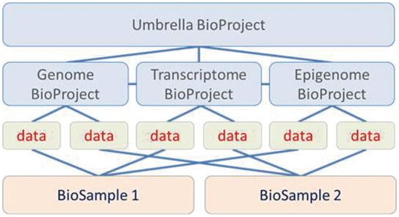

Slide 21
Sra HIERARCHY
Stands for | NCBI Prefix
BioProject | PRJNA123456
Sequence Read Archive Study | SRP123456
Sequence Read Archive Experiment | SRX123456
Sequence Read Archive Run | SRR123456
Notes:
Then within the bioproject you have a single study, then within the study you could have multiple experiments.

Slide 22
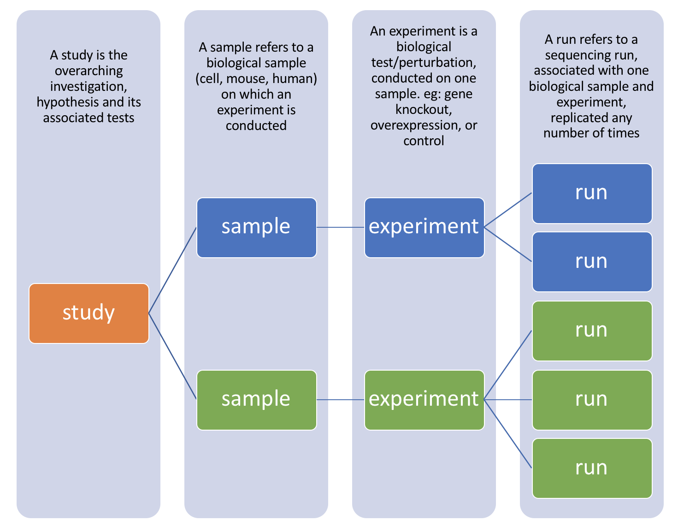
SRR1
SRR2
SRR3
SRR4
SRR5
Notes:
Most studies include multiple samples and a high number of replicates, it is useful to know how to download all the sequencing runs from all samples in a study, without having to hunt down and type in individual SRR numbers one by one.

Slide 23
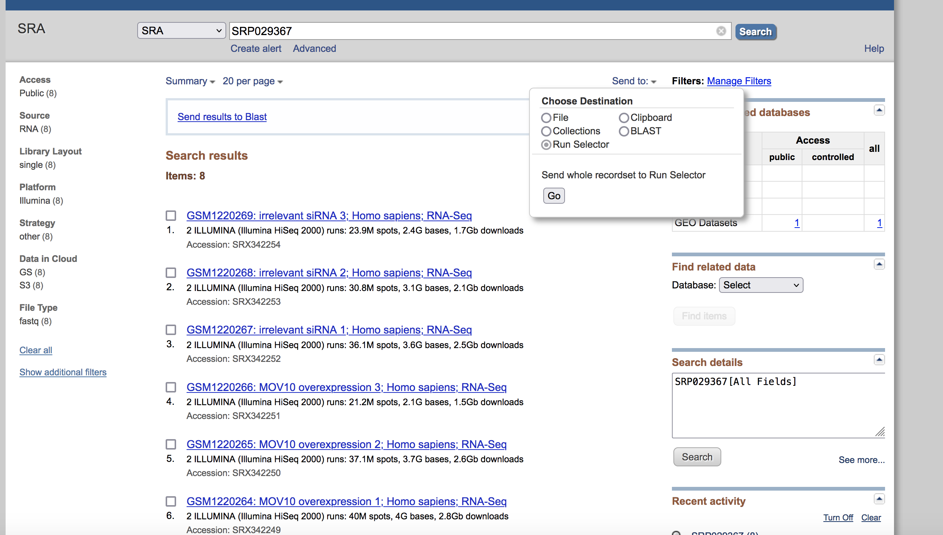
Step 1: Collect srr numbers USING RUN SELECTOR

Slide 24
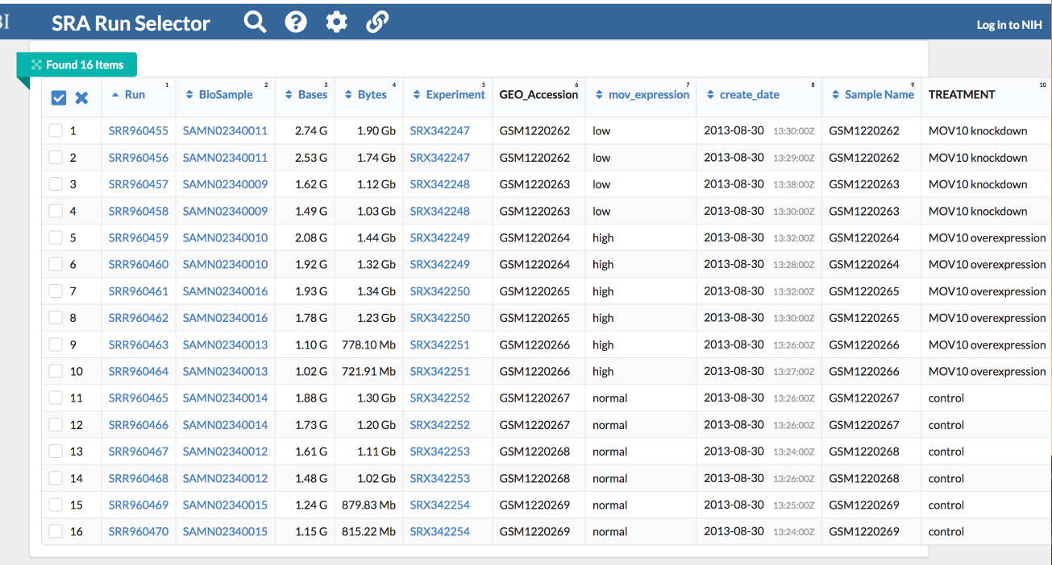
Notice, there are 8 samples however for each sample there were (2) runs making the final total 16

Slide 25
SRX342247
SRR960455
SRR960456

Slide 26
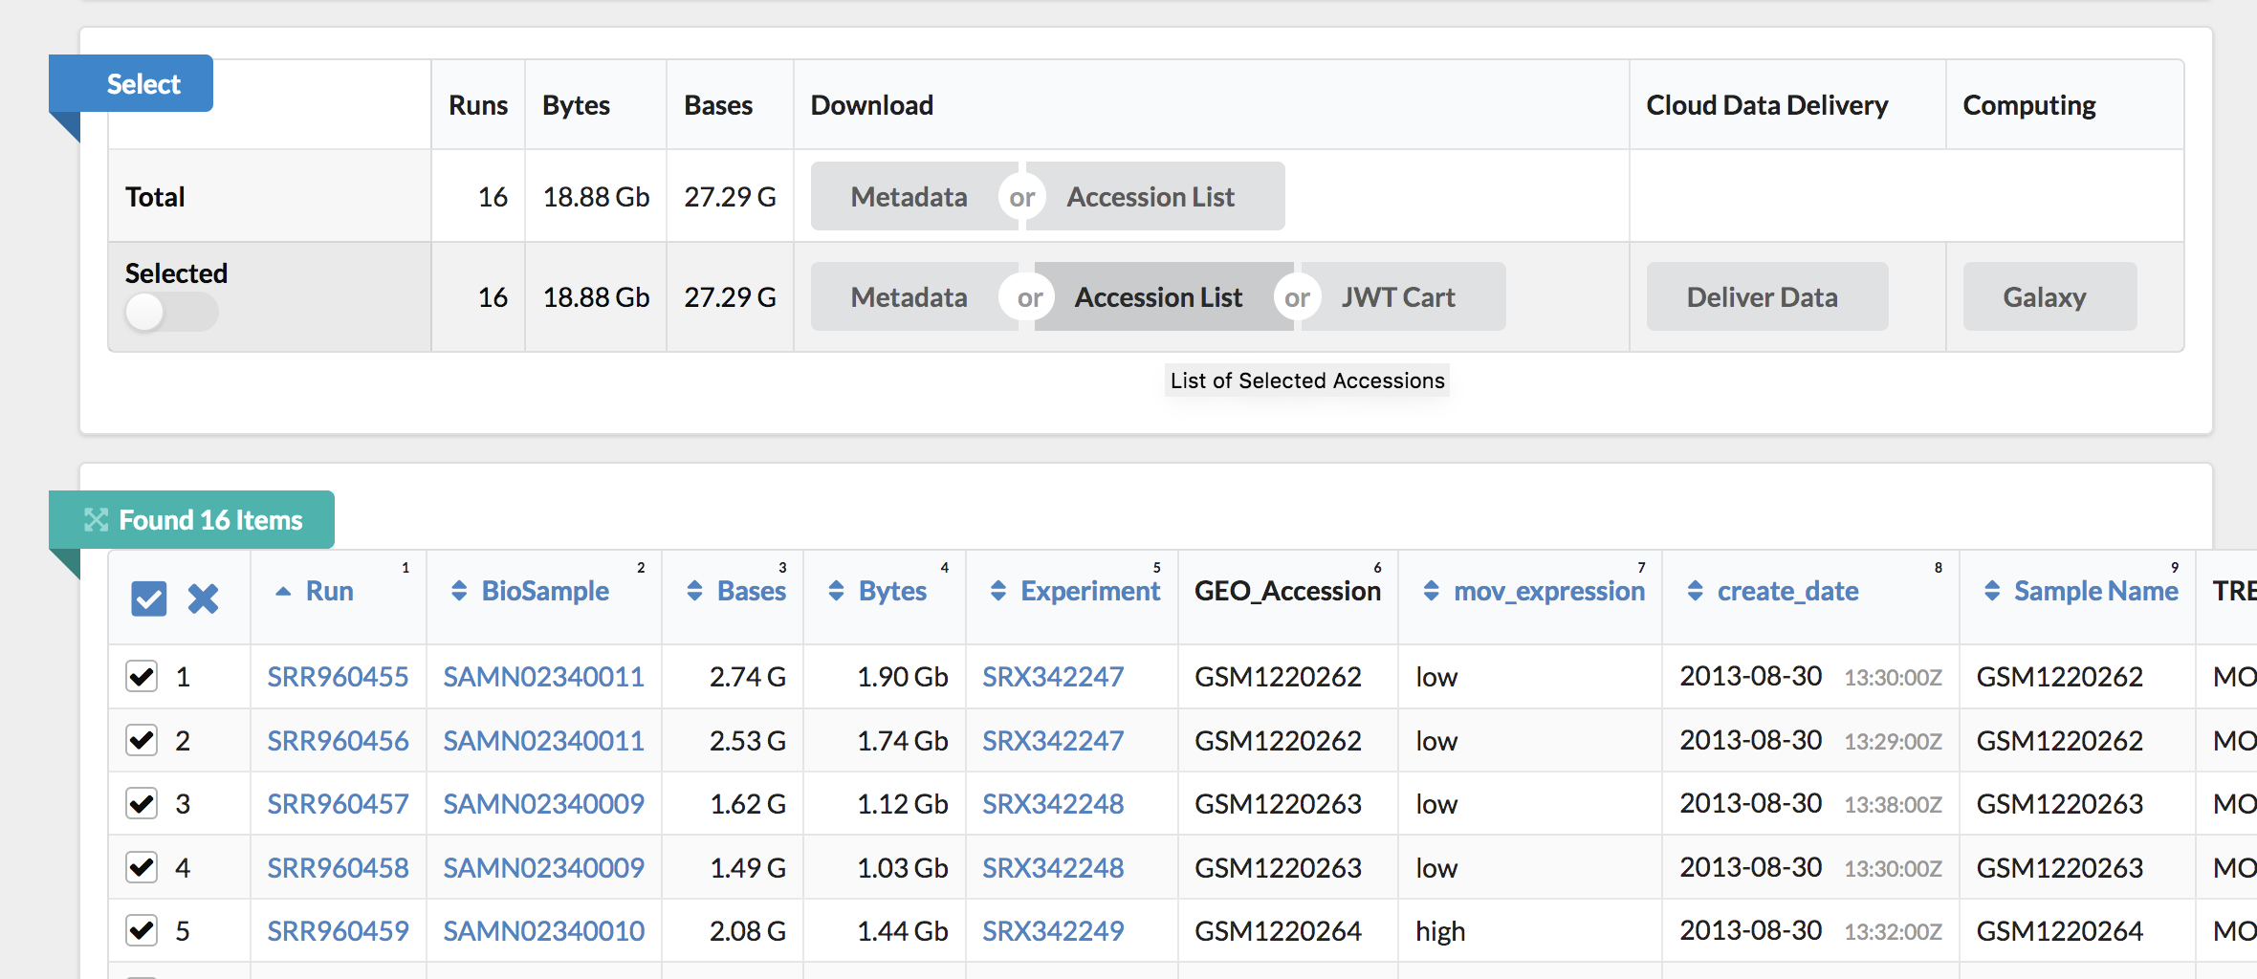

Select only the desired samples!

Slide 27
Output .txt file with list of SRR
SRR960455
SRR960456
SRR960457
SRR960458
SRR960459
SRR960460
SRR960461
SRR960462
SRR960463
SRR960464
SRR960465
SRR960466
SRR960467
SRR960468
SRR960469
SRR960470
Step #1 is complete!

Slide 28
Step 2: Download SRA-toolkit
SRA-Toolkit was developed by HPC at the NIH
Using SRA-Toolkit you will be able to download SRR FASTQ files using the fasterq-dump tool

Slide 29
How Do you run a program on the VACC?
Install it in your personal VACC account and then be able to call it
Or load it from the shared computing cluster using module package

Slide 30
How Do you run a program on the VACC?
Install it in your personal VACC account and then be able to call it
Or load it from the shared computing cluster using module package
We will do this for Alignment: HiSAT2

Slide 31
Step 2: Download SRA-toolkit
Follow Steps 1-3 under ## Download SRA-toolkit
Continue to step 4 only if you are confident

Slide 32
Environmental Variables
What are they?
How do we use them?
Why do we use them?

Slide 33
User Environmental Variables
User environmental variables are those that are local to the user profile
These variables are used to store user-specific information such as the PATH to a local installation of libraries
You do not need the system administrator (staff of VACC) to make changes to these variables, you can do this yourself as the user

Slide 34
Bash profile
Bash shell uses a few startup files to set up the environment
Bash profile is a file that Bash runs every time a new Bash session is created
This is useful because it will run certain code specific to your environment before you begin coding
Users can personalize their environment by modifying the Bash profile
In Step #4 you are adding the PATH to sratoolkit to your environment

Slide 35
PATH
PATH is an environmental variable
PATH contains a list of file system paths where the operating system can find programs to run
The operating system will look for the program in each of the paths that PATH contains, starting with the first path listed
If the operating system can’t find the program in the first path, it will look in the second path, and so on – therefore order matters!

Slide 36
echo $PATH
/users/m/m/mmg232in/miniconda3/condabin:/gpfs1/arch/spack-0.14.2/bin:/usr/local/bin:/usr/bin:/usr/local/sbin:/usr/sbin:/var/cfengine/bin:/usr/lpp/mmfs/bin:/opt/env-switcher/bin:/users/m/m/mmg232in/.local/bin:/users/m/m/mmg232in/bin:/users/m/m/mmg232in/software/sratoolkit.3.0.1-ubuntu64/bin
Each path is delimited by a colon (:)

Slide 37
Why bin folder?
The path `/bin` is usually where executable programs are stored
We will be running the program called “fastq-dump” however there are many more!

Slide 38
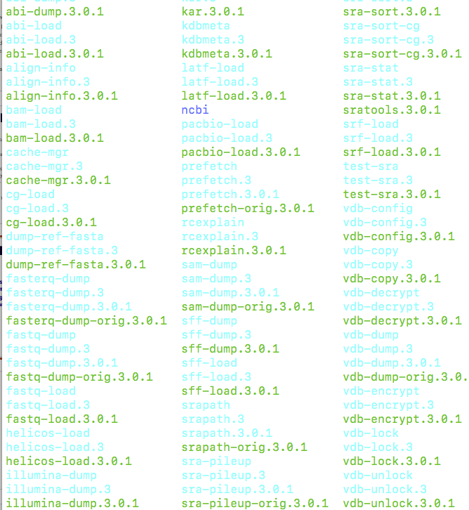
By downloading sratoolkit, we now have access to many executable programs, each with their own function.
This will be a reoccurring theme!

Slide 39
Why do this?
Every time you run a program you will need to designate the FULL PATH to the program to use it!
/users/m/m/mmg232in/software/sratoolkit.3.0.1-ubuntu64/bin/fastq-dump <inputfile>
Imagine typing that every time!

Slide 40
Why do this?
Instead, now all you have to do is type the program name!
Fastq-dump <inputfile>

Slide 41
STEPs to downloading data from geo:
Collect SRR Numbers using RUN SELECTOR
Download SRA-ToolKit and set up
Note: Once this is done, you do not need to do this again!
Run sra_fqdump.sh script using output from step #1
But…in order to run this script we need to submit a job on SLURM!

Slide 42
Running batch jobs

Slide 43
In order to submit a job, need to use the job scheduler Slurm
Some common slurm directive
#!/bin/bash
#SBATCH --partition=bluemoon
#SBATCH --nodes=1
#SBATCH --ntasks=4
#SBATCH --mem=50G
#SBATCH --time=30:00:00
#SBATCH --job-name=RNAseq
# %x=job-name %j=jobid
#SBATCH --output=%x_%j.out

Slide 44
In order to submit a job, need to use the job scheduler Slurm
Some common slurm directive
shebang = used to tell the linux OS which interpreter to use
#!/bin/bash
#SBATCH --partition=bluemoon
#SBATCH --nodes=1
#SBATCH --ntasks=2
#SBATCH --mem=50G
#SBATCH --time=30:00:00
#SBATCH --job-name=RNAseq
# %x=job-name %j=jobid
#SBATCH --output=%x_%j.out

Slide 45
In order to submit a job, need to use the job scheduler Slurm
Some common slurm directive
partition = default is bluemoon if not specified
Other partitions are available and this is important if you are running a “job” that will take longer than 3 days
#!/bin/bash
#SBATCH --partition=bluemoon
#SBATCH --nodes=1
#SBATCH --ntasks=2
#SBATCH --mem=50G
#SBATCH --time=30:00:00
#SBATCH --job-name=RNAseq
# %x=job-name %j=jobid
#SBATCH --output=%x_%j.out

Slide 46
In order to submit a job, need to use the job scheduler Slurm
Some common slurm directive
Node: A “node” is a server in the cluster. Each node has is configured with a certain number of cores (CPUs).
Task: A “task” is a process sent to a core. By default, 1 core is assigned per 1 task
Recommend that you begin with 1 node and 2 processes
#!/bin/bash
#SBATCH --partition=bluemoon
#SBATCH --nodes=1
#SBATCH --ntasks=2
#SBATCH --mem=50G
#SBATCH --time=30:00:00
#SBATCH --job-name=RNAseq
# %x=job-name %j=jobid
#SBATCH --output=%x_%j.out

Slide 47
In order to submit a job, need to use the job scheduler Slurm
Some common slurm directive
#!/bin/bash
#SBATCH --partition=bluemoon
#SBATCH --nodes=1
#SBATCH --ntasks=2
#SBATCH --mem=50G
#SBATCH --time=30:00:00
#SBATCH --job-name=RNAseq
# %x=job-name %j=jobid
#SBATCH --output=%x_%j.out
If your job requires more than 1G of memory – need to specify this

Slide 48
In order to submit a job, need to use the job scheduler Slurm
Some common slurm directive
#!/bin/bash
#SBATCH --partition=bluemoon
#SBATCH --nodes=1
#SBATCH --ntasks=4
#SBATCH --mem=50G
#SBATCH --time=30:00:00
#SBATCH --job-name=RNAseq
# %x=job-name %j=jobid
#SBATCH --output=%x_%j.out
Walltime is the maximum amount of time your job will run.

Slide 49
Inputs
Inputs
Reads R1
Reads R2
Reads R1
Reads R2
Control
Control
4 files
FastQ
FastQ
FastQ
FastQ
Treatment
Reads R1
Reads R2
Treatment
Reads R1
Reads R2
4 files
FastQ
FastQ
FastQ
FastQ
LANE 1
LANE 2
4 files X 4 biological replicates = 16 files per treatment
16 FASTQ files for Control
16 FASTQ files for Treatment

