Slide 2
Alignments files

Slide 3
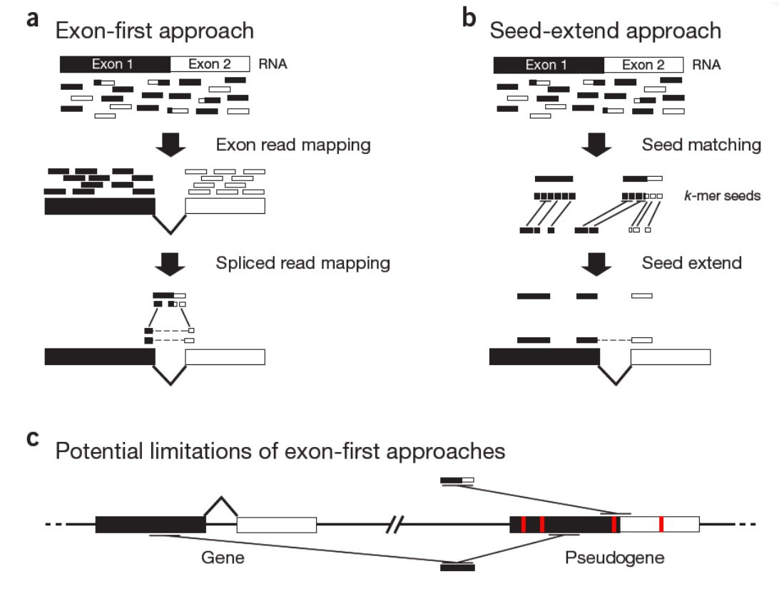
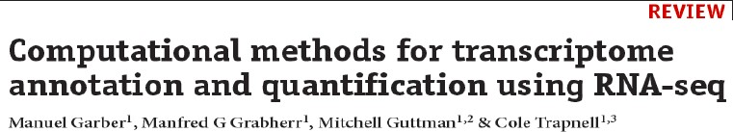
Exon first vs seed extend

Slide 4
Read alignments files: the BAM/SAM format
BAM is the Binary equivalent of SAM (which is plain text) In practice: we essentially use BAM files
‘Sequence Alignment/Map’ format
http://samtools.sourceforge.net/SAMv1.pdf
Supported by all major alignment packages.
SAM/BAM files an be manipulated with SAMtools (and others)
Header section:
Metadata about the genome, the samples, the pipeline
Header lines start with @
Alignments (or ‘records’) section:
6_1303_10584_85775 | 99 | groupVIII | 311 | 3 | 63M3I34M | = | 780 | 572 | GGGTATTGGGC @CFFFFFHFH
6_1111_20943_90813 | 163 | groupVIII | 315 | 40 | 100M | = | 809 | 594 | TAATGAAGCCAT @BDDFDDA+<A<
6_2111_2016_88235 | 355 | groupVIII | 315 | 3 | 100M | = | 856 | 573 | TAATGAAGCCAT @?DADDBD>D>B
6_1104_8139_99999 | 163 | groupVIII | 316 | 14 | 100M | = | 818 | 602 | AATGAAGCCATT @@FFFFFGHGHH
6_1304_4167_91751 | 163 | groupVIII | 322 | 5 | 52M3I29M | = | 812 | 573 | GCCATTTTTAC <<BDBDEHHDF
6_2301_14383_16382 | 163 | groupVIII | 323 | 40 | 51M3I46M | = | 809 | 589 | CCATTTTTACT CCFFFFFHHHH

Slide 5
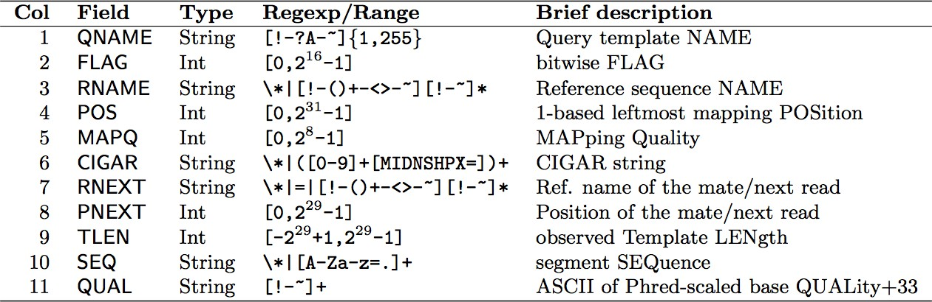
SAM alignment section
cf. FASTQ format
Read Name FLAG Chrom AlnStart CIGAR Sequence BaseQuals
6_1303_10584_85775 | 99 | groupVIII | 311 | 3 | 63M3I34M | = | 780 | 572 | GGGTATTGGGC @CFFFFFHFH
6_1111_20943_90813 | 163 | groupVIII | 315 | 40 | 100M | = | 809 | 594 | TAATGAAGCCAT @BDDFDDA+<A<
6_2111_2016_88235 | 355 | groupVIII | 315 | 3 | 100M | = | 856 | 573 | TAATGAAGCCAT @?DADDBD>D>B
6_1104_8139_99999 | 163 | groupVIII | 316 | 14 | 100M | = | 818 | 602 | AATGAAGCCATT @@FFFFFGHGHH
6_1304_4167_91751 | 163 | groupVIII | 322 | 5 | 52M3I29M | = | 812 | 573 | GCCATTTTTAC <<BDBDEHHDF
6_2301_14383_16382 | 163 | groupVIII | 323 | 40 | 51M3I46M | = | 809 | 589 | CCATTTTTACT CCFFFFFHHHH

Slide 6
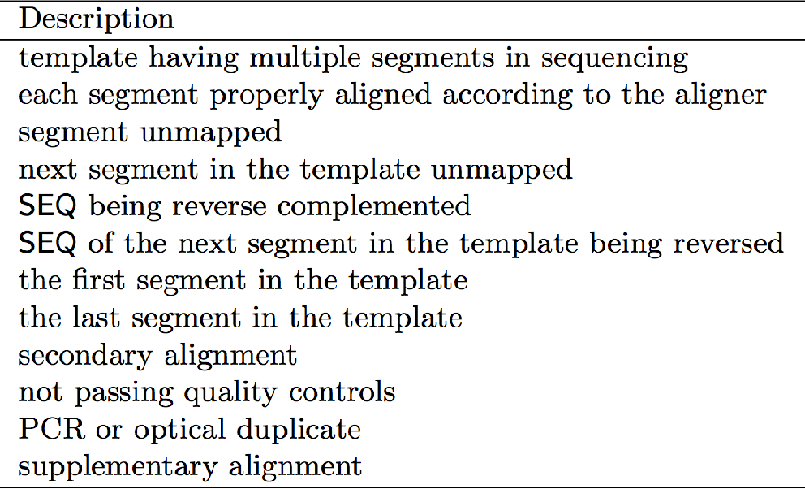
SAM flags
Base 16
Base 10
Base 2
00000000 | 00000001
00000000 | 00000010
00000000 | 00000100
00000000 | 00001000
00000000 | 00010000
00000000 | 00100000
00000000 | 01000000
00000000 | 10000000
00000001 | 00000000
00000010 | 00000000
00000100 | 00000000
00001000 | 00000000
0x1 | 1
0x2 | 2
0x4 | 4
0x8 | 8
0x10 | 16
0x20 | 32
0x40 | 64
0x80 | 128
0x100 | 256
0x200 | 512
0x400 | 1024
0x800 | 2048
₂0
₂1
₂2
₂3
₂4
₂5
₂6
₂7
₂8
₂9
₂10
₂11
SAM flags are displayed in base 10 (decimal) but only have a meaning when converted to binary numbers
You can decode them with samtools flags:
samtools flags 163
# 0xA3 163 PAIRED,PROPER_PAIR,MREVERSE,READ2

Slide 7
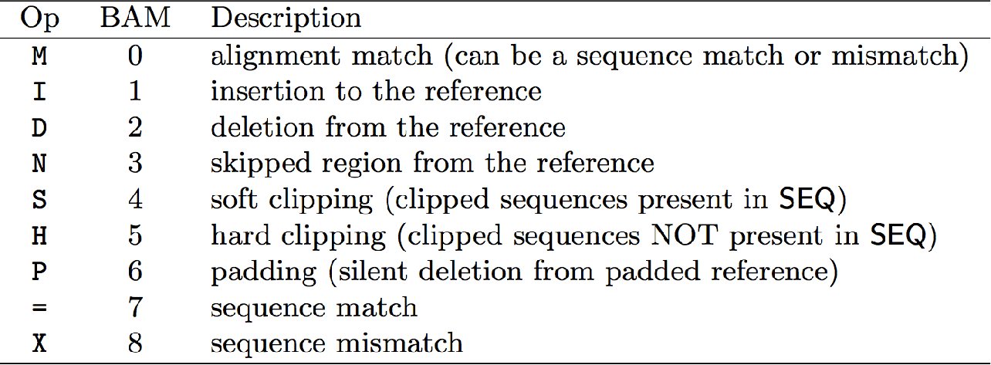
‘CIGAR strings’ (Alignments)
6_1303_10584_85775 | 99 | groupVIII | 311 | 3 | 63M3I34M | = | 780 | 572 | GGGTATTGGGC @CFFFFFHFH
6_1111_20943_90813 | 163 | groupVIII | 315 | 40 | 100M | = | 809 | 594 | TAATGAAGCCAT @BDDFDDA+<A<
6_2111_2016_88235 | 355 | groupVIII | 315 | 3 | 100M | = | 856 | 573 | TAATGAAGCCAT @?DADDBD>D>B
6_1104_8139_99999 | 163 | groupVIII | 316 | 14 | 100M | = | 818 | 602 | AATGAAGCCATT @@FFFFFGHGHH
6_1304_4167_91751 | 163 | groupVIII | 322 | 5 | 52M3I29M | = | 812 | 573 | GCCATTTTTAC <<BDBDEHHDF
6_2301_14383_16382 | 163 | groupVIII | 323 | 40 | 51M3I46M | = | 809 | 589 | CCATTTTTACT CCFFFFFHHHH
100M — 100 matching nucleotides (i.e. no gaps)
63M-3I-34M — 63 matching nucleotides
3 nucleotides not in the reference (3bp insertion) 34 matching nucleotides
Aligned Read
TGCAGGATGGATGTGTTCCTCCTCAGCTGCTTATTTTAACTCCACTGCACAACATGTTTTGTGTTATATTCTTTCGCTGTGTAGTCTGTAAGC
TGCAGGGACTGCAGGATGGATGTGTTCCTCCTCAGCTGCTTATTTTAACTCCAC---ACAACATGTTTTGTGTTATATTCTTTCGCTGTGTAGTCTGTAAGCAGAGTATGATACTG
Reference

Slide 8
The SAMtools program
samtools <subprogram>
Major SAMtools subprograms and options:
view [options] <file>
[options]
Default: converts to ‘beheaded’ SAM;
-H: output the SAM header, -h: convert to full SAM, -b: leave in (or
convert to) BAM format
-f/-F <int>: filter for/against flags matching the integer.
e.g. -F 0x904 removes all records flagged 0x4 (unmapped), 0x100 (secondary) or 0x800 (supplementary).
If file is - (hyphen) STDIN is used
sort <file> — Sorts the alignments within a BAM file (ie. by chromosome
and coordinate). If file is - (hyphen) STDIN is used.
index <file> — Creates an index file (.bai) for the given (sorted) BAM file
faidx <file> — Creates an index file (.fai) for the given FASTA file
flags <integer> — Print the meaning(s) of the given flag.
flagstats <file> — Print statistics on the alignments in the BAM file.

Slide 9

Sequence alignment and map
– SAM (Sequence Alignment/Map) format:
●
Capture all of the critical information about NGS data in a single indexed and compressed file
Sharing : data across and tools Generic alignment format
●
●
SAMTOOLS: provide various
utilities for manipulating alignments in the SAM format:sorting, merging, indexing...
http://samtools.sourceforge.net/ http://picard.sourceforge.net/explain-flags.html
●

Slide 10
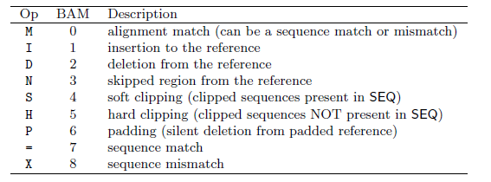
Spliced cigar line
–
Extend CIGAR strings
–
Example: intron de 81 bases
ERR022486.8388510 81 22 32099 255 58M81N18M = 27484 -4772 CCTTGGTCTTGCCGAAGTAGATCTCATTGAGAGTGGAGCGGATCTTGTTCTCCATTTCCTCCA CCAGGCGTCCGAT :9=<==;<<><=><?>>?<?==>>?>><?>>??<AA? @AFADDD;GDGAG@GGCBE@GG?GG>GGGG?GGGGGGGG NM:i:0 XS:A:- NH:i:1

Slide 11
Bam & Bed
– BAM (Binary Alignment/Map) format:
Compressed binary representation of SAM
Greatly reduces storage space requirements to about 27% of original SAM
Bamtools: reading, writing, and manipulating BAM files
●
●
– Bed (Browser Extensible Data) format:
tab-delimited text file that defines a feature track http://genome.ucsc.edu/FAQ/FAQformat.html#format1 The first three required BED fields are:
<chromosome> <start> <end> 9 additional optional BED fields
●
●

Slide 12
Aligning reads to a genome (using STAR)
Make sure the commands work. (hypens; updated paths, matching sample names…)
Provide any new files for the day (eg. trimmed files…)!
Check file permissions!

Slide 13
Using STAR to align reads
Assuming a previously built STAR genome index!

Slide 14
STAR genome index (database)
Created from the FASTA & GTF files downloaded from Ensembl
Commands:
module load STAR
fasta_file=./Mus_musculus.GRCm38.dna_sm.primary_assembly.fa gtf_file=./Mus_musculus.GRCm38.98.gtf
mkdir star_db
STAR \
--runMode genomeGenerate \
--genomeFastaFiles $fasta_file \
--sjdbGTFfile $gtf_file \
--genomeDir ./star_db/
Submitted as a grid job with 92G memory
Already done!!
The STAR genome database is in:
/u/project/scampbel/nrochett/GENOMES/m38p6.M22/e98/star_db

Slide 15
Using STAR to align reads
The (previously built) STAR genome index is in:
/u/project/scampbel/nrochett/GENOMES/m38p6.M22/e98/star_db
On the cluster:
module load STAR module load samtools # STAR -h | less
sample=P10_rep1 star_db_dir=/u/project/scampbel/nrochett/GENOMES/m38p6.M22/e98/star_db
STAR \
--genomeDir $star_db_dir \
--readFilesIn $sample.five_percent.trimmo.fastq.gz \
--readFilesCommand zcat \
--outFileNamePrefix $sample. \
--outSAMtype BAM SortedByCoordinate \
--outFilterMismatchNmax 5 \
--outFilterMultimapNmax 1

Slide 16
Assessing read alignments !
Percentage of reads that successfully aligned: typically >80% for human/mouse references
Outcome differences between samples (quality outliers and/or batch effects)
If paired-end sequencing: Percentage of pairs that co-align (‘properly paired’ statistics)
Dedicated quality-control tools exist:
RSeQC (Wang et al. 2012)
QoRTs (Hartley&Mullikin2015)

