Slide 2
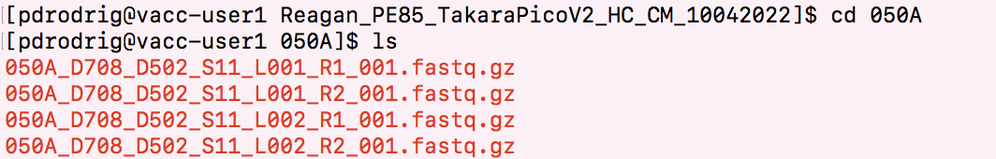
This is per sample!
Why so many files?

Slide 3


Inputs
Reads R1
Control
FastQ
Treatment
Reads R1
FastQ
SE – single end dataset -> Read 1 only
PE – paired end dataset -> Read 1 and 2
Sequenced over 2 lanes

Slide 4
Inputs
Inputs
Reads R1
Reads R2
Reads R1
Reads R2
Control
Control
4 files
FastQ
FastQ
FastQ
FastQ
Treatment
Reads R1
Reads R2
Treatment
Reads R1
Reads R2
4 files
FastQ
FastQ
FastQ
FastQ
LANE 1
LANE 2
4 files X 4 biological replicates = 16 files per treatment
16 FASTQ files for Control
16 FASTQ files for Treatment

Slide 5


What is a FASTQ?
@NS500177:196:HFTTTAFXX:1:11101:10916:1458 2:N:0:CGCGGCTG ACACGACGATGAGGTGACAGTCACGGAGGATAAGATCAATGCCCTCATTAAAGCAGCCGGTGTAA
+ AAAAAEEEEEEEEEEE//AEEEAEEEEEEEEEEE/EE/<<EE/AAEEAEE///EEEEAEEEAEA<
1
2
3
4
Each sequencing “read” consists of 4 lines of data :
1. The first line (which always starts with ‘@’) is a unique ID for the sequence that follows
2. The second line contains the bases called for the sequenced fragment
3. . The third line is always a “+” character
4. The fourth line contains the quality scores for each base in the sequenced fragment

Slide 6
FASTQ files are huge!
zipped-up
Notice, its fastq.gz
No need to decompress it
Any programs can use the .gz file as input
We need to merge these files by lane – not by read

Slide 7
cat command
Cat(concatenate) command is frequently used in Linux
One major function is to merge the contents of multiple files
cat filename1 filename2 > merged_file
Merge read1
Merge read 2
From 4 files to 2 files
Check size with disk usage command

Slide 8
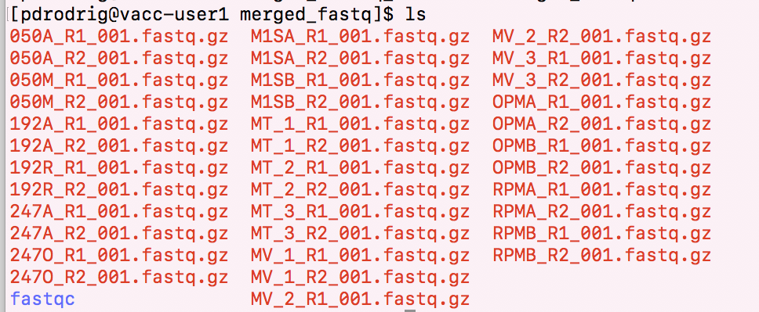
results of cat

Slide 9
How would you run a program on the VACC?
Install it in your personal VACC account and then be able to call it
Or load it from the shared computing cluster using module package

Slide 10
Running batch jobs

Slide 11
Important to know about VACC
Once you feel confident about programs being installed and/or your scripts, you may want to ‘submit a job’
For example, it may be annoying to do this one by one:
htseq-count -f bam -s yes -i gene_name -m union sample1.bam annotation.gtf > sample1.count.txt
htseq-count -f bam -s yes -i gene_name -m union sample2.bam annotation.gtf > sample2.count.txt
Also, some programs take very long to run!

Slide 12
In order to submit a job, need to use the job scheduler Slurm
Some common slurm directive
#!/bin/bash
#SBATCH --partition=bluemoon
#SBATCH --nodes=1
#SBATCH --ntasks=4
#SBATCH --mem=50G
#SBATCH --time=30:00:00
#SBATCH --job-name=RNAseq
# %x=job-name %j=jobid
#SBATCH --output=%x_%j.out

Slide 13
In order to submit a job, need to use the job scheduler Slurm
Some common slurm directive
shebang = used to tell the linux OS which interpreter to use
#!/bin/bash
#SBATCH --partition=bluemoon
#SBATCH --nodes=1
#SBATCH --ntasks=4
#SBATCH --mem=50G
#SBATCH --time=30:00:00
#SBATCH --job-name=RNAseq
# %x=job-name %j=jobid
#SBATCH --output=%x_%j.out

Slide 14
In order to submit a job, need to use the job scheduler Slurm
Some common slurm directive
partition = default is bluemoon if not specified
Other partitions are available and this is important if you are running a “job” that will take longer than 3 days
#!/bin/bash
#SBATCH --partition=bluemoon
#SBATCH --nodes=1
#SBATCH --ntasks=4
#SBATCH --mem=50G
#SBATCH --time=30:00:00
#SBATCH --job-name=RNAseq
# %x=job-name %j=jobid
#SBATCH --output=%x_%j.out

Slide 15
In order to submit a job, need to use the job scheduler Slurm
Some common slurm directive
Node: A “node” is a server in the cluster. Each node has is configured with a certain number of cores (CPUs).
Task: A “task” is a process sent to a core. By default, 1 core is assigned per 1 task
Recommend that you begin with 1 node and 2 processes
#!/bin/bash
#SBATCH --partition=bluemoon
#SBATCH --nodes=1
#SBATCH --ntasks=4
#SBATCH --mem=50G
#SBATCH --time=30:00:00
#SBATCH --job-name=RNAseq
# %x=job-name %j=jobid
#SBATCH --output=%x_%j.out

Slide 16
In order to submit a job, need to use the job scheduler Slurm
Some common slurm directive
#!/bin/bash
#SBATCH --partition=bluemoon
#SBATCH --nodes=1
#SBATCH --ntasks=4
#SBATCH --mem=50G
#SBATCH --time=30:00:00
#SBATCH --job-name=RNAseq
# %x=job-name %j=jobid
#SBATCH --output=%x_%j.out
If your job requires more than 1G of memory – need to specify this

Slide 17
In order to submit a job, need to use the job scheduler Slurm
Some common slurm directive
#!/bin/bash
#SBATCH --partition=bluemoon
#SBATCH --nodes=1
#SBATCH --ntasks=4
#SBATCH --mem=50G
#SBATCH --time=30:00:00
#SBATCH --job-name=RNAseq
# %x=job-name %j=jobid
#SBATCH --output=%x_%j.out
Walltime is the maximum amount of time your job will run.

