Slide 1
RSeQC & HTSeq
March 7th, 2024

Slide 2
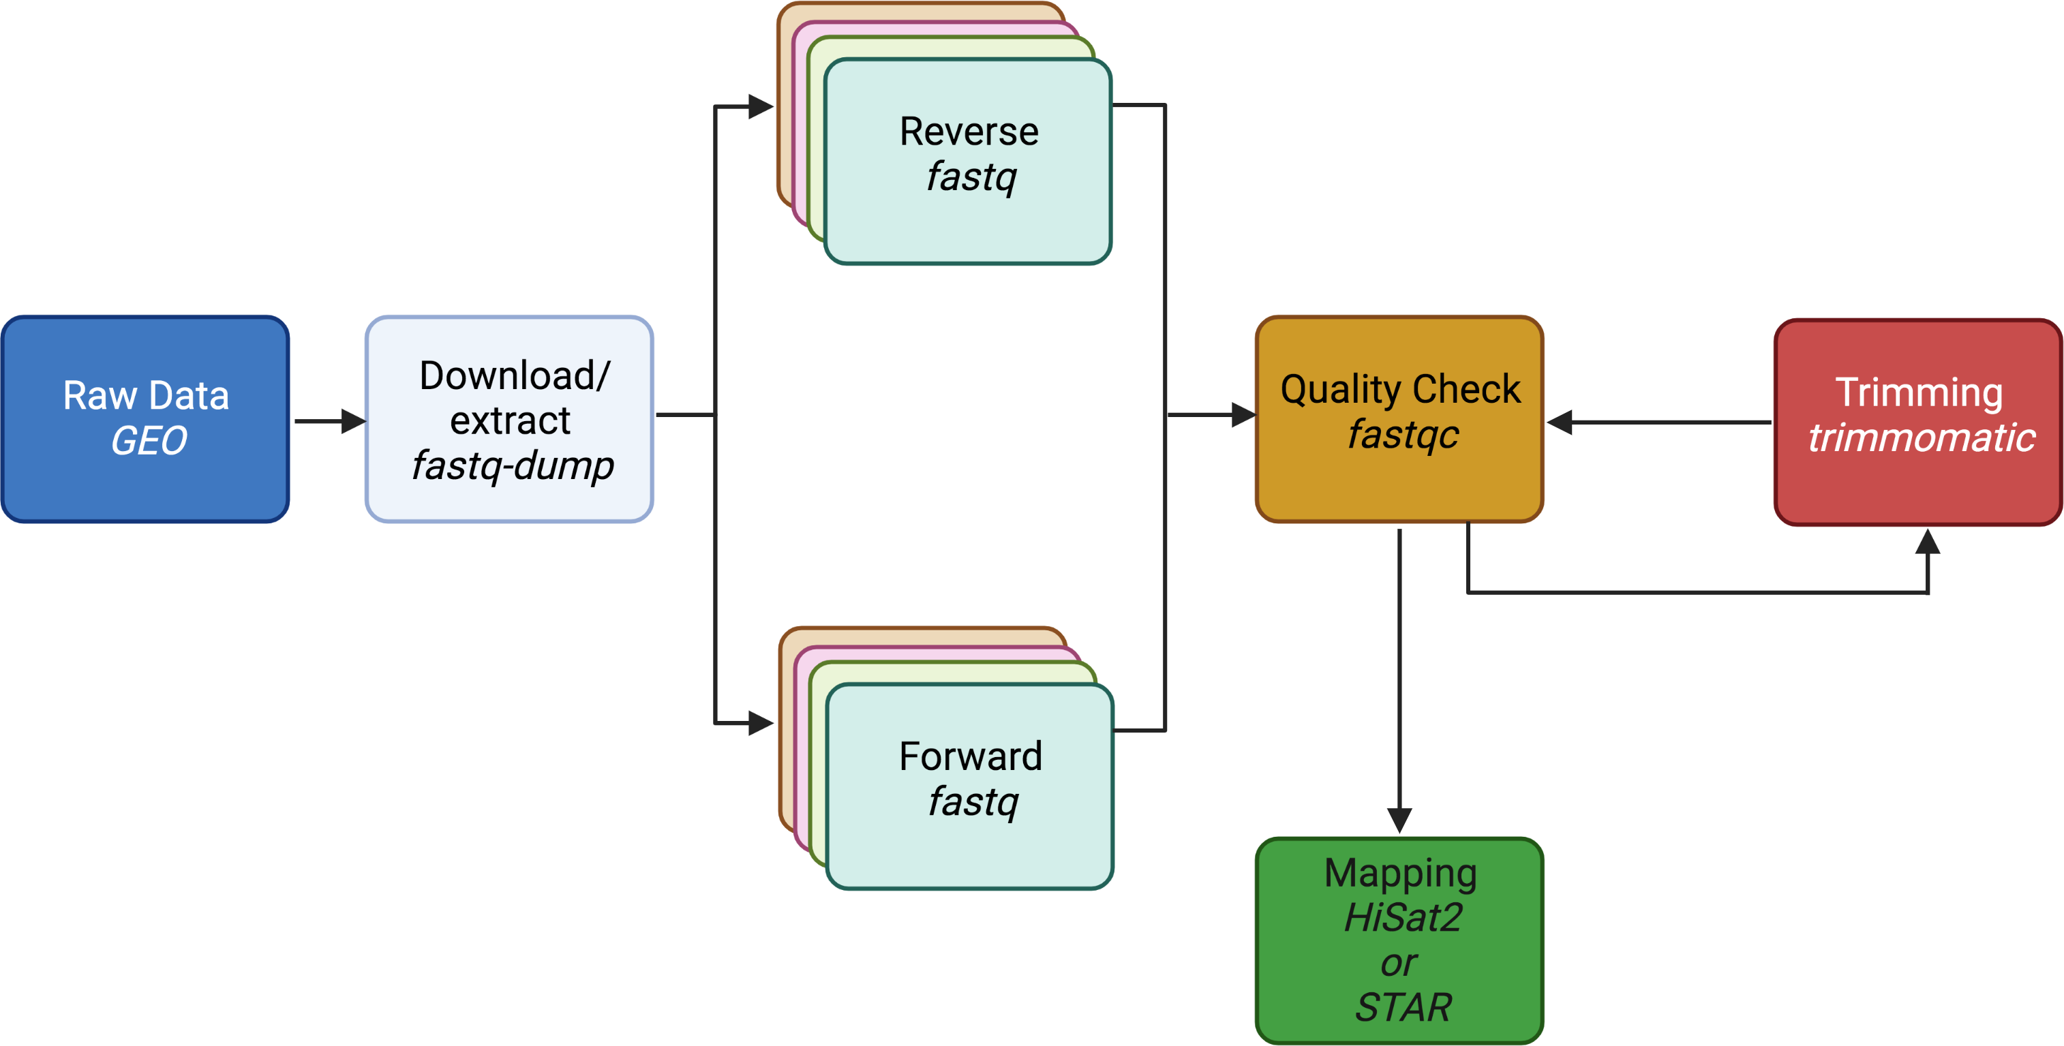

Slide 3
Determine strandedness RSeQC
SAM/BAM
Count reads
HTseq-count
count

Slide 4
FASTA
GFF
contigs
FASTQ
SAM/BAM
VCF
bigwig
counts
narrowPeak

Slide 5
Determine strandedness RSeQC
Count reads
HTseq-count
Take a break to install RSeQC with pip

Slide 6


Pre & post alignment QC
raw reads QC
adapter/primer/other contaminating and over-represented sequences
sequencing quality
GC distributions
duplication levels
Pre-alignment: FastQC, fastp
aligned reads QC
% (uniquely) aligned reads
% exonic vs. intronic/intergenic
gene diversity
gene body coverage
strandedness
Post-alignment: RSeQC, QoRTs

Slide 7
Pre QC Questions
Before mapping:
How to identify and remove reads with low base calls?
How to identify and remove reads with linkers/adaptors ?
How to screen for potential species/vector/ribosomal contamination?
How is your library complexity?

Slide 8
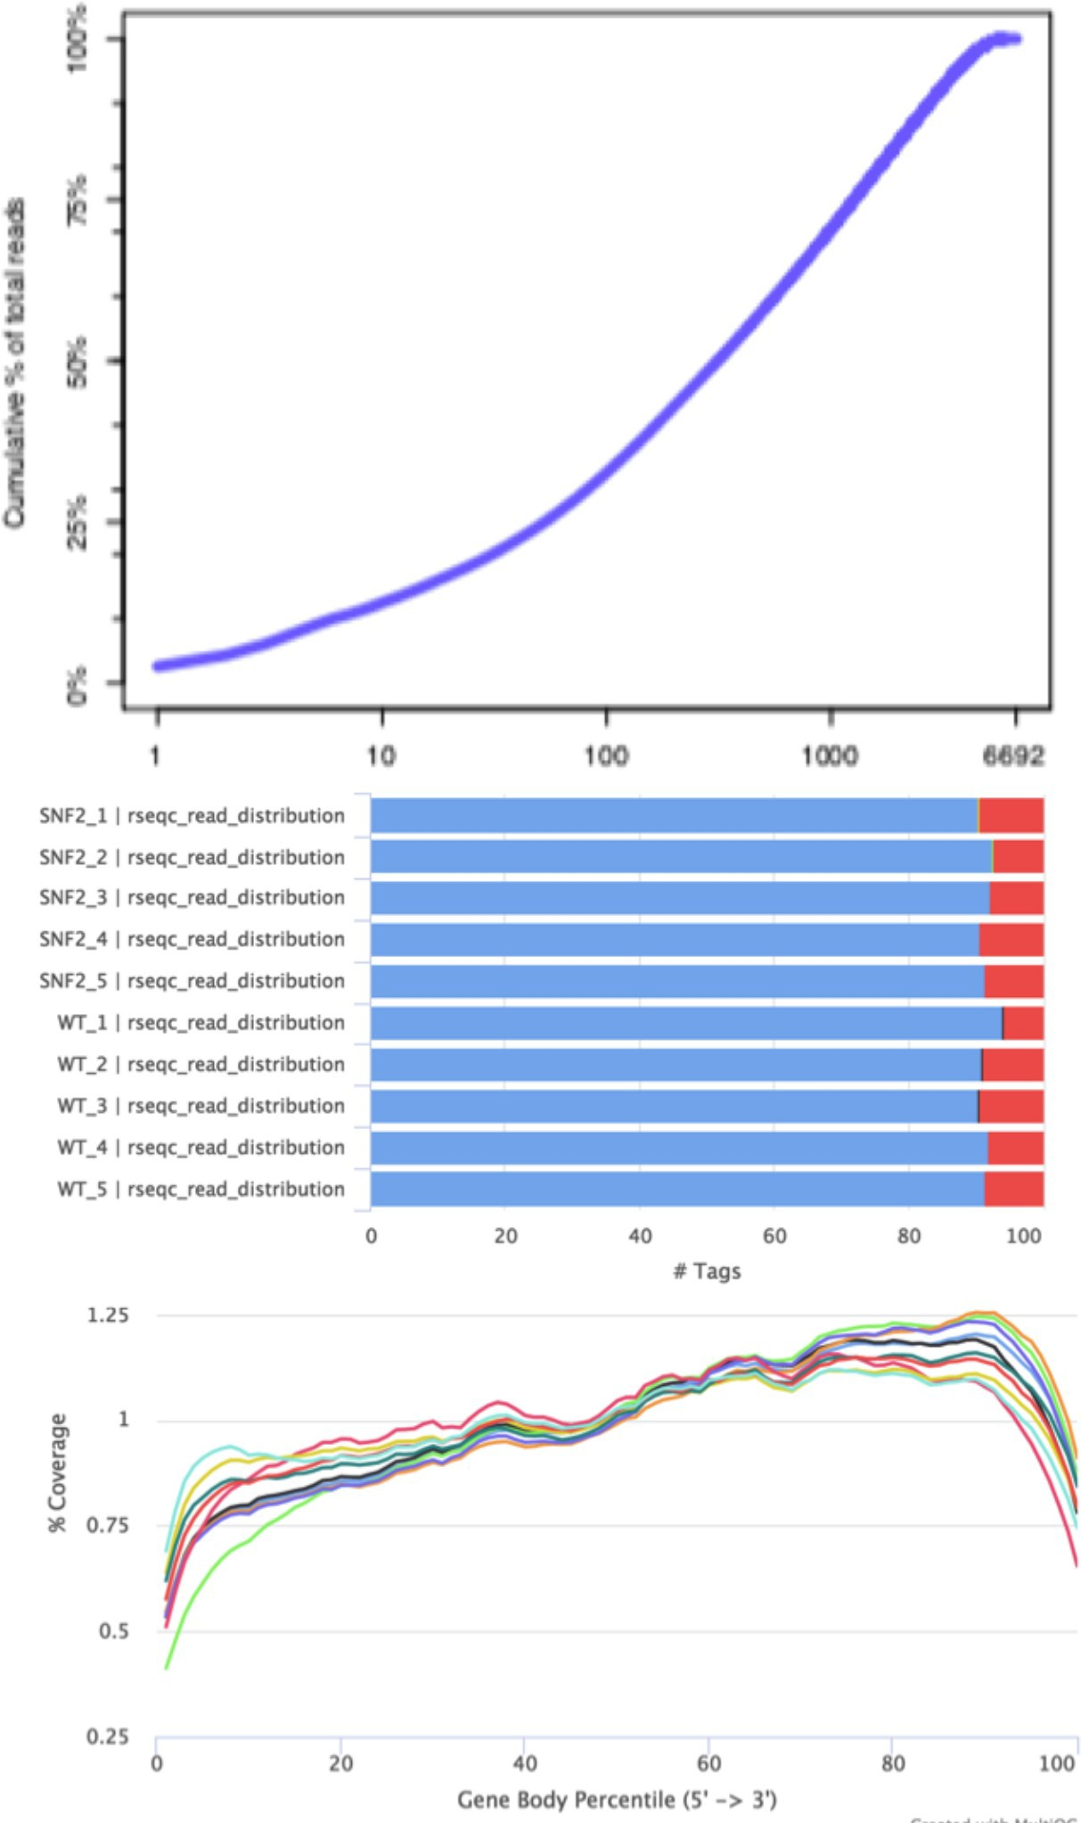
Post-alignment QC
cumulative % of total reads
QoRTs
lack of gene diversity:
dominance of rRNAs, tRNAs or other highly abundant transcripts
read distribution
high intron coverage: incomplete poly(A) enrichment
many intergenic reads: gDNA contamination
exons
introns
gene body coverage
3’ bias: RNA degradation + poly(A) enrichment
% Coverage
RSeQC
What is percentage of reads aligned?
Is your sequencing library stranded or unstranded?
Gene Body Percentile (5’ ➔ 3’)

Slide 9
Stranded libraries
A major decision to be made during the library preparation step is whether to preserve RNA strand information.
Unlike DNA molecules, RNA molecules exist as single-stranded threads that could result from the sense or antisense strand.
The creation of stranded libraries are now standard with Illumina TruSeq ‘stranded’ RNA-Seq kits
This means that with a great amount of certainty you can identify which strand of DNA the RNA was transcribed from

Slide 10
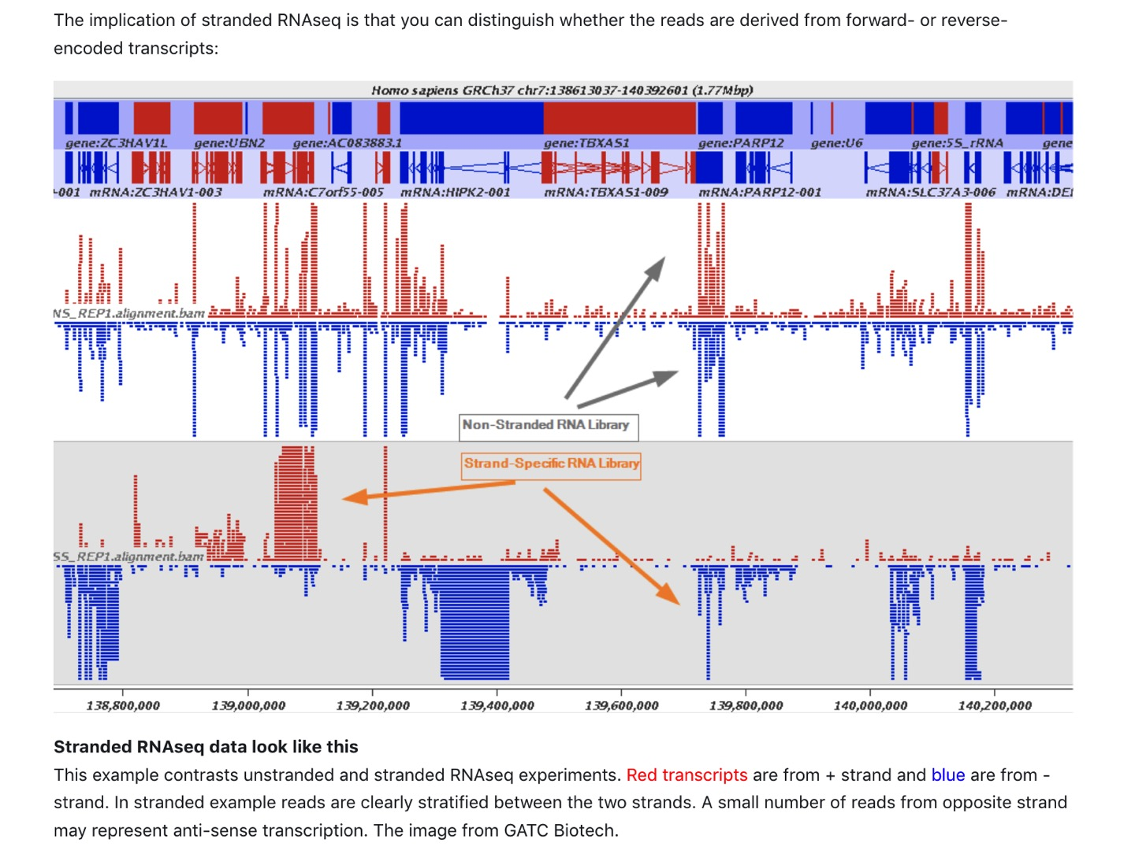

Slide 11
Why retain stranded information?
It makes sense to begin with the most information possible – even if immediately that is not of interest
Useful for identifying antisense transcripts, mapping splicing events, and detecting overlapping transcripts.
They are commonly used in studies of transcriptomics, gene expression analysis, and RNA editing, and de novo assembly.

Slide 12
Why is this important to determine prior to counting?
If you use wrong directionality parameter in the read counting step with HTSeq, the reads are considered to be from the wrong strand.
This means you won't get any counts, and if there is a gene in the same location on the other strand, your reads are counted for the wrong gene.
So its important to check, if you are unsure, using tools!

Slide 13
Three scenarios when it comes to stranded libraries
Forward (secondstrand) – reads resemble the gene sequence
Reverse (firststrand) – reads resemble the complementary sequence
Unstranded

Slide 14

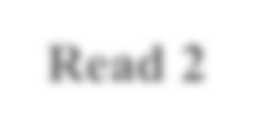




DNA, coding/sense strand
5’
3’
DNA, noncoding/antisense strand
Read 1 |  | Read 2
If sequences of Read 1 align to the coding, sense strand – the library is “stranded”

Slide 15





DNA, coding/sense strand
5’
3’
DNA, noncoding/antisense strand
Read 2
Read 1
If sequences of Read 2 align to the coding, sense strand – the library is “ reverse stranded”

Slide 16
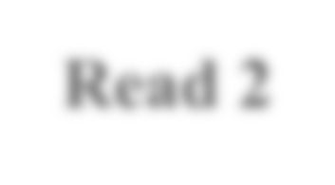




DNA, coding/sense strand
5’
3’
DNA, noncoding/antisense strand
Read 2 |  | Read 1
If both Read 1 and Read 2 align to the coding, sense strand – the library is “unstranded”

Slide 17
Different tools have different names for stranded settings:
 | Option 1 RF/fr-firststrand Reverse | Option 2 FR/fr- secondstrand Stranded | Option 3 Unstranded
HISAT2 (--rna-strandedness) | RF (for PE) R (for SE) | FR (for PE) F (for SE) | Default
STAR | n/a | n/a | n/a
SALMON | -I ISR | -I ISR | -I IU
HTSeq | stranded=reverse | stranded=yes | stranded=no
Methods or Kits | dUTP Illumina TruSeq NEBNext Ultra II | Ligation Standard SOLID, NuGEN, 10X | Standard Illumina NuGEN, SMARTer

Slide 18
Option 1 RF/fr-firststrand
 | Option 1 RF/fr-firststrand | Option 2 FR/fr- secondstrand | Option 3 Unstranded
HISAT2 (--rna-strandedness) | RF (for PE) R (for SE) | FR (for PE) F (for SE) | Default
STAR | n/a | n/a | n/a
SALMON | -I ISR | -I ISR | -I IU
HTSeq | stranded=reverse | stranded=yes | stranded=no
Methods or Kits | dUTP Illumina TruSeq NEBNext Ultra II | Ligation Standard SOLID, NuGEN, 10X | Standard Illumina NuGEN, SMARTer

Slide 19
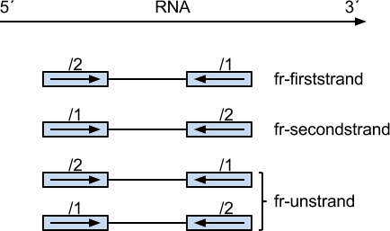
Infer_experiment.py pair-end RNA-seq
The second read (read 2) is from the original RNA strand/template, first read (read 1) is from the opposite strand.
Fraction of reads explained by "1++,1--,2+-,2-+": 0.0169
Fraction of reads explained by "1+-,1-+,2++,2-- ": 0.8827
Strand-specific pair-end RNA-seq data using dUTP protocol

Slide 20
Option 2 FR/fr-secondstrand
 | Option 1 RF/fr-firststrand | Option 2 FR/fr-secondstrand | Option 3 Unstranded
HISAT2 (--rna-strandedness) | RF (for PE) R (for SE) | FR (for PE) F (for SE) | Default
STAR | n/a | n/a | n/a
SALMON | -I ISR | -I ISR | -I IU
HTSeq | stranded=reverse | stranded=yes | stranded=no
Methods or Kits | dUTP Illumina TruSeq NEBNext Ultra II | Ligation Standard SOLID, NuGEN, 10X | Standard Illumina NuGEN, SMARTer

Slide 21
Infer_experiment.py pair-end RNA-seq
The first read (read 1) is from the original RNA strand/template, second read (read 2) is from the opposite strand.
Fraction of reads explained by "1++,1--,2+-,2-+": 0.9807
Fraction of reads explained by "1+-,1-+,2++,2-- ": 0.0193
Strand-specific pair-end RNA-seq data using Ligation protocol

Slide 22
Option 3 Unstranded
 | Option 1 RF/fr-firststrand | Option 2 FR/fr-secondstrand |  | Option 3 Unstranded
HISAT2 | RF (for PE) R (for SE) | FR (for PE) F (for SE) |  | Default
STAR | n/a | n/a |  | n/a
SALMON | -I ISR | -I ISR |  | -I IU
HTSeq | stranded=reverse | stranded=yes |  | stranded=no
Methods or Kits | dUTP Illumina TruSeq NEBNext Ultra II | Ligation Standard SOLID, NuGEN, 10X |  | Standard Illumina NuGEN, SMARTer

Slide 23
Infer_experiment.py pair-end RNA-seq
Fraction of reads failed to determine: 0.0648
Fraction of reads explained by "1++,1--,2+-,2-+": 0.4590 Fraction of reads explained by "1+-,1-+,2++,2--": 0.4763
Information regarding the strand is not conserved
(it is lost during the amplification of the mRNA fragments).

Slide 24
Determine strandedness RSeQC
Count reads
HTseq-count
Take a break to run RSeQC to infer strandedness

Slide 25
Is your library stranded or not stranded?
–RSeQC
(http://rseqc.sourceforge.net/)
– infer_experiment.py -i sample.bam –r gene_model.bed

Slide 26
What would you choose for the unknown?
 |  | Option 1 RF/fr-firststrand | Option 2 FR/fr-secondstrand | Option 3 Unstranded
 | HISAT2 | RF (for PE) R (for SE) | FR (for PE) F (for SE) | Default
 | STAR | n/a | n/a | n/a
 | SALMON | -I ISR | -I ISR | -I IU
 | HTSeq | stranded=reverse | stranded=yes | stranded=no
 | Methods or Kits | dUTP Illumina TruSeq NEBNext Ultra II | Ligation Standard SOLID, NuGEN, 10X | Standard Illumina NuGEN, SMARTer

Slide 27
Summary
Fraction of reads explained by "1++,1--,2+-,2-
+": 0.0193
Fraction of reads explained by "1+-,1-+,2++,2-
- ": 0.8827
Fraction of reads explained by "1++,1--,2+-,2-
+": 0.9807
Fraction of reads explained by "1+-,1-+,2++,2-
- ": 0.0193
Fraction of reads failed to determine: 0.0648
Fraction of reads explained by "1++,1--,2+-,2-+":0.4590
Fraction of reads explained by "1+-,1-+,2++,2--": 0.4763

Slide 28


Infer_experiment.py
single-end RNA-seq
RNA
Two different ways to strand reads: i) ++,--
5’
3’
read mapped to '+' strand indicates parental gene on '+' strand read mapped to '-' strand indicates parental gene on '-' strand
ii) +-,-+
read mapped to '+' strand indicates parental gene on '-' strand read mapped to '-' strand indicates parental gene on '+' strand
RNA
Strand-specific example:
5’
3’
Fraction of reads failed to determine: 0.0170 Fraction of reads explained by "++,--": 0.9669 Fraction of reads explained by "+-,-+": 0.0161
FR/fr-secondstrand stranded=yes

Slide 29
CLASS ACTIVITY #2

Slide 30
COUNTING READS
Determine strandedness RSeQC
Count reads
HTseq-count

Slide 31
Bioinformatics workflow of RNA-seq analysis
Raw reads
.fastq
Mapping
STAR
Which regions are expressed?
Aligned reads
.sam/.bam
Counting
HTSeq-counts
Read count table
How much are they expressed?
Normalized read count table
List of fold changes & statistical values
Downstream analyses on DE genes

Slide 32
Gene counting programs
HTSeq (Anders et al.2015, Bioinformatics 31:2)
Cufflinks (Trapnell et al, 2010, Nat Biotech 28:5)
StringTie (Pertea et al. 2015, Nat Biotech 33:3)
featureCounts
We are using HTSeq as this approach will obtain gene-level quantification by directly overlapping with gene loci

Slide 33
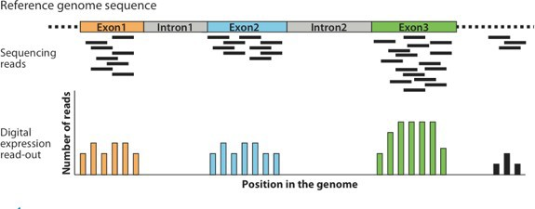
Counting per-gene alignments
 | sample1 | sample2 | sample3 | sample4 | ...
gene1 | 999 | 701 | 616 | 595
gene2 | 532 | 520 | 41 | 26
gene3 | 14 | 36 | 305 | 322
…
HTSeq package
Anders, Pyl & Huber, 2015, Bioinformatics 31:2
Hompage at https://htseq.readthedocs.io/
Allows per-exon counts
Designed for differential gene expression testing
Includes the htseq-count command

Slide 34
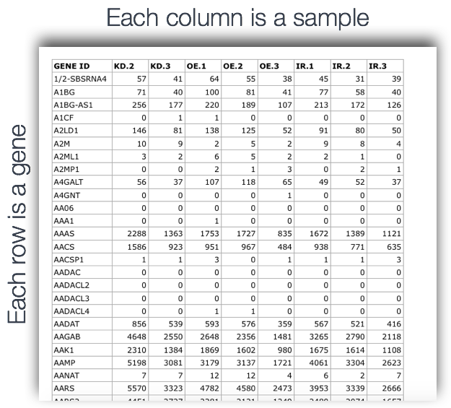

Slide 35
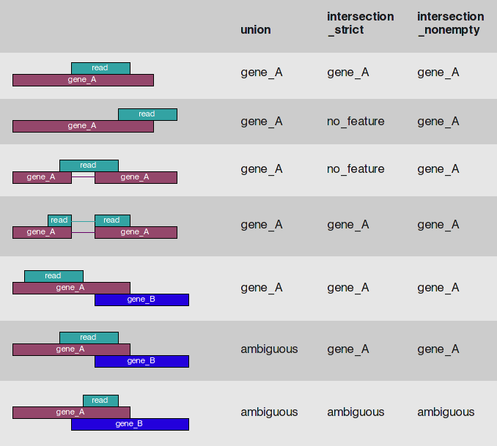
Counting features with htseq-count
What features are of interest? Gene, transcript, and/or exon counts?
type=exon
What happens if a read overlaps with multiple features?
mode=union
Is the RNA stranded, reversed strand, or
unstranded?

Slide 36
CLASS ACTIVITY #3

