Slide 2
HiSat2

Slide 3
HiSat2
Reference FastA files
Indexed Genome
Reference GTF Models
Reads
(fastq)
Yes
Maps with known junctions
Report
Pool of known splice junctions
Yes
Add
Maps convincingly with novel junction?
Report
No
Discard

Slide 4
Example of code using hisat2
hisat2-build *.fasta <name>
hisat2 \
-p 8 \
-x {GENOME} \
-1 {SAMPLE}_unmapped_R1_001.fastq.gz \
-2 {SAMPLE}_unmapped_R2_001.fastq.gz \
-S {SAMPLE}.sam

Slide 5
Alignments files (BAM & SAMtools)

Slide 6
Read alignments files: the BAM/SAM format
BAM is the Binary equivalent of SAM (which is plain text) In practice: we essentially use BAM files
‘Sequence Alignment/Map’ format
http://samtools.sourceforge.net/SAMv1.pdf
Supported by all major alignment packages.
SAM/BAM files an be manipulated with SAMtools (and others)
Header section:
Metadata about the genome, the samples, the pipeline
Header lines start with @
Alignments (or ‘records’) section:
6_1303_10584_85775 | 99 | groupVIII | 311 | 3 | 63M3I34M | = | 780 | 572 | GGGTATTGGGC @CFFFFFHFH
6_1111_20943_90813 | 163 | groupVIII | 315 | 40 | 100M | = | 809 | 594 | TAATGAAGCCAT @BDDFDDA+<A<
6_2111_2016_88235 | 355 | groupVIII | 315 | 3 | 100M | = | 856 | 573 | TAATGAAGCCAT @?DADDBD>D>B
6_1104_8139_99999 | 163 | groupVIII | 316 | 14 | 100M | = | 818 | 602 | AATGAAGCCATT @@FFFFFGHGHH
6_1304_4167_91751 | 163 | groupVIII | 322 | 5 | 52M3I29M | = | 812 | 573 | GCCATTTTTAC <<BDBDEHHDF
6_2301_14383_16382 | 163 | groupVIII | 323 | 40 | 51M3I46M | = | 809 | 589 | CCATTTTTACT CCFFFFFHHHH

Slide 7
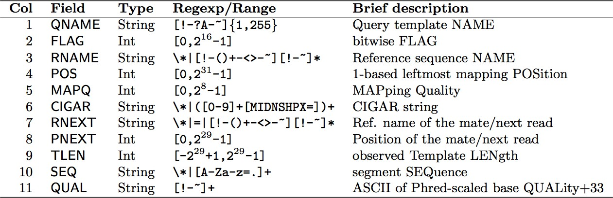
SAM alignment section
cf. FASTQ format
Read Name FLAG Chrom AlnStart CIGAR Sequence BaseQuals
6_1303_10584_85775 | 99 | groupVIII | 311 | 3 | 63M3I34M | = | 780 | 572 | GGGTATTGGGC @CFFFFFHFH
6_1111_20943_90813 | 163 | groupVIII | 315 | 40 | 100M | = | 809 | 594 | TAATGAAGCCAT @BDDFDDA+<A<
6_2111_2016_88235 | 355 | groupVIII | 315 | 3 | 100M | = | 856 | 573 | TAATGAAGCCAT @?DADDBD>D>B
6_1104_8139_99999 | 163 | groupVIII | 316 | 14 | 100M | = | 818 | 602 | AATGAAGCCATT @@FFFFFGHGHH
6_1304_4167_91751 | 163 | groupVIII | 322 | 5 | 52M3I29M | = | 812 | 573 | GCCATTTTTAC <<BDBDEHHDF
6_2301_14383_16382 | 163 | groupVIII | 323 | 40 | 51M3I46M | = | 809 | 589 | CCATTTTTACT CCFFFFFHHHH

Slide 8
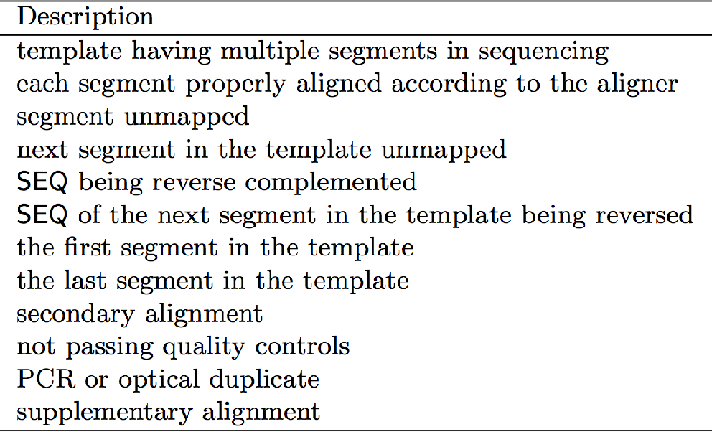
SAM flags
Base 16
Base 10
Base 2
00000000 | 00000001
00000000 | 00000010
00000000 | 00000100
00000000 | 00001000
00000000 | 00010000
00000000 | 00100000
00000000 | 01000000
00000000 | 10000000
00000001 | 00000000
00000010 | 00000000
00000100 | 00000000
00001000 | 00000000
0x1 | 1
0x2 | 2
0x4 | 4
0x8 | 8
0x10 | 16
0x20 | 32
0x40 | 64
0x80 | 128
0x100 | 256
0x200 | 512
0x400 | 1024
0x800 | 2048
₂0
₂1
₂2
₂3
₂4
₂5
₂6
₂7
₂8
₂9
₂10
₂11
SAM flags are displayed in base 10 (decimal) but only have a meaning when converted to binary numbers
You can decode them with samtools flags:
samtools flags 163
# 0xA3 163 PAIRED,PROPER_PAIR,MREVERSE,READ2

Slide 9
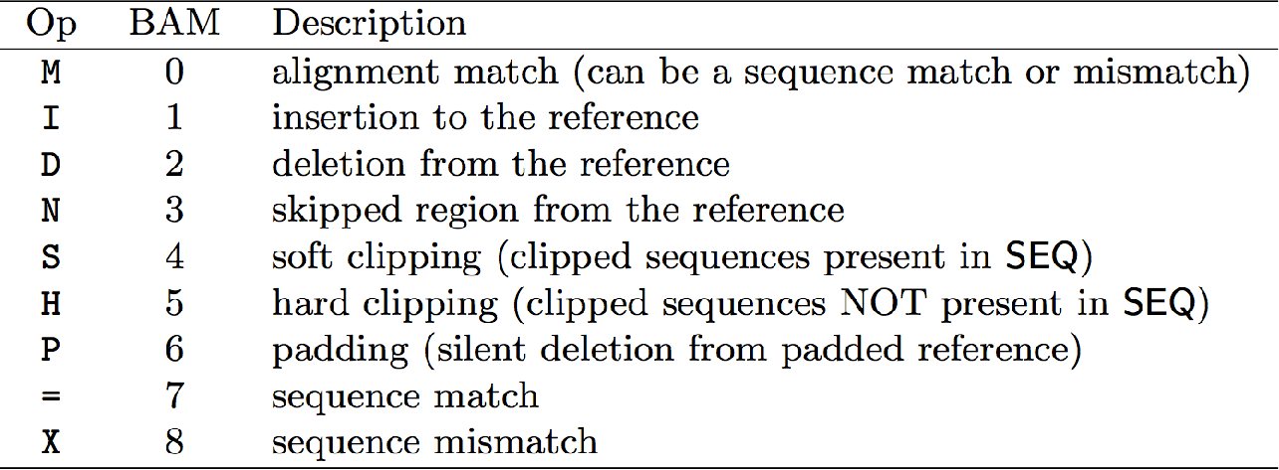
‘CIGAR strings’ (Alignments)
6_1303_10584_85775 | 99 | groupVIII | 311 | 3 | 63M3I34M | = | 780 | 572 | GGGTATTGGGC @CFFFFFHFH
6_1111_20943_90813 | 163 | groupVIII | 315 | 40 | 100M | = | 809 | 594 | TAATGAAGCCAT @BDDFDDA+<A<
6_2111_2016_88235 | 355 | groupVIII | 315 | 3 | 100M | = | 856 | 573 | TAATGAAGCCAT @?DADDBD>D>B
6_1104_8139_99999 | 163 | groupVIII | 316 | 14 | 100M | = | 818 | 602 | AATGAAGCCATT @@FFFFFGHGHH
6_1304_4167_91751 | 163 | groupVIII | 322 | 5 | 52M3I29M | = | 812 | 573 | GCCATTTTTAC <<BDBDEHHDF
6_2301_14383_16382 | 163 | groupVIII | 323 | 40 | 51M3I46M | = | 809 | 589 | CCATTTTTACT CCFFFFFHHHH
100M — 100 matching nucleotides (i.e. no gaps)
63M-3I-34M — 63 matching nucleotides
3 nucleotides not in the reference (3bp insertion) 34 matching nucleotides
Aligned Read
TGCAGGATGGATGTGTTCCTCCTCAGCTGCTTATTTTAACTCCACTGCACAACATGTTTTGTGTTATATTCTTTCGCTGTGTAGTCTGTAAGC
TGCAGGGACTGCAGGATGGATGTGTTCCTCCTCAGCTGCTTATTTTAACTCCAC---ACAACATGTTTTGTGTTATATTCTTTCGCTGTGTAGTCTGTAAGCAGAGTATGATACTG
Reference

Slide 10
The SAMtools program
samtools <subprogram>
Major SAMtools subprograms and options:
view [options] <file>
[options]
Default: converts to ‘beheaded’ SAM;
-H: output the SAM header, -h: convert to full SAM, -b: leave in (or
convert to) BAM format
-f/-F <int>: filter for/against flags matching the integer.
e.g. -F 0x904 removes all records flagged 0x4 (unmapped), 0x100 (secondary) or 0x800 (supplementary).
If file is - (hyphen) STDIN is used
sort <file> — Sorts the alignments within a BAM file (ie. by chromosome
and coordinate). If file is - (hyphen) STDIN is used.
index <file> — Creates an index file (.bai) for the given (sorted) BAM file
faidx <file> — Creates an index file (.fai) for the given FASTA file
flags <integer> — Print the meaning(s) of the given flag.
flagstats <file> — Print statistics on the alignments in the BAM file.

Slide 11
Aligning reads to a genome (using STAR)
Make sure the commands work. (hypens; updated paths, matching sample names…)
Provide any new files for the day (eg. trimmed files…)!
Check file permissions!

Slide 12
Using STAR to align reads
Assuming a previously built STAR genome index!

Slide 13
STAR genome index (database)
Created from the FASTA & GTF files downloaded from Ensembl
Commands:
module load STAR
fasta_file=./Mus_musculus.GRCm38.dna_sm.primary_assembly.fa gtf_file=./Mus_musculus.GRCm38.98.gtf
mkdir star_db
STAR \
--runMode genomeGenerate \
--genomeFastaFiles $fasta_file \
--sjdbGTFfile $gtf_file \
--genomeDir ./star_db/
Submitted as a grid job with 92G memory
Already done!!
The STAR genome database is in:
/u/project/scampbel/nrochett/GENOMES/m38p6.M22/e98/star_db

Slide 14
Using STAR to align reads
The (previously built) STAR genome index is in:
/u/project/scampbel/nrochett/GENOMES/m38p6.M22/e98/star_db
On the cluster:
module load STAR module load samtools # STAR -h | less
sample=P10_rep1 star_db_dir=/u/project/scampbel/nrochett/GENOMES/m38p6.M22/e98/star_db
STAR \
--genomeDir $star_db_dir \
--readFilesIn $sample.five_percent.trimmo.fastq.gz \
--readFilesCommand zcat \
--outFileNamePrefix $sample. \
--outSAMtype BAM SortedByCoordinate \
--outFilterMismatchNmax 5 \
--outFilterMultimapNmax 1

Slide 15
Assessing read alignments !
Percentage of reads that successfully aligned: typically >80% for human/mouse references
Outcome differences between samples (quality outliers and/or batch effects)
If paired-end sequencing: Percentage of pairs that co-align (‘properly paired’ statistics)
Dedicated quality-control tools exist:
RSeQC (Wang et al. 2012)
QoRTs (Hartley&Mullikin2015)

