Slide 1
Mapping with HISAT2

Slide 2
Grab these files:
cp -r /gpfs1/cl/mmg232/course_materials/HISAT2_example .
Copy into your VACC account

Slide 3
Inside HISAT2_example folder
(2) FASTQ files
Script called hisat2_align.sh
RUN hisat2_align.sh using sbatch
sbatch hisat2_align.sh
Notes:
This script will take ~30 mins to run, therefore, we will start our lecture while it is running. Then go back and explain what we just ran!

Slide 4
Outline for today
~15 mins | PART 1 Learning more UNIX
~10 mins | Part 2 Mapping with HISAT2 Lecture
~20 mins | Part 3 Writing & understanding the code that we just submitted using sbatch

Slide 5
More bash!
cp -r /gpfs1/cl/mmg232/course_materials/six_commands/ .

Slide 6
PART 2
Mapping with HISAT2

Slide 7
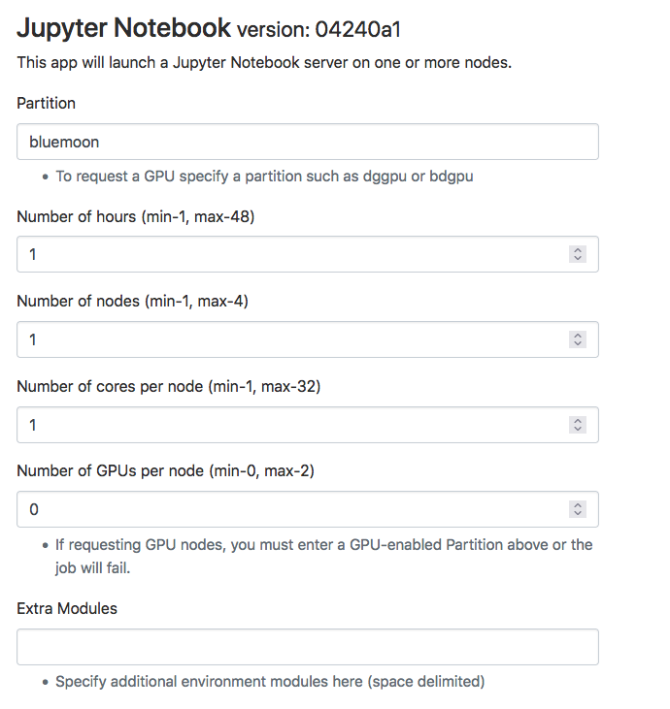

Slide 8
Learning objectives
Explore the splice-aware mapper called HISAT2
Generate the bash script required to align and generate the desired outputs using HISAT2 and SAMtools, respectively
Understand the output files from HISAT2 & SAMtools

Slide 9
ALIGNER | Designed for (Type of Data) | Programming Language | Algorithm | Mode | Clip
BOWTIE2 | DNA, RNA | C++ | BWT | Local | Soft
HISAT2 | DNA, RNA | Python | BWT | Local | Soft
STAR | RNA | C++ | BWT | Local | Soft
TOPHAT2 | RNA | C++ | BWT | Global | Soft
BWT = Burrows-Wheeler transform
Notes:
We won’t go deeply into the guts of this alignment algorithm, but I will briefly state that nearly all alignment methods rely on pre-processing the reference genome into a data-structure (like a suffix tree) that provides an index which makes it fast to find the place in a genome where a query sequence matches. Such indexes can take up a large amount of computer memory. The Burrows-Wheeler Transform (BWT) provides a way of decreasing the size of such indexes.

Slide 10

Indexing benefits
Indexing a genome can be explained similar to indexing a book.
If you want to know on which page a chapter begins, it is much more efficient to look up the page number in a pre-built index (table of contents) than going through every page of the book until you found it.
Notes:
Indexing a genome can be explained similar to indexing a book. If you want to know on which page a certain word appears or a chapter begins, it is much more efficient/faster to look it up in a pre-built index than going through every page of the book until you found it.

Slide 11
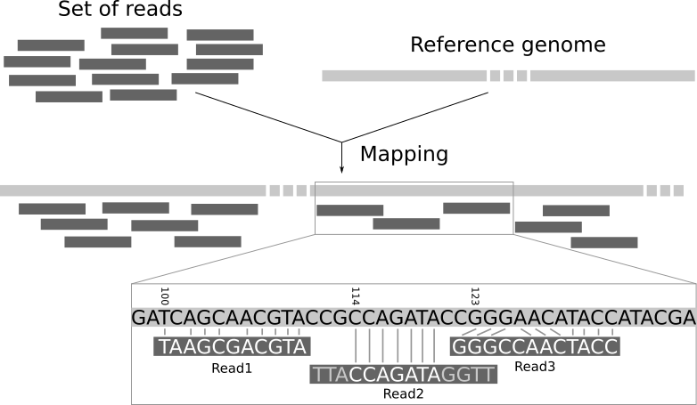
Notes:
To align sequenced reads, an aligner must first fragment the reference genome into smaller components. Each fragment’s location and sequence content are then stored in a data structure. Indexing the reference genome allows for an aligner to work more efficiently by finding all exact matches to a sequenced read using the given data structure and not scanning the entire reference genome from start to finish for each read

Slide 12
HISAT2
STAR
Bowtie2
Splice-aware aligners
Splice-unaware aligner
RNA-Seq
ChIP-Seq

Slide 13
What does it mean to be splice-aware?
The major problem is that introns not only vary in length but that they can also be very long.
A splice-unaware aligner will have to introduce a long gap in the mapping of a read to span an intron.
Would know not to try to align reads to introns, and identifies exons and tries to align to those instead, ignoring introns altogether
Notes:
This is not desired for DNA read mapping and might lead to false mappings or low alignment scores

Slide 14
Two groups of splice-aware aligners
Group 1: Splice-aware aligners that use the genome sequence and known gene annotations to calculate gene or transcript abundance – these can not be used to identify new splice junctions
Group 2: de novo splice-aware aligners which can align RNA-Seq reads to a reference genomic sequence without prior information on gene annotations
STAR (Spliced Transcripts Alignment to a Reference)

Slide 15
HISAT2
Stands for hierarchical indexing for spliced alignment of transcripts 2
HISAT2 is an aligner that is used for mapping next-generation sequencing reads
Used for whole genome, whole-exome, and transcriptome datasets

Slide 16
HISAT2 is fast
Is the fastest spliced mapper currently available
This is possible due to its novel indexing strategy
Uses BWT algorithm to compress genomes therefore, requiring very little memory to store.
But additionally, it builds these genomes using FM-indexing.
Using both makes it possible to search through genomes rapidly

Slide 17
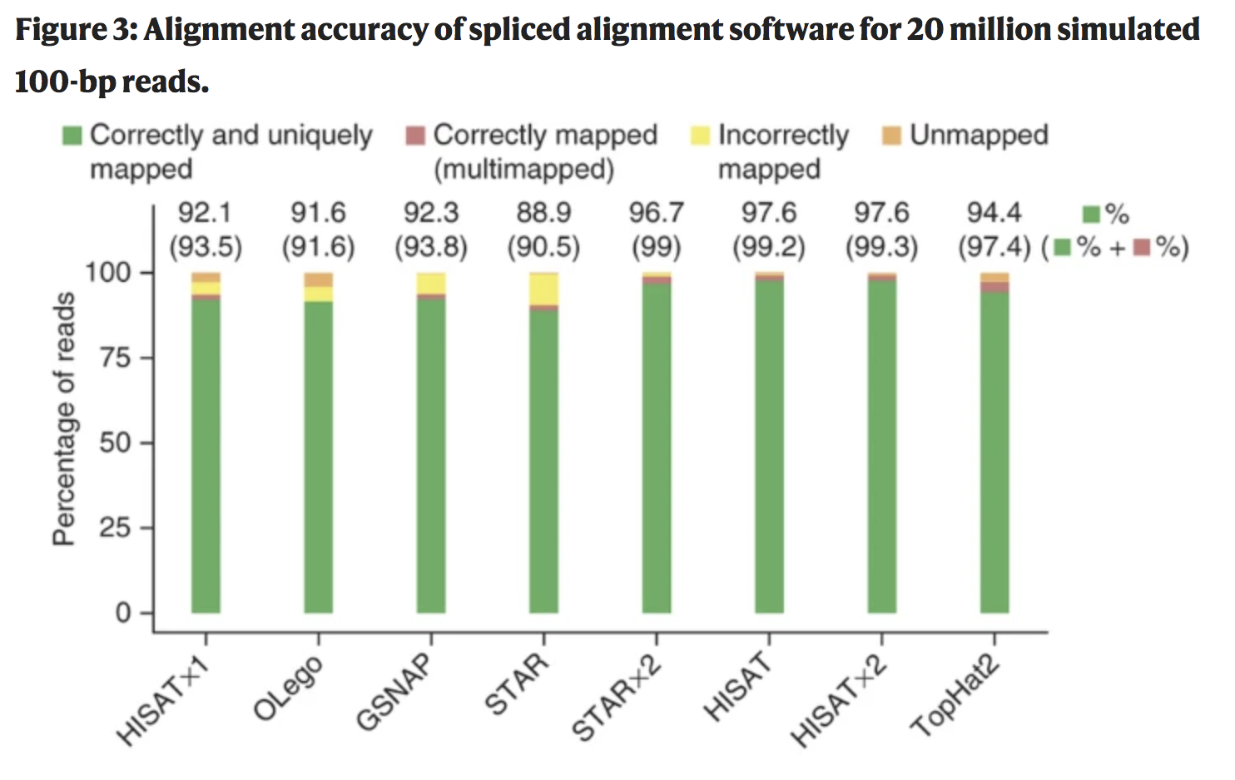
HISAT2 has a small memory footprint
The STAR program runs faster than TopHat2 but both have a memory requirement of ~28GB
The memory requirement for HISAT2 is ~5GB
This makes it possible to do alignments on your laptop

Slide 18
The dataset

Slide 21

Bash variable
Is one of the most important concepts in computer programming

Slide 22

One way to think about variables
In general, variables in computer programming work like variables in algebra
x=7
y=x+5
We can conclude that y=12

Slide 23
How to create a variable
nameofvarible=valueofvarible
Notes:
To create a variable in bash, you provide the name of the variable, followed by the equals sign, and finish with the value we want to assign to the variable. Note that the variable name cannot contain spaces, nor can there be spaces on either side of the equals sign.

Slide 24

BASH Variables are not physical files
When you create files you can use `ls` to list contents and see if the file exists.
A variable will not be listed once created

Slide 25
To recall the contents of the variable
echo $nameofvariable

Slide 26
Utility of variables
Variables can be used to store information that can be used later in the script (once or many times over)

Slide 27
DBDIR=/users/p/d/pdrodrig/genome_index
In this case, this is showing a location to a specific directory
Notes:
We’re going to see variables that represent a few different items.

Slide 28
for loop syntax
Notes:
A bash for loop is a bash programming language statement which allows code to be repeatedly executed. A for loop is classified as an iteration statement i.e. it is the repetition of a process within a bash script. For example, you can run UNIX command or task 5 times or read and process list of files using a for loop. A for loop can be used at a shell prompt or within a shell script itself.

Slide 29
HISAT2 usage

Slide 30
SAMtools usage

