Slide 1
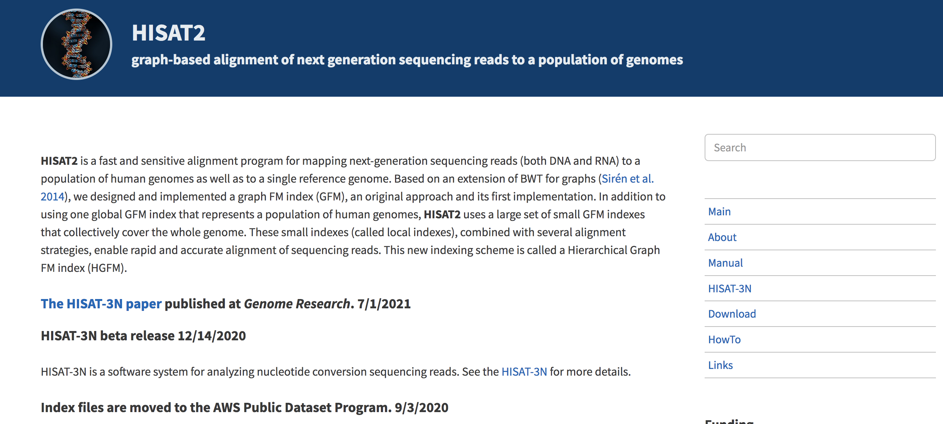
Unit 2: Mapping with HISAT2
February 23, 2023

Slide 2
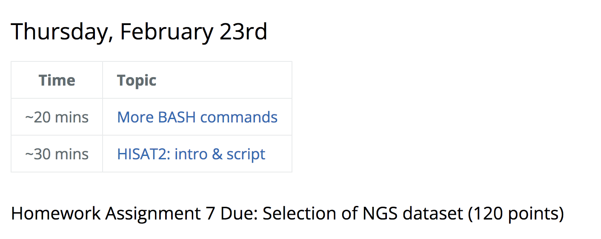
First, grab these files:
cp -r /gpfs1/cl/mmg232/course_materials/HISAT2_example .

Slide 3
Inside HISAT2_example folder
(2) FASTQ files
Script called hisat2_align.sh
Run script:
sbatch hisat2_align.sh
Notes:
This script will take ~30 mins to run, therefore, we will start our lecture while it is running. Then go back and explain what we just ran!

Slide 4
Outline for today
~10 mins | Part 1 Learning more UNIX command
~15 mins | Part 2 Mapping with HISAT2 Lecture
~20 mins | Part 3 Writing & understanding the code that we just submitted using sbatch

Slide 5
More bash!
Please grab these files too -
cp -r /gpfs1/cl/mmg232/course_materials/six_commands/ .

Slide 6
PART 2
Mapping with HISAT2

Slide 7
Learning objectives
Explore the splice-aware mapper called HISAT2
Create a bash script used to align and generate the desired outputs using HISAT2 and SAMtools programs
Understand the output files from HISAT2 & SAMtools

Slide 8
ALIGNER | Designed for (Type of Data) | Programming Language | Algorithm | Mode | Clip
BOWTIE2 | DNA, RNA | C++ | BWT | Local | Soft
HISAT2 | DNA, RNA | Python | BWT | Local | Soft
STAR | RNA | C++ | BWT | Local | Soft
TOPHAT2 | RNA | C++ | BWT | Global | Soft
BWT = Burrows-Wheeler transform
Notes:
We won’t go deeply into the guts of this alignment algorithm, but I will briefly state that nearly all alignment methods rely on pre-processing the reference genome into a data-structure. This data structure will provides an index which makes it fast for the aligner to find the place in a genome where a raw read sequences match the reference genome. These indexes can take up a large amount of computer memory. The Burrows-Wheeler Transform (BWT) to decrease the size of the index

Slide 9

Indexing benefits
Indexing a genome can be explained similar to indexing a book.
If you want to know on which page a chapter begins, it is much more efficient to look up the page number in a pre-built index (table of contents) than going through every page of the book until you found the chapter you are looking for.
Notes:
Indexing a genome can be explained similar to indexing a book. If you want to know on which page a certain word appears or a chapter begins, it is much more efficient/faster to look it up in a pre-built index than going through every page of the book until you found it.

Slide 10
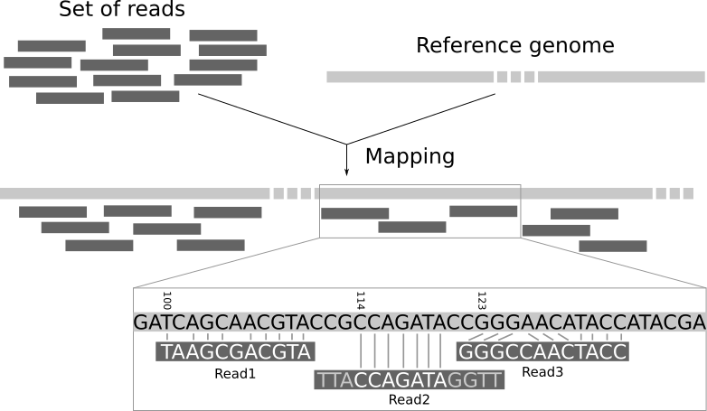
Notes:
To align sequenced reads, an aligner must first fragment the reference genome into smaller components. Each fragment’s location and sequence content are then stored in a data structure. Indexing the reference genome allows for an aligner to work more efficiently by finding all exact matches and not scanning the entire reference genome from start to finish for each read

Slide 11
HISAT2
STAR
Bowtie2
Splice-aware aligners
Splice-unaware aligner
RNA-Seq
ChIP-Seq

Slide 12
What does it mean to be splice-aware?
The major problem is that introns not only vary in length but that they can also be very long.
A splice-unaware aligner will have to introduce a long gap in the mapping of a read to span an intron.
Would know not to try to align reads to introns, and identifies exons and tries to align to those instead, ignoring introns altogether
Notes:
This is not desired for DNA read mapping and might lead to false mappings or low alignment scores

Slide 13
Two groups of splice-aware aligners
Group 1: Splice-aware aligners that use the genome sequence and known gene annotations to calculate gene or transcript abundance – these can not be used to identify new splice junctions
Group 2: de novo splice-aware aligners which can align RNA-Seq reads to a reference genomic sequence without prior information on gene annotations
STAR (Spliced Transcripts Alignment to a Reference)

Slide 14
HISAT2
Stands for hierarchical indexing for spliced alignment of transcripts 2
HISAT2 is an aligner that is used for mapping next-generation sequencing reads
Used for whole genome, whole-exome, and transcriptome datasets

Slide 15
HISAT2 is fast
Is the fastest spliced mapper currently available
This is possible due to its novel indexing strategy
Uses BWT algorithm to compress genomes therefore, requiring very little memory to store.
But additionally, it builds these genomes using FM-indexing.
Using both makes it possible to search through genomes rapidly

Slide 16
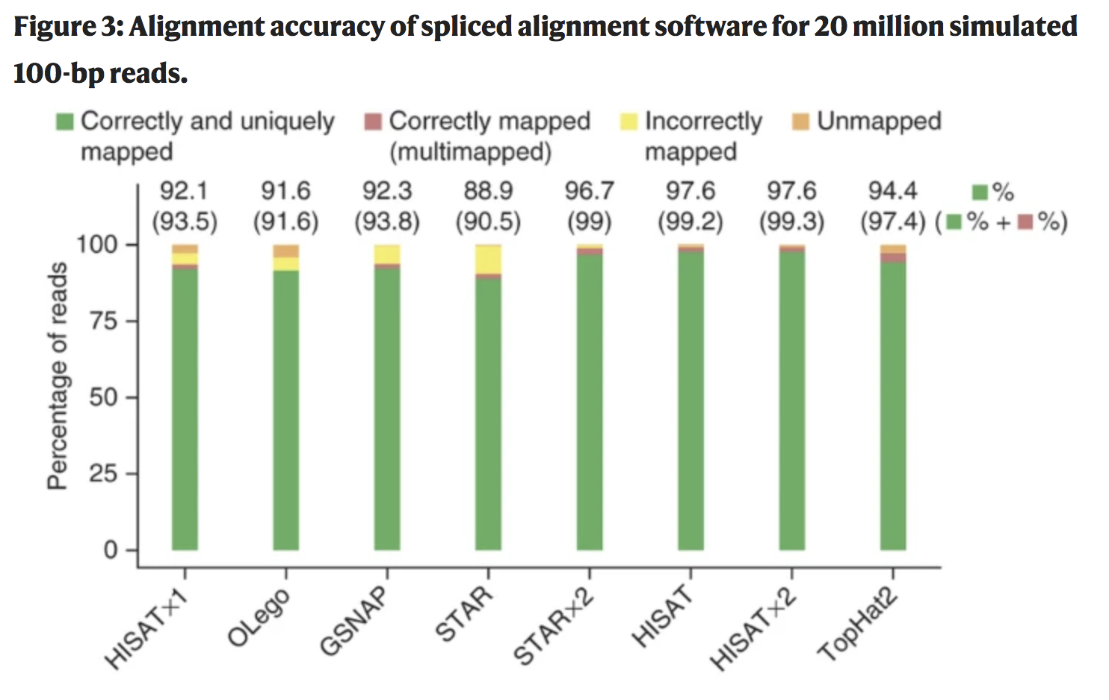
HISAT2 has a small memory footprint
The STAR program runs faster than TopHat2 but both have a memory requirement of ~28GB
The memory requirement for HISAT2 is ~5GB
This makes it possible to do alignments on your laptop

Slide 17
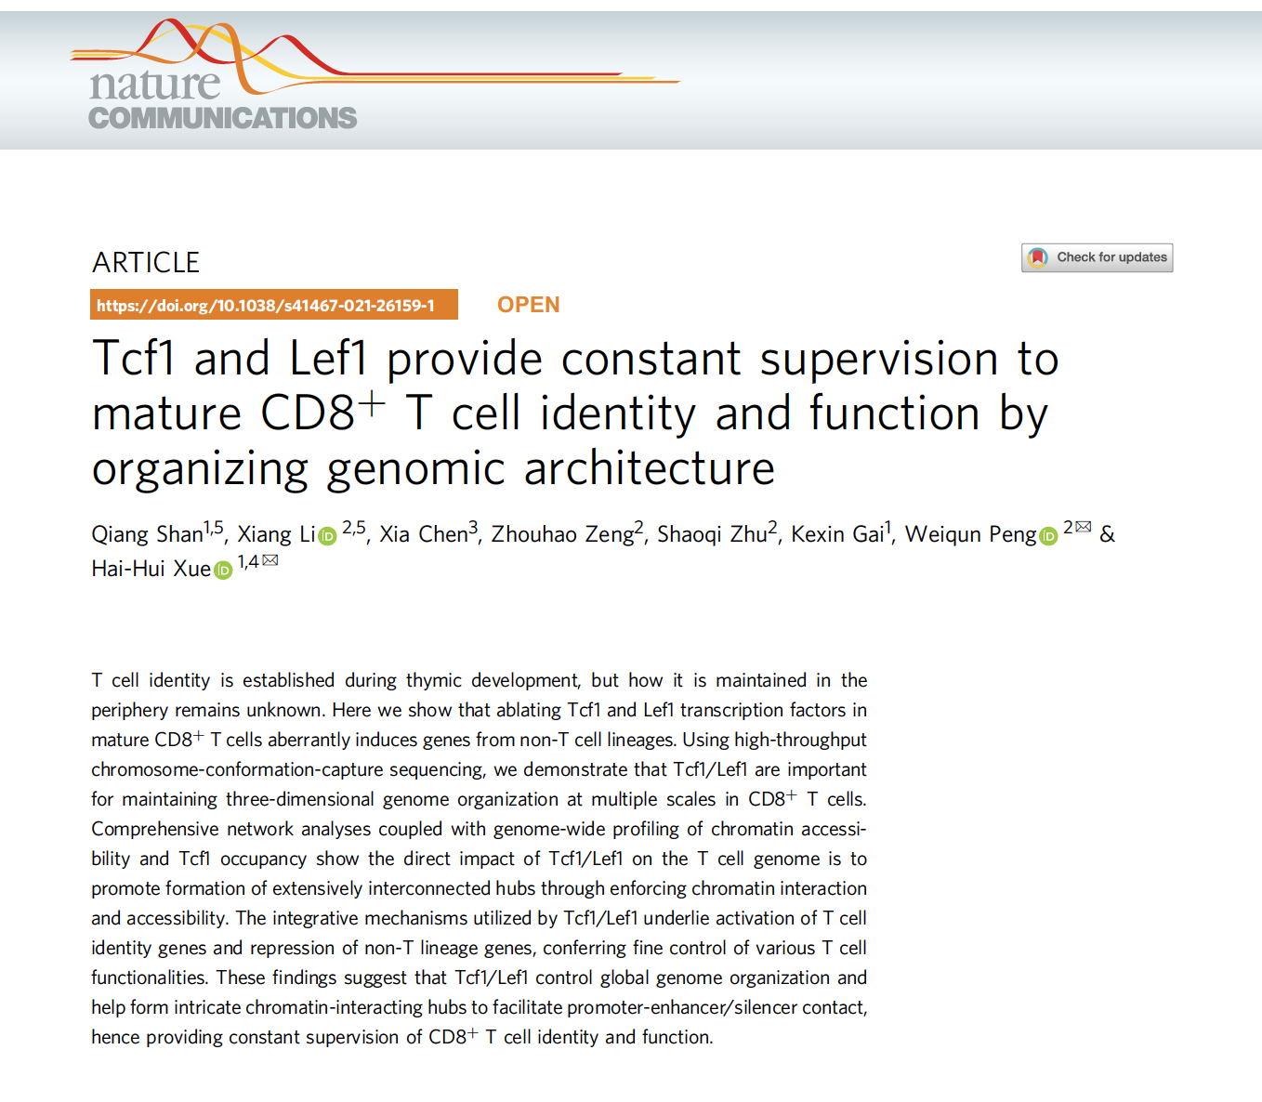
The dataset

Slide 20
This script will contain:
Variables
Sed command
For loop
Module load
hisat2
samtools

Slide 21
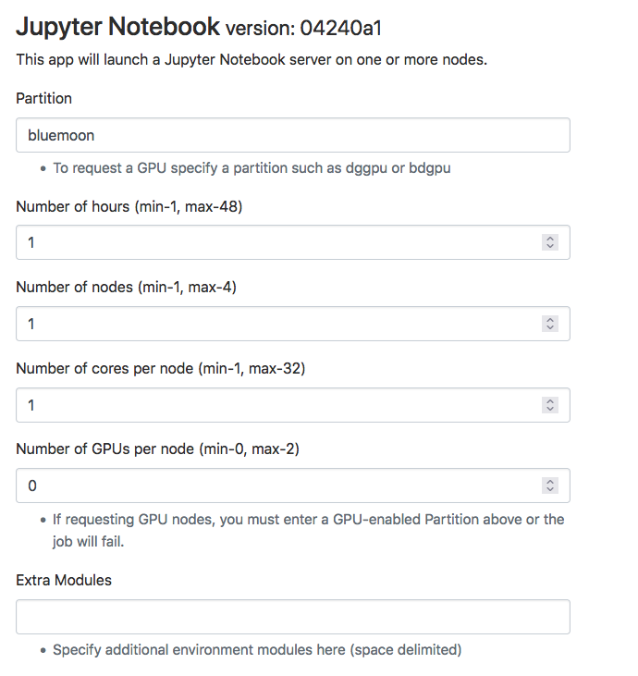
Or use your favorite text editor!
Notes:
I’m going to use text

Slide 22
How to create a variable
nameofvarible=valueofvarible
Notes:
To create a variable in bash, you provide the name of the variable, followed by the equals sign, and finish with the value we want to assign to the variable. Note that the variable name cannot contain spaces, nor can there be spaces on either side of the equals sign.

Slide 23
To recall the contents of the variable
echo $nameofvariable

Slide 24
Utility of variables
Variables can be used to store information that can be used later in the script (once or many times over)

Slide 25
Example of Variable usage
DBDIR=/users/p/d/pdrodrig/genome_index
In this case, this is showing a location to a specific directory
Notes:
We’re going to see variables that represent a few different items.

Slide 26
Curly braces {}
https://devhints.io/bash
Substitutions, manipulations, etc.. So much more!

Slide 27
backslash \
is used by bash to indicate a line continuation and is commonly used in bash scripts

Slide 28
Indenting and blank lines
Indenting is done to clarify your code. Indentations are usually used for loops, if statements, function definitions to make it easy to see what statements are part of that loop or part of the if statement.
Another trick to make your code more readable is adding blank lines to separate out blocks of related code.

Slide 29
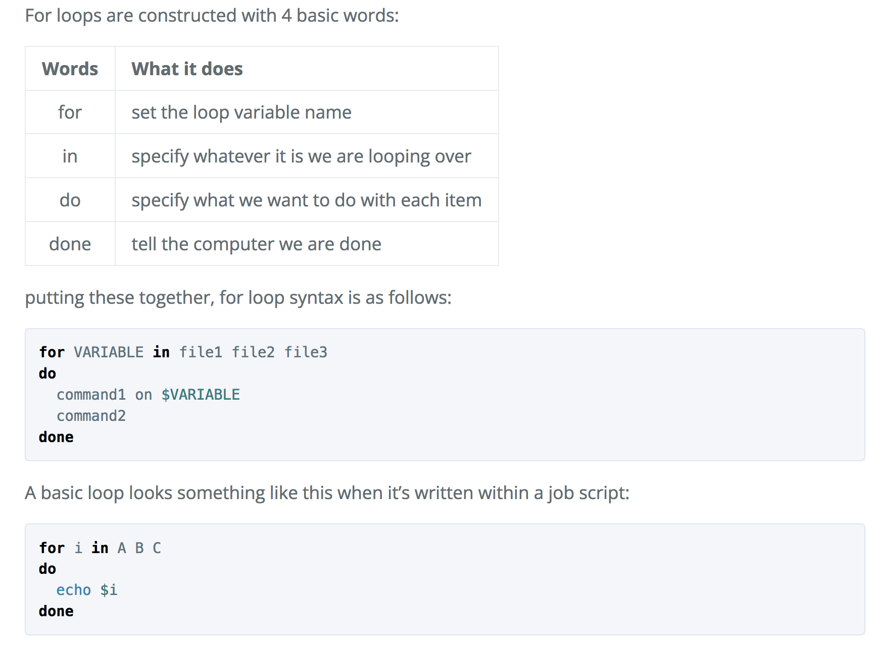
for loop is classified as an iteration statement
Notes:
Everyone will be downloading a minimum of (6) FASTQ files from the GEO repository. To repeat the alignment and downstream processing steps for each sample precisely, its best to run the same line of code to each sample at the same time. For this we can turn to loops, a function of programming languages that allow us to write out a series of commands and perform them on all the files we want at one time. In addition to being a major time saver, this makes your code a lot easier to read and much more concise overall.

Slide 30
for loop syntax
Notes:
The VARIABLE could be any letter or word that is meaningful, but is commonly represented by a single letter like “i” for ease. Often the in portion will be a directory instead of single files (A, B, C) - i.e. a directory that contains the FASTQ files you want to work with.

Slide 31
HISAT2 usage
http://daehwankimlab.github.io/hisat2/
hisat2 [options]* -x <hisat2-idx> {-1 <m1> -2 <m2> | -U <r> | --sra-acc <SRA accession number>} [-S <hit>]

Slide 32
HISAT2 usage
-x <hisat2-idx> The basename of the index for the reference genome. The basename is the name of any of the index files up to but not including the final .1.ht2 / etc. hisat2 looks for the specified index first in the current directory, then in the directory specified in the HISAT2_INDEXES environment variable.
/gpfs1/cl/mmg232/course_materials/hisat2_index

Slide 33
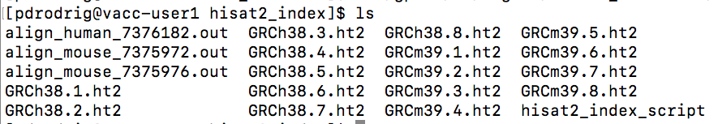

Slide 34
HISAT2 usage
-1 <m1> Comma-separated list of files containing mate 1s (filename usually includes _1), e.g. -1 flyA_1.fq,flyB_1.fq. Sequences specified with this option must correspond file-for-file and read-for-read with those specified in <m2>. Reads may be a mix of different lengths. If - is specified, hisat2 will read the mate 1s from the “standard in” or “stdin” filehandle.
-2 <m2> Comma-separated list of files containing mate 2s (filename usually includes _2), e.g. -2 flyA_2.fq,flyB_2.fq. Sequences specified with this option must correspond file-for-file and read-for-read with those specified in <m1>. Reads may be a mix of different lengths. If - is specified, hisat2 will read the mate 2s from the “standard in” or “stdin” filehandle.

Slide 35
HISAT2 usage
-U <r> Comma-separated list of files containing unpaired reads to be aligned, e.g. lane1.fq,lane2.fq,lane3.fq,lane4.fq. Reads may be a mix of different lengths. If - is specified, hisat2 gets the reads from the “standard in” or “stdin” filehandle.
-S <hit> File to write SAM alignments to. By default, alignments are written to the “standard out” or “stdout” filehandle (i.e. the console).

Slide 37
SAMtools usage
http://www.htslib.org/doc/samtools.html
samtools view [options] in.sam|in.bam|in.cram [region...]
samtools flagstat in.sam|in.bam|in.cram
samtools sort [-l level] [-u] [-m maxMem] [-o out.bam] [-O format] [-M] [-K kmerLen] [-n] [-t tag] [-T tmpprefix] [-@ threads] [in.sam|in.bam|in.cram]
samtools index [-bc] [-m INT] aln.sam|aln.bam|aln.cram [out.index]

