Slide 1
Course Recap

Slide 2
Overview
Update in Grading

Slide 3
Change in Final Grade

Slide 4
Shell
A shell is a command line interpreter, used to launch software in Linux
There are many different shells available:
BASH
CSH
ZSH etc.
Most software will work the same in all shells
Some functions and automation are different between shells
We will use the most popular shell, BASH

Slide 5
Running programs
Type the name of the program you want to run
Add on any options the program needs
Press return - the program will run
When the program ends control will return to the shell
Run the next program!

Slide 6
Running programs
student@ip1-2-3-4:~$ ls
Desktop Documents Downloads examples.desktop Music Pictures Public Templates
Videos
student@ip1-2-3-4:~$
Command prompt - you can't enter a command unless you can see this
The command we're going to run (ls in this case, to list files) The output of the command - just text in this case

Slide 7
Command

Slide 8
Unit 1 Summary

Slide 9
Application of bioinformatics

Slide 10

Green Mountain Trail

Slide 11
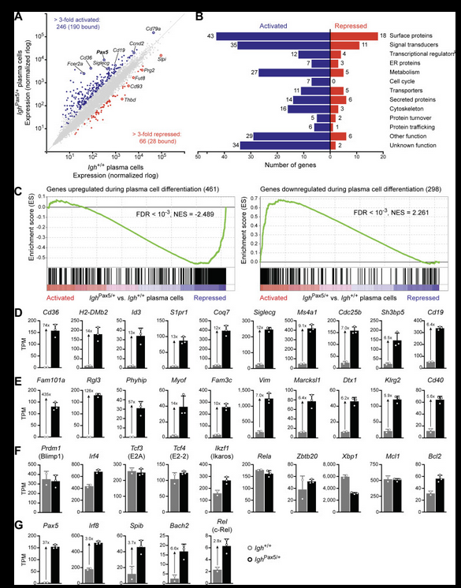
Green Path

Slide 12

Blue Sky Trail

Slide 14

Black Diamond Trail

Slide 16

You’re taking this course (or any course) with a specific goal in mind.
Please have a Goal with the Final Project
This will instill a sense of purpose
I do not want you to lose sight of this
This should be your compass forward.

Slide 17
Unit 2: Guideline

Slide 18
Downloading data from GEO:
Collect SRR Numbers using RUN SELECTOR
Download SRA-ToolKit and set up
Note: Once this is done, you do not need to do this again!
Run sra_fqdump.sh script using output from step #1
But…in order to run this script we need to submit a job using SLURM!

Slide 19
Basic Steps to Job Submission:
1. Log in to VACC
2. Write job script
3. Submit Job
4. Monitor job and wait for it to run
5. Retrieve your output

Slide 20
Basic Steps to Job Submission:
1. Log in to VACC
2. Write job script
3. Submit Job
4. Monitor job and wait for it to run!
5. Retrieve your output
Requires an understanding of SLURM directives

Slide 21
What are SLURM Directives?
At the top of the job script will always be several lines that start with #SBATCH.
The Slurm directives provide the job setup information used by Slurm.
This information is then followed by the commands to be executed in the script.

Slide 22
Common SLURM Directives
#!/bin/bash
#SBATCH --partition=bluemoon
#SBATCH --nodes=1
#SBATCH --ntasks=4
#SBATCH --mem=50G
#SBATCH --time=30:00:00
#SBATCH --job-name=RNAseq
# %x=job-name %j=jobid
#SBATCH --output=%x_%j.out

Slide 23
Common SLURM Directives
#!/bin/bash
#SBATCH --partition=bluemoon
#SBATCH --nodes=1
#SBATCH --ntasks=2
#SBATCH --mem=50G
#SBATCH --time=30:00:00
#SBATCH --job-name=RNAseq
# %x=job-name %j=jobid
#SBATCH --output=%x_%j.out
shebang = used to tell the linux OS which interpreter to use

Slide 24
Common SLURM Directives
partition = default is bluemoon if not specified
Other partitions are available.
This is important to know as some jobs will take longer to run!
#!/bin/bash
#SBATCH --partition=bluemoon
#SBATCH --nodes=1
#SBATCH --ntasks=2
#SBATCH --mem=50G
#SBATCH --time=30:00:00
#SBATCH --job-name=RNAseq
# %x=job-name %j=jobid
#SBATCH --output=%x_%j.out

Slide 25
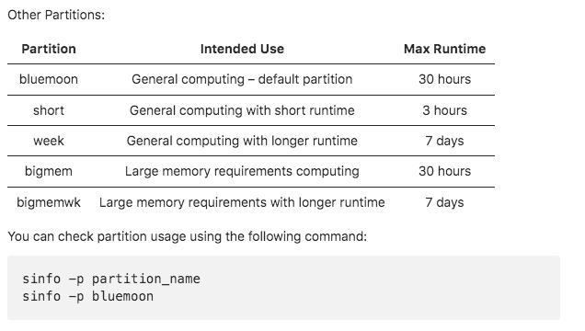

Slide 26
Common SLURM Directives
Node: A “node” is a server in the cluster. Each node has is configured with a certain number of cores (CPUs).
Task: A “task” is a process sent to a core. By default, 1 core is assigned per 1 task
Recommend that you begin with 1 node and 2 processes
#!/bin/bash
#SBATCH --partition=bluemoon
#SBATCH --nodes=1
#SBATCH --ntasks=2
#SBATCH --mem=50G
#SBATCH --time=30:00:00
#SBATCH --job-name=RNAseq
# %x=job-name %j=jobid
#SBATCH --output=%x_%j.out

Slide 27
Common SLURM Directives
#!/bin/bash
#SBATCH --partition=bluemoon
#SBATCH --nodes=1
#SBATCH --ntasks=2
#SBATCH --mem=50G
#SBATCH --time=30:00:00
#SBATCH --job-name=RNAseq
# %x=job-name %j=jobid
#SBATCH --output=%x_%j.out
If your job requires more than 1G of memory – need to specify this

Slide 28
Common SLURM Directives
#!/bin/bash
#SBATCH --partition=bluemoon
#SBATCH --nodes=1
#SBATCH --ntasks=2
#SBATCH --mem=50G
#SBATCH --time=30:00:00
#SBATCH --job-name=RNAseq
# %x=job-name %j=jobid
#SBATCH --output=%x_%j.out
Walltime is the maximum amount of time your job will run.

Slide 29
Downloading data from GEO:
Collect SRR Numbers using RUN SELECTOR
Download SRA-ToolKit and set up
Note: Once this is done, you do not need to do this again!
Run sra_fqdump.sh script using output from step #1

Slide 30
Scripts used to download SRR files from GEO:
Location on VACC:
cp -r /gpfs1/cl/mmg232/ course_materials/download_from_SRA .

Slide 31
To run script use sbatch command:
sbatch sra_fqdump.sh

Slide 32
Other important commands:

Slide 34
What we know already
How to run programs
How to modify the options for a program using switches
How to supply data to programs using file paths and wildcards

Slide 35
What else can we do
Record the output of programs
Check for errors in programs which are running
Link programs together into small pipelines
Automate the running of programs over batches of files
All of these are possible with some simple BASH scripting

Slide 36
Recording the output of programs
Three data streams exist for all Linux programs
STDIN (Standard Input - a way to send data into the program)
STDOUT (Standard Output - a way to send expected data out of the program)
STDERR (Standard Error - a way to send errors or warnings out of the program)
STDOUT STDERR
STDIN
program
By default STDOUT and STDERR are connected to your shell, so when you see text coming from a program, it's coming from these streams.

Slide 37
Redirecting standard streams
You can redirect using arrows at the end of your command
> [file]
2> [file]
2>&1
Redirects STDOUT Redirects STDERR
Sends STDERR into STDOUT
$ find . -print > file_list.txt 2> errors.txt
$ ls
Data Desktop Documents Downloads errors.txt examples.desktop file_list.txt Music Pictures Public Templates Videos
$ head file_list.txt
.
./Downloads
./Pictures
./Public
./Music
./.bash_logout
./.local
./.local/share
./.local/share/icc
./.local/share/icc/edid-33d524c378824a7b78c6c679234da6b1.icc

Slide 38
Conda download

Slide 39
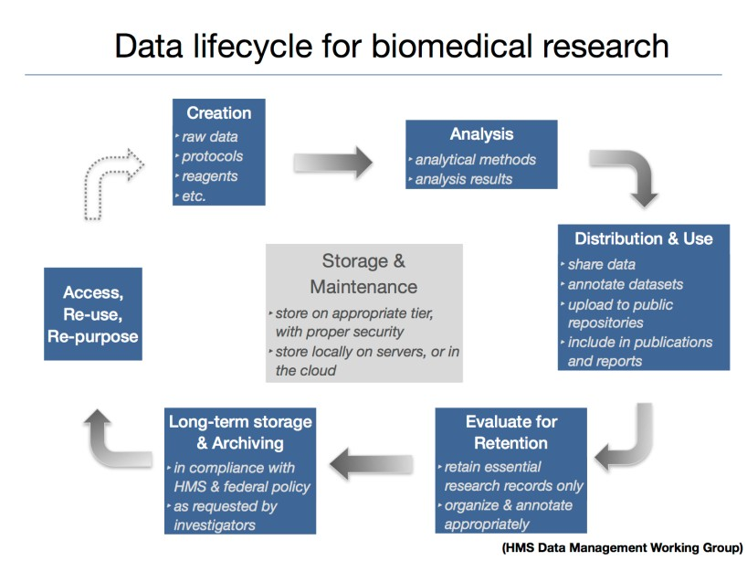
Data life-cycle

Slide 40
Data management planning
Consider the datatype and file sizes. How much total raw data do you have?
Consider the type of analyses you plan on performing. What types of intermediate data files will I generate?
What is the best way to organize my directory structure?

Slide 41


Data types: Raw data
For NGS experiments, these are the FASTQ files you obtain from your sequencing facility (can be anything you start your analysis with)
This data should never be directly modified (i.e. always keep a copy of this stored somewhere, untouched from its original state)
Consider creating a read-only directory for this data

Slide 42

Metadata is information about your data.
Ask yourself:
What type of information do you have about your the data you have generated? What information is it important to keep track of?
Would a new project member be able to step in and follow how data were created, stored and analyzed?
Documenting your metadata is key to reproducible science!
CSV file, Excel spreadheet, README
Data types: Metadata

Slide 43
File Naming conventions
Should be descriptive and provide contextual information. Consider including some combination of the following:
Project/experiment name/acronym, Lab name/location, Date or date range, Type of data, Experimental conditions, Version number
Consider length of filename
not too long (40-50 characters); limits differ by operating system Use naming conventions consistently

Slide 44
DO’s
DONT’s
Avoid special characters, these are sometimes used in specific tasks for some OS i.e. ~ ! @ # $ % ^ & * ( ) ` ; :
< > ? . , [ ] { } ’ ” |
Don’t use carriage returns Don’t use spaces. Instead try:
Underscores (e.g. file_name.xxx) Dashes (e.g file-name.xxx)
No separation (e.g. filename.xxx) Camel-case (e.g. fileName.xxx)
Dates: YYYYMMDD e.g, 20161101
Times: use 24-hour military time
Sequential numbering: use leading zeros (e.g 001, 002, … 010, 020, etc)
Names: surname then given (i.e Smith_Bob)
Versioning: use numbers to indicate updated versions (e.g. v1, v2)

Slide 45

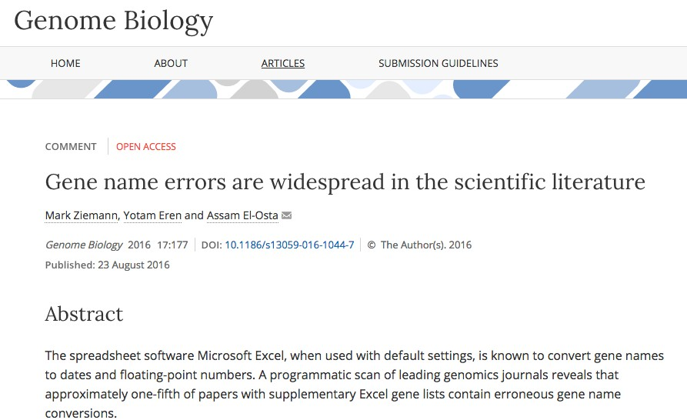
Be careful with Excel!

Slide 46
Data compression methods
zip: DEFLATE coding gzip: Lempel-Ziv coding
bzip2: Burrows-Wheeler block sorting text and Huffman coding
tar: archival utility, preserving hierarchy and permissions, often used with gzip and bzip2
.zip
.gz
.bz2

