Slide 1

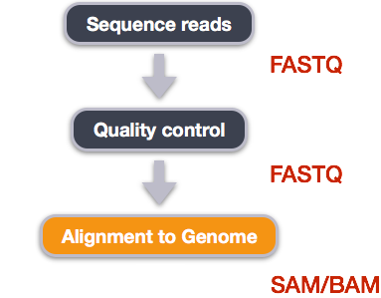
FASTQC
February 16th, 2023

Slide 2
Workflow
Raw Reads
Quality control (FASTQC)

Slide 3
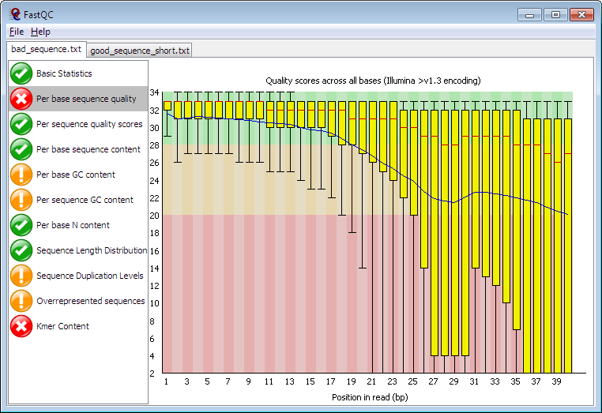
FastQC
Reads raw fastq files as input
Performs multiple checks
Pass/warn/fail
Compares to genomic library
HTML Report
http://www.bioinformatics.babraham.ac.uk/projects/fastqc/

Slide 4
Sequence Output Format
FASTQ
Line 1: Unique ID for a sequencing read
Line 2: Sequences
Line 3:+
Line 4: Base calling quality score (American Standard Code for Information Interchange (ASCII) value)
Example:
@HISEQ:126:H14YJADXX:1:1101:1118:2101 1:N:0:ATCACG CTCCATAGTCAGAAACTTCAGCATGACAGTACCTCATGCTGCATCAGGTGATCATGAAAAGATTACAGGCTTTCTAAAATTATCAGCAAGATATGG
+ @@?ADDDD?ADHDIIIIIIIEIIIGEFHC<?FH4C9E9BGAFIGH<DG9BD?@DGGEGHHG<DCBBCC8C>FHCGEHIGEEE>EEHEEEEC>A>;;

Slide 5
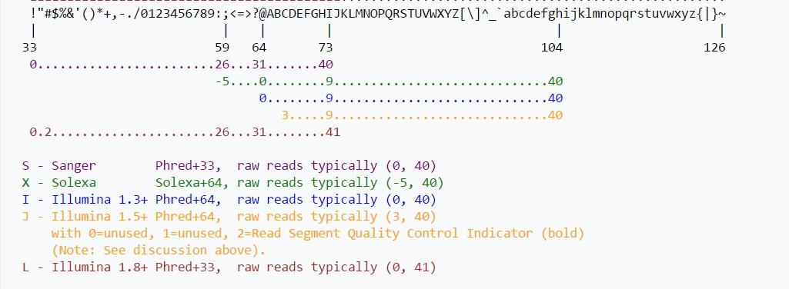
Quality Score Representation
Quality scores are represented as ASCII characters in order to save space, so that there is one ASCII character per base.
Converts between the ASCII value into Phred score

Slide 6
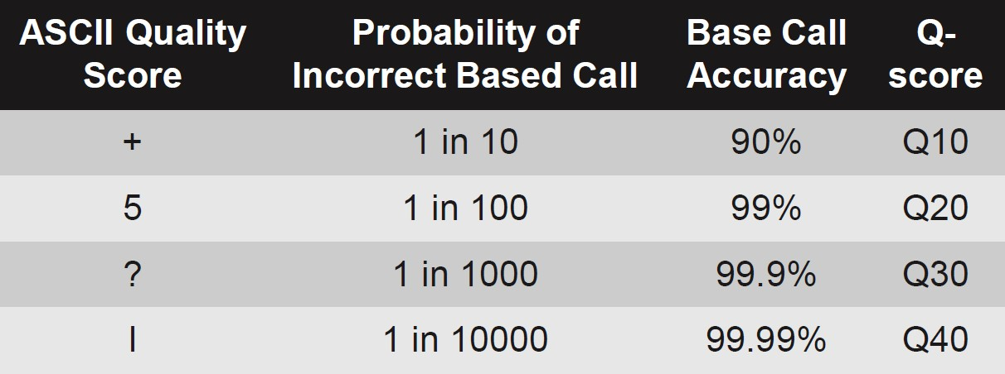
Quality Scores
A quality value (Q) is an integer representation of the probability p that the corresponding base call is incorrect
Q score

Slide 7
Base Call Qualities (Phred scores)
For most runs, quality should be good for most reads through the whole run
If quality deteriorates we should understand how and why
Good (Illumina) quality is generally Phred > 30
Concerning (Illumina) quality is Phred < 20

Slide 8
What should you look at in your libraries?

Slide 9
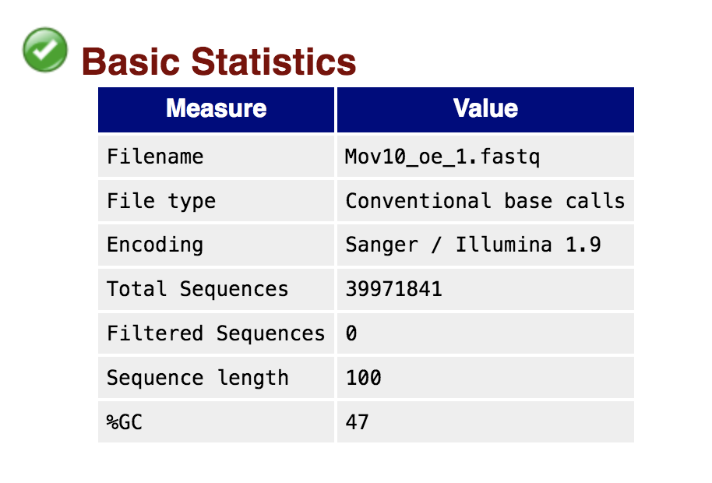

Slide 10
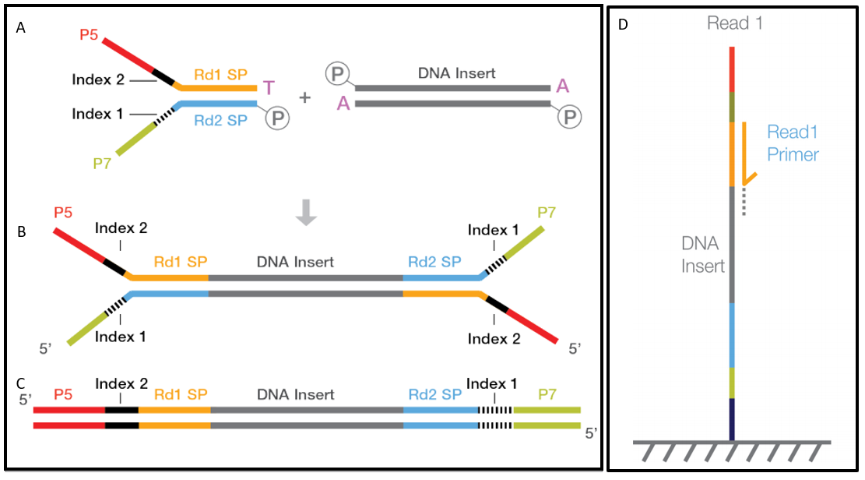
Architecture of Standard Illumina NGS library
P5 and p7 sequences are required to bind the flow cell
Adaptors will serve as primer binding sites for amplification and sequencing
Indices are used to combine many samples into 1 seq. run

Slide 11
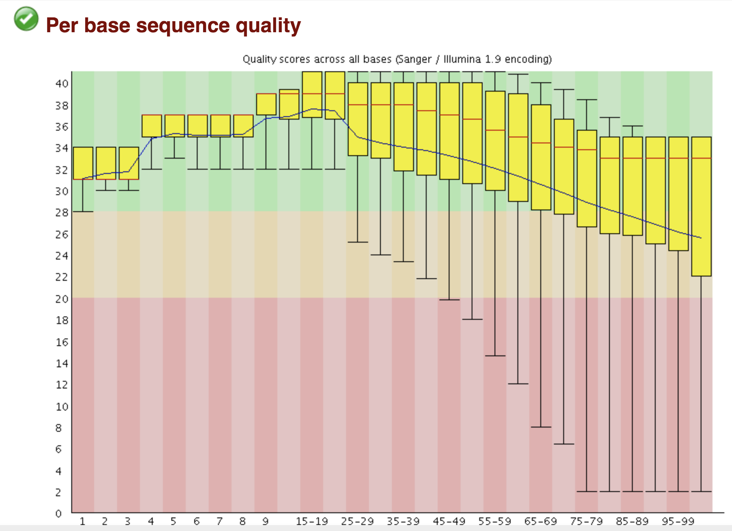
Phred Score
Cycles of Chemistry
For each position a BoxWhisker type plot is drawn.
The central red line is the median value
The yellow box represents the inter-quartile range (25-75%)
The upper and lower whiskers represent the 10% and 90% points
The blue line represents the mean quality

Slide 12
FastQC Report
PHRED Quality Score | Probability of incorrect base call | Base call accuracy
10 | 1 in 10 | 90 %
20 | 1 in 100 | 99 %
30 | 1 in 1000 | 99.9 %
40 | 1 in 10000 | 99.99 %
50 | 1 in 100000 | 99.999 %
Notes:
The higher the score the better the base call. The background of the graph divides the y axis into very good quality calls (green), calls of reasonable quality (orange), and calls of poor quality (red).

Slide 13
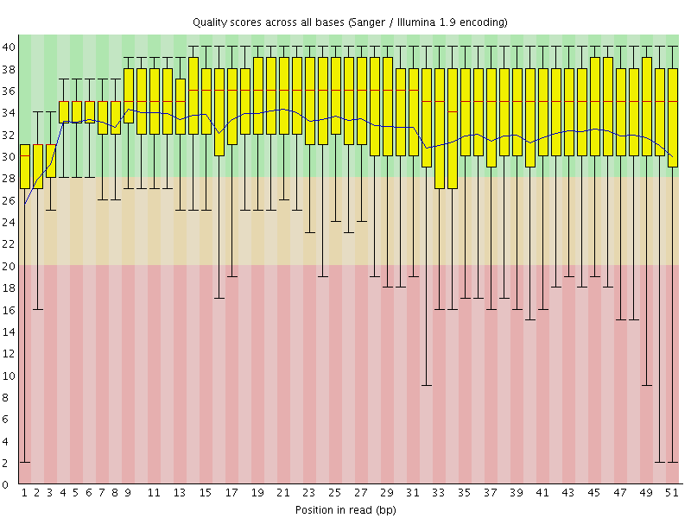
Base Call Qualities – Per Cycle
Read 1
Read 2
The quality of base call tend to degrade as the run progresses

Slide 14
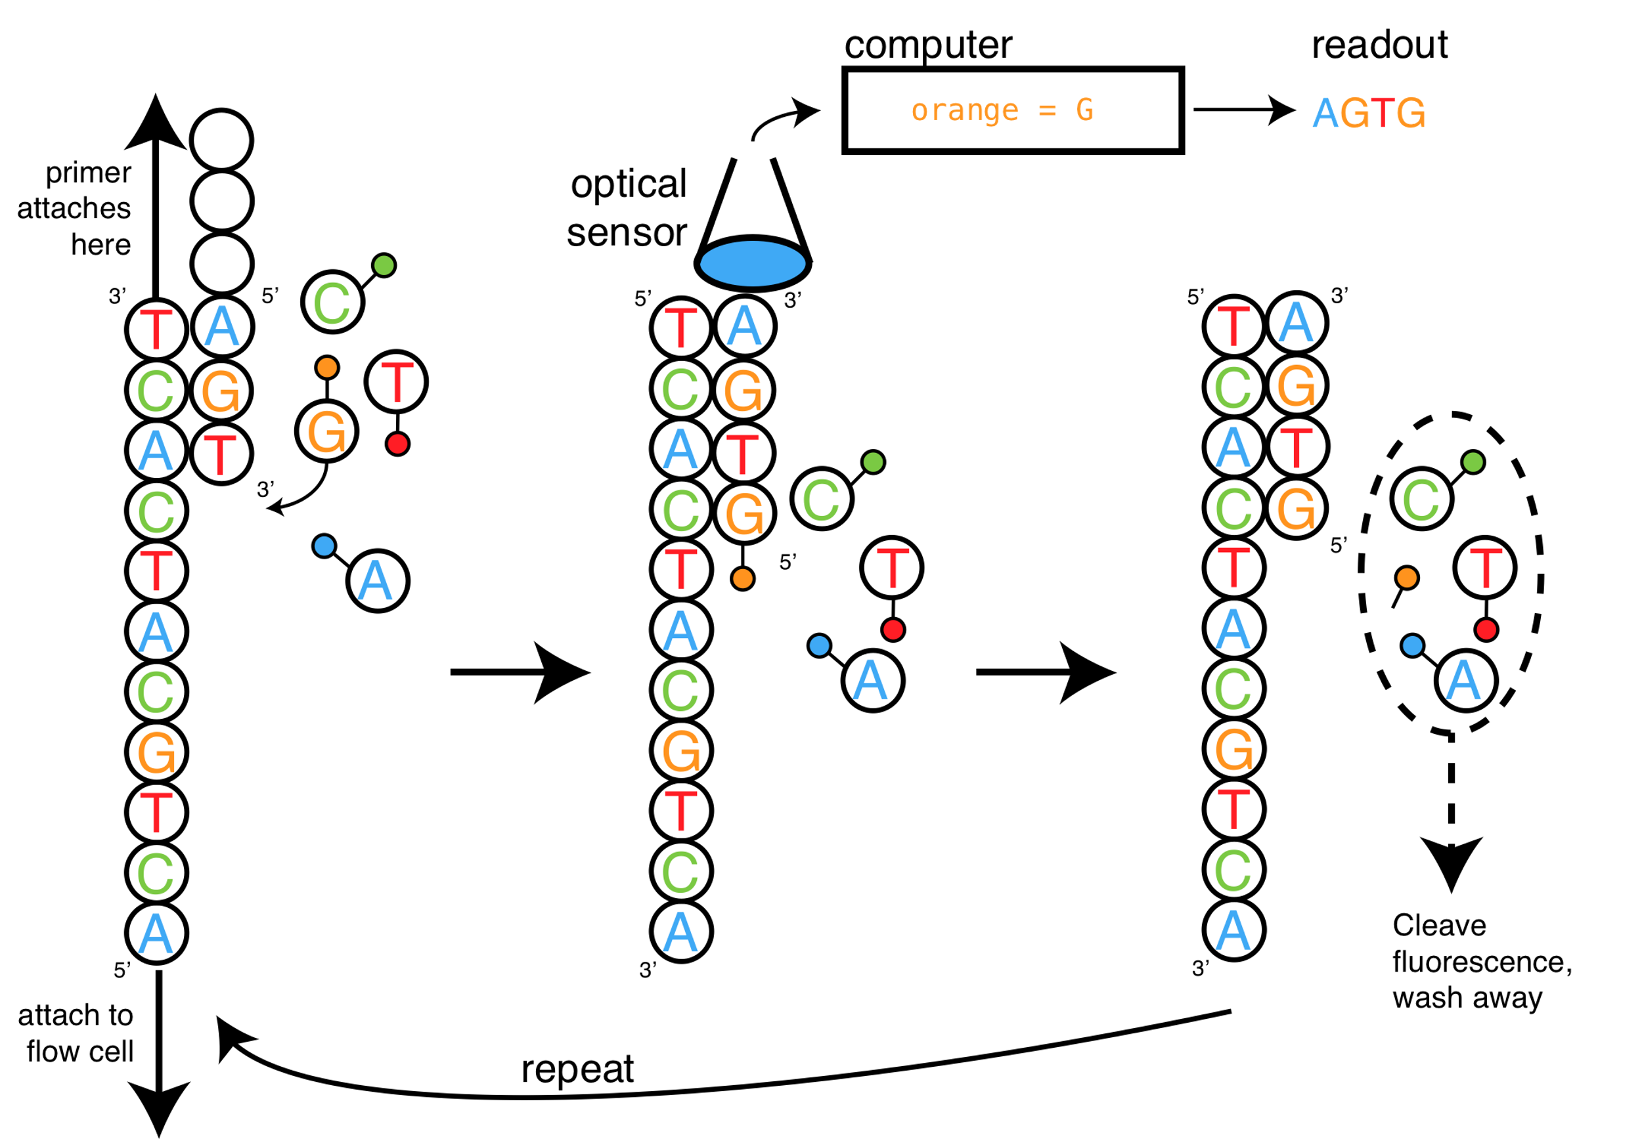
Then sequencing begins!
Have fluorescent-labeled nucleotides
Each dNTP has a corresponding color
During each cycle, a labeled dNTP is added to the growing chain
An image is then taken
Then the fluorescent dye is cleaved to allow for the next nucleotide to be incorporated in the next cycle

Slide 15
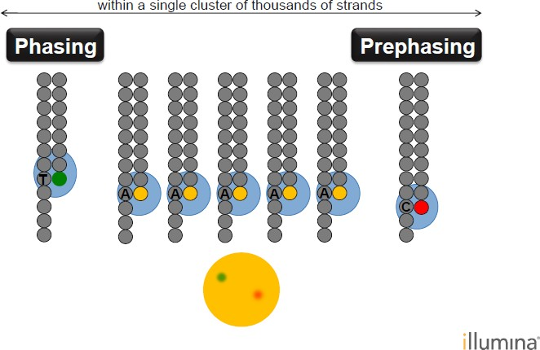
Problem
As the chain grows, signal quality deteriorates
At each cycle, accumulates noise
Solution
Sequence only (up to 300bp)
Enables robust base-calling across the genome including in repetitive sequence regions

Slide 16
Trimming
If the quality of the library falls to a low level then the most common remedy is to perform quality trimming where reads are truncated based on their average quality.
Trimming must be performed on all samples - Before committing to any action, check in

Slide 17
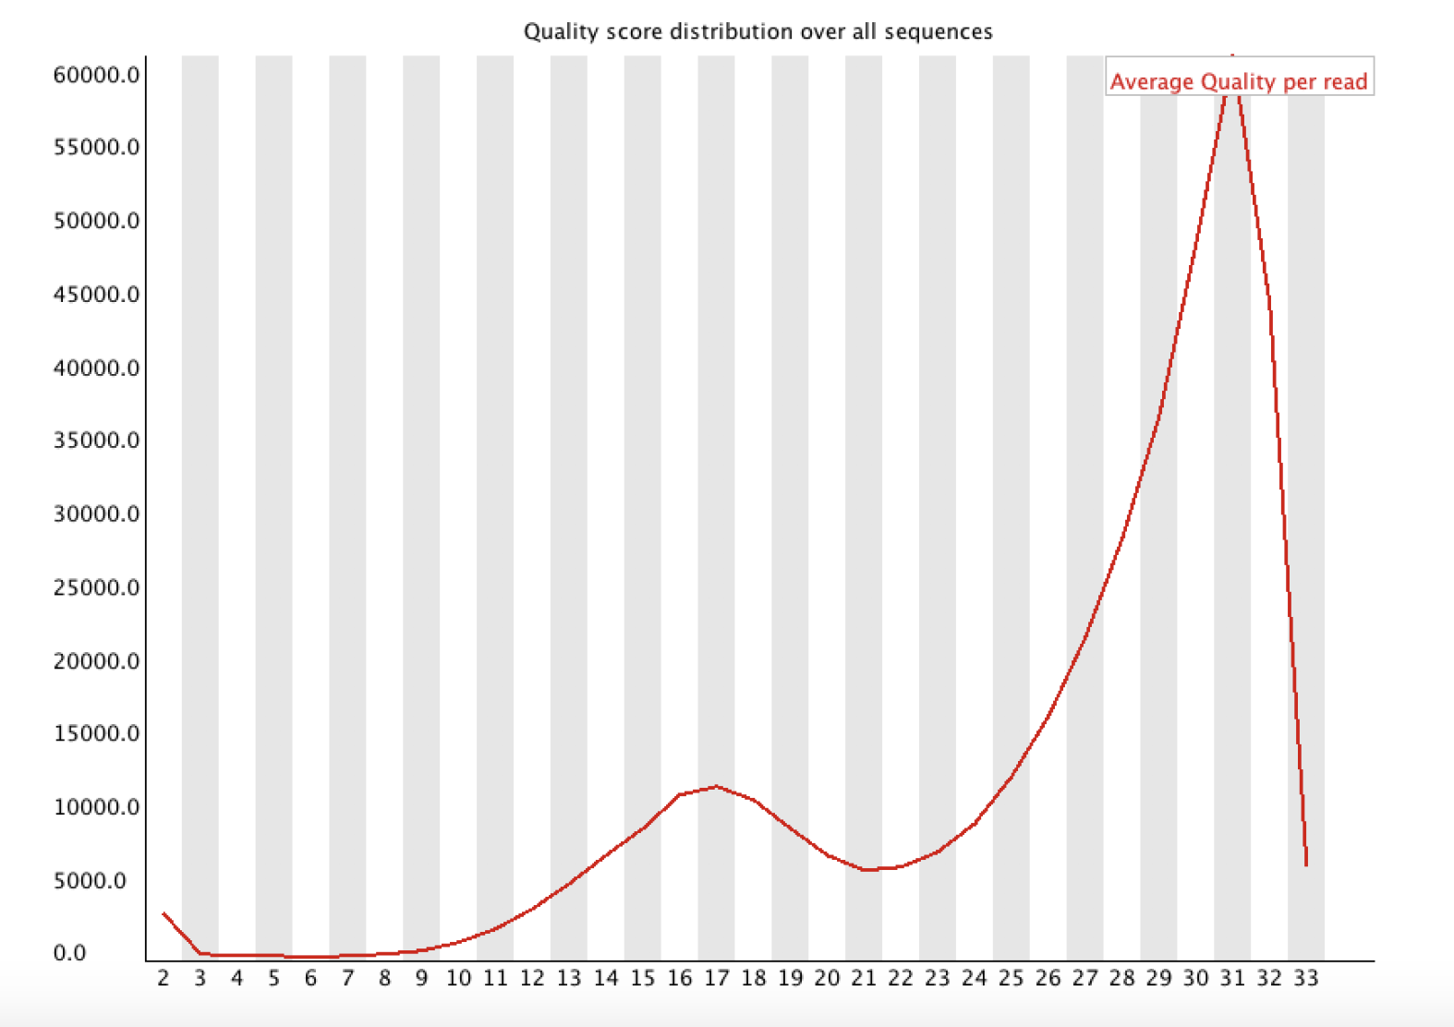
Is it a subset of the sequences that have low scores or is it the majority of them?
Per Sequence Quality Score
# of sequences
Phred score

Slide 18
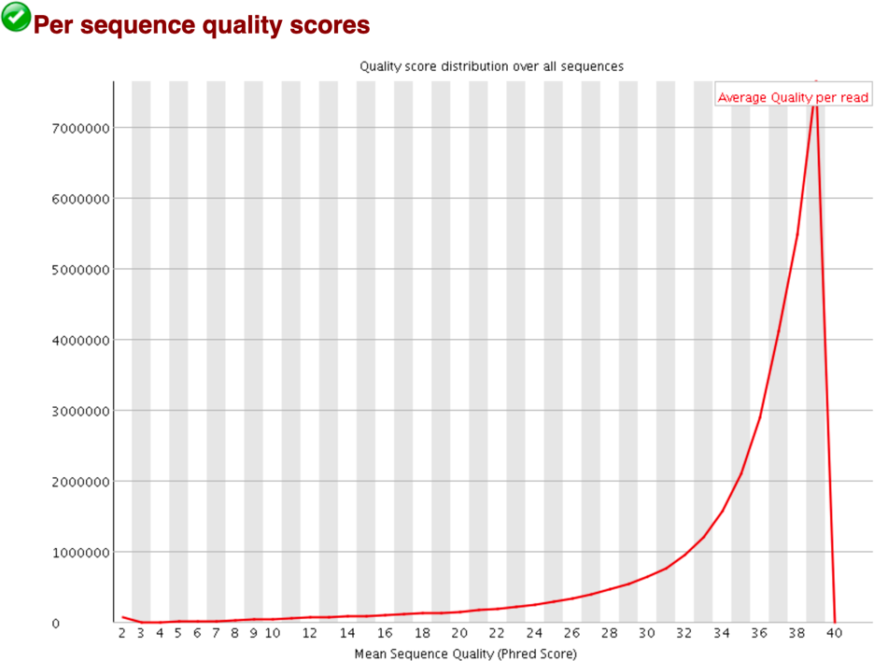
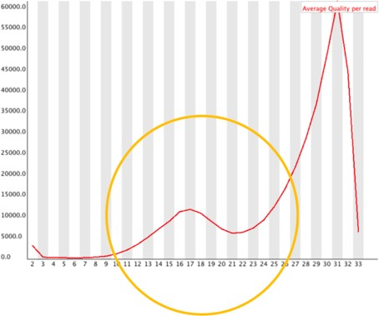
FastQC: per-read mean base qualities
(bad)

Slide 19
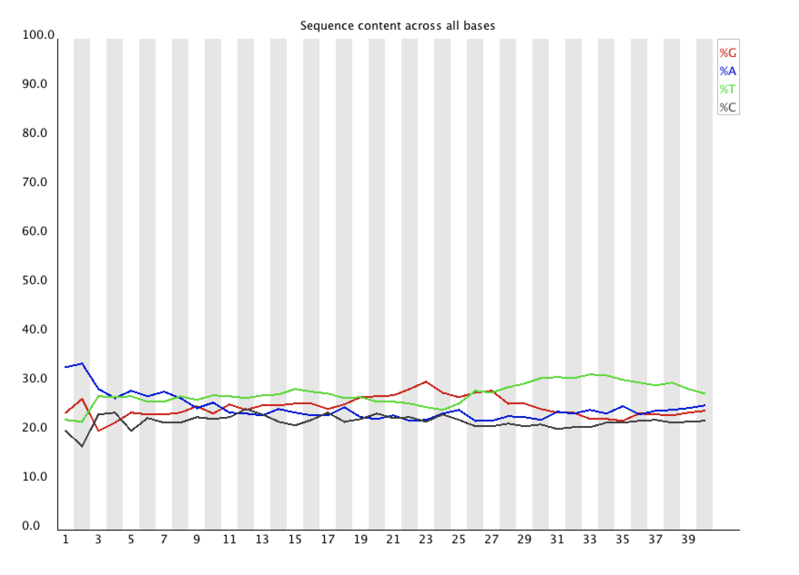
Per Base Sequence content
What is the proportion of each base in the file?
Percentage
If there are 4 bases out of 100% what is the gold standard?

Slide 20
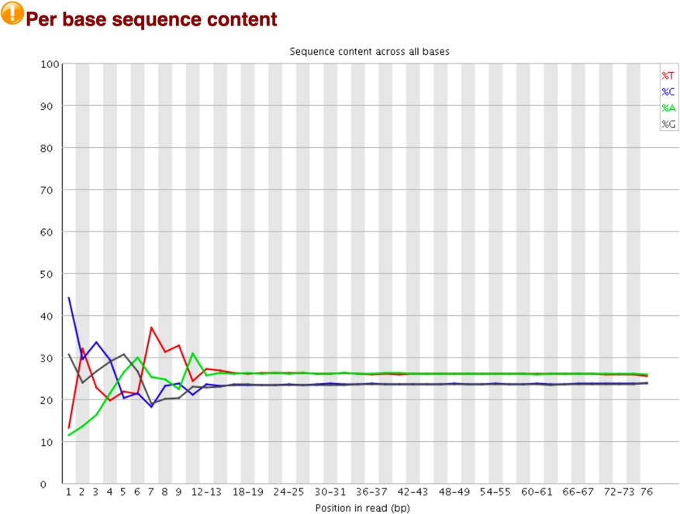
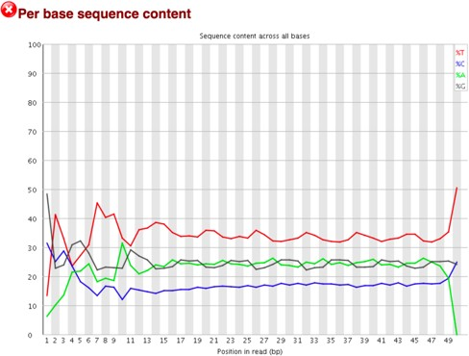
FastQC: %ACGT over read length
(bad)
If there is a strong preference, this indicates an overrepresented sequence

Slide 21
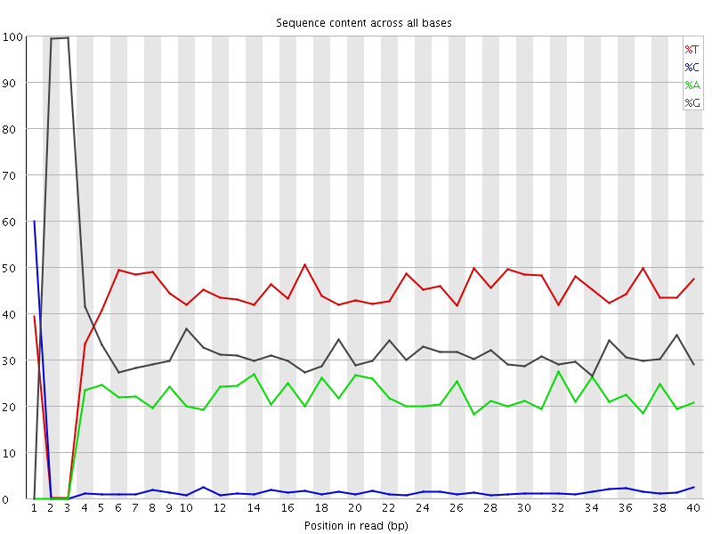
Library Base Composition
Bisulphite treated – C is converted to T

Slide 22
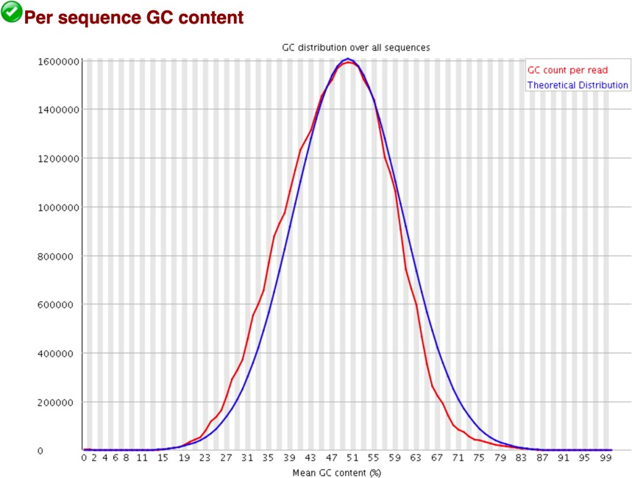
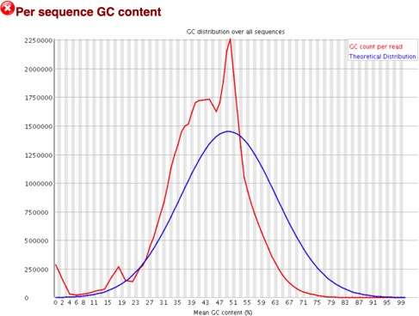
FastQC: per-read %GC
(bad)

Slide 23
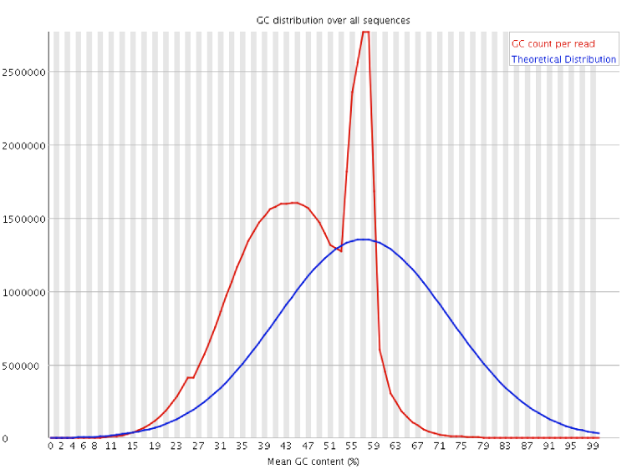
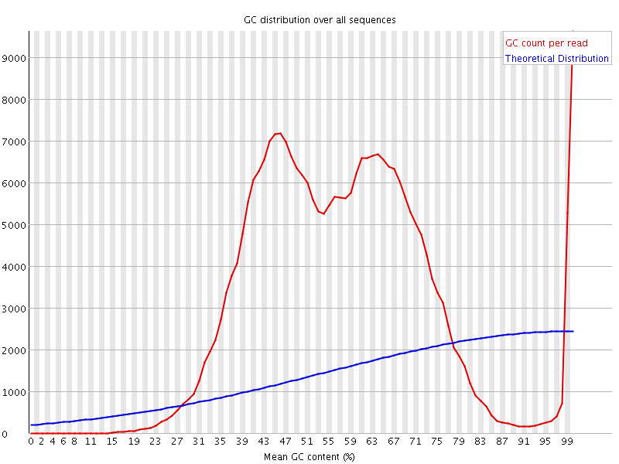
Library GC Content
Specific Contamination
Broad Contamination

Slide 24
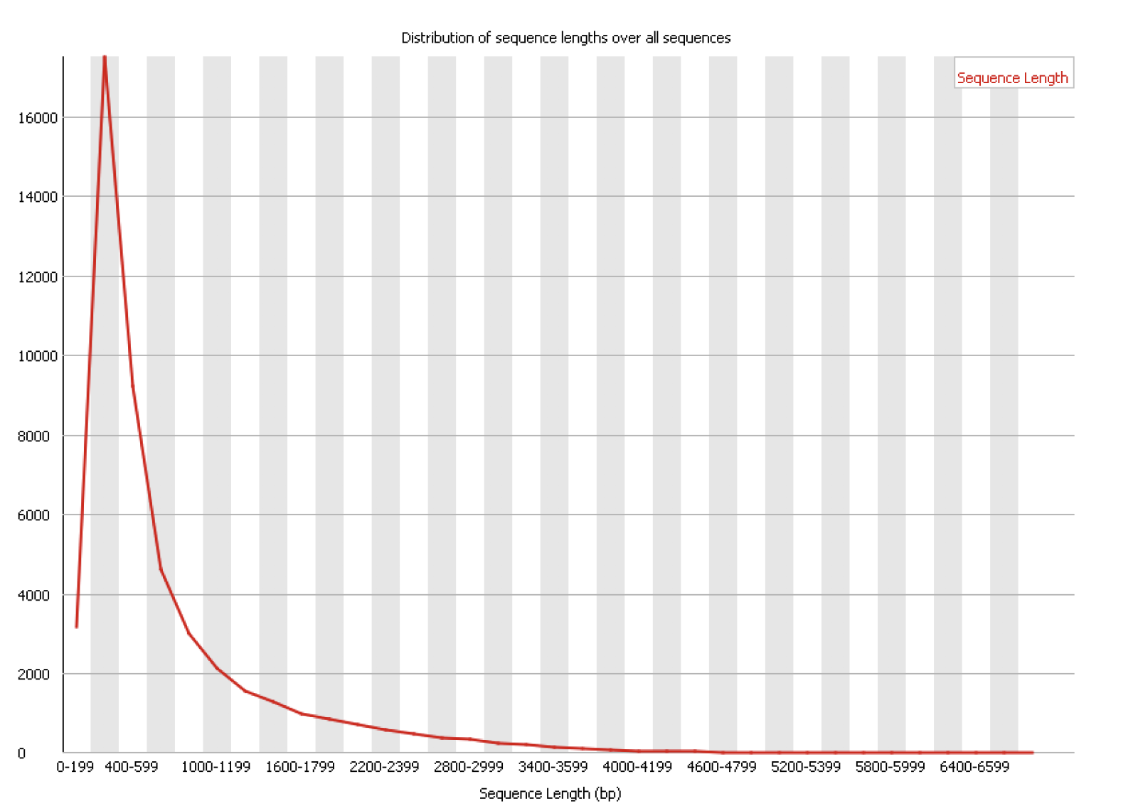
What is the average fragment length?
# of sequences
Sequence length

Slide 25
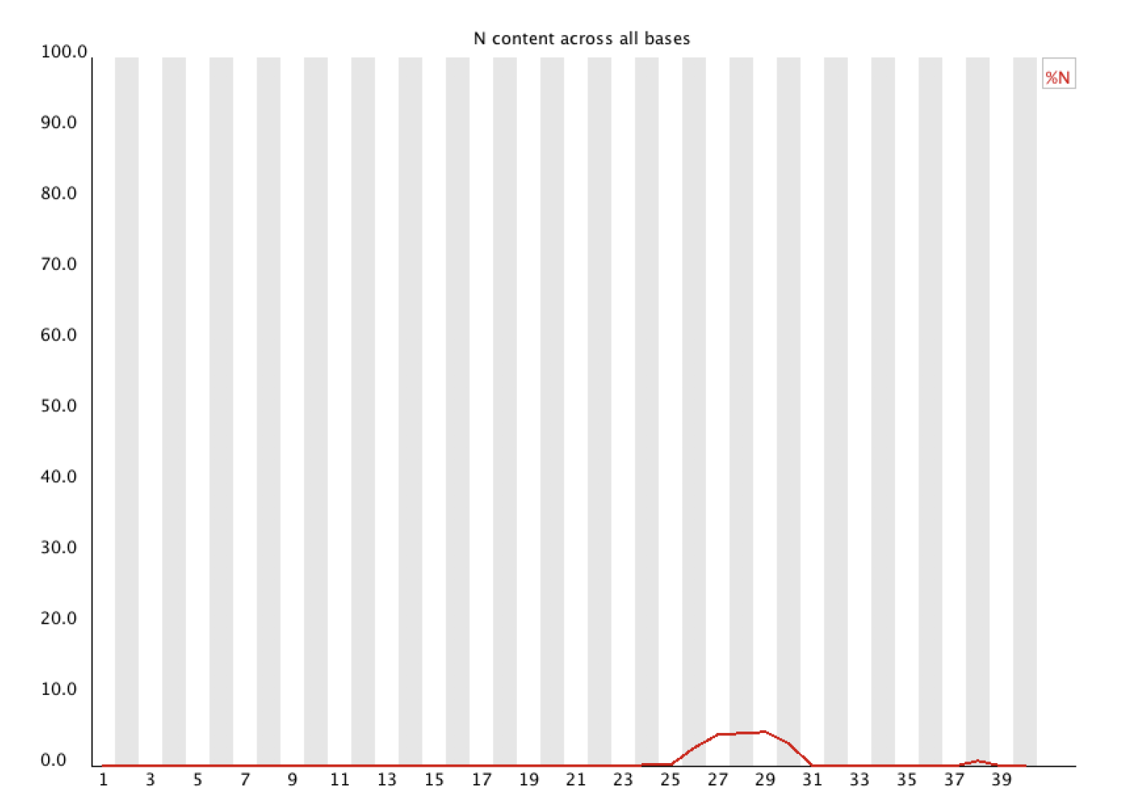
What is the percentage over each position for which an N was called?
N= not enough confidence to call an A,T,C,G

Slide 26
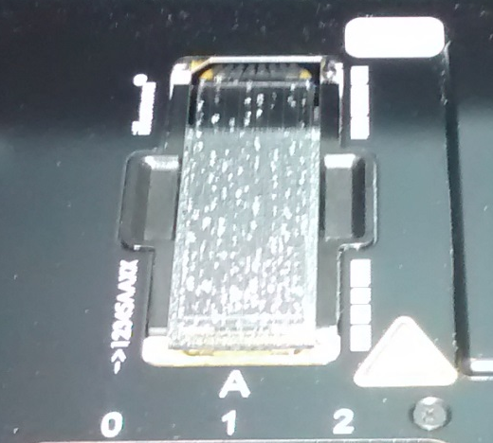
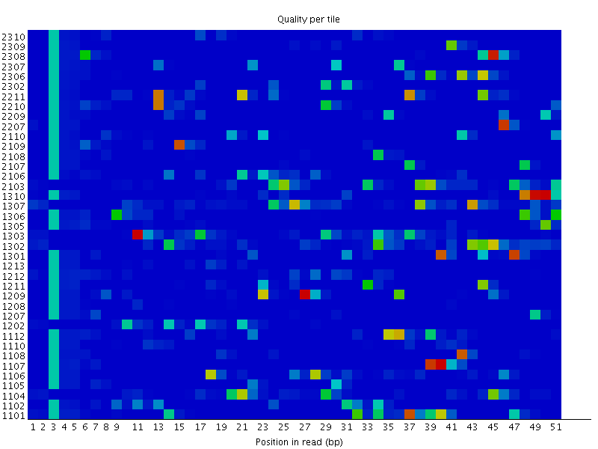
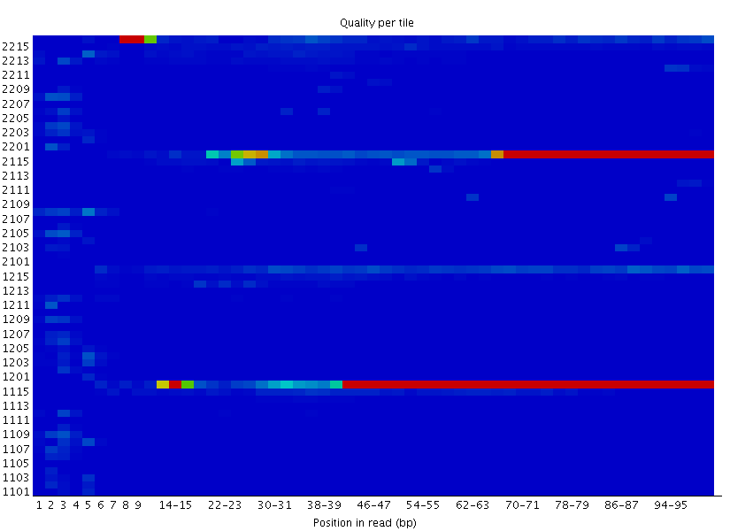
Positional Quality
Random Patterning
Tiles
Lanes
Top
Bottom
Position Specific
Patterning
Notes:
This graph will only appear in your analysis results if you're using an Illumina library which retains its original sequence identifiers. The graph allows you to look at the quality scores from each tile across all of your bases to see if there was a loss in quality associated with only one part of the flowcell.
The plot shows the deviation from the average quality for each tile. The colours are on a cold to hot scale, with cold colours being positions where the quality was at or above the average for that base in the run, and hotter colours indicate that a tile had worse qualities than other tiles for that base. A good plot should be blue all over.
Reasons for seeing warnings or errors on this plot could be transient problems such as bubbles going through the flowcell, or they could be more permanent problems such as smudges on the flowcell or debris inside the flowcell lane. Or flowcell is overloaded.

Slide 27
Duplication
The exact same sequence appears more than once in your library
The sequences come from different biological molecules and the duplication is coincidental
Deep sequencing
Highly present sequences (repeats for example)
Restricted diversity libraries (amplicon sequencing, restricted libraries)
The sequences come from the same biological and the duplication is technical
PCR duplicates

Slide 28
Duplication
Most sequences are unique
High diversity (or low coverage)

Slide 29
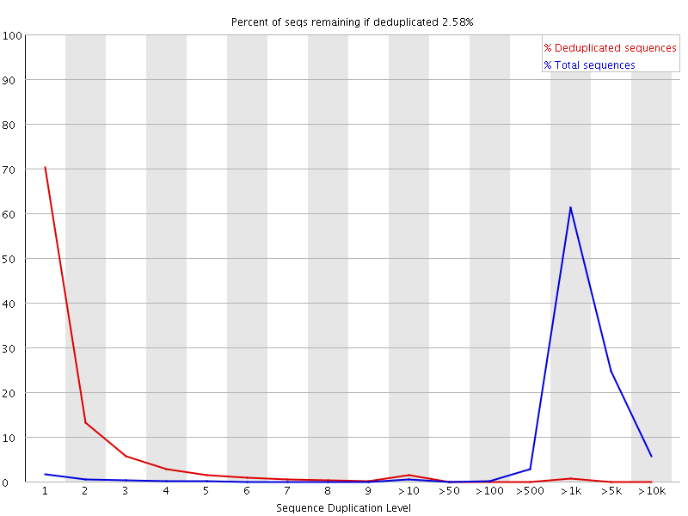
Duplication
Most sequences are present many times
Highly duplicated (low diversity)

Slide 30
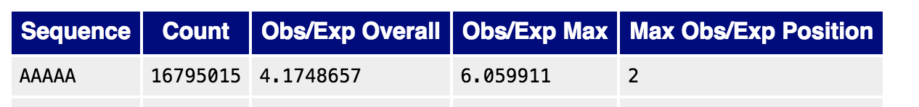
Overrepresented Sequences
PolyA – Common in RNA-Seq
PolyG – Empty space in 2-colour chemistry
PolyN – Quality too poor to make any calls
Specific sequences – Normally Adapter Dimers
Notes:
Extreme duplication – the exact same sequence is a significant proportion of the whole library (which might not be duplicated overall).
Normally comes from artificial sequences (primers, adapters, vectors etc)
Can search a database of known sequences to find matches

Slide 31
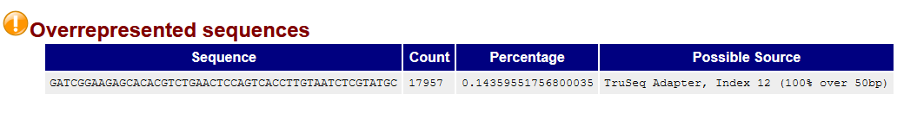
Adapter Dimers
Barcode
Adapter
Insert
Adapter
Barcode
Barcode
Adapter
Adapter
Barcode

Slide 32
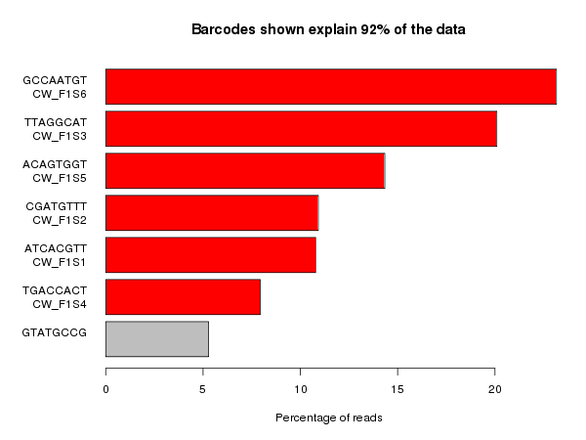
Barcode Sequences
Barcode
Adapter
Insert
Adapter
Barcode

Slide 33
Read-through Adapters
Primer
Read 1
Adapter
Insert
Adapter
Primer
Read 1
Adapter
Insert
Adapter

Slide 34
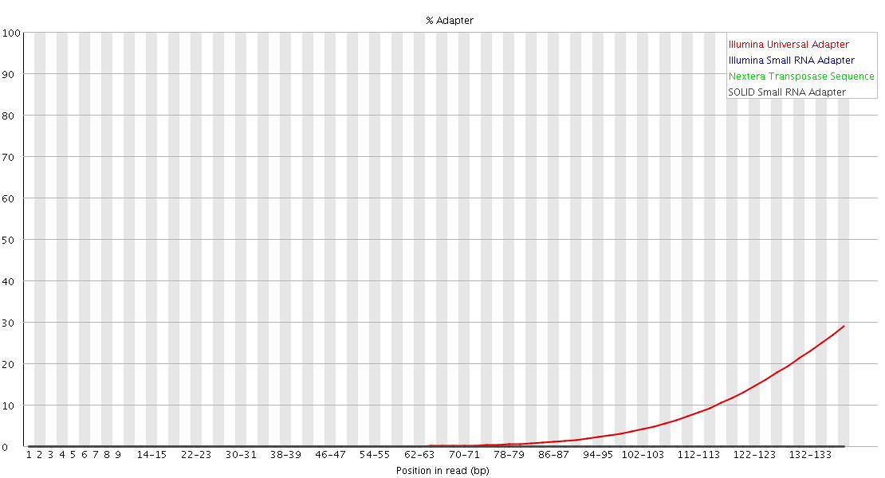
Measuring Read-though Adapters

Slide 35
Let’s run FASTQC

Slide 36

Aggregated Statistics
Individual QC reports are useful but can be difficult to interpret without context
The simplest way to spot a local QC problem is that one sample doesn't look like the rest
We can aggregate and plot a range of QC statistics to make this easier

Slide 37
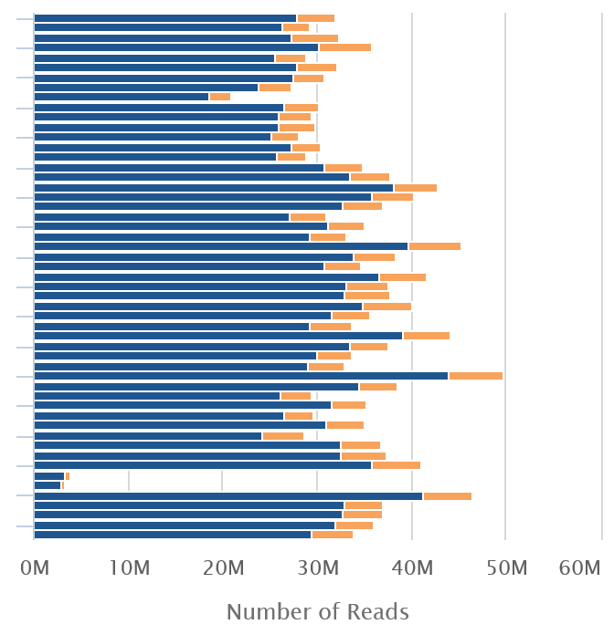
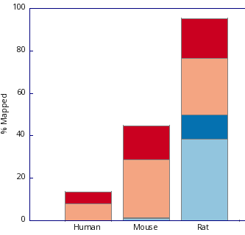
Aggregated Mapping Stats
FastQ Screen

Slide 38
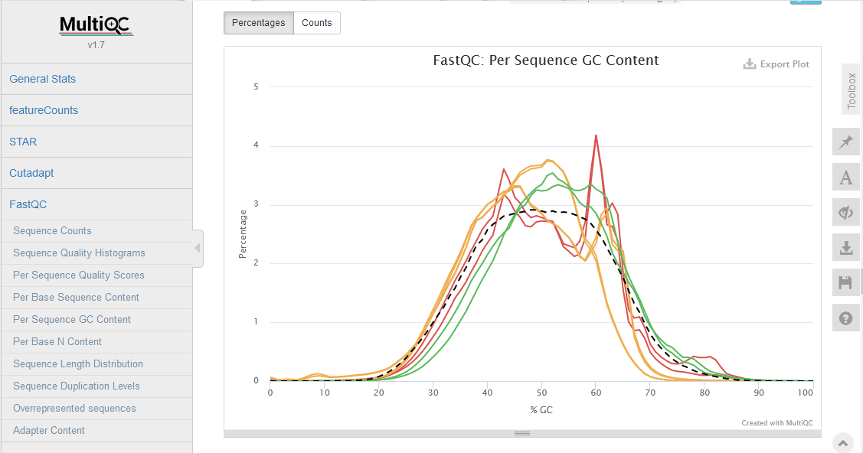
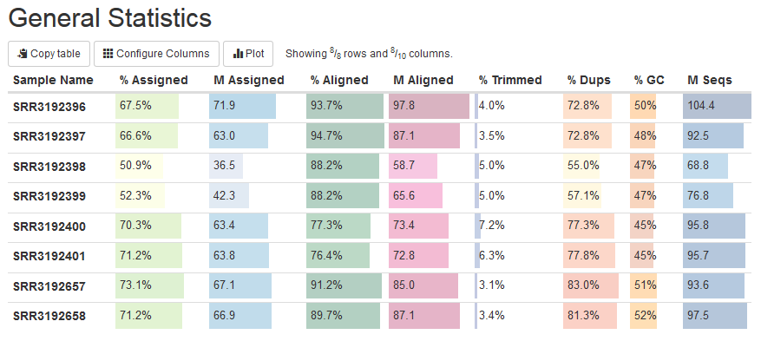
MultiQC
Aggregates QC information from multiple samples
Large number of programs supported
Combined HTML report
https://multiqc.info/

