Slide 1

Week 1: Advanced Bioinformatics Dr. Princess Rodriguez
MMG 3320/5320
Spring 2024

Slide 2
Please call me either:
Dr. Rodriguez
or
Princess

Slide 3



My Background
Bachelors in Biology
Masters in Immunology and Microbial Disease
Doctor of Philosophy in Cellular Molecular Biology
Epigenetics
Next Generation Sequencing
B cell biology

Slide 4

Course Audience
This course was designed for primarily an undergraduate audience with training in the biological sciences
Students who have no formal training in the data or computer sciences
Computer/data background be warned that you may find the class pace slow…still

Slide 5
My Approach
Yes, I will primarily teach you how to run bioinformatics software
With a focus on building bioinformatic skills for the purpose of extracting meaning from complex, large datasets
Reproducible: to the point where your work can be repeated by other researchers, and they can arrive at the same result

Slide 6

The decision to focus on sequencing data
Sequencing data is abundant and has broad applications
Variant detection
Transcriptome
Protein-DNA interactions
Methylation
Used the analysis of these data to hone bioinformatic skills
Data management
Communication
Visualization

Slide 7
What I am keeping from last semester (i.e. what you can expect)
"I think the homework assignments and projects were a really great way for me to be able to apply what I was learning.”
“During in–class activities”
“The final project was my favorite part of the course. It helped us to engage with the coding, troubleshoot, and learn for ourselves!”
“Dr. Rodriguez also made ample time for students who were having difficulty with their code or had questions about it.”
“…it seems as if you could get the same amount of knowledge from reading the powerpoints in your own time than attending lectures.”

Slide 8
Learning and expertise varies
Auditory vs visual learners, neurodivergent, while others learn- by-doing
There are varying levels of expertise in this room.
Notes:
Some of you are already proficient in R therefore, I do try my best to provide students with the same materials.
This way you know ahead of time… is this class for me? Should I attend? Do I know the material enough to complete the homework assignment?
If the answer is no, you should probably attend class…
If you do decide to skip class, and I know I covered the materials at length during class, I now have the option to say, “Please see the class materials for the day you missed to complete the assignment”

Slide 9
How I am trying to improve this course
“I just wish there was more time to go over the coding parts because if you got messed up then you were left behind.” “I wish we had moved a little slower during the coding sections.”
“Include homework or small assignments so that we are able to apply what we learn in class..” (coding)
“The R studio section felt like way too much for individuals without prior knowledge”
“I would have appreciated more time in class to actually work through writing our own code so that we could work through issues and better understand what each line does and how to build a working script.”

Slide 10

Let’s go over the syllabus

Slide 11
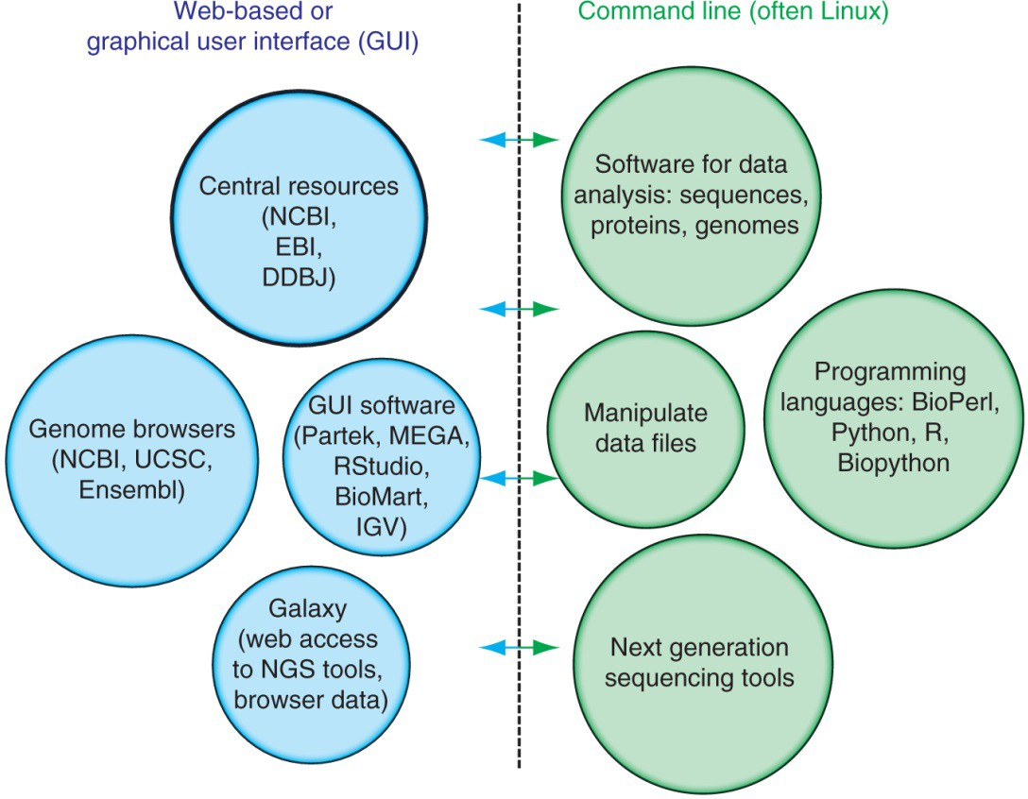
Two major approaches to bioinformatics
Tools are immediately accessible
Steeper learning curve

Slide 12
What is the command line?
Underneath the Graphical User Interface (GUI) of your computer is the command line that runs your Operating System (OS)
Working this way gives you access to internal controls, remote servers, and the ability to customize workflows (scripts)
We access it with a shell (Terminal) which let’s you give your computer commands via keyboard rather than a point and click

Slide 13
Command line + Bioinformatics
Why bother?
GUI tools require memory just to run the interface, and most
Bioinformatics applications are memory intensive to begin with or have additional flexibility on the command line
Most of the time you will be working on a High Performance Cluster or remote server, as typical PCs do not have the required storage or compute power
Reproducibility
Ability to automate + create pipelines, or work with many files at once

Slide 14
Reproducibility
Human error
When we try to do the same thing 100 times we make mistakes
A computer can perform the same task thousands of times without error
Easier to communicate steps to others for reproducibility
A different analyst re-performs the analysis with the same code and the same data and obtains the same result.

Slide 15
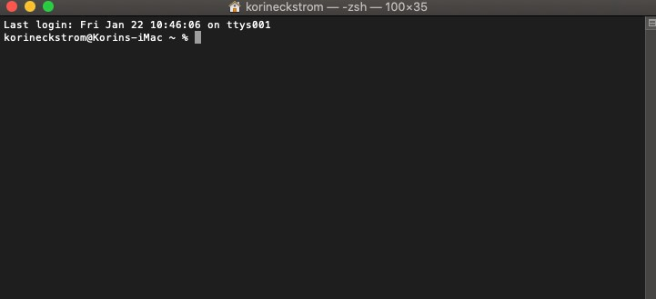
Topics we will cover:
How to access your shell
Remote Servers & Benefits

Slide 16
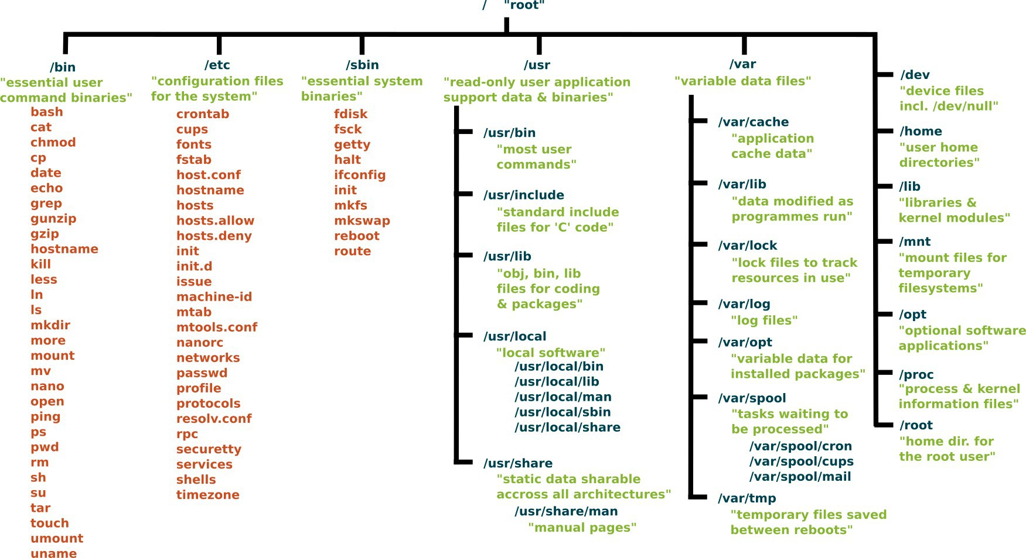
Topics we will cover:
Syntax = the “grammar” of a programming languages, needs to be exact for the computer to understand
Directories

Slide 17
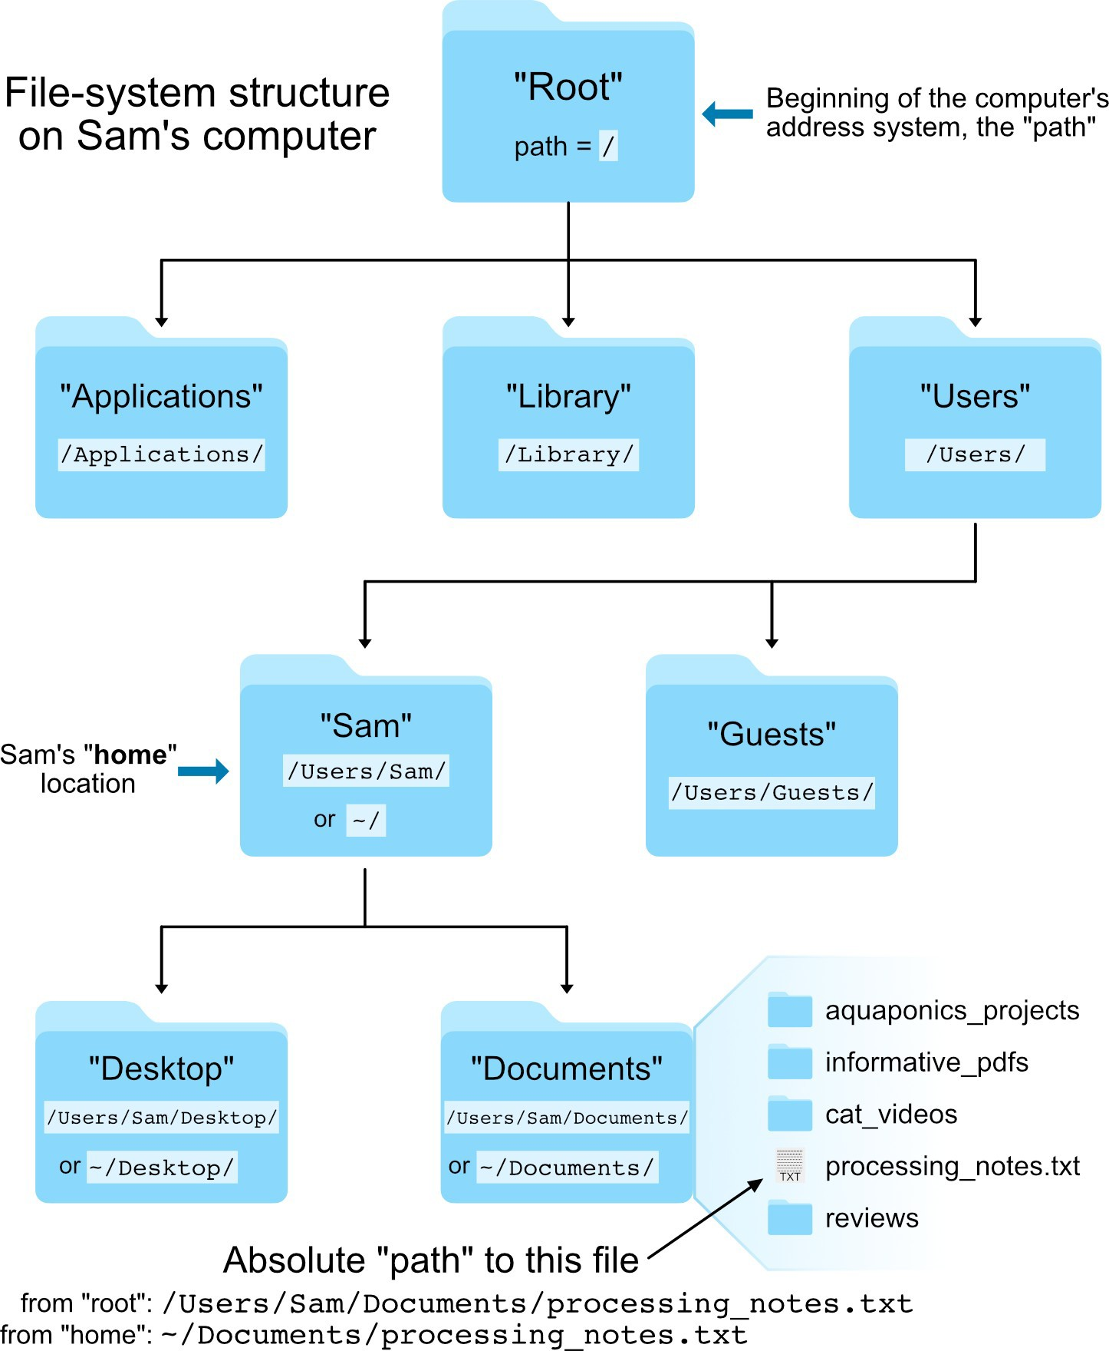
Topics we will cover:
PATH
Where am I? Where is that file?
Can’t click or drag and drop, and the computer can only find things if you tell it where they are
PATH vs $PATH
Absolute vs relative
There are two locations all Unix-based systems share:
“Root” = where the address system of the computer starts
“Home” = where the user’s location starts
Unix Getting Started

Slide 18
Topics we will cover:
Naming Files
Case sensitive
File.txt ≠ file.txt
Spaces without “” won’t be read correctly
Adding dates can help with versions
GUI:
becomes….
/OneDrive\ -\ UVM\ Larner\ College\ of\ Medicine/

Slide 19
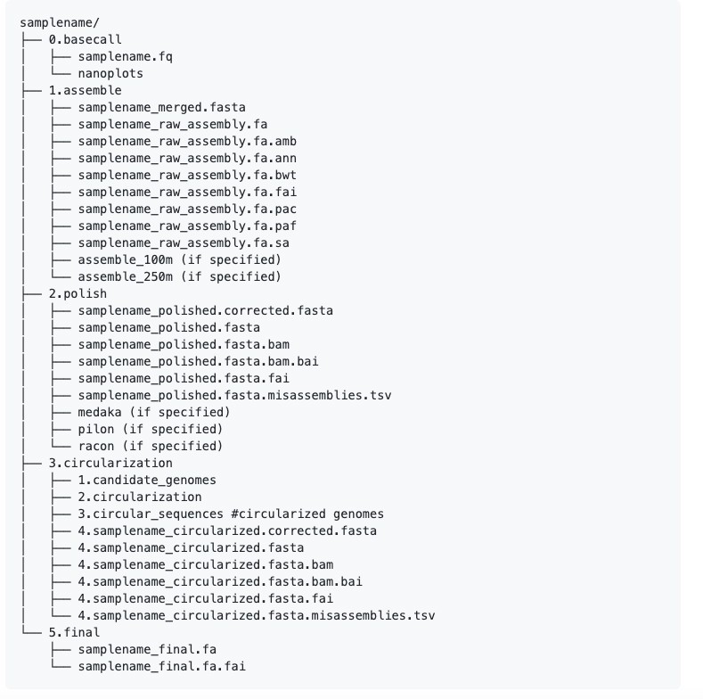
Topics we will cover:
Organization
Many pipelines don’t just generate the final results file, but all of the intermediate steps it took to get there
Having everything in one directory can not only be overwhelming, but can make automation that much harder
Good organization can save you many headaches later on!
You might do something like:
RawReads/
TrimmedReads/
Scripts/

Slide 20
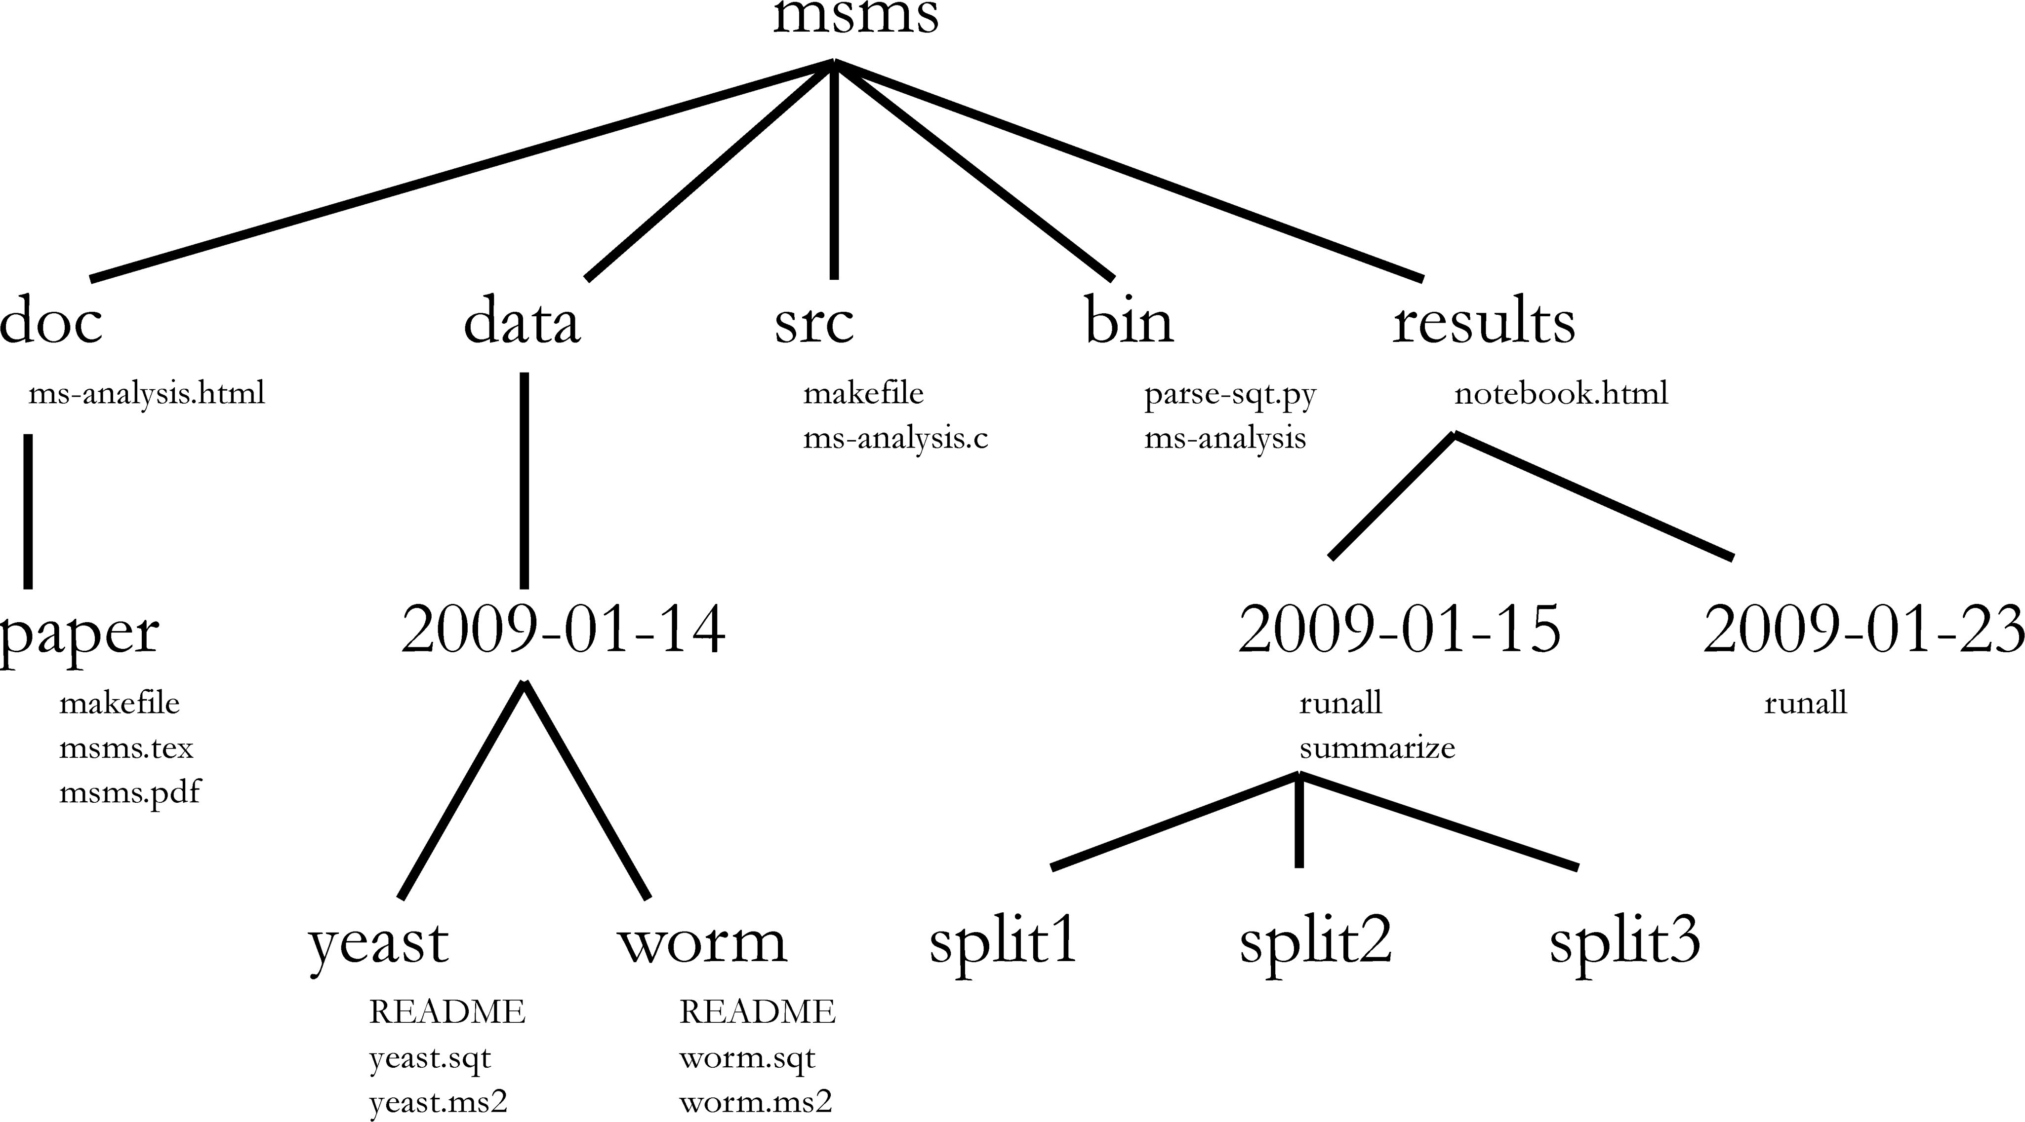
Topics we will cover:
Organization User Level
If that’s for an individual project, your VACC account might end up looking something like this
Each new project gets a directory
Versions or samples within these
Tools or programs in one place that can be accessed from anywhere
Noble, PLoS Computational Biology 2019

Slide 21
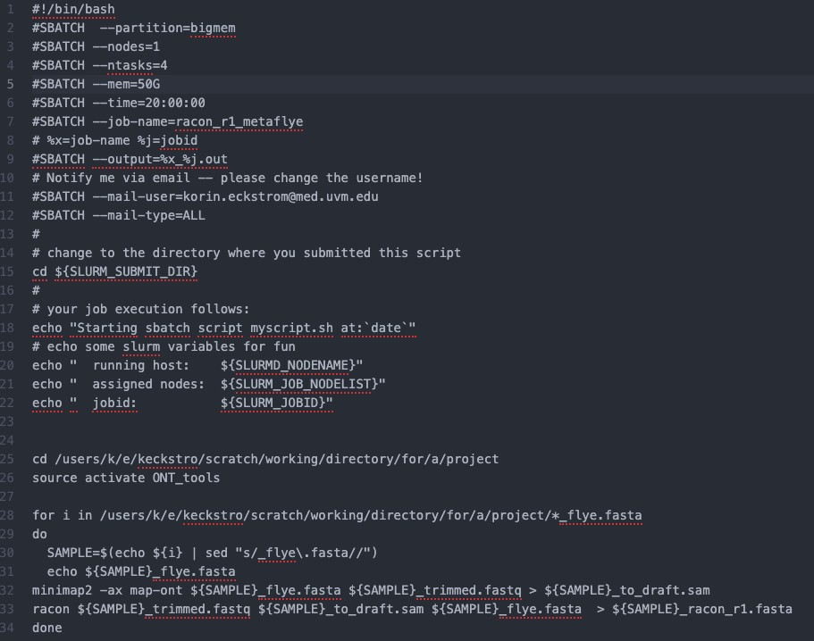
Topics we will cover:
Submitting Jobs
Slurm scheduler
If everyone tried to run their scripts at the same time, nodes would get mixed up, large jobs would take all the resources, and ineﬃciencies would be created
T o prevent this, HPCs run using “batch systems”, which allows users to submit jobs requesting specific resources + with specific instructions in the form of a script
Instead of a single command at a time, you can submit whole workflows this way
Knowledge Base: Run a job

Slide 22

Let’s make sure we can login

