Slide 1
RSeQC Feb 25, 2026

Slide 2
Next Week
Wednesday, March 5th - Course Catch Up Day
Bring Homework #6 specific questions
Notes:
Navigate to course website

Slide 3
Determine strandedness RSeQC
SAM/BAM
Count reads
HTseq-count
count
Notes:
FastQC checks raw reads, HISAT2 gives alignment metrics. But alignment does not always equal being biologically valid. So today, we are going to evaluate whether RNA-Seq reads reflect real biology or technical noise.

Slide 4
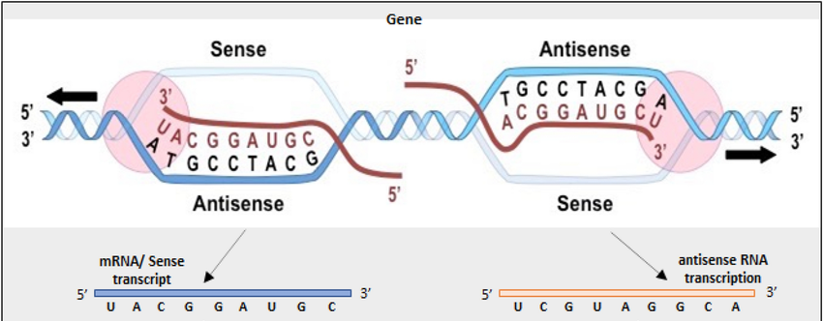
Stranded libraries
A major decision to be made during the library preparation step is whether to preserve RNA strand information.
Unlike DNA molecules, RNA molecules exist as single-stranded threads that could result from the sense or antisense strand.
The creation of stranded libraries are now standard with Illumina TruSeq ‘stranded’ RNA-Seq kits
Allows for the identification of which strand of DNA the RNA was transcribed from

Slide 5
Why is strandedness important to determine?
If you use an incorrect directionality parameter during the alignment or read counting step, the reads may orient to the wrong strand.
This means you may not get any read counts (all equal to 0) or if there is a gene in the same location these reads can be counted for the wrong gene.
Its important to check using QC tools!

Slide 6
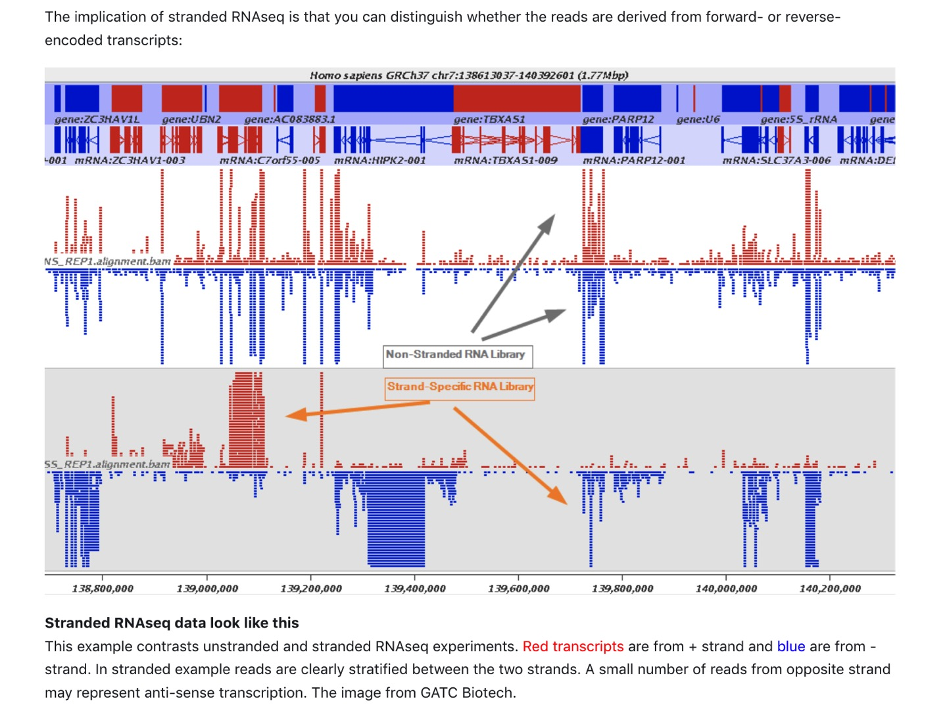
Notes:
Notice, if the strandedness parameter is incorrect, most of the sequencing reads are assigned incorrectly!!

Slide 7


Pre & post alignment QC
raw reads QC
adapter/primer/other contaminating and over-represented sequences
sequencing quality
GC distributions
duplication levels
Pre-alignment: FastQC, fastp
aligned reads QC
% (uniquely) aligned reads
% exonic vs. intronic/intergenic
strandedness
splice junction detection/annotation
Post-alignment: RSeQC, QoRTs
Notes:
In order to proceed to the counts step, one must determine strandedness. But note, all the other steps we had to determine to comfortably move forward.

Slide 8
RNA-Seq library preparation protocols
Strandedness Type | Example Protocols
Unstranded | Standard Illumina mRNA-Seq
Forward-stranded (1st strand) | Illumina TruSeq Stranded, NEBNext Ultra Directional RNA
Reverse-stranded (2nd strand) | Illumina ScriptSeq, SMARTer Stranded
After today’s activity you should be modifying your hisat2 script!

Slide 9
Why retain stranded information?
It makes sense to begin with the most information possible – even if immediately that is not of interest
Useful for identifying antisense transcripts, mapping splicing events, and detecting overlapping transcripts.
They are commonly used in studies of transcriptomics, gene expression analysis, and RNA editing, and de novo assembly.

Slide 10
Three possible scenarios
Forward (sense) – reads resemble the DNA sequence
Reverse (antisense) – reads resemble the complementary sequence
Unstranded

Slide 11

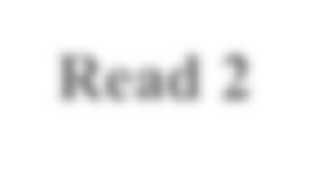




DNA, coding/sense strand
Forward (sense)
5’
3’
Read 1 |  | Read 2
DNA, noncoding/antisense strand
If sequences of Read 1 align to the coding, sense strand – the library is “stranded”

Slide 12





DNA, coding/sense strand
Reverse (antisense)
5’
3’
Read 2
Read 1
DNA, noncoding/antisense strand
If sequences of Read 2 align to the coding, sense strand – the library is “ reverse stranded”

Slide 13
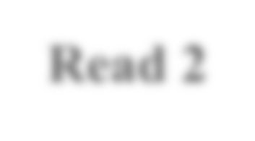




DNA, coding/sense strand
Unstranded
5’
3’
DNA, noncoding/antisense strand
Read 2 |  | Read 1
If both Read 1 and Read 2 align to the coding, sense strand – the library is “unstranded”

Slide 14
Options to select from when aligning and counting
 | Option 1 Stranded/sense | Option 2 Reverse/antisense | Option 3 Unstranded
HISAT2 (--rna-strandedness) | FR (for PE) F (for SE) | RF (for PE) R (for SE) | Default
STAR | n/a | n/a | n/a
HTSeq | stranded=yes | stranded=reverse | stranded=no
Notes:
The default for --rna-strandedness in HISAT2 is none, meaning it assumes unstranded RNA-Seq data unless specified otherwise.
STAR aligns reads to both strands and does not assign strand-specific information.

Slide 15
An Example HISAT2 command with strandedness accounted for
hisat2 -x genome_index -1 reads_R1.fq -2 reads_R2.fq --rna-strandedness RF -S output.sam
In this example, specified --rna-strandedness RF for reverse stranded libraries

Slide 16
However, in the context of single-end RNA-Seq, we only have Read 1 (R1), so it is based on whether R1 maps to the sense or antisense strand.
Read1

Slide 17
Today’s Exercises
All will utilize a “package of python scripts” bundled as RSeQC
infer_experiment.py
read_distribution.py

Slide 18
Strand-Specificity
infer_experiment.py
Purpose
Determine strand specificity from aligned BAM file
Crucial for differential expression analysis as strand specific libraries require correct orientation for accurate read assignment
Avoids misinterpretation of gene expression levels causes by incorrect strand assignment
Notes:
This script predicts the “strandedness” of the protocol (i.e. unstranded, sense or antisense) that was used to prepare the sample for sequencing by assessing the orientation in which aligned reads overlay gene features in the reference genome. This information is not always available in public datasets.

Slide 19

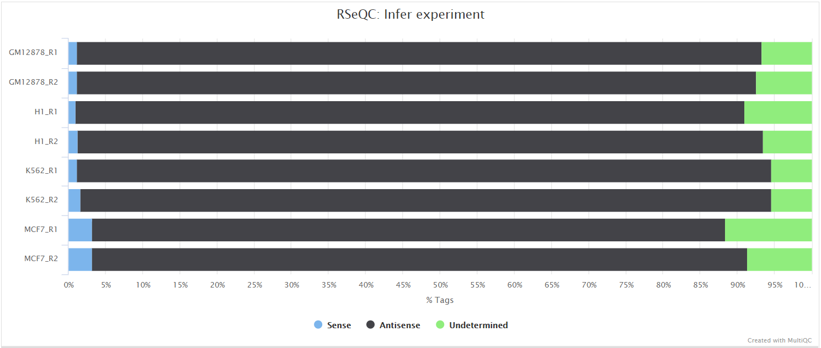
Strand-Specificity
infer_experiment.py
Expected Output:
Notes:
File containing fraction of reads mapping to given strandedness configurations

Slide 20
Our goal is to understand which option to select for the alignment and read counting steps
 | Option 1 Stranded/sense | Option 2 Reverse/antisense | Option 3 Unstranded
HISAT2 (--rna-strandedness) | FR (for PE) F (for SE) | RF (for PE) R (for SE) | Default
STAR | n/a | n/a | n/a
HTSeq | stranded=yes | stranded=reverse | stranded=no

Slide 21
Read Distribution Across Genomic Features
read_distribution.py
Why use it?
Ensures the expected proportion of reads fall within exons for RNA-Seq experiments
Notes:
Analyzes how reads are distributed across different genomic features (e.g., exons, introns, UTRs, intergenic regions)

Slide 22
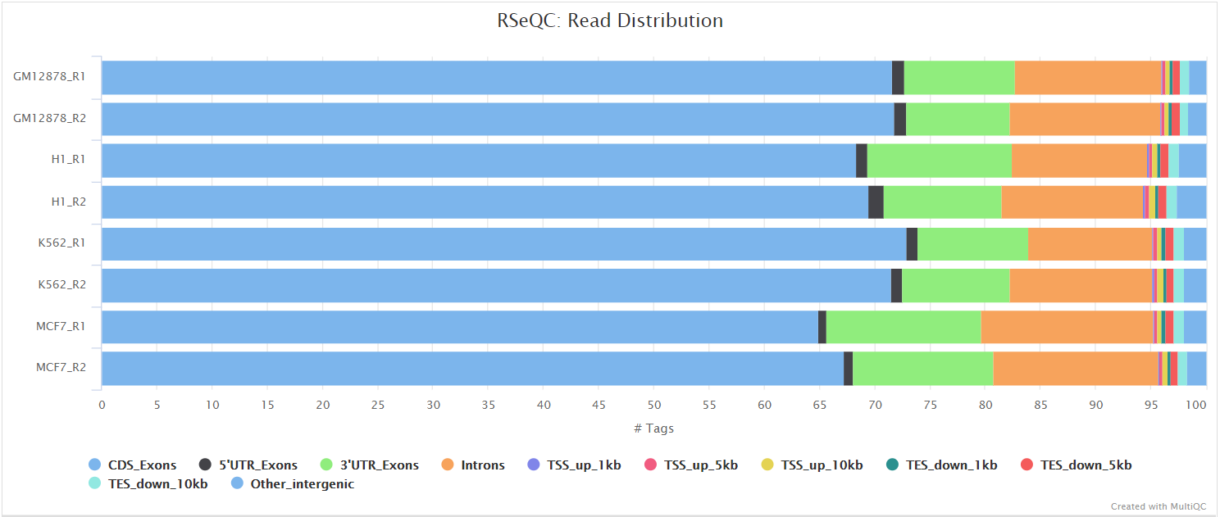
Read Distribution Across Genomic Features
read_distribution.py
Expected Output:
For RNA-Seq, most reads (>70%) should align to exons.
Notes:
Dot plot

Slide 23
Class Exercise #4
read_distribution.py
If done correctly, look inside of Irrel_kd_1.subset_read.log:
Total Reads 217042
Total Tags 285170
Total Assigned Tags 270555
=====================================================================
Group Total_bases Tag_count Tags/Kb
CDS_Exons 41135377 167362 4.07
5’UTR_Exons 50276940 9969 0.20
3'UTR_Exons 74969271 67281 0.90
Introns 1591346634 21456 0.01
TSS_up_1kb 26447701 226 0.01
TSS_up_5kb 118706417 596 0.01
TSS_up_10kb 217519222 771 0.00
TES_down_1kb 30123959 846 0.03
TES_down_5kb 130727548 2947 0.02
TES_down_10kb 231251776 3716 0.02
=====================================================================

Slide 24
Tool | Question Answered | Biological Meaning
Infer_experiment.py | Is library stranded? | Can we count correctly?
Read_distribution.py | Where do reads map? | RNA enrichment quality

