Slide 1



SACNAS 2023 RNA-seq Tutorial
Post-Sequencing Processing Steps
Princess Rodriguez, Noelle Gillis, Sophie Kogut, & Seth Frietze
October 27th, 2023

Slide 2
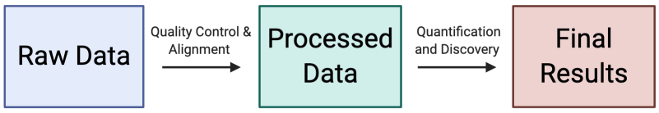

Steps to get you from raw RNA-seq data to DEG’s and beyond!
How I learned how to do this:
Trial and Error.
Spending lots of time reading the program manuals.
Googling error messages.
Asking for help when I get stuck.

Slide 3
Steps to get you from raw RNA-seq data to DEG’s and beyond!
Phase 1: Processing
Processing Step | Tools
Quality control of raw sequences | FastQC, cutadapt, trimGalore
Alignment/Mapping to the genome | STAR
Generating gene counts | HT-seq
Phase 2: Analysis
Analysis Step | Tools
Quality control of replicates | DESeq2, edgeR
Differential expression analysis | DESeq2, edgeR
Pathway analysis | GSEA, IPA, clusterProfiler

Slide 4
Quality Control of Raw Sequences
FASTQ File Format
Quality Control Steps
Generate FASTQC reports.
Check the quality of base-calls.
Check for “over-represented sequences.”
Trim low-quality bases.
Remove adapter sequences.
Example Commands:
fastqc 2D_WT_shGFP_E2_R50_001_S10_R1_001.fastq.gz
trim_galore --paired --Illumina 2D_WT_shGFP_E2_R50_001_S10_R2_001.fastq.gz
2D_WT_shGFP_E2_R50_001_S10_R2_001.fastq.gz

Slide 5
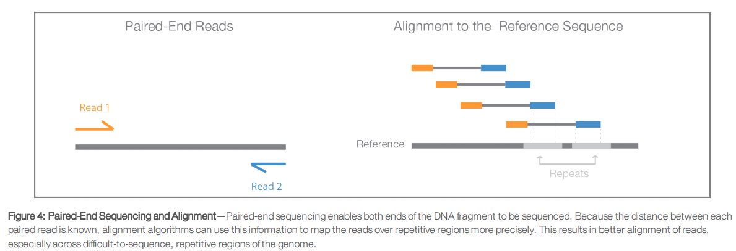
Alignment/Mapping to the Genome
Alignment Steps
Align FASTQ files to a reference genome.
Check the alignment statistics.
Adjust alignment settings as needed.
Convert to BAM format.
Where do you get the reference genome files? https://www.ncbi.nlm.nih.gov/assembly/GCF_000001405.26/
Example Command:
STAR Alignment Summary:
STAR --runThreadN 12 \
--genomeDir /home/langeca/gilli431/software/STAR_hg38 \
--readFilesCommand zcat \
--readFilesIn 2D_WT_shGFP_E2_R50_001_S10_R1_001.fastq.gz 2D_WT_shGFP_E2_R50_001_S10_R2_001.fastq.gz \
--outFileNamePrefix 2D_WT_shGFP_E2_R50_001
Number of input reads | 35202511
Average input read length | 299
UNIQUE READS:
Uniquely mapped reads number | 33777023
Uniquely mapped reads % | 95.95%
Average mapped length | 298.68

Slide 6
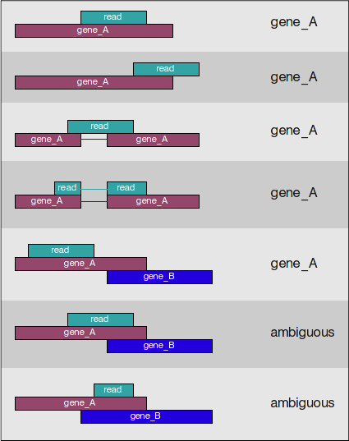
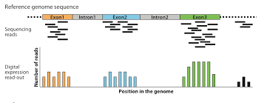
Generating Gene Counts
Gene Counting Steps
Check that bam files are sorted and indexed
Run HT-seq on bam files.
Save .cnts files for analysis.
Example Command:
htseq-count -f bam -r name -s reverse -m union -i gene_id bam_files/${base}_sorted.bam ~/software/gencode.v38.primary_assembly.annotation.gtf > count_files/${base}.counts

Slide 7
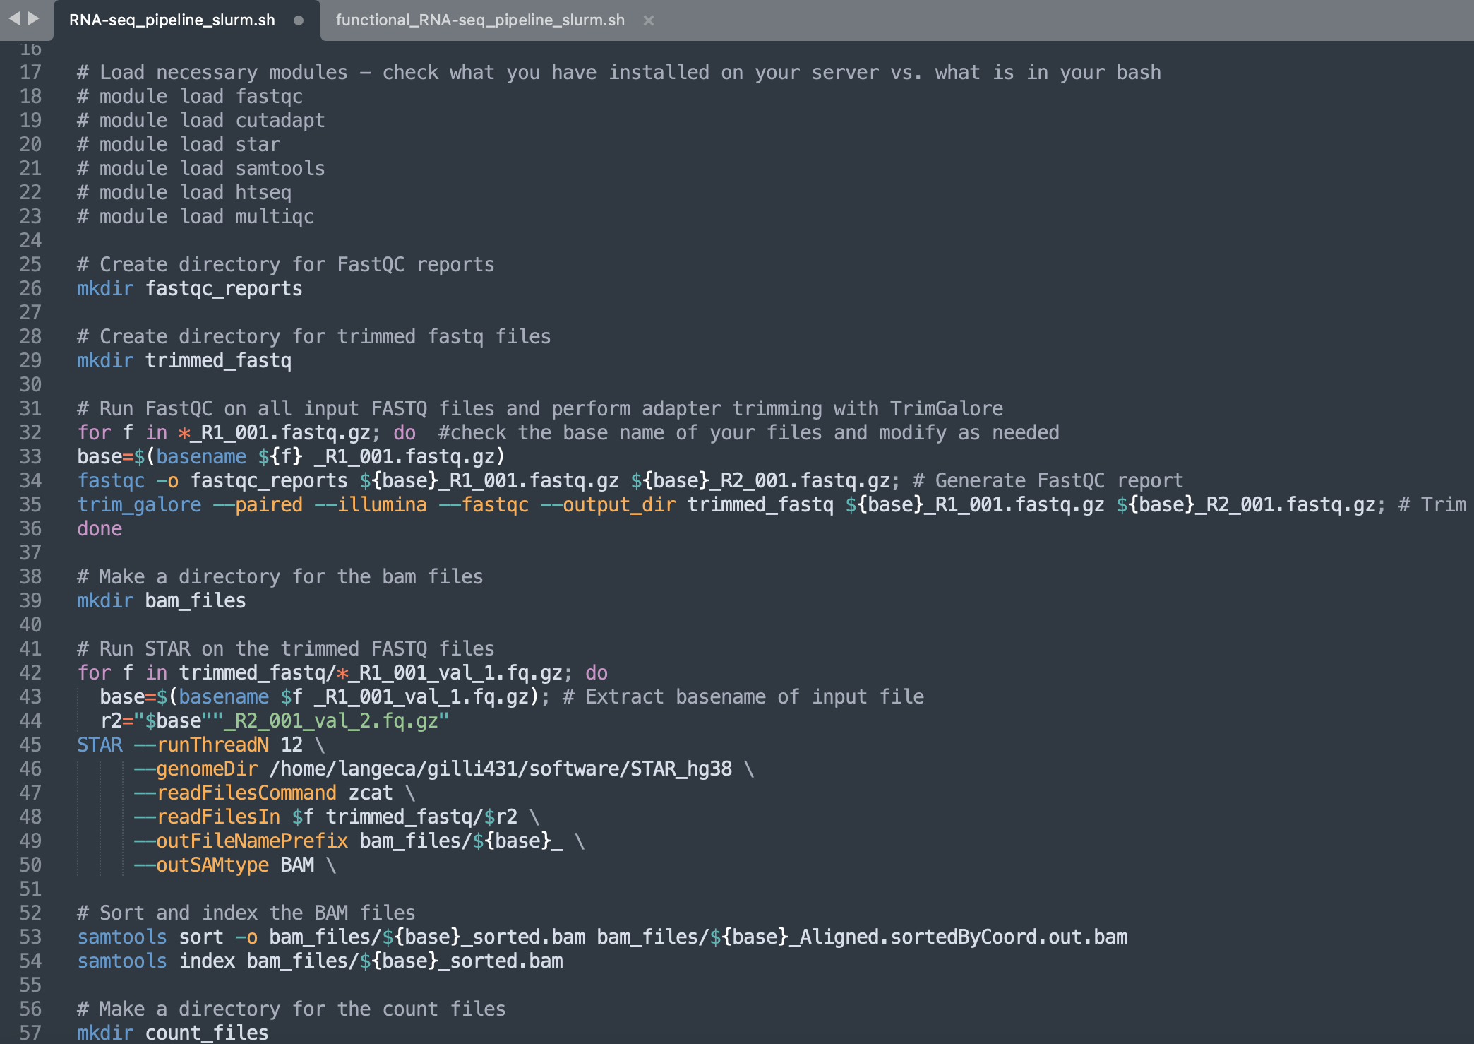
All these steps can be strung together into a “pipeline.”
Alignment
Read counting
FASTQ
Bam
Counts
Put the raw data for the experiment you are analyzing into a single folder (on MSI).
Modify the SLURM header in the pipeline script
Send the job out for analysis.
Wait 12-24 hours.
Check your QC metrics and retrieve the count files.

Slide 8
What can be done with the processed data?

Slide 9
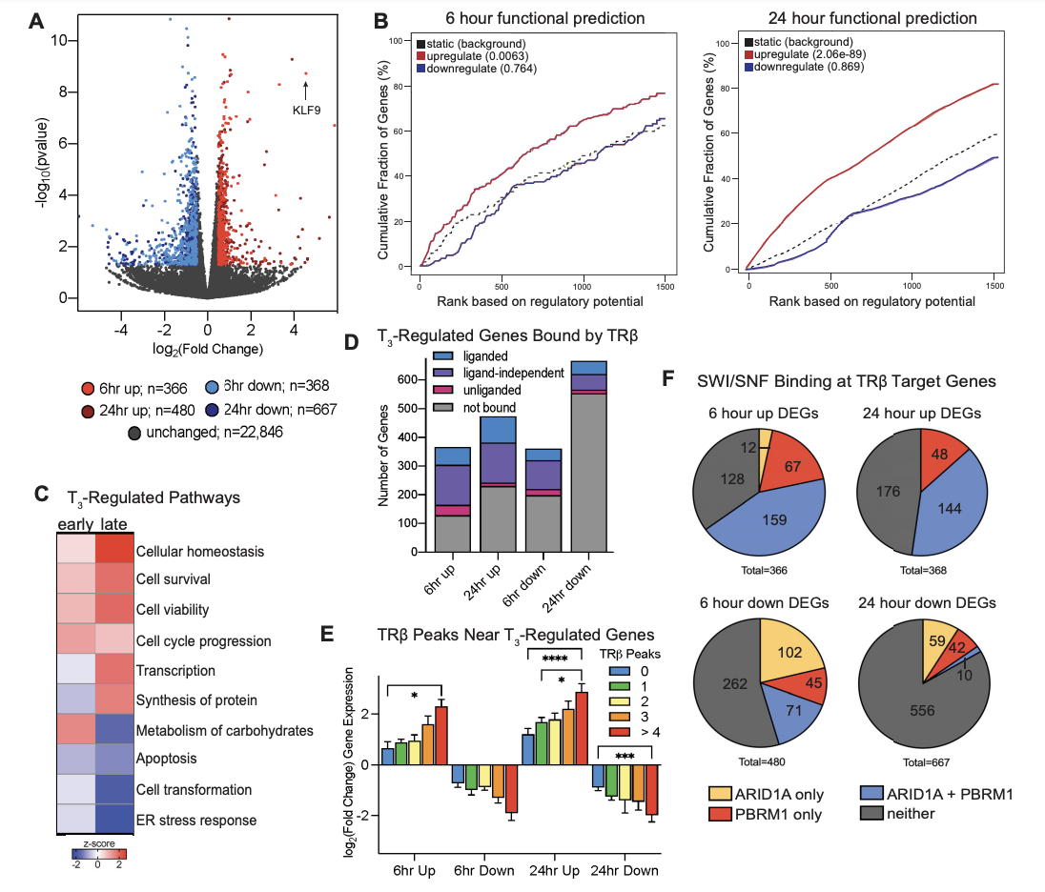
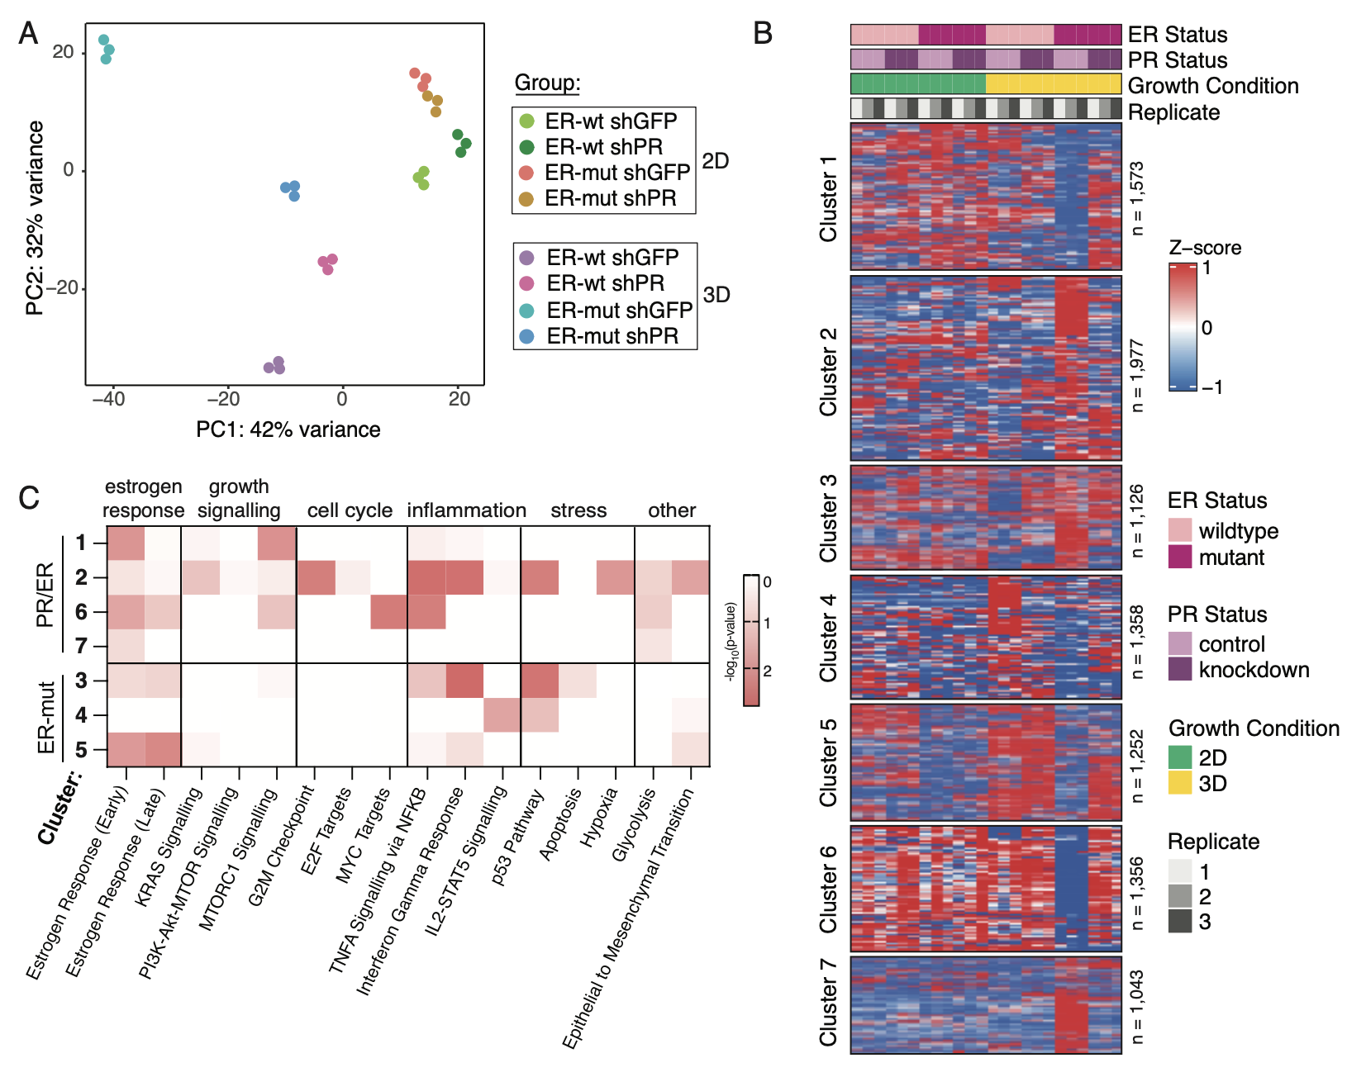
What can be done with the processed data?

Slide 10
Resources, References, and Manuals
Tool: | Reference: | Manual:
FastQC | https://www.bioinformatics.babraham.ac.uk/projects/fastqc/ | https://www.bioinformatics.babraham.ac.uk/projects/fastqc/Help/
STAR | Dobin,A., Davis,C.A., Schlesinger,F., Drenkow,J., Zaleski,C., Jha,S., Batut,P., Chaisson,M. and Gingeras,T.R. (2013) STAR: ultrafast universal RNA-seq aligner. Bioinformatics, 29, 15–21. | https://github.com/alexdobin/STAR/blob/master/doc/STARmanual.pdf
HT-Seq | Anders,S., Pyl,P.T. and Huber,W. (2015) HTSeq–a Python framework to work with high-throughput sequencing data. Bioinformatics, 31, 166–169 | https://htseq.readthedocs.io/en/master/overview.html
DESeq2 | Love,M.I., Huber,W. and Anders,S. (2014) Moderated estimation of fold change and dispersion for RNA-seq data with DESeq2. Genome Biology, 15, 550 | http://bioconductor.org/packages/devel/bioc/vignettes/DESeq2/inst/doc/DESeq2.html
R for Data Science Ebook: https://r4ds.had.co.nz/
Unix Command Line Basics: https://www.unixtutorial.org/basic-unix-commands
Bioconductor: http://bioconductor.org/
Guide to Using R Markdown Files: https://bookdown.org/yihui/rmarkdown/
Guide to Making and Using Shiny Apps: https://shiny.rstudio.com/
ChatGPT: https://chat.openai.com/chat

