Slide 1
Data Structures and Algorithms
Text Books:
  T. H. Cormen, C. E. Leiserson, R. L. Rivest, and C. Stein, Introduction to Algorithms, MIT Press, 3/e, 2009.
  S. Sahni, Data Structures, Algorithms, and Applications in C++, Silicon Press, 2/e, 2005.

Slide 2
Data Structure and Algorithms
Program development process will requires to:
  Represent data in an effective way
  Develop a suitable step-by-step procedure which can be implemented as a computer program
Algorithm:
  Outline of the steps the program has to take
  Processing carried out on the data
Program:
  Implementation of an algorithm in some programming language
Data Structure:
  The way we need to organise data so that it can be effectively used by program

Slide 3
Algorithms
An algorithm is any well defined computational procedure that
  takes some value, or set of values as input
  produces some value, or set of values as output
Algorithm is a sequence of computational steps that transform the input into the output
Algorithm is a tool for solving well-specified computational problems
Specification of input
Specification of output
as
function of input
Algorithm

Slide 4
Good Algorithm
For the same problem, there can be infinitely many algorithms
Good algorithm means efficient algorithm
Efficient algorithm:
  The algorithm with smaller running time (time complexity) and takes less memory (space complexity)
These measures of efficiency are seen as a function of input size
The time taken by the program will increases with the increase in the input size
Measuring running time:
  Experimental study

Slide 5
General Methodology for Analysing Running Time
Using of high level description of the algorithm, instead of testing one of its implementations
This helps in evaluating the efficiency of any algorithm (as a function of input size) independent of the hardware and software requirement
High level description specify the key aspect of algorithm
High level description is given in the form of pseudo-code
Identify the primitive operations in the pseudo-code
  Data movement statements, control statements, arithmetic and logical operation statements
Count the number primitive operations executed by the algorithm

Slide 6
Sorting Problem
Sequence of numbers
a₁, a₂,…, a_{n}
Sequence of numbers
a’₁, a’₂,…, a’_{n}
Sort
The output a’₁,a’₂,…,a’_{n} is the permutation (reordering) of the input sequence such that a’₁≤a’₂≤ …≤a’_{n}
Running time depends on
  Number of elements (n)
  How sorted the numbers are?
  What algorithm we are using?

Slide 7
Insertion Sort

Slide 8
Insertion Sort
INPUT : A[1..n], array of integers
OUTPUT: Rearrangement of A such that A[1]≤A[2] ≤… ≤A[n]
INSERTION-SORT (A)
1. for j = 2 to n
2. key = A[j]
3. // Insert A[j] into the sorted sequence A[1 … j - 1]
4. i = j - 1
5. while i > 0 and A[i] > key
6. A[i+1] = A[i]
7. i = i - 1
8. A[i + 1] = key

Slide 9
Insertion Sort
INSERTION-SORT (A)
1. for j = 2 to n
2. key = A[j]
3. // Insert A[j] into the sorted sequence A[1 … j - 1]
4. i = j - 1
5. while i > 0 and A[i] > key
6. A[i+1] = A[i]
7. i = i - 1
8. A[i + 1] = key
0
1
2
3
4
5
5
5
5
2
5
2
2
4
4
6
6
1
1
i
i
j
key = 2

Slide 10
Insertion Sort
INSERTION-SORT (A)
1. for j = 2 to n
2. key = A[j]
3. // Insert A[j] into the sorted sequence A[1 … j - 1]
4. i = j - 1
5. while i > 0 and A[i] > key
6. A[i+1] = A[i]
7. i = i - 1
8. A[i + 1] = key
0
1
2
3
4
5
2
2
5
5
5
4
4
4
5
6
6
1
1
i
i
j
key = 4

Slide 11
Insertion Sort
INSERTION-SORT (A)
1. for j = 2 to n
2. key = A[j]
3. // Insert A[j] into the sorted sequence A[1 … j - 1]
4. i = j - 1
5. while i > 0 and A[i] > key
6. A[i+1] = A[i]
7. i = i - 1
8. A[i + 1] = key
0
1
2
3
4
5
2
4
5
5
6
6
1
1
i
j
key = 6

Slide 12
Insertion Sort
INSERTION-SORT (A)
1. for j = 2 to n
2. key = A[j]
3. // Insert A[j] into the sorted sequence A[1 … j - 1]
4. i = j - 1
5. while i > 0 and A[i] > key
6. A[i+1] = A[i]
7. i = i - 1
8. A[i + 1] = key
0
1
2
3
4
5
2
2
2
1
2
4
4
4
5
5
5
4
5
6
6
6
6
1
1
i
i
i
i
i
j
key = 1

Slide 13
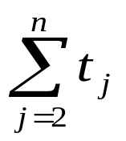
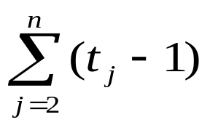

Analysis of Insertion Sort Algorithm
INSERTION-SORT (A) cost times
1. for j = 2 to n c₁ n
2. key = A[j] c₂ n - 1
3. // Insert A[j] into the sorted
sequence A[1 … j - 1]
4. i = j – 1 c₃ n - 1
5. while i > 0 and A[i] > key c₄
6. A[i+1] = A[i] c₅
7. i = i - 1 c₆
8. A[i + 1] = key c₇ n - 1

Slide 14
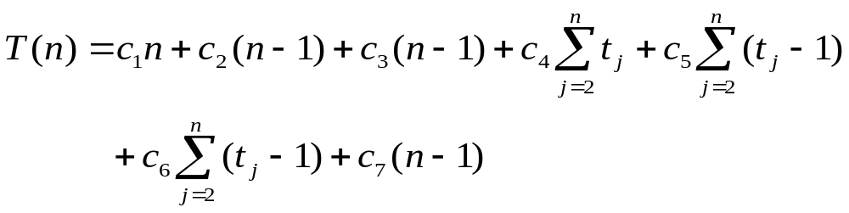
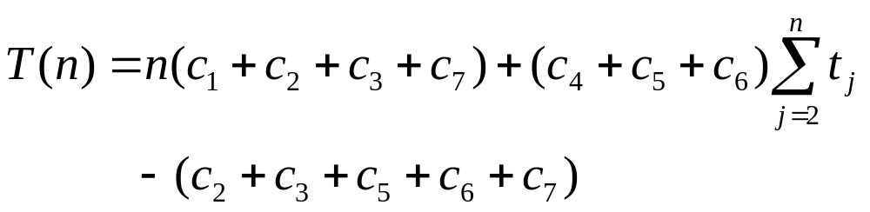
Analysis of Insertion Sort Algorithm
Total Time T(n):
This can be reorganized as

Slide 15



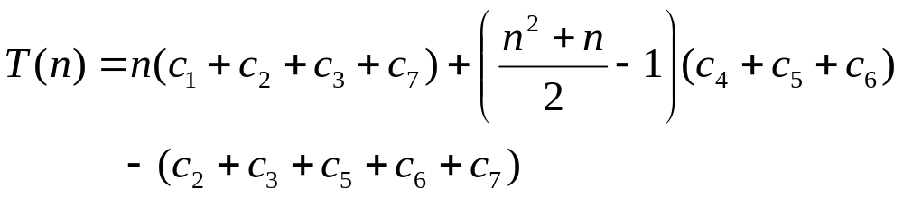

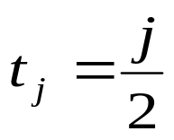
Analysis of Insertion Sort Algorithm
Best case:
Worst case:
Average case:

Slide 16
Rank Sort

Slide 17
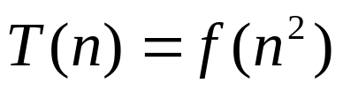
Rank Sort
INPUT : A[1..n], array of integers
OUTPUT: Rearrangement of A such that A[1]≤A[2] ≤… ≤A[n]
RANK-SORT (A)
1. for j = 1 to n
2. R[j] = 1
// Rank the n elements in A into R
3. for j = 2 to n
4. for i = 1 to j - 1
5. if A[i] <= A[j]
6. R[j] = R[j] + 1
7. else
8. R[i] = R[i] + 1
// Move to correct place in U[1 . . n]
9. for j = 1 to n
10. U[R[j]] = A[j]
// Move the sorted entries into A
11. for j = 1 to n
12. A[j] = U[j]
i
j
i
j
i
j
i
j
1
2
3
4
5
A
5
5
2
2
2
4
4
4
6
6
6
1
1
R
1
2
3
4
2
1
1
2
3
1
2
3
4
5
1
1
1
2
3
4
5
U
1
2
4
5
6
A
1
2
4
5
6

Slide 18
Selection Sort

Slide 19
Selection Sort
INPUT : A[1..n], array of integers
OUTPUT: Rearrangement of A such that A[1]≤A[2] ≤… ≤A[n]
SELECTION-SORT (A)
//Determine the largest element and move it to A[n], next largest element into A[n-1] and so on.
1. sorted = false
2. j = n
3. while j > 1 and sorted = false
4. pos = 1
5. sorted = true
// Find the position of the largest element
6. for i = 2 to j
7. if A[pos] <= A[i]
8. pos = i
9. else
10. sorted = false
// Move A[j] to the position of largest element by swapping
11. temp = A[pos]
12. A[pos] = A[j]
13. A[j] = temp
14. j = j - 1
pos
1
2
3
4
5
5
5
2
2
4
6
1
i
j
sorted = false
sorted = true
i+1

Slide 20
Selection Sort
INPUT : A[1..n], array of integers
OUTPUT: Rearrangement of A such that A[1]≤A[2] ≤… ≤A[n]
SELECTION-SORT (A)
//Determine the largest element and move it to A[n], next largest element into A[n-1] and so on.
1. sorted = false
2. j = n
3. while j > 1 and sorted = false
4. pos = 1
5. sorted = true
// Find the position of the largest element
6. for i = 2 to j
7. if A[pos] <= A[i]
8. pos = i
9. else
10. sorted = false
// Move A[j] to the position of largest element by swapping
11. temp = A[pos]
12. A[pos] = A[j]
13. A[j] = temp
14. j = j - 1
pos
1
2
3
4
5
5
5
2
4
4
6
6
1
i
i
j
sorted = false

Slide 21
Selection Sort
INPUT : A[1..n], array of integers
OUTPUT: Rearrangement of A such that A[1]≤A[2] ≤… ≤A[n]
SELECTION-SORT (A)
//Determine the largest element and move it to A[n], next largest element into A[n-1] and so on.
1. sorted = false
2. j = n
3. while j > 1 and sorted = false
4. pos = 1
5. sorted = true
// Find the position of the largest element
6. for i = 2 to j
7. if A[pos] <= A[i]
8. pos = i
9. else
10. sorted = false
// Move A[j] to the position of largest element by swapping
11. temp = A[pos]
12. A[pos] = A[j]
13. A[j] = temp
14. j = j - 1
pos
1
2
3
4
5
5
2
4
6
6
1
i
j
sorted = false

Slide 22
Selection Sort
INPUT : A[1..n], array of integers
OUTPUT: Rearrangement of A such that A[1]≤A[2] ≤… ≤A[n]
SELECTION-SORT (A)
//Determine the largest element and move it to A[n], next largest element into A[n-1] and so on.
1. sorted = false
2. j = n
3. while j > 1 and sorted = false
4. pos = 1
5. sorted = true
// Find the position of the largest element
6. for i = 2 to j
7. if A[pos] <= A[i]
8. pos = i
9. else
10. sorted = false
// Move A[j] to the position of largest element by swapping
11. temp = A[pos]
12. A[pos] = A[j]
13. A[j] = temp
14. j = j - 1
pos
1
2
3
4
5
5
2
4
6
6
1
1
1
6
i=j
sorted = false

Slide 23
Selection Sort
INPUT : A[1..n], array of integers
OUTPUT: Rearrangement of A such that A[1]≤A[2] ≤… ≤A[n]
SELECTION-SORT (A)
//Determine the largest element and move it to A[n], next largest element into A[n-1] and so on.
1. sorted = false
2. j = n
3. while j > 1 and sorted = false
4. pos = 1
5. sorted = true
// Find the position of the largest element
6. for i = 2 to j
7. if A[pos] <= A[i]
8. pos = i
9. else
10. sorted = false
// Move A[j] to the position of largest element by swapping
11. temp = A[pos]
12. A[pos] = A[j]
13. A[j] = temp
14. j = j - 1
pos
pos
1
2
3
4
5
5
5
2
2
4
1
6
i
j
sorted = false
sorted = true

Slide 24
Selection Sort
INPUT : A[1..n], array of integers
OUTPUT: Rearrangement of A such that A[1]≤A[2] ≤… ≤A[n]
SELECTION-SORT (A)
//Determine the largest element and move it to A[n], next largest element into A[n-1] and so on.
1. sorted = false
2. j = n
3. while j > 1 and sorted = false
4. pos = 1
5. sorted = true
// Find the position of the largest element
6. for i = 2 to j
7. if A[pos] <= A[i]
8. pos = i
9. else
10. sorted = false
// Move A[j] to the position of largest element by swapping
11. temp = A[pos]
12. A[pos] = A[j]
13. A[j] = temp
14. j = j - 1
pos
1
2
3
4
5
5
5
2
4
4
1
6
i
j
sorted = false

Slide 25
Selection Sort
INPUT : A[1..n], array of integers
OUTPUT: Rearrangement of A such that A[1]≤A[2] ≤… ≤A[n]
SELECTION-SORT (A)
//Determine the largest element and move it to A[n], next largest element into A[n-1] and so on.
1. sorted = false
2. j = n
3. while j > 1 and sorted = false
4. pos = 1
5. sorted = true
// Find the position of the largest element
6. for i = 2 to j
7. if A[pos] <= A[i]
8. pos = i
9. else
10. sorted = false
// Move A[j] to the position of largest element by swapping
11. temp = A[pos]
12. A[pos] = A[j]
13. A[j] = temp
14. j = j - 1
pos
1
2
3
4
5
5
5
1
2
4
1
1
5
6
i=j
sorted = false

Slide 26
Selection Sort
INPUT : A[1..n], array of integers
OUTPUT: Rearrangement of A such that A[1]≤A[2] ≤… ≤A[n]
SELECTION-SORT (A)
//Determine the largest element and move it to A[n], next largest element into A[n-1] and so on.
1. sorted = false
2. j = n
3. while j > 1 and sorted = false
4. pos = 1
5. sorted = true
// Find the position of the largest element
6. for i = 2 to j
7. if A[pos] <= A[i]
8. pos = i
9. else
10. sorted = false
// Move A[j] to the position of largest element by swapping
11. temp = A[pos]
12. A[pos] = A[j]
13. A[j] = temp
14. j = j - 1
pos
1
2
3
4
5
1
1
2
2
4
5
6
i
j
sorted = false
sorted = true

Slide 27
Selection Sort
INPUT : A[1..n], array of integers
OUTPUT: Rearrangement of A such that A[1]≤A[2] ≤… ≤A[n]
SELECTION-SORT (A)
//Determine the largest element and move it to A[n], next largest element into A[n-1] and so on.
1. sorted = false
2. j = n
3. while j > 1 and sorted = false
4. pos = 1
5. sorted = true
// Find the position of the largest element
6. for i = 2 to j
7. if A[pos] <= A[i]
8. pos = i
9. else
10. sorted = false
// Move A[j] to the position of largest element by swapping
11. temp = A[pos]
12. A[pos] = A[j]
13. A[j] = temp
14. j = j - 1
pos
1
2
3
4
5
1
2
2
4
5
6
i
j
sorted = false
sorted = true

Slide 28
Selection Sort
INPUT : A[1..n], array of integers
OUTPUT: Rearrangement of A such that A[1]≤A[2] ≤… ≤A[n]
SELECTION-SORT (A)
//Determine the largest element and move it to A[n], next largest element into A[n-1] and so on.
1. sorted = false
2. j = n
3. while j > 1 and sorted = false
4. pos = 1
5. sorted = true
// Find the position of the largest element
6. for i = 2 to j
7. if A[pos] <= A[i]
8. pos = i
9. else
10. sorted = false
// Move A[j] to the position of largest element by swapping
11. temp = A[pos]
12. A[pos] = A[j]
13. A[j] = temp
14. j = j - 1
pos
1
2
3
4
5
1
2
2
4
4
5
6
i=j
sorted = false
sorted = true

Slide 29
Selection Sort
INPUT : A[1..n], array of integers
OUTPUT: Rearrangement of A such that A[1]≤A[2] ≤… ≤A[n]
SELECTION-SORT (A)
//Determine the largest element and move it to A[n], next largest element into A[n-1] and so on.
1. sorted = false
2. j = n
3. while j > 1 and sorted = false
4. pos = 1
5. sorted = true
// Find the position of the largest element
6. for i = 2 to j
7. if A[pos] <= A[i]
8. pos = i
9. else
10. sorted = false
// Move A[j] to the position of largest element by swapping
11. temp = A[pos]
12. A[pos] = A[j]
13. A[j] = temp
14. j = j - 1
pos
1
2
3
4
5
1
2
4
4
5
6
i=j
sorted = false
sorted = true

Slide 30
Selection Sort
INPUT : A[1..n], array of integers
OUTPUT: Rearrangement of A such that A[1]≤A[2] ≤… ≤A[n]
SELECTION-SORT (A)
//Determine the largest element and move it to A[n], next largest element into A[n-1] and so on.
1. sorted = false
2. j = n
3. while j > 1 and sorted = false
4. pos = 1
5. sorted = true
// Find the position of the largest element
6. for i = 2 to j
7. if A[pos] <= A[i]
8. pos = i
9. else
10. sorted = false
// Move A[j] to the position of largest element by swapping
11. temp = A[pos]
12. A[pos] = A[j]
13. A[j] = temp
14. j = j - 1
pos
1
2
3
4
5
1
2
4
5
6
j
sorted = false
sorted = true

Slide 31

Analysis of Selection Sort Algorithm
Best case:
Worst case:

Slide 32
Bubble Sort

Slide 33
Bubble Sort
INPUT : A[1..n], array of integers
OUTPUT: Rearrangement of A such that A[1]≤A[2] ≤… ≤A[n]
BUBBLE-SORT (A)
// Sort by bubbling the smallest element to current position.
1. j = n
2. while j ≥ 2
// Bubble up the smallest element to its correct position
3. for i = 1 to j - 1
4. if A[i] > A[i + 1]
5. temp = A[i]
6. A[i] = A[i + 1]
7. A[i + 1] = temp
8. j = j - 1
i
i+1
1
2
3
4
5
5
5
2
2
2
5
4
6
1
j

Slide 34
Bubble Sort
INPUT : A[1..n], array of integers
OUTPUT: Rearrangement of A such that A[1]≤A[2] ≤… ≤A[n]
BUBBLE-SORT (A)
// Sort by bubbling the smallest element to current position.
1. j = n
2. while j ≥ 2
// Bubble up the smallest element to its correct position
3. for i = 1 to j - 1
4. if A[i] > A[i + 1]
5. temp = A[i]
6. A[i] = A[i + 1]
7. A[i + 1] = temp
8. j = j - 1
i
i+1
1
2
3
4
5
2
5
5
4
4
4
5
6
1
j

Slide 35
Bubble Sort
INPUT : A[1..n], array of integers
OUTPUT: Rearrangement of A such that A[1]≤A[2] ≤… ≤A[n]
BUBBLE-SORT (A)
// Sort by bubbling the smallest element to current position.
1. j = n
2. while j ≥ 2
// Bubble up the smallest element to its correct position
3. for i = 1 to j - 1
4. if A[i] > A[i + 1]
5. temp = A[i]
6. A[i] = A[i + 1]
7. A[i + 1] = temp
8. j = j - 1
i
i+1
i
i+1
1
2
3
4
5
2
4
5
5
6
6
6
1
1
1
6
j

Slide 36
Bubble Sort
INPUT : A[1..n], array of integers
OUTPUT: Rearrangement of A such that A[1]≤A[2] ≤… ≤A[n]
BUBBLE-SORT (A)
// Sort by bubbling the smallest element to current position.
1. j = n
2. while j ≥ 2
// Bubble up the smallest element to its correct position
3. for i = 1 to j - 1
4. if A[i] > A[i + 1]
5. temp = A[i]
6. A[i] = A[i + 1]
7. A[i + 1] = temp
8. j = j - 1
i
i
i+1
i+1
i
i+1
1
2
3
4
5
2
2
4
4
4
5
5
5
1
1
1
5
6
j

Slide 37
Bubble Sort
INPUT : A[1..n], array of integers
OUTPUT: Rearrangement of A such that A[1]≤A[2] ≤… ≤A[n]
BUBBLE-SORT (A)
// Sort by bubbling the smallest element to current position.
1. j = n
2. while j ≥ 2
// Bubble up the smallest element to its correct position
3. for i = 1 to j - 1
4. if A[i] > A[i + 1]
5. temp = A[i]
6. A[i] = A[i + 1]
7. A[i + 1] = temp
8. j = j - 1
i
i
i+1
i+1
1
2
3
4
5
2
2
4
4
4
1
1
1
4
5
6
j

Slide 38
Bubble Sort
INPUT : A[1..n], array of integers
OUTPUT: Rearrangement of A such that A[1]≤A[2] ≤… ≤A[n]
BUBBLE-SORT (A)
// Sort by bubbling the smallest element to current position.
1. j = n
2. while j ≥ 2
// Bubble up the smallest element to its correct position
3. for i = 1 to j - 1
4. if A[i] > A[i + 1]
5. temp = A[i]
6. A[i] = A[i + 1]
7. A[i + 1] = temp
8. j = j - 1
i
i+1
1
2
3
4
5
2
2
1
1
1
2
4
5
6
j

