Slide 1
Running Time Analysis of Algorithms

Slide 2
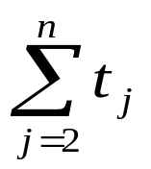
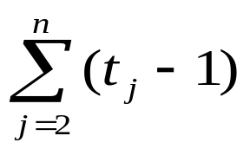

Analysis of Insertion Sort Algorithm
INSERTION-SORT (A) cost times
1. for j = 2 to n c₁ n
2. key = A[j] c₂ n - 1
3. // Insert A[j] into the sorted
sequence A[1 … j - 1]
4. i = j – 1 c₃ n - 1
5. while i > 0 and A[i] > key c₄
6. A[i+1] = A[i] c₅
7. i = i - 1 c₆
8. A[i + 1] = key c₇ n - 1

Slide 3
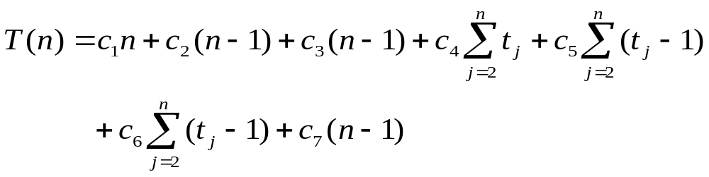
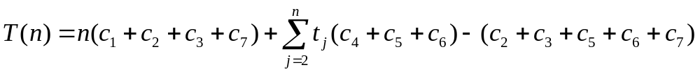
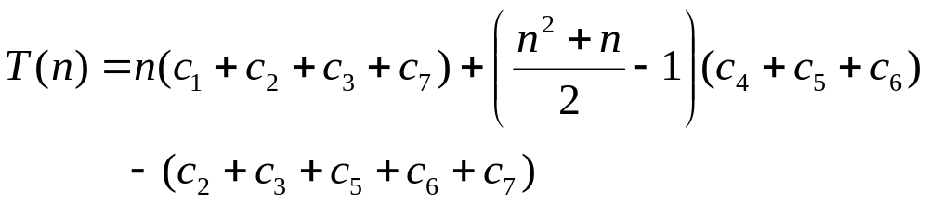
Analysis of Insertion Sort Algorithm
Total Time T(n):
This can be reorganized as
Best case:
Worst case:

Slide 4
Asymptotic Analysis

Slide 5
Asymptotic Analysis of Running Time
Goal: Analyze the running time by excluding the superficial details
We are interested in how the running time of algorithm increases with the size of the input in the limit
Asymptotic notation applies on functions
Running time is seen as a function of input size
We abstract away some details of this function
Different asymptotic notations:
  O-notation (Big-Oh notation)
  Ω-notation (Big-Omega notation)
  Θ-notation (Big-Theta notation)

Slide 6
O-notation
Let f(n) be the actual running time of an algorithm
Let g(n) be some other function
Both the functions are non-negative, non-decreasing functions
f(n)=O(g(n)), if there exists constants c and n₀ such that f(n) ≤ c g(n) for n ≥ n₀
O-notation gives the asymptotic upper bound
O-notation used for worst case analysis
c g(n)
f(n)
Running Time
n
n₀

Slide 7
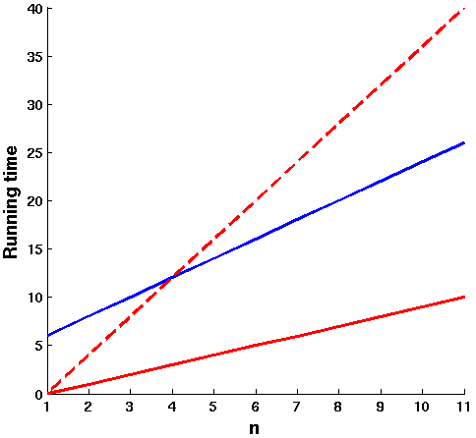
Illustration for O-notation
f(n)=O(g(n)), if there exists constants c and n₀ such that f(n) ≤ c g(n) for n ≥ n₀
O(g(n)) is the set of all functions with a smaller or same order of growth as g(n)
  n = O(n²)
  n³ ≠ O(n²) or n² ≠ O(n),
c g(n) = 4n
f(n) = 2n + 6
c g(n) = n
n₀

Slide 8
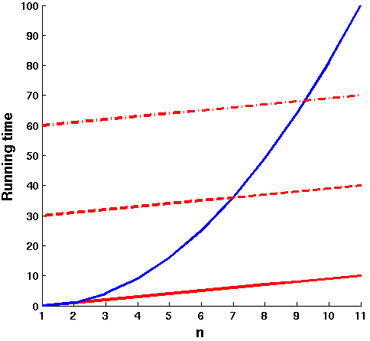
Illustration for O-notation
f(n)=O(g(n)), if there exists constants c and n₀ such that f(n) ≤ c g(n) for n ≥ n₀
n² is not O(n)
f(n) = n²
c g(n) = 60n
c g(n) = 30n
c g(n) = n

Slide 9
Different Running Time Functions
Constant O(1)
Logarithmic O(log n)
Linear O(n)
Quadratic O(n²)
Cubic O(n³)
Exponential O(a^{n}), a > 1
Polynomial O(n^{k}), k ≥ 1
Factorial O(n!)
Hierarchy of functions:
log n < n < n log n < n² < n³ < 2^{n} < n!

Slide 10
Ω-notation
Let f(n) be the running time of an algorithm
Let g(n) be some other function
f(n)=Ω(g(n)), if there exists constants c and n₀ such that f(n) ≥ c g(n) for n ≥ n₀
Ω-notation gives the asymptotic lower bound
Ω-notation used to describe best case running time
Ω(g(n)) is the set of all functions with a greater or same order of growth as g(n)
Can n² = Ω(n)?
f(n)
Running Time
c g(n)
n
n₀
- Yes

Slide 11
Θ-notation
Let f(n) be the running time of an algorithm
Let g(n) be some other function
f(n)=Θ(g(n)), if there exists constants c₁, c₂ and n₀ such that c₁ g(n) ≤ f(n) ≤ c₂ g(n) for n ≥ n₀
Θ-notation gives the asymptotic tight bound
c₂ g(n)
f(n)
Running Time
c₁ g(n)
n
n₀

Slide 12
Other Asymptotic Notations
Let f(n) be the running time of an algorithm
Let g(n) be some other function
o-notation (Little-oh notation)
  It gives non-tight analogous of O-notation
  f(n)=o(g(n)), for every constant c there should exist n₀ such that f(n) ≤ c g(n) for all n ≥ n₀
ω-notation (Little-omega notation)
  It gives non-tight analogous of Ω-notation
  f(n)=ω(g(n)), for every constant c there should exist n₀ such that f(n) ≥ c g(n) for all n ≥ n₀

Slide 13
Readings
Read Chapter 3 in Corman book
Read Chapter 2 in Sahani book

