Slide 1
Divide and Conquer Method

Slide 2
Divide and Conquer Method
Divide:
  Divide the problem into two or more sub parts (sub problems)
Conquer:
  Recursively solve the sub parts (sub problems)
Combine:
  Once we have the solution for the sub parts, combine them to get the solution for original problem
Merge sort and Quick sort uses divide and conquer paradigm for designing sorting algorithms

Slide 3
Merge Sort
Let A be the set of n numbers to be sorted
Divide:
  Split A into two sets A₁ and A₂ with roughly equal size
Conquer:
  Sort A₁ and A₂ recursively using merge sort
Combine:
  Merge A₁ and A₂ into sorted sequence A

Slide 4
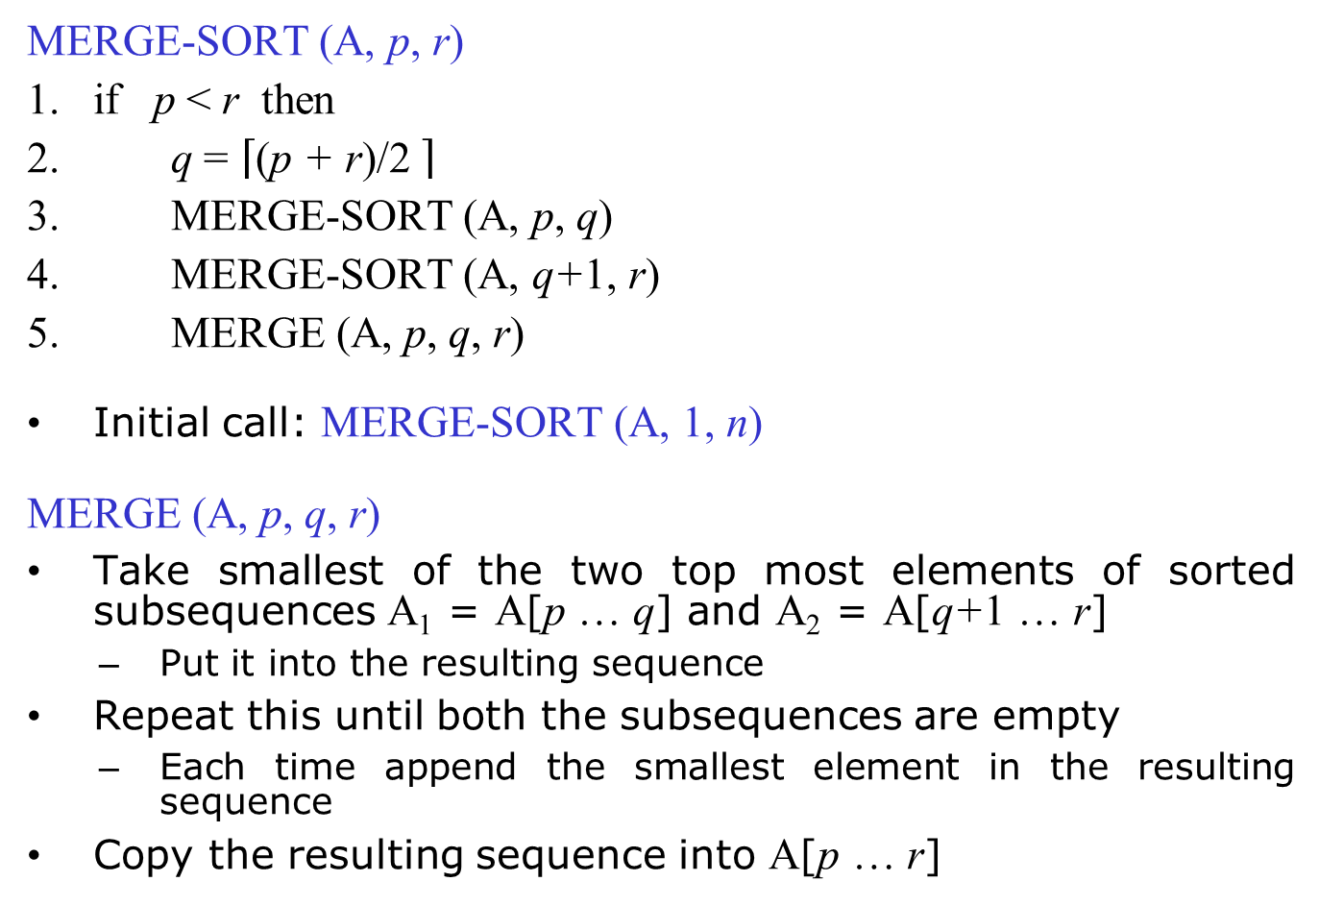
Pseudo-code for Merge Sort

Slide 5

Merging Two Sequences
MERGE (A, p, q, r)
1. n₁ = q - p + 1
2. n₂ = r - q
3. A₁[n₁+1] = ∞
4. A₂[n₂+1] = ∞
5. i = 1
6. j = 1
7. for k = p to r
8. if A₁[i] ≤ A₂[j]
9. A[k] = A₁[i]
10. i = i + 1
11. else
12. A[k] = A₂[j]
13. j = j + 1
MERGE (A, 1, 4, 8)
p = 1; q = 4; r = 8
k
k
k
k
k
k
k
k
k
1
2
3
4
5
6
7
8
A
1
2
2
3
4
5
6
7
i
i
i
i
i
j
j
j
j
j
1
2
3
4
5
1
2
3
4
5
A₁
2
4
5
7
∞
A₂
1
2
3
6
∞

Slide 6
Merge Sort Example
MERGE-SORT (A, p, r)
if p < r then
q = (p + r)/2
3. MERGE-SORT (A, p, q)
4. MERGE-SORT (A, q+1, r)
5. MERGE (A, p, q, r)
MERGE-SORT (A, 1, 8)
p = 1; r = 8
q = 4
A
5 2 4 7
1 3 2 6
5 2 4 7
1 3 2 6

Slide 7
Merge Sort Example
MERGE-SORT (A, p, r)
if p < r then
q = (p + r)/2
3. MERGE-SORT (A, p, q)
4. MERGE-SORT (A, q+1, r)
5. MERGE (A, p, q, r)
MERGE-SORT (A, 1, 4)
p = 1; r = 4
q = 2
1 3 2 6
1 3 2 6
5 2
4 7
5 2
4 7

Slide 8
Merge Sort Example
MERGE-SORT (A, p, r)
if p < r then
q = (p + r)/2
3. MERGE-SORT (A, p, q)
4. MERGE-SORT (A, q+1, r)
5. MERGE (A, p, q, r)
MERGE-SORT (A, 1, 2)
p = 1; r = 2
q = 1
1 3 2 6
1 3 2 6
4 7
4 7
5
2
5
2

Slide 9
Merge Sort Example
MERGE-SORT (A, p, r)
if p < r then
q = (p + r)/2
3. MERGE-SORT (A, p, q)
4. MERGE-SORT (A, q+1, r)
5. MERGE (A, p, q, r)
MERGE-SORT (A, 1, 1)
p = 1; r = 1
1 3 2 6
1 3 2 6
4 7
4 7
2
2
5

Slide 10
Merge Sort Example
q = 1
MERGE-SORT (A, p, r)
if p < r then
q = (p + r)/2
3. MERGE-SORT (A, p, q)
4. MERGE-SORT (A, q+1, r)
5. MERGE (A, p, q, r)
MERGE-SORT (A, 2, 2)
MERGE (A, 1, 1, 2)
p = 2; r = 2
p = 1; q = 1; r = 2
1 3 2 6
1 3 2 6
4 7
4 7
2
5
5
2

Slide 11
Merge Sort Example
MERGE-SORT (A, p, r)
if p < r then
q = (p + r)/2
3. MERGE-SORT (A, p, q)
4. MERGE-SORT (A, q+1, r)
5. MERGE (A, p, q, r)
MERGE-SORT (A, 3, 4)
p = 3; r = 4
q = 3
1 3 2 6
1 3 2 6
2
5
4
7
4
7

Slide 12
Merge Sort Example
MERGE-SORT (A, p, r)
if p < r then
q = (p + r)/2
3. MERGE-SORT (A, p, q)
4. MERGE-SORT (A, q+1, r)
5. MERGE (A, p, q, r)
MERGE-SORT (A, 3, 3)
p = 3; r = 3
1 3 2 6
1 3 2 6
2
5
7
7
4

Slide 13
Merge Sort Example
q = 3
MERGE-SORT (A, p, r)
if p < r then
q = (p + r)/2
3. MERGE-SORT (A, p, q)
4. MERGE-SORT (A, q+1, r)
5. MERGE (A, p, q, r)
MERGE-SORT (A, 4, 4)
MERGE (A, 3, 3, 4)
p = 4; r = 4
p = 3; q = 3; r = 4
1 3 2 6
1 3 2 6
2
5
4
7
4
7

Slide 14
Merge Sort Example
MERGE-SORT (A, p, r)
if p < r then
q = (p + r)/2
3. MERGE-SORT (A, p, q)
4. MERGE-SORT (A, q+1, r)
5. MERGE (A, p, q, r)
MERGE (A, 1, 2, 4)
p = 1; q = 2; r = 4
1 3 2 6
1 3 2 6
2
4
5
7
2
5
4
7

Slide 15
Merge Sort Example
MERGE-SORT (A, p, r)
if p < r then
q = (p + r)/2
3. MERGE-SORT (A, p, q)
4. MERGE-SORT (A, q+1, r)
5. MERGE (A, p, q, r)
2
4
5
7
1 3
2 6
1 3
2 6

Slide 16
Merge Sort Example
MERGE-SORT (A, p, r)
if p < r then
q = (p + r)/2
3. MERGE-SORT (A, p, q)
4. MERGE-SORT (A, q+1, r)
5. MERGE (A, p, q, r)
2
4
5
7
2 6
2 6
1
3
1
3

Slide 17
Merge Sort Example
MERGE-SORT (A, p, r)
if p < r then
q = (p + r)/2
3. MERGE-SORT (A, p, q)
4. MERGE-SORT (A, q+1, r)
5. MERGE (A, p, q, r)
2
4
5
7
2 6
2 6
3
3
1

Slide 18
Merge Sort Example
MERGE-SORT (A, p, r)
if p < r then
q = (p + r)/2
3. MERGE-SORT (A, p, q)
4. MERGE-SORT (A, q+1, r)
5. MERGE (A, p, q, r)
2
4
5
7
2 6
2 6
1
3
1
3

Slide 19
Merge Sort Example
MERGE-SORT (A, p, r)
if p < r then
q = (p + r)/2
3. MERGE-SORT (A, p, q)
4. MERGE-SORT (A, q+1, r)
5. MERGE (A, p, q, r)
2
4
5
7
1
3
2
6
2
6

Slide 20
Merge Sort Example
MERGE-SORT (A, p, r)
if p < r then
q = (p + r)/2
3. MERGE-SORT (A, p, q)
4. MERGE-SORT (A, q+1, r)
5. MERGE (A, p, q, r)
2
4
5
7
1
3
6
6
2

Slide 21
Merge Sort Example
MERGE-SORT (A, p, r)
if p < r then
q = (p + r)/2
3. MERGE-SORT (A, p, q)
4. MERGE-SORT (A, q+1, r)
5. MERGE (A, p, q, r)
2
4
5
7
1
3
2
6
2
6

Slide 22
Merge Sort Example
MERGE-SORT (A, p, r)
if p < r then
q = (p + r)/2
3. MERGE-SORT (A, p, q)
4. MERGE-SORT (A, q+1, r)
5. MERGE (A, p, q, r)
2
4
5
7
1
2
3
6
1
3
2
6

Slide 23
Merge Sort Example
MERGE-SORT (A, p, r)
if p < r then
q = (p + r)/2
3. MERGE-SORT (A, p, q)
4. MERGE-SORT (A, q+1, r)
5. MERGE (A, p, q, r)
1
2
2
3
4
5
6
7
2
4
5
7
1
2
3
6

Slide 24
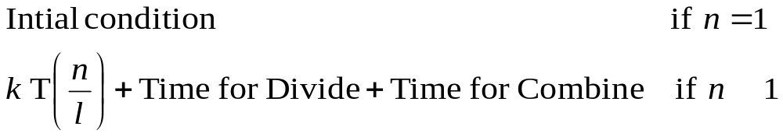

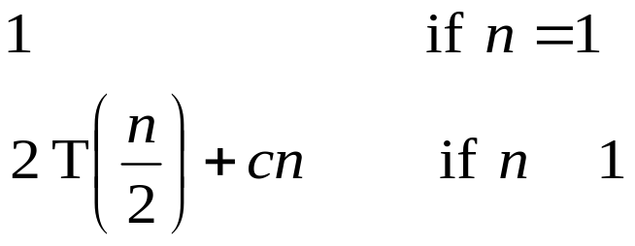
Analysis of Divide and Conquer Method
Recurrence relations:
  Function that described in terms of its values in previous points on small inputs
  E.g.: f(n) = f(n - 1) + c
T(n) : Time taken to solve the problem of size n
k : Number pieces the problem is divided
l: Number of factors the problem is divided
General recurrence relation for divide and conquer method:
Merge Sort:
>
>

Slide 25
Solving Recurrence Relations
Repeated substitution method
  Expand the recurrence by substituting repeatedly and noticing the available patterns
Substitution method
  Guess a solution to the recurrence
  Verify the solution by mathematical induction
Recursion trees
  Draw the tree after every recursion call
  Count at each node how much time it take
Master method
  Read from Cormen Book: Chapter 4.5

