Slide 1
Divide and Conquer Method

Slide 2
Divide and Conquer Method
Divide:
  Divide the problem into two or more sub parts (sub problems)
Conquer:
  Recursively solve the sub parts (sub problems)
Combine:
  Once we have the solution for the sub parts, combine them to get the solution for original problem
Merge sort and Quick sort uses divide and conquer paradigm for designing sorting algorithms

Slide 3
Merge Sort
Let A be the set of n numbers to be sorted
Divide:
  Split A into two sets A₁ and A₂ with roughly equal size
Conquer:
  Sort A₁ and A₂ recursively using merge sort
Combine:
  Merge A₁ and A₂ into sorted sequence A

Slide 4
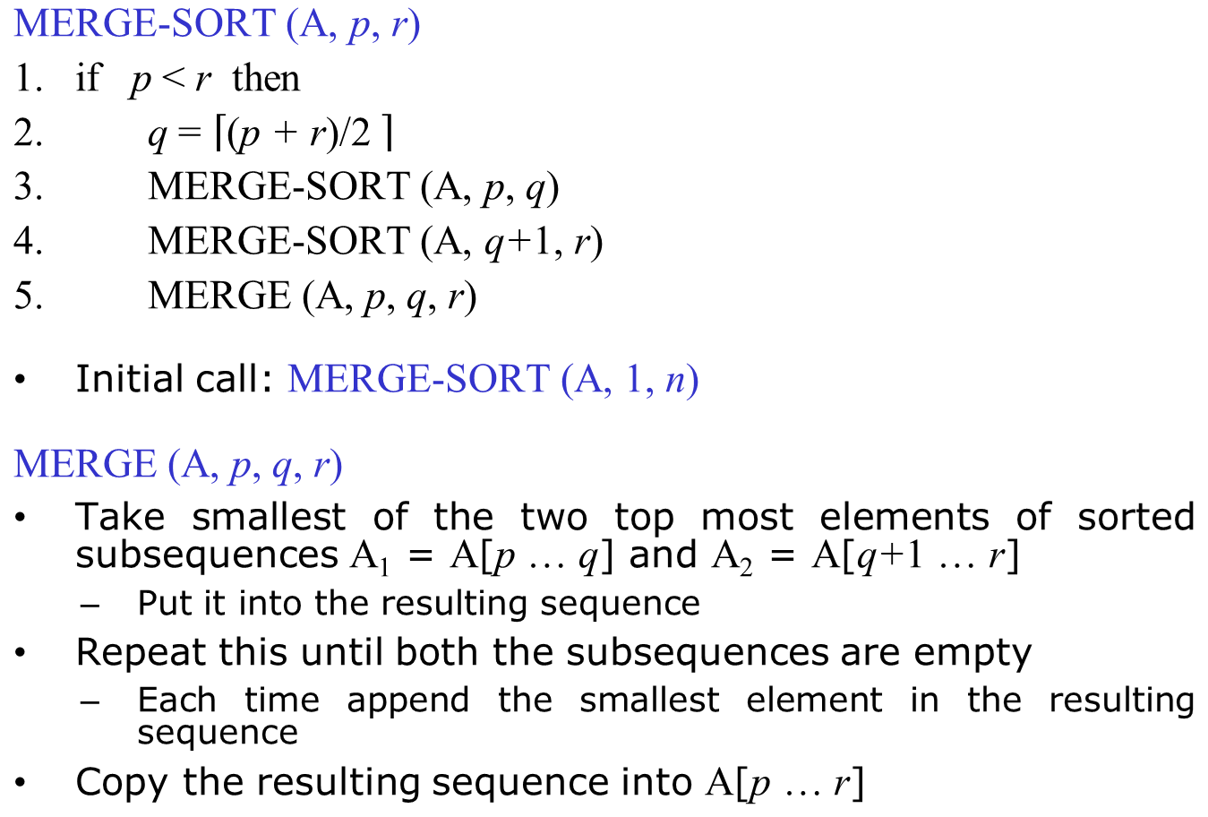
Pseudo-code for Merge Sort

Slide 5

Merging Two Sequences
MERGE (A, p, q, r)
1. n₁ = q - p + 1
2. n₂ = r - q
3. A₁[n₁+1] = ∞
4. A₂[n₂+1] = ∞
5. i = 1
6. j = 1
7. for k = p to r
8. if A₁[i] ≤ A₂[j]
9. A[k] = A₁[i]
10. i = i + 1
11. else
12. A[k] = A₂[j]
13. j = j + 1
MERGE (A, 1, 4, 8)

Slide 6
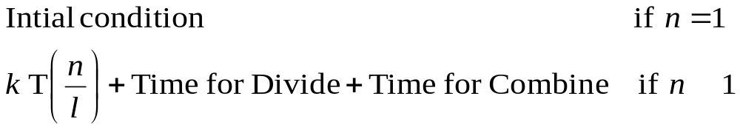

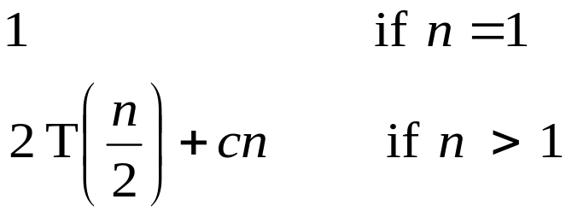
Analysis of Divide and Conquer Method
Recurrence relations:
  Function that described in terms of its values in previous points on small inputs
  E.g.: f(n) = f(n - 1) + c
T(n) : Time taken to solve the problem of size n
k : Number pieces the problem is divided
l: Number of factors the problem is divided
General recurrence relation for divide and conquer method:
Merge Sort:
>

Slide 7
Solving Recurrence Relations
Repeated substitution method
  Expand the recurrence by substituting repeatedly and noticing the available patterns
Substitution method
  Guess a solution to the recurrence
  Verify the solution by mathematical induction
Recursion trees
  Draw the tree after every recursion call
  Count at each node how much time it take
Master method
  Read from Cormen Book: Chapter 4.5

Slide 8
Quick Sort
It is a quick algorithm i.e. it is fast in practice
  It has small number of constants
It is an in-place sorting algorithm
Let A be the set of n numbers to be sorted
Divide:
  Partition the array A into two parts, one is left part and another is right part
  Every element in the left part is lower than every element in the right part
Conquer:
  Sort the left and right parts recursively using quick sort
Combine:
  It is a trivial case since the sorting done in-place

Slide 9
Pseudo-code for Quick Sort
QUICK-SORT (A, p, r)
if p < r then
q = PARTITION (A, p, r)
3. QUICK-SORT (A, p, q)
4. QUICK-SORT (A, q+1, r)
Initial call: QUICK-SORT (A, 1, n)
q = PARTITION (A, p, r)
Partitioning is done around a pivot element
From the array A, take one of the elements as pivot
Everything smaller than the pivot element will be in left part
Everything larger than the pivot element will be in right part

Slide 10

Procedure for Partition
PARTITION (A, p, r)
1. pivot = A[r] // Pivot
2. i = p - 1
3. j = r + 1
4. while TRUE
5. do
6. j = j - 1
7. while A[j] > pivot
8. do
9. i = i + 1
10. while A[i] < pivot
11. if j > i
12. exchange A[i] with A[j]
13. else if j = i
14. return j - 1
15 else
16 return j
q = PARTITION (A, 1, 8)
p = 1; r = 8
pivot = 3
j
j
j
j
j
j
1
2
3
4
5
6
7
8
A
5
2
4
7
1
6
2
3
3
2
2
1
7
6
4
5
i
i
i
i
i
i

Slide 11
Procedure for Quick Sort
QUICK-SORT (A, p, r)
if p < r then
q = PARTITION (A, p, r)
3. QUICK-SORT (A, p, q)
4. QUICK-SORT (A, q+1, r)
pivot = 3
q
1
2
3
4
5
6
7
8
A
5
2
4
7
1
6
2
3
3
2
2
1
7
6
4
5

Slide 12
Procedure for Quick Sort
QUICK-SORT (A, p, r)
if p < r then
q = PARTITION (A, p, r)
3. QUICK-SORT (A, p, q)
4. QUICK-SORT (A, q+1, r)
1
2
3
4
5
6
7
8
A
5
2
4
7
1
6
2
3
3
2
2
1
7
6
4
5
pivot = 1
q
q
q
q
q
1
2
3
4
5
6
7
8
A
3
2
2
1
1
2
2
3
7
6
4
5
i
i
i

Slide 13
Procedure for Quick Sort
QUICK-SORT (A, p, r)
if p < r then
q = PARTITION (A, p, r)
3. QUICK-SORT (A, p, q)
4. QUICK-SORT (A, q+1, r)
1
2
3
4
5
6
7
8
A
5
2
4
7
1
6
2
3
3
2
2
1
7
6
4
5
1
2
3
4
5
6
7
8
A
3
2
2
1
1
2
2
3
7
6
4
5
1
2
3
4
5
6
7
8
A
1
2
2
3
7
6
4
5

Slide 14
Procedure for Quick Sort
QUICK-SORT (A, p, r)
if p < r then
q = PARTITION (A, p, r)
3. QUICK-SORT (A, p, q)
4. QUICK-SORT (A, q+1, r)
1
2
3
4
5
6
7
8
A
5
2
4
7
1
6
2
3
3
2
2
1
7
6
4
5
1
2
3
4
5
6
7
8
A
3
2
2
1
1
2
2
3
7
6
4
5
1
2
3
4
5
6
7
8
A
1
2
2
3
7
6
4
5
pivot = 3
q
q
q
1
2
3
4
5
6
7
8
A
1
2
2
3
7
6
4
5
2
2
3
i
i
i
i

Slide 15
Procedure for Quick Sort
QUICK-SORT (A, p, r)
if p < r then
q = PARTITION (A, p, r)
3. QUICK-SORT (A, p, q)
4. QUICK-SORT (A, q+1, r)
pivot = 2
q
q
q
1
2
3
4
5
6
7
8
A
1
2
2
2
2
3
7
6
4
5
i
i
i
1
2
3
4
5
6
7
8
A
5
2
4
7
1
6
2
3
3
2
2
1
7
6
4
5
1
2
3
4
5
6
7
8
A
3
2
2
1
1
2
2
3
7
6
4
5
1
2
3
4
5
6
7
8
A
1
2
2
3
7
6
4
5
1
2
3
4
5
6
7
8
A
1
2
2
3
7
6
4
5
2
2
3

Slide 16
Procedure for Quick Sort
1
2
3
4
5
6
7
8
QUICK-SORT (A, p, r)
if p < r then
q = PARTITION (A, p, r)
3. QUICK-SORT (A, p, q)
4. QUICK-SORT (A, q+1, r)
A
1
2
2
3
7
6
4
5
2
2
1
2
3
4
5
6
7
8
A
1
2
2
3
7
6
4
5
1
2
3
4
5
6
7
8
1
2
3
4
5
6
7
8
A
1
2
2
3
7
6
4
5
A
5
2
4
7
1
6
2
3
3
2
2
1
7
6
4
5
1
2
3
4
5
6
7
8
1
2
3
4
5
6
7
8
A
1
2
2
3
7
6
4
5
A
3
2
2
1
1
2
2
3
7
6
4
5
pivot = 5
1
2
3
4
5
6
7
8
1
2
3
4
5
6
7
8
A
1
2
2
3
7
6
4
5
A
1
2
2
3
7
6
4
5
5
4
6
7
1
2
3
4
5
6
7
8
A
1
2
2
3
7
6
4
5
2
2
3

Slide 17
Procedure for Quick Sort
1
2
3
4
5
6
7
8
QUICK-SORT (A, p, r)
if p < r then
q = PARTITION (A, p, r)
3. QUICK-SORT (A, p, q)
4. QUICK-SORT (A, q+1, r)
A
1
2
2
3
7
6
4
5
2
2
1
2
3
4
5
6
7
8
A
1
2
2
3
7
6
4
5
1
2
3
4
5
6
7
8
1
2
3
4
5
6
7
8
A
1
2
2
3
7
6
4
5
A
5
2
4
7
1
6
2
3
3
2
2
1
7
6
4
5
1
2
3
4
5
6
7
8
1
2
3
4
5
6
7
8
A
1
2
2
3
7
6
4
5
A
3
2
2
1
1
2
2
3
7
6
4
5
1
2
3
4
5
6
7
8
1
2
3
4
5
6
7
8
A
1
2
2
3
7
6
4
5
5
4
6
7
A
1
2
2
3
7
6
4
5
1
2
3
4
5
6
7
8
1
2
3
4
5
6
7
8
A
1
2
2
3
4
5
4
5
6
7
A
1
2
2
3
7
6
4
5
2
2
3
1
2
3
4
5
6
7
8
A
1
2
2
3
4
5
6
7

Slide 18
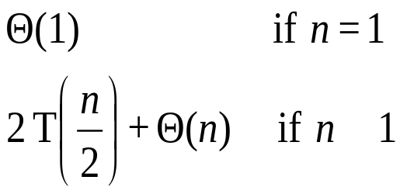


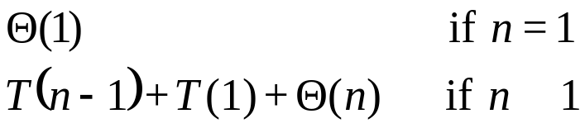


Analysis of Quick Sort
Time taken by the quick sort depends on which element is used for partitioning
Best case: Recurrence for the running time is
Worst case:
  One side gets one element and other side gets (n-1) elements
Balanced/Average case:
>
>

