Slide 1

CS 207: Applied Database Practicum
Week 4
Varun Dutt
School of Computing and Electrical Engineering
School of Humanities and Social Sciences
Indian Institute of Technology Mandi, India
Scaling the Heights
1

Slide 2
GROUP BY STATEMENT
The GROUP BY statement is used to group the result-set by one or more columns or group rows that have the same values.
It is often used with aggregate functions (COUNT, MAX, MIN, SUM, AVG)
GROUP BY Syntax :
  SELECT column_name(s)
        FROM table_name
        WHERE condition
        GROUP BY column_name(s)
        ORDER BY column_name(s);
2

Slide 3
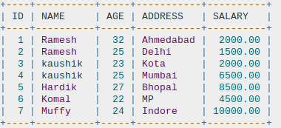
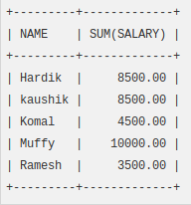
EXAMPLE – GROUP BY
  The following SQL statement lists he total amount of salary on each customer:
    SELECT NAME, SUM(SALARY) FROM CUSTOMERS
    GROUP BY NAME;
3

Slide 4
EXAMPLE – GROUP BY WITH COUNT FUNCTION
The following SQL statement lists the number of customers in each country, sorted high to low:
      SELECT Name, COUNT(*), FROM Customers
      GROUP BY Name
      ORDER BY COUNT(Name) DESC;
4

Slide 5
ORDER BY CLAUSE
The SQL ORDER BY clause is used to sort the data in ascending or descending order, based on one or more columns.
Some databases sort the query results in an ascending order by default.
Syntax :
    SELECT column-list
    FROM table_name
    [WHERE condition]
    [ORDER BY column1, column2, .. columnN]
    [ASC | DESC];
5

Slide 6
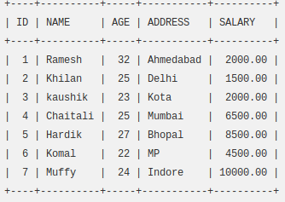
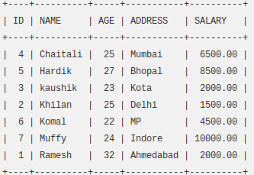
ORDER BY EXAMPLE
The following SQL statement lists the customers information in an ascending order by the NAME and the SALARY
    SELECT * FROM CUSTOMERS
    ORDER BY NAME, SALARY;
6

Slide 7
UNION Operator
The UNION operator is used to combine the result-set of two or more SELECT statements.
Each SELECT statement within UNION must have the same number of columns
The columns must also have similar data types
The columns in each SELECT statement must also be in the same order
The UNION operator selects only Distinct values by default.
To allow duplicate values, use UNION ALL.
7

Slide 8
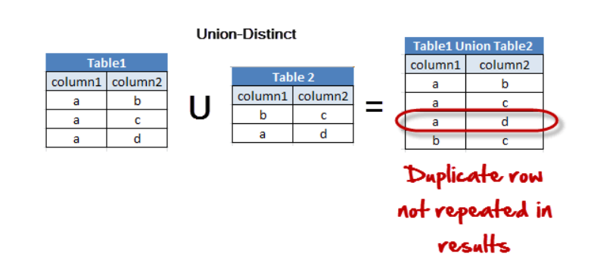
UNION SYNTAX
UNION syntax
    SELECT column_name(s) FROM table1
    UNION
    SELECT column_name(s) FROM table2;
8

Slide 9
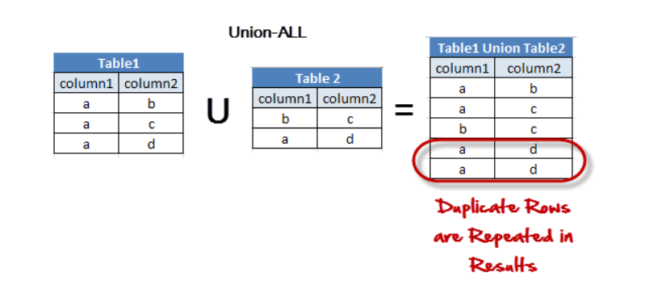
UNION ALL SYNTAX
UNION ALL syntax
    SELECT column_name(s) FROM table1
UNION ALL
SELECT column_name(s) FROM table2;
9

Slide 10
REFERENCES
https://www.w3schools.com/sql/sql_groupby.asp
https://www.tutorialspoint.com/sql/sql-order-by.htm
https://www.w3schools.com/sql/sql_union.asp
https://www.w3resource.com/mysql/mysql-union.php
Acknowledgements: Thank you to Suryavanshi Virendrasingh, Aj R Laddha and Abhinav Choudhury for their help with the lecture, activity and assignment materials for this week.
10

