Slide 1

CS 207: Applied Database Practicum
Week 5
Varun Dutt
School of Computing and Electrical Engineering
School of Humanities and Social Sciences
Indian Institute of Technology Mandi, India
Scaling the Heights
1

Slide 2
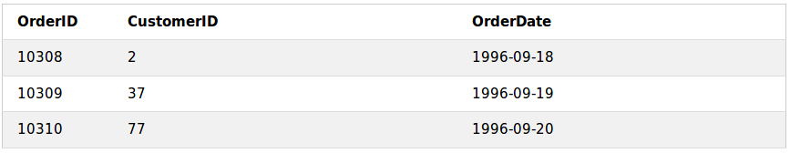
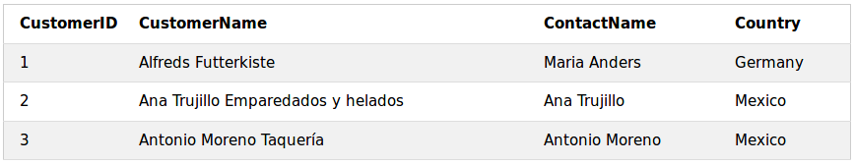
Joins in MySQL
A JOIN clause is used to combine rows from two or more tables, based on a related column between them.
For example, have a look at the tables:
"Orders":
“Customers”:
2

Slide 3
Joins in MySQL
Notice that the "CustomerID" column in the "Orders" table refers to the "CustomerID" in the "Customers" table. The relationship between the two exemplar tables is the "CustomerID" column.
Then, we can create the following SQL statement (that contains an INNER JOIN), that selects records that have matching values in both tables:
3

Slide 4
Joins in MySQL
The output of the previous statement would be:
4

Slide 5
Different Types of MySQL Joins
INNER JOIN - Returns records that have matching values in both tables
LEFT (OUTER) JOIN: Returns all records from the left table, and the matched records from the right table
RIGHT (OUTER) JOIN: Returns all records from the right table, and the matched records from the left table
NATURAL JOIN: It performs the same task as an INNER or LEFT JOIN, in which the ON or USING clause refers to all columns that the tables to be joined have in common.
CROSS JOIN: Returns the complete cross product of the two tables
5

Slide 6

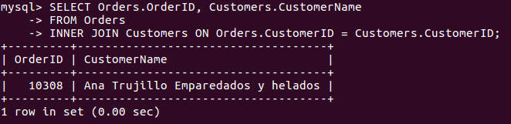
MySQL Inner Join
The INNER JOIN keyword selects records that have matching values in both tables.
Syntax:
For example:
6

Slide 7
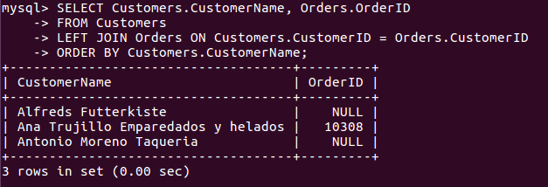
MySQL Left Join
The LEFT JOIN keyword returns all records from the left table (table1), and the matched records from the right table (table2). The result is NULL from the right side, if there is no match.
Syntax:
For example:
7

Slide 8

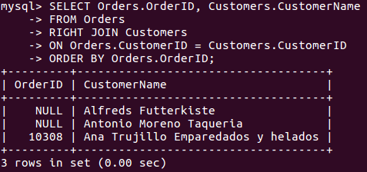
MySQL Right Join
The RIGHT JOIN keyword returns all records from the right table (table2), and the matched records from the left table (table1). The result is NULL from the left side, when there is no match.
Syntax:
For example:
8

Slide 9
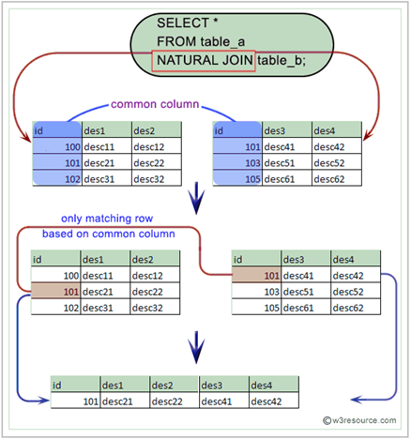
MySQL Natural join
Syntax:
SELECT column_name(s) FROM Table 1 NATURAL JOIN Table2;
In MySQL, the NATURAL JOIN is a join that performs the same task as an INNER JOIN except it does not return any redundant columns.
9

Slide 10

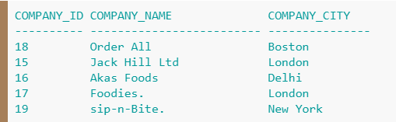

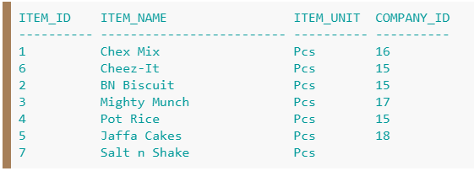
Difference between Natural join and Inner join
Table 1
Table 2
10

Slide 11

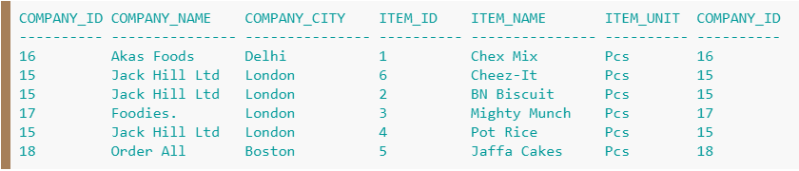

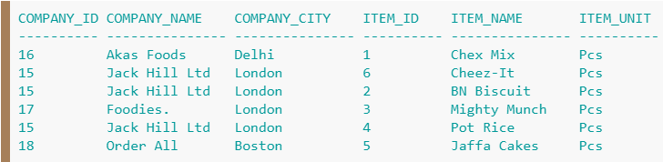
Difference between Natural join and Inner join
Inner Join
Natural Join
11

Slide 12
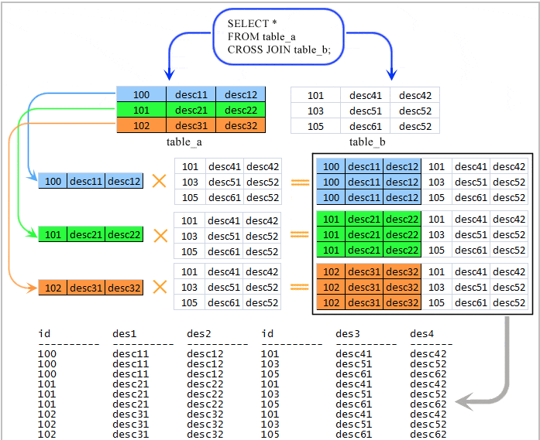
MySQL cross join
Syntax:
SELECT column_name(s) FROM Table 1 CROSS JOIN Table2;
In this join, the result table is obtained by multiplying each row of the first table with all rows in the second table if no condition is introduced with CROSS JOIN.
12

Slide 13

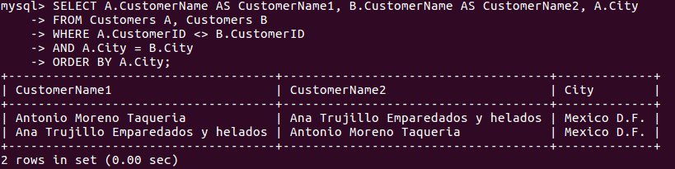
MySQL Self Join
A self JOIN is a regular join, but the table is joined with itself.
Syntax:
For example:
13

Slide 14
MySQL – Stored Procedure
A stored procedure is a prepared SQL code that you can save, so the code can be reused over and over again.
A stored procedure has three main parts:
Input: Store procedure can accept parameter values as inputs. Depending on how the parameters are defined, modified values can be passed back to the calling program
Execution: Stored procedures can execute SQL statements, utilize conditional logic such as IF THEN or CASE statements and lopping constructs to perform tasks.
Outputs: A stored procedure can return a single values such as a number or text value or a result set.
14

Slide 15
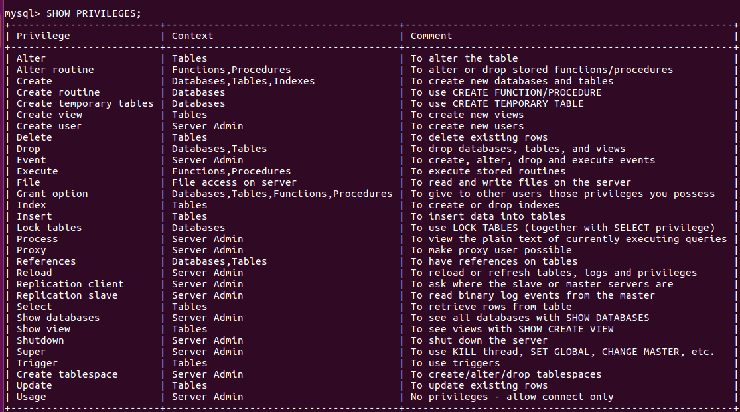
Stored Procedure
For creating and executing a stored procedure the user should have “create routine” privilege
15

Slide 16
Stored Procedure Syntax
PROCEDURE procedure_name ([proc_parameter[,...]])
proc_parameter: [ IN | OUT | INOUT ] param_name type
type:
Any valid MySQL data type
routine_body:
Valid SQL routine statement
Executing a Stored Procedure:
CALL procedure_name;
Deleting a Stored Procedure:
DROP PROCEDURE procedure_name;
16

Slide 17
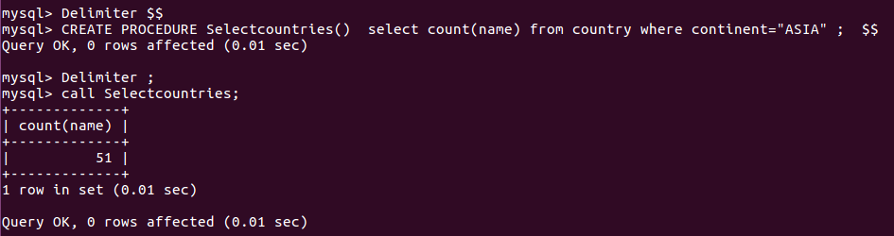
Stored Procedure:Example
Delimiter is used to tell that statement ending with ‘delimiter’ denotes the end of one statement. Here, the use of delimiter is necessary to so that the MySQL treats the statements inside (BEGIN...END) as part of one statement.
17

Slide 18
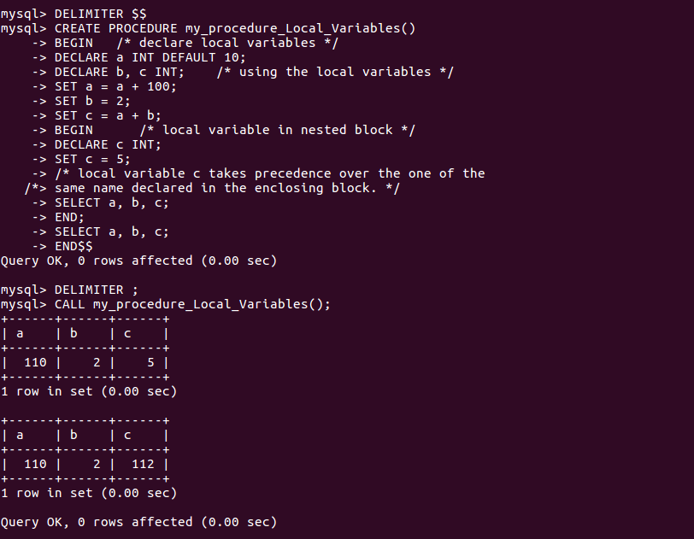
Stored Procedure: Compound Statement
BEGIN ... END block is used to write compound statements, i.e. when you need more than one statement within stored programs (e.g. stored procedures, functions, triggers, and events)
18

Slide 19
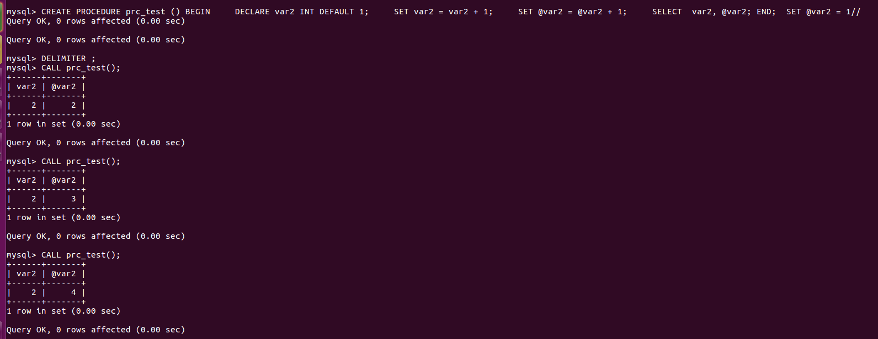
Stored Procedure: User Variables
In MySQL stored procedures, user variables are referenced with an ampersand (@) prefixed to the user variable name (for example, @x and @y).
The difference between a procedure variable and a session-specific user-defined variable is that procedure variable is reinitialized to NULL each time the procedure is called, while the session-specific variable is not
19

Slide 20
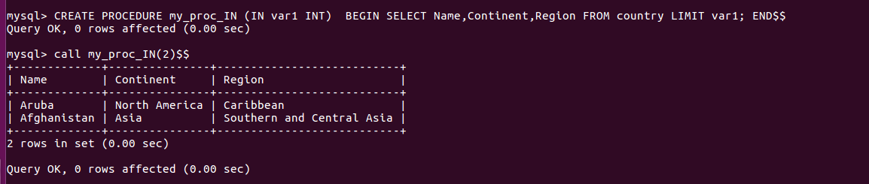
Parameters:IN
In the following procedure, we have used a IN parameter 'var1' (type integer) which accept a number from the user. Within the body of the procedure, there is a SELECT statement which fetches rows from 'country' table and the number of rows will be supplied by the user.
20

Slide 21
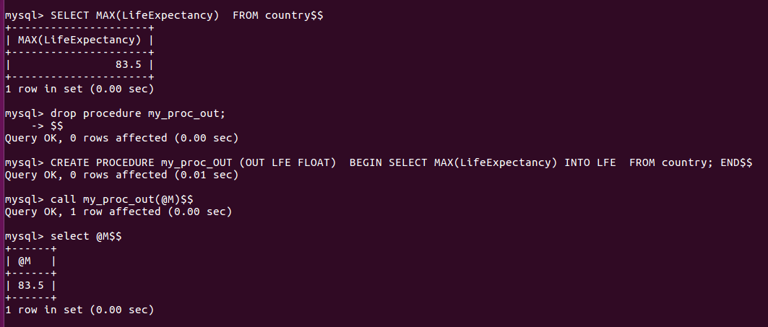
Parameters:OUT
In the body of this procedure, the parameter will get the highest Life Expectancy from LifeExpectancy column. After calling the procedure the word OUT tells the DBMS that the value goes out from the procedure. Here LFE is the name of the output parameter and we have passed its value to a session variable named @M, in the CALL statement.
21

Slide 22
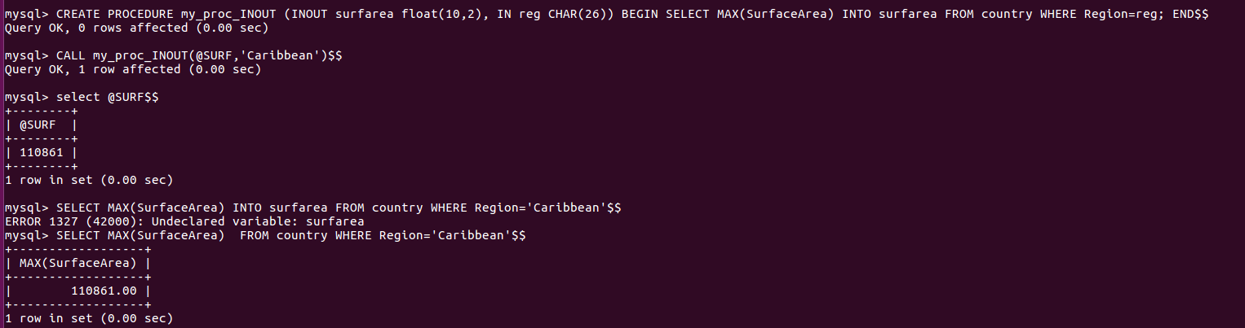
Parameters:INOUT
In this stored procedure that uses an INOUT parameter and an IN parameter. The user will supply a Region name through IN parameter (reg) to find the highest Surface Area in the region given by the user . The INOUT parameter (surfarea) will return the result to a user.
22

Slide 23
References
https://www.w3schools.com/sql/sql_join.asp
http://www.mysqltutorial.org/mysql-join/
https://dev.mysql.com/doc/refman/8.0/en/create-procedure.html
http://www.mysqltutorial.org/getting-started-with-mysql-stored-procedures.aspx
Acknowledgements: Thank you to Shashwat Garg, Aman Khandelwal and Abhinav Choudhury for their help with the lecture, activity and assignment materials for this week.
23

