Slide 1

CS 207: Applied Database Practicum
Week 6
Varun Dutt
School of Computing and Electrical Engineering
School of Humanities and Social Sciences
Indian Institute of Technology Mandi, India
Scaling the Heights
1

Slide 2

MySQL Stored Functions
A stored function is a special kind stored program that returns a single value.
It is different from a stored procedure in the sense that we can use a stored function in SQL statements wherever an expression is used.
Syntax
Parameters of the stored function are listed inside the parentheses. By default, all parameters are the IN parameters. One cannot specify IN , OUT or INOUT modifiers to the parameters.
2

Slide 3
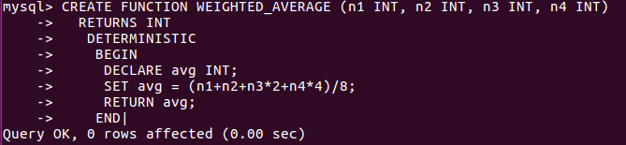
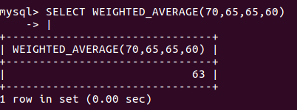
Stored Function example
Result:
3

Slide 4
MySQL Cursors
To handle a result set inside a stored procedure, a cursor is used.
A cursor allows you to iterate a set of rows returned by a query and process each row accordingly.
MySQL cursor has three properties:
Read-only: you cannot update data in the underlying table through the cursor.
Non-scrollable: you can only fetch rows in the order determined by the SELECT statement. You cannot fetch rows in the reversed order. In addition, you cannot skip rows or jump to a specific row in the result set.
4

Slide 5
MySQL Cursors
Asensitive: There are two kinds of cursors: asensitive cursor and insensitive cursor. An asensitive cursor points to the actual data, whereas an insensitive cursor uses a temporary copy of the data. An asensitive cursor performs faster than an insensitive cursor because it does not have to make a temporary copy of data. However, any changes made to the data (from other connections) will affect the data that is being used by an asensitive cursor, therefore, it is safer if you do not update the data that is being used by an asensitive cursor. MySQL cursor is asensitive.
You can use MySQL cursors in stored procedures, stored functions, and triggers.
5

Slide 6
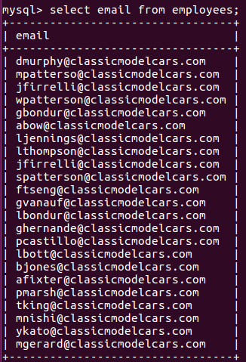
MySQL Cursor Example
We are going to develop a stored procedure with a cursor that concatenates the email of all customers in the employees table:
6

Slide 7
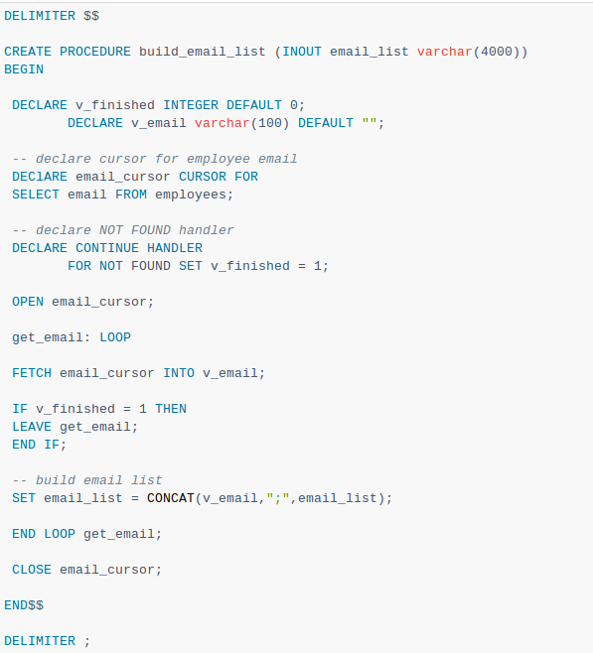
MySQL Cursor Example
The build_email_list stored procedure is as follows:
7

Slide 8

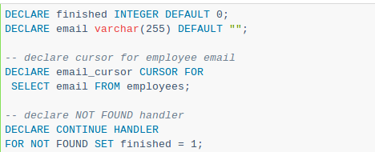
MySQL Cursor Example
Declare a HANDLER variable and an email variable (for storing the email Ids)
A cursor for looping over the email_address of customers, and a NOT FOUND handler:
Next, open the email_cursor by using the OPEN statement:
8

Slide 9
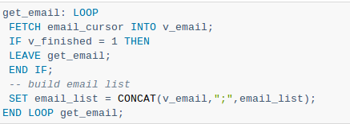
MySQL Cursor Example
Then, iterate the email list, and concatenate all email where each email is separated by a semicolon(;):
After that, inside the loop we used the v_finished variable to check if there is an address in the list to terminate the loop.
9

Slide 10

MySQL Cursor Example
Finally, close the cursor using the CLOSE statement:
You can test the build_email_list stored procedure using the following script:
10

Slide 11
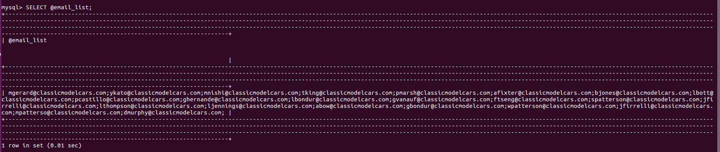
MySQL Cursor Result
11

Slide 12
Using MySQL Cursor
First, you have to declare a cursor by using the DECLARE statement:
DECLARE cursor_name CURSOR FOR SELECT_statement;
The cursor declaration must be after any variable declaration. If you declare a cursor before variables declaration, MySQL will issue an error. A cursor must always be associated with a SELECT statement.
Next, you open the cursor by using the OPEN statement. The OPEN statement initializes the result set for the cursor, therefore, you must call the OPEN statement before fetching rows from the result set.
OPEN cursor_name;
12

Slide 13
Using MySQL Cursor
Then, you use the FETCH statement to retrieve the next row pointed by the cursor and move the cursor to the next row in the result set.
FETCH cursor_name INTO variables list;
After that, you can check to see if there is any row available before fetching it.
Finally, you call the CLOSE statement to deactivate the cursor and release the memory associated with it as follows:
CLOSE cursor_name;
When the cursor is no longer used, you should close it.
13

Slide 14
NOT FOUND Handler
When working with MySQL cursor, you must also declare a NOT FOUND handler to handle the situation when the cursor could not find any row. Because each time you call the FETCH statement, the cursor attempts to read the next row in the result set. When the cursor reaches the end of the result set, it will not be able to get the data, and a condition is raised. The handler is used to handle this condition.
To declare a NOT FOUND handler, you use the following syntax:
DECLARE CONTINUE HANDLER FOR NOT FOUND SET finished = 1;
The finished is a variable to indicate that the cursor has reached the end of the result set. Notice that the handler declaration must appear after variable and cursor declaration inside the stored procedures.
14

Slide 15
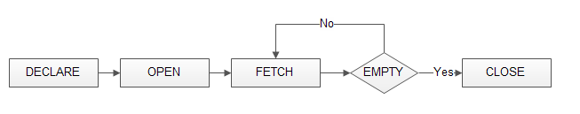
Flow Diagram for MySQL Cursor
The following diagram illustrates how MySQL cursor works.
15

Slide 16
MySQL - Triggers
A SQL trigger is a set of SQL statements stored in the database catalog. A SQL trigger is executed or fired whenever an event associated with a table occurs e.g., insert, update or delete.
A SQL trigger is a special type of stored procedure. It is special because it is not called directly like a stored procedure. The main difference between a trigger and a stored procedure is that a trigger is called automatically when a data modification event is made against a table whereas a stored procedure must be called explicitly.
16

Slide 17
Advantages of triggers
Provides an alternative way to check the integrity of data.
Provide a way to automatically run scheduled tasks because triggers are invoked automatically before or after a change is made in the table.
Very useful to audit the changes in the table.
Provide transparent event logging
Prevent invalid transactions.
17

Slide 18
Types of triggers
A trigger can be defined to be invoked either before or after the data is changed by INSERT, UPDATE or DELETE statement.
BEFORE INSERT - activated before data is inserted into the table.
AFTER INSERT - activated after data is inserted into the table.
BEFORE UPDATE - activated before data in the table is updated.
AFTER UPDATE - activated after data in the table is updated.
18

Slide 19
Types of Triggers
BEFORE DELETE - activated before data is removed from table.
AFTER DELETE - activated after data is removed from table.
19

Slide 20
Syntax for Triggers
CREATE
[DEFINER = { user | CURRENT_USER }] (Optional)
TRIGGER trigger_name
trigger_time trigger_event
ON table_name FOR EACH ROW
trigger_body
trigger_time: { BEFORE | AFTER }
trigger_event: { INSERT | UPDATE | DELETE }
Within the trigger body, the OLD and NEW keywords enable you to access columns in the rows affected by a trigger. OLD and NEW are not case-sensitive.
20

Slide 21
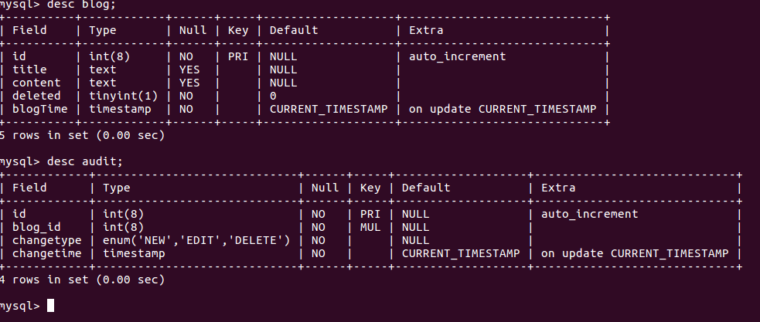
Example on triggers
Tables description-
21

Slide 22
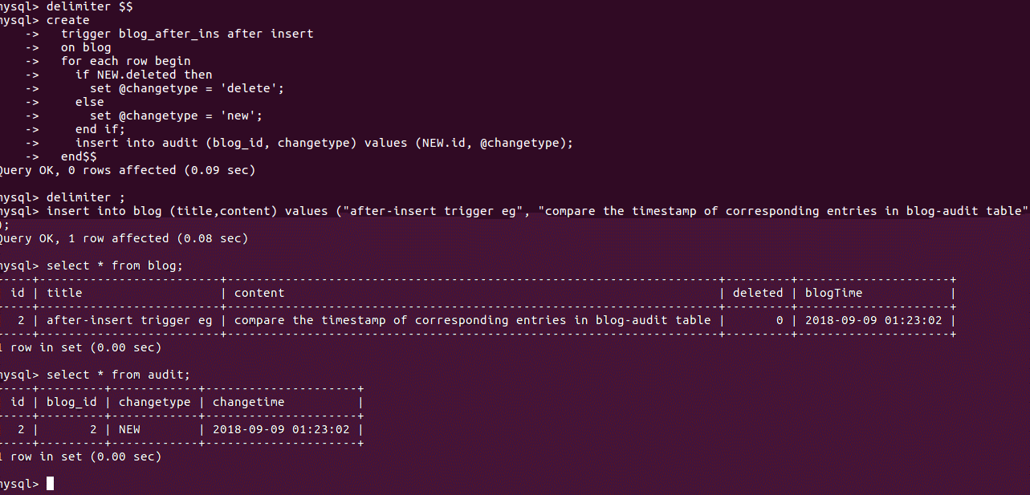
Example using after-insert
22

Slide 23
Example Explanation
In above example whenever some new entry is inserted in blog table, new entry in audit table gets create automatically to keep note the changetype and timestamp. Next example deal with same table and show how any modification in table blog causes new entry in table audit referring to corresponding modified entry.
23

Slide 24
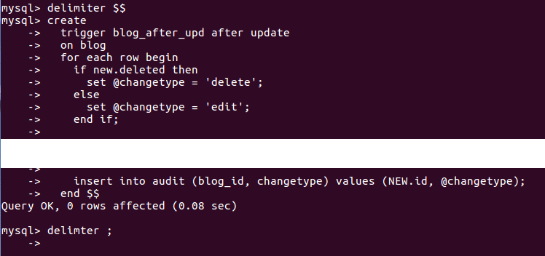
Example of after-update
Creation of trigger
24

Slide 25
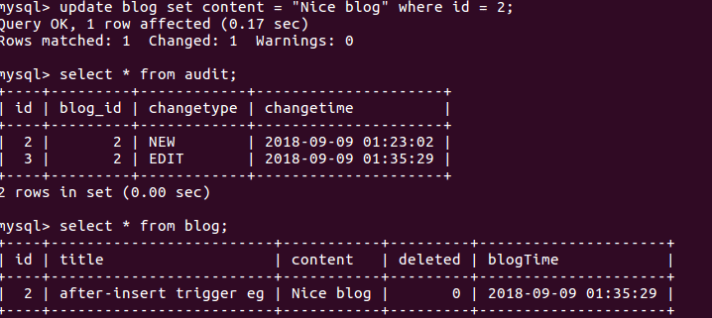
Example of after-update
Realization of trigger -
Above example shows the modification of entry in blog table causes new entry in audit table automatically.
25

Slide 26
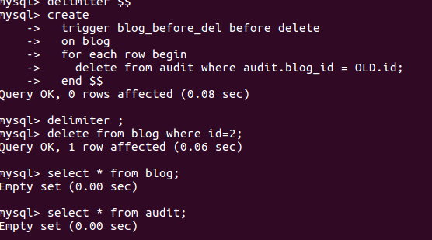
Example on before delete
o
Using same table as above:
Trigger creation and realization -
26

Slide 27
Example
Above example shows how one can save him/her from error.
As per the example, before deleting entry of primary key, we have to be sure that we first delete foreign key entries of it in another table. So we can use trigger before -delete here, so before deleting primary key entry clear all entries of it as foreign key in another table.
27

Slide 28
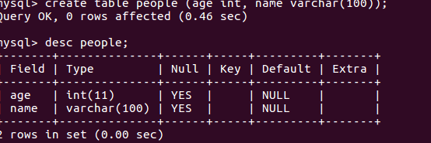
Example on before insert
For next two examples we’ll using following table:
Table description-
28

Slide 29
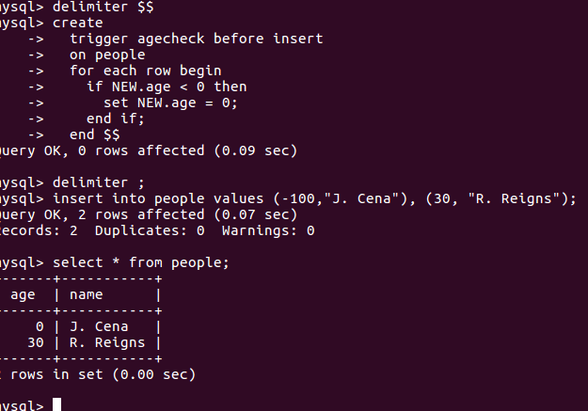
Example on before insert
Trigger creation and realization
29

Slide 30
Example on before insert
In above example upon insertion of invalid negative age, MySQL with triggers modify it to zero.
30

Slide 31
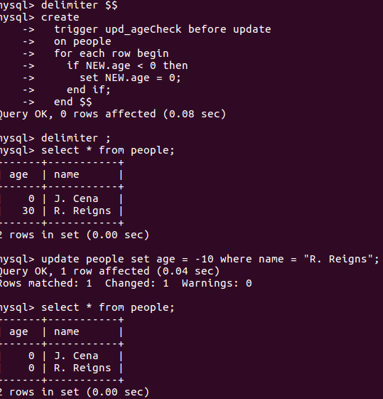
Example on before-update
Trigger creation and realization-
31

Slide 32
Example on before-update
In above eg. upon modification of entry in table people MySQL trigger checks if there is invalid modification (age < 0), set age to zero.
32

Slide 33
References
http://w3schools.com/
http://www.mysqltutorial.org/mysql-triggers.aspx
https://dev.mysql.com/doc/refman/8.0/en/cursors.html
Acknowledgements: Thank you to Shashwat Garg, Aman Khandelwal and Abhinav Choudhury for their help with the lecture, activity, and assignment materials for this week.
33

