Slide 1

CS 207: Applied Database Practicum
Week 8
Varun Dutt
School of Computing and Electrical Engineering
School of Humanities and Social Sciences
Indian Institute of Technology Mandi, India
Scaling the Heights
1

Slide 2
DBMS - Data Models
Data models define how the logical structure of a database is modeled. Data Models are fundamental entities to introduce abstraction in a DBMS. Data models define how data is connected to each other and how they are processed and stored inside the system.
2

Slide 3
Entity-Relationship Model
Entity-Relationship (ER) Model is based on the notion of real-world entities and relationships among them. ER-Diagram is a pictorial representation of data that describes how data is communicated and related to each other.
ER Model is best used for the conceptual design of a database.
3

Slide 4
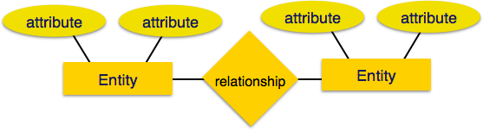
ER Model
ER Model is based on -
Entities and their attributes.
Relationships among entities.
4

Slide 5
Entity
An entity in an ER Model is a real-world entity having properties called attributes. For example, in a school database, students, teachers, classes, and courses offered can be considered as entities. All these entities have some attributes or properties that give them their identity.
5

Slide 6
Attributes
Entities are represented by means of their properties, called attributes. All attributes have values. For example, a student entity may have name, class, and age as attributes.
There exists a domain or range of values that can be assigned to attributes. For eg., student’s age can’t be negative.

Slide 7
Types of Attributes
Simple - Simple attributes are atomic values, which cannot be divided further. For example, a employee’s phone number is an atomic value of 10 digits.
Composite - Composite attributes are made of more than one simple attribute. For example, a employee’s complete name may have first_name and last_name.
7

Slide 8
Types of Attributes
Derived - Derived attributes are the attributes that do not exist in the physical database, but their values are derived from other attributes present in the database. For eg., age can be derived from date of birth.
Single value - Single-value attributes contain single value. For example − Social_Security_Number.
8

Slide 9
Types of Attributes
Multivalue - Multi-value attributes may contain more than one values. For example, a person can have more than one phone number.
9

Slide 10
Entity set and keys
An entity set is a collection of similar types of entities. An entity set may contain entities with attribute sharing similar values. For eg., a Students set may contain all the students of a school.
Key is an attribute or collection of attributes that uniquely identifies an entity among entity set. For eg., the roll no. of a student makes him/her identifiable among students.
10

Slide 11
Keys
Super Key - A set of attributes (one or more) that collectively identifies an entity in an entity set.
Candidate Key - A minimal super key is called a candidate key. An entity set may have more than one candidate key.
Primary Key - A primary key is one of the candidate keys chosen by the database designer to uniquely identify the entity set.
11

Slide 12
Relationship
asabo
The association among entities is called a relationship. For eg., an employee works_at a department, here works_at is the name of relationship between entities employee and department.
Relationship set - A set of relationships of similar type is called a relationship set. Like entities, a relationship too can have attributes. These attributes are called descriptive attributes.
12

Slide 13
Degree of Relationship
The number of participating entities in a relationship defines the degree of the relationship.
Binary = degree 2
Ternary = degree 3
n-ary = degree n
13

Slide 14

Binary Relationship
A Journalist writes an article
A article is written by a Journalist
14

Slide 15
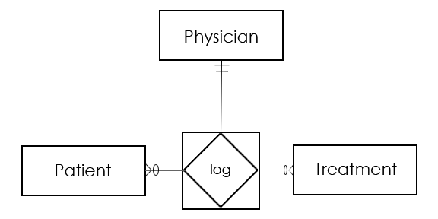
Ternary Relationship
1 Physician with 1 specific Patient can log M Treatments
1 Physician logs 1 specific Treatment for N Patients
1 Patient is logged 1 specific Treatment by 1 Physician
So the ternary relationship log is an M-N-1 relationship between the participating entities Treatment-Patient-Physician
15

Slide 16
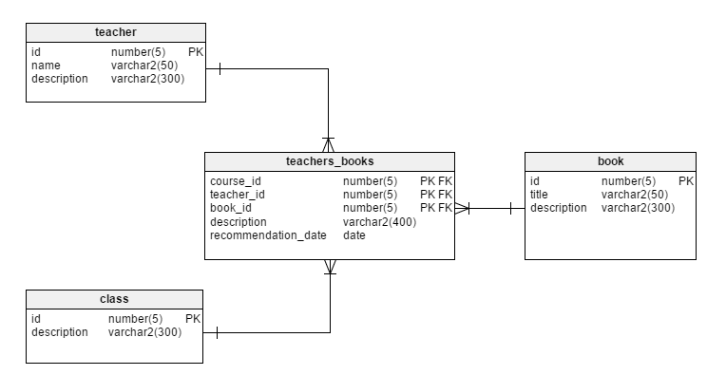
N-ary Relationship
16

Slide 17
Mapping Cardinalities
Cardinality defines the number of entities in one entity set, which can be associated with the number of entities of other set via relationship set.
17

Slide 18
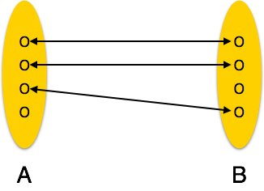
Types of Mapping cardinalities
One to one - One entity from entity set A can be associated with at most one entity of entity set B and vice versa.
e.g. One person can have only one Aadhar number
18

Slide 19
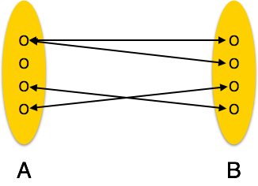
Types of cardinalities
One to many - One entity from entity set A can be associated with more than one entities of entity set B however an entity from entity set B, can be associated with at most one entity.
e.g. One person can have multiple Phone numbers
19

Slide 20
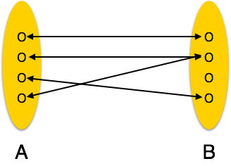
Types of cardinalities
Many to one - More than one entities from entity set A can be associated with at most one entity of entity set B, however an entity from entity set B can be associated with more than one entity from entity set A.
e.g. Many Courses can have a single Instructor
20

Slide 21
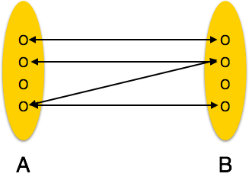
Types of cardinalities
Many to many - One entity from A can be associated with more than one entity from B and vice versa.
e.g. One course can have multiple students enrolled and each student can be enrolled multiple courses
21

Slide 22
ER Diagram Representation
Entity - Entities are represented by means of rectangles. Rectangles are named with the entity set they represent.
22

Slide 23
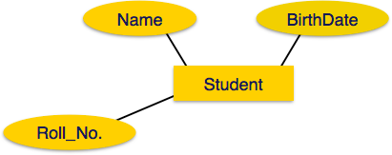
Attributes Representation
Attributes - Attributes are represented by means of ellipses. Every ellipse represents one attribute and is directly connected to its entity (rectangle).
23

Slide 24
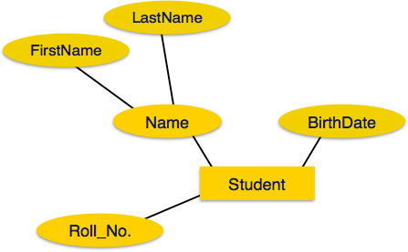
Attributes Representation
Composite Attributes - These are further divided in a tree like structure. Every node is then connected to its attribute.
24

Slide 25
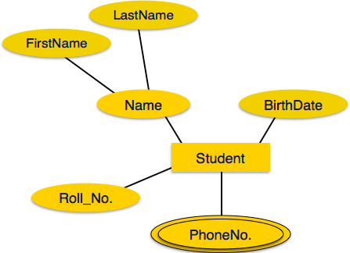
Attributes Representation
Multivalued Attributes are depicted by double ellipse.
25

Slide 26
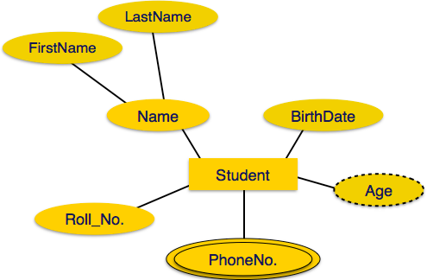
Attributes Representation
Derived attributes are depicted by dashed ellipse.
26

Slide 27
Relationship Representation
Relationships are represented by diamond-shaped box. Name of the relationship is written inside the diamond-box. All the entities (rectangles) participating in a relationship, are connected to it by a line.
27

Slide 28
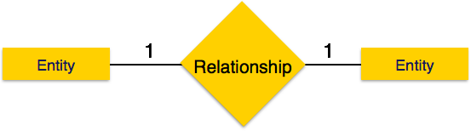
Cardinality Representation
One to one - When only one instance of an entity is associated with the relationship, it is marked as '1:1'.
It depicts one-to-one relationship.
28

Slide 29
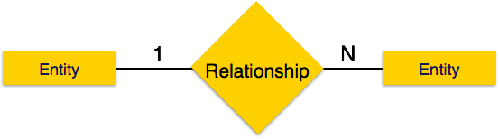
Cardinality Representation
One to many - When more than one instance of an entity is associated with a relationship, it is marked as '1:N'.
It depicts one-to-many relationship.
29

Slide 30
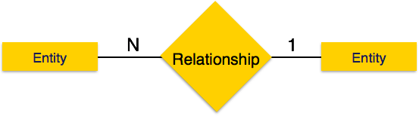
Cardinality Representation
Many to one - When more than one instance of entity is associated with the relationship, it is marked as 'N:1'.
It depicts many-to-one relationship.
30

Slide 31
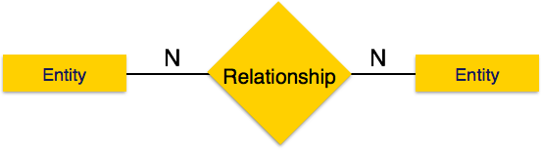
Cardinality Representation
Many to many - When more than one instance of entity is associated with the relationship, it is marked as 'N:N'.
It depicts many-to-many relationship.
31

Slide 32

Key representation
To represent a Key attribute, the attribute name inside the Ellipse is underlined.
32

Slide 33
Umbrello Introduction
Umbrello UML Modeller is a UML diagram tool that can support you in the software development process. Especially during the analysis and design phases of this process, Umbrello UML Modeller will help you to get a high quality product.
Having a good model of your software is the best way to communicate with other developers working on the project and with your customers.
33

Slide 34
Umbrello Introduction
UML is the diagramming language used to describing such models. You can represent your ideas in UML using different types of diagrams. Umbrello UML Modeller 2.11 supports the following types:
Class Diagram
Sequence Diagram
Collaboration Diagram
Use Case Diagram
State Diagram
Activity Diagram
Component Diagram
Deployment Diagram
Entity Relationship Diagram
34

Slide 35
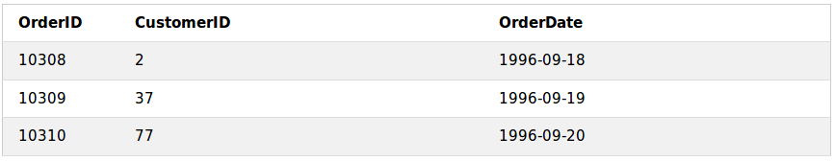
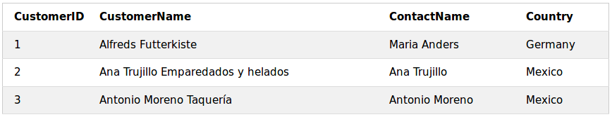
Drawing ER Diagrams using Umbrello
We will draw the ER-Diagram for the examplar tables that we took earlier:
“Orders”:
“Customers”:
35

Slide 36
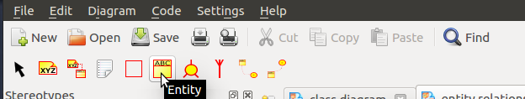
Drawing ER Diagrams using Umbrello
First, select the “Diagram” drop down from the Umbrello Menu Bar.
Click on “New” and select “Entity Relationship Diagram”.
To create an entity, click on the following icon in the toolbar:
36

Slide 37
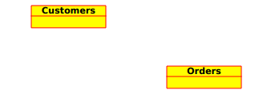
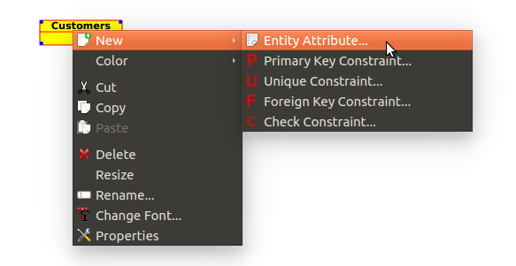
Drawing ER Diagrams using Umbrello
Make the two entities “Orders” and “Customers”:
To create attributes, right click on the entity and select “New”>”Entity Attribute”
37

Slide 38
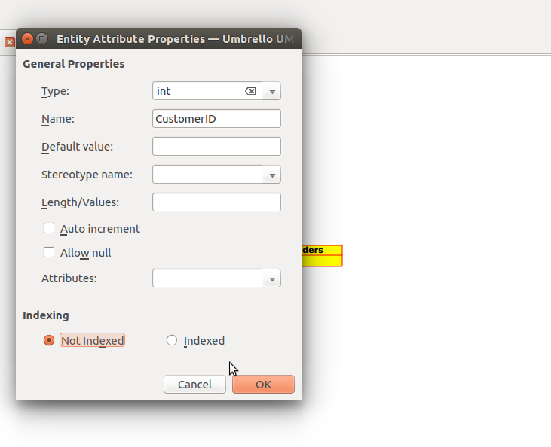
Drawing ER Diagrams using Umbrello
Enter the Data Type (Type) of the attribute and it’s name.
38

Slide 39
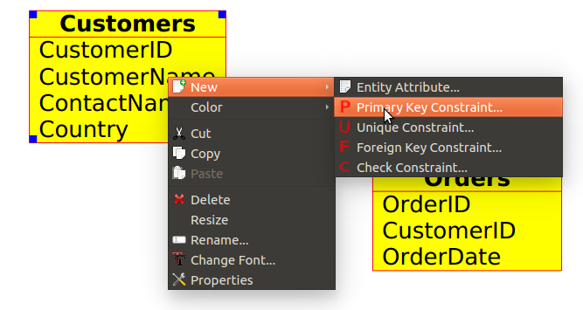
Drawing ER Diagrams using Umbrello
After creating all the attributes for both the entities, we need to insert the primary key constraint. To do this, right click on the entity, select “New”>”Primary Key Constraint”.
39

Slide 40
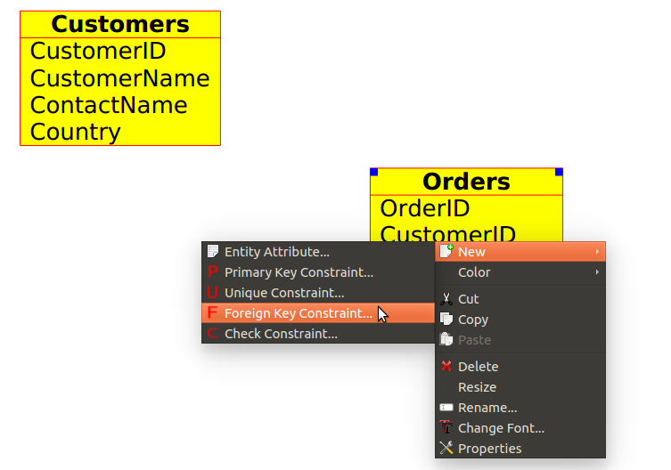
Drawing ER Diagrams using Umbrello
Now, to create the Foreign Key constraint, right click on the entity, select “New”>”Foreign Key Constraint”.
40

Slide 41
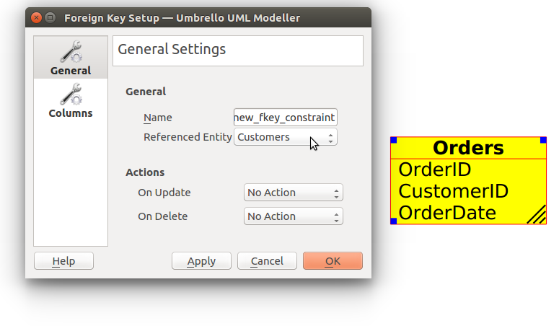
Drawing ER Diagrams using Umbrello
In the resulting dialogue box, in the General Settings tab set the Referenced Entity as the Entity whose column you wish to use as reference (e.g. Customers for CustomerID here).
41

Slide 42
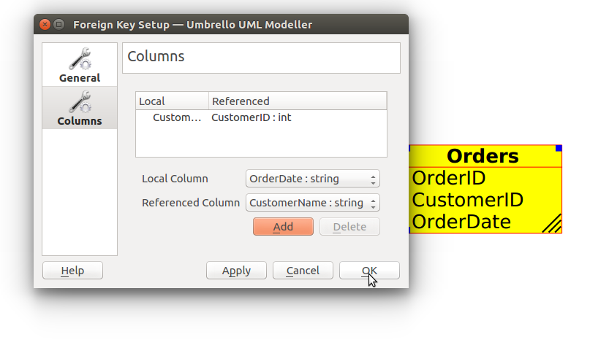
Drawing ER Diagrams using Umbrello
In the “Columns” tab, select the columns which will work as the foreign key constraints.
42

Slide 43

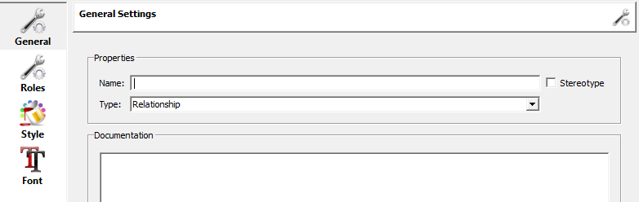
Drawing ER Diagrams using Umbrello
To create an relationship, click on the following icon in the toolbar
To define the relationship between Entities double-click on the relationship
43

Slide 44
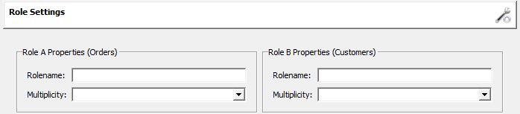
Drawing ER Diagrams using Umbrello
To define the role of each entity and the multiplicity of each entity.
44

Slide 45
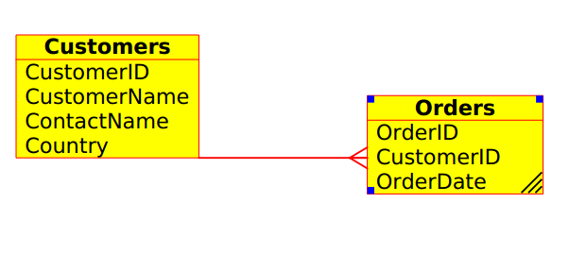
Drawing ER Diagrams using Umbrello
And hence, the complete exemplar ER Diagram will look like:
45

Slide 46
References
https://w3schools.in
https://tutorialspoint.com
https://docs.kde.org/trunk4/en/kdesdk/umbrello/index.html
Acknowledgements: Thank you to Suryavanshi Virendrasingh, Shashwat Garg, Aman Khandelwal and Abhinav Choudhary for their help with the lecture, activity and assignment materials for this week.
46

