Slide 1
Settlement of sandy soil using strain influence factor
Presented by: Sanjeev (B17022)
Saurabh (B17023)

Slide 2
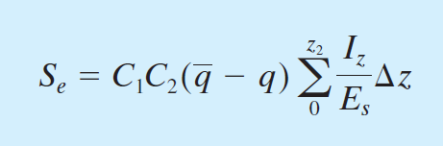
The settlement of granular soils can also be evaluated by the use of a semiempirical
strain influence factor proposed by Schmertmann et al. (1978). According to this method
the settlement is
Eq (1)

Slide 3

What are C1 & C2 and how to find them?
C1 is a correction factor for the depth of foundation embedment.
C2 is a factor to account creep in soil.
$$C1=1−0.5\frac{q}{\overline{q}−q}$$
$$C2=1+0.2log⁡(\frac{time in years}{0.1})$$
$$q=effective stress at the base of boundation$$
$$\overline{q}=stress at the level of foundation$$
Eq (2)
Eq (3)

Slide 4


Correlation between Modulus of Elasticity and Cone
Penetration Resistance
Schmertmann et al. (1978) suggested that
Es = 2.5qc (for square foundation)
Es 3.5qc (for $\frac{L}{B}≥10$)
where qc is cone penetration resistance.
Eq (4)
Eq (5)
$$Es\left(rec\right)=(1+0.4\left(log\frac{L}{B}\right))Es(Square)$$
Eq (6)

Slide 5

Correlation between Modulus of Elasticity and Standard
Penetration Number
The modulus of elasticity of granular soils (Es) is an important parameter in estimating the elastic settlement of foundations. A first order estimation for Es was given by Kulhawy and Mayne (1990) as
$$\frac{Es}{Pa}=αN60$$
Where,
$$Pa=Atmospheric pressure \left(Same unit as Es\right)=Approx\frac{100kN}{m^{2}}$$
$$α=\{5 for sands with fines$$
$$α=\{10 for clean normally consolidated sand$$
$$α=\{15 for clean overconsolidated sand$$
Eq (7)

Slide 6
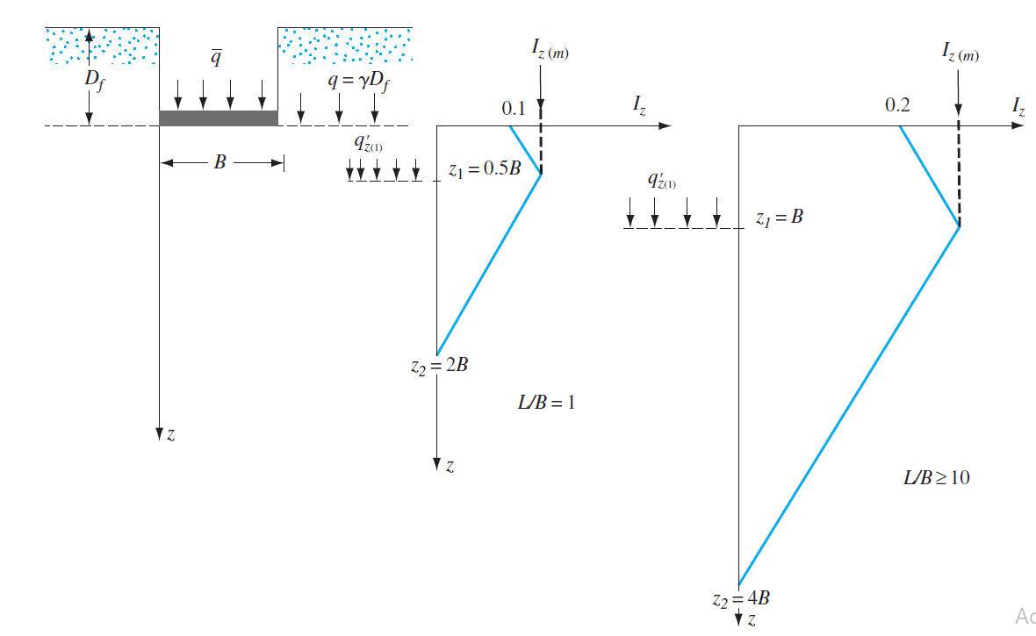

What is $Iz$ ?
Iz is a strain influence factor .
The recommended variation of the strain influence factor Iz for square ($\frac{L}{B}=1$) or
circular foundations and for foundations with $\frac{L}{B}≤10$is shown in Figure.

Slide 7

The Iz diagram for $1<\frac{L}{B}<10$ can be interpolated.
OR
The following relations are suggested by Salgado (2008) for interpolation of Iz at
z = 0, z1/B, and z2/B for rectangular foundations.
Iz at z = 0
$$Iz=0.1+0.0111\left(\frac{L}{B}−1\right)≤0.2$$
Variation of z1/B for Iz(m)
$$\frac{z1}{B}=0.5+0.0555\left(\frac{L}{B}−1\right)≤1$$
Variation of z2/B
$$\frac{z2}{B}=2+0.222\left(\frac{L}{B}−1\right)≤4$$
Eq (8)
Eq (9)
Eq (10)

Slide 8
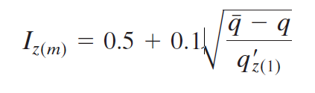
Note that the maximum value of Iz [that is, Iz(m)] occurs at z = z1 and then reduces to zero at z = z2. The maximum value of Iz can be calculated as
Eq (11)
q’z(1) = effective stress at a depth of z1 before construction of the foundation

Slide 9
The procedure for calculating elastic settlement using Eq. (1) is given here
(Figure in next slide).
Step 1. Plot the foundation and the variation of Iz with depth to scale (Figure a).
Step 2. Using the correlation from standard penetration resistance (N60) or cone
penetration resistance (qc), plot the actual variation of Es with depth
(Figure b).
Step 3. Approximate the actual variation of Es into a number of layers of soil having a constant Es, such as Es(1), Es(2), . . . , Es(i), . . . Es(n) (Figure b).
Step 4. Divide the soil layer from z = 0 to z = z2 into a number of layers by drawing
horizontal lines. The number of layers will depend on the break in continuity
in the Iz and Es diagrams.
Step 5. Prepare a table (such as Table given in next to next slide) to obtain
Step 6. Calculate C1 and C2.
Step 7. Calculate Se from Eq. (1).

Slide 10
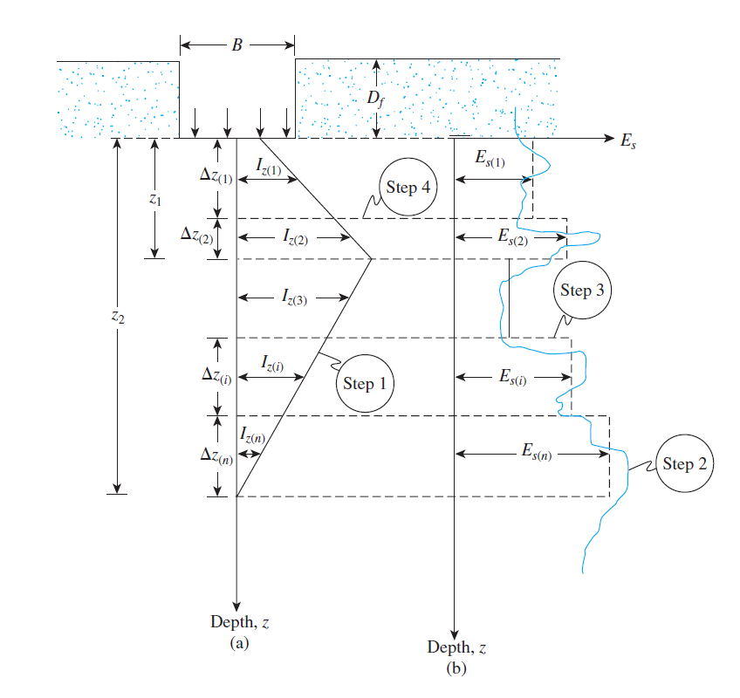

Slide 11
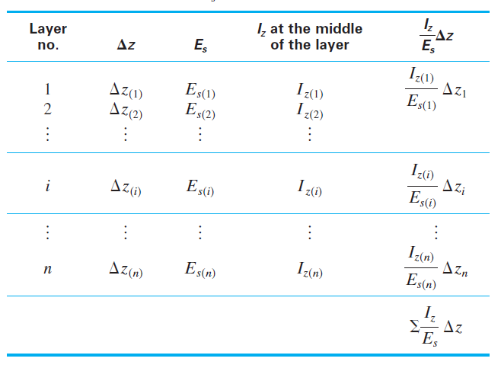
Calculate Se from Eq. (1)

Slide 12
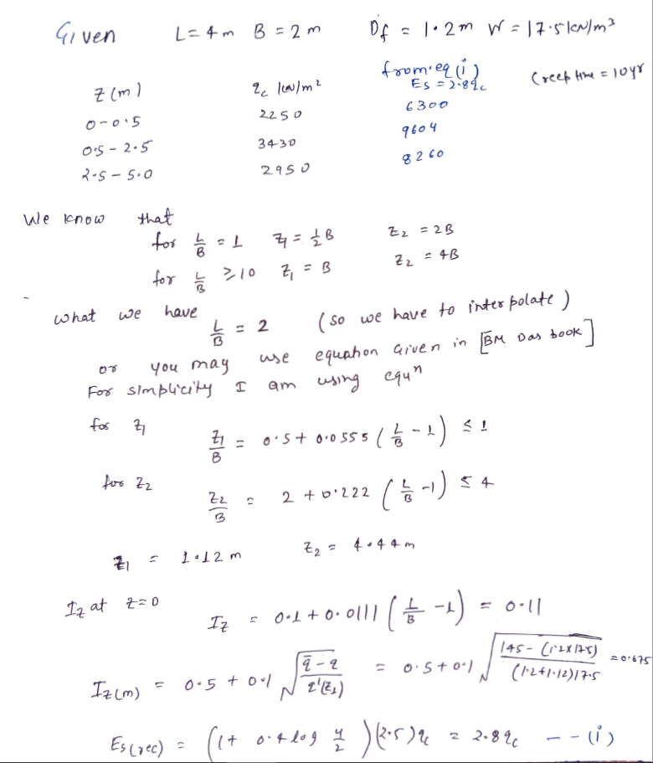
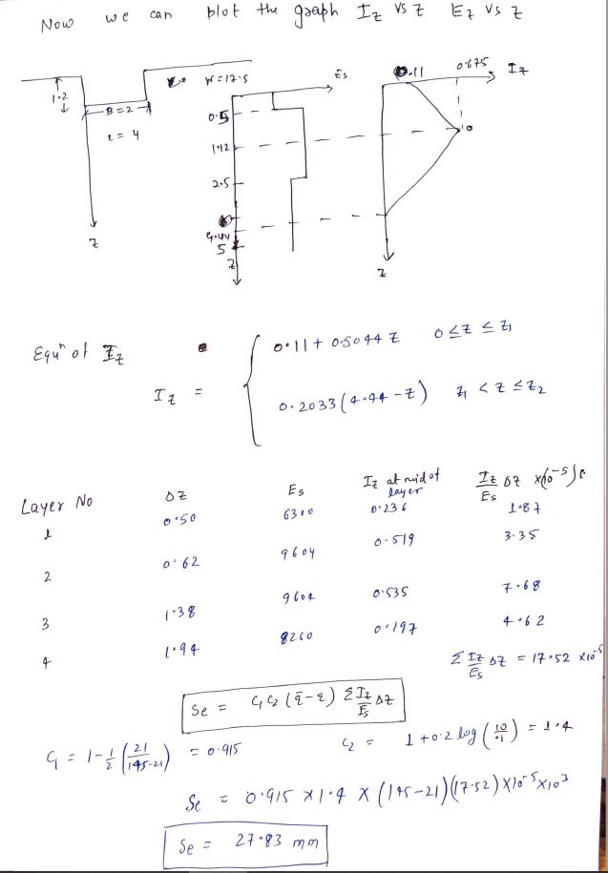
Solution of this problem

Slide 13
Code Interface
Enter the length, breadth and depth of footing in meter as L B D: 4 2 1.2
Enter the creep time in years: 10
Give q_bar Intensity(kN/m2) or Load(kN): 1 Intensity or 2 load: 1 145
Do you have SPT data or CPT data? Enter 1 for SPT or Enter 2 for CPT: 2
Enter the breakpoints as(m) x1 x2 x3...: 0.5 2.5 5
Enter the qc values(kN/m2) qc1 qc2 qc3...: 2250 3430 2950
Enter 0 if water table below the D+z1 or Enter 1 if it is above D+z1: 0
Enter the average unit weight of soil in kN/m3: 17.5

Slide 14
Code Interface
OUTPUT
C1 = 0.9153225806451613
C2 = 1.4
z1 = 1.111
z2 = 4.444
iz_0 = 0.1111
iz_max = 0.6751022979203078

Slide 15
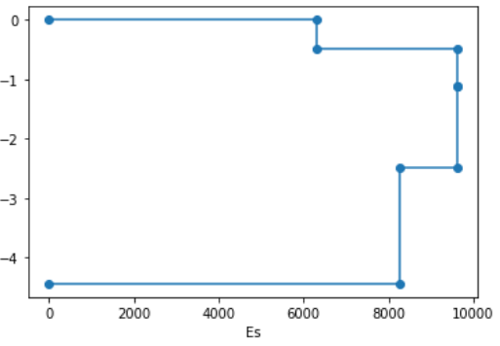
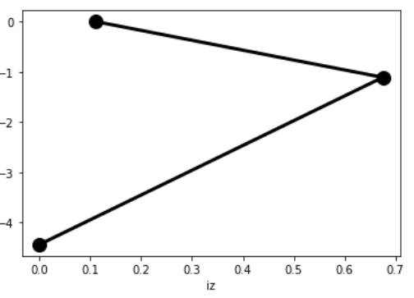
Code Interface
OUTPUT

Slide 16
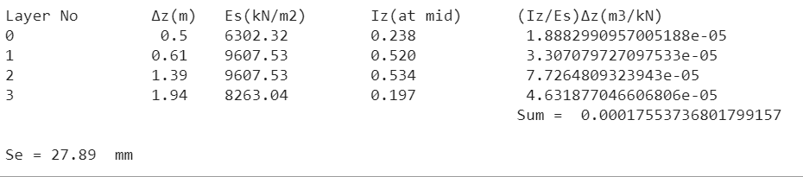
Code Interface
OUTPUT

Slide 17
References
[1] Principle of foundation engineering (B.M. Das)

Slide 18
Thank You!

