Slide 1

Optimized route for electric vehicles from 25/03/2018 to 23/04/2018
LIU Jixiong | MANGEARD Benoît | OBAME EDOU Yves William
XUAN Yuang | MAILLY Charles
Advisor:
BERRADIA Tahar
TROJET Wassim

Slide 2
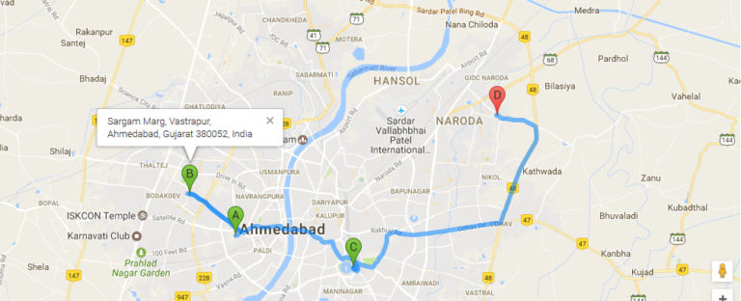
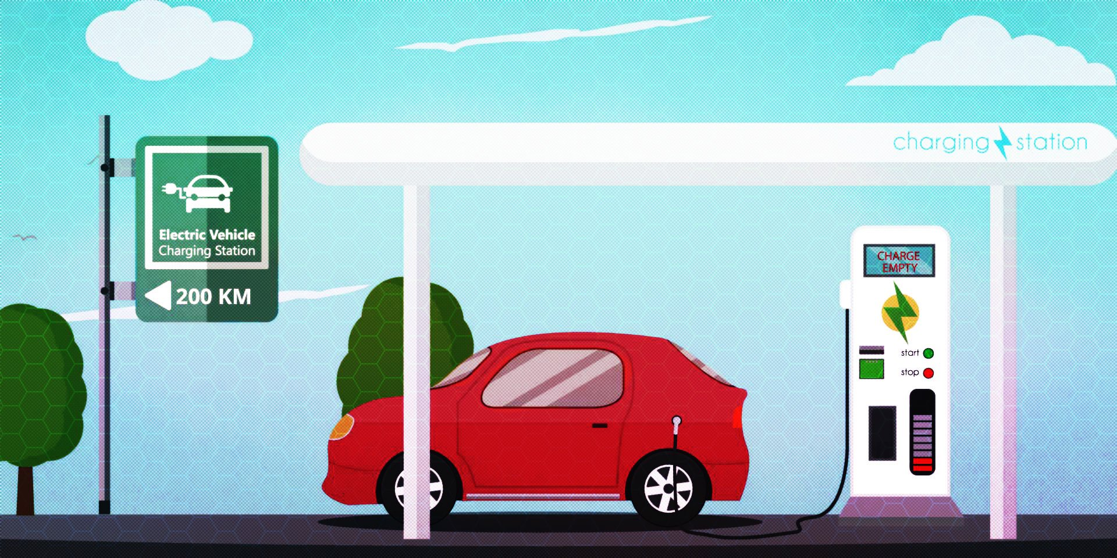
INTRODUCTION
Electric vehicle can reach it’s destination by this optimized route
Recharging time

Slide 3
PLAN
I) Generate the data
Simplification
Generate the database
II) Find a best path
III) Display the map in a site
IV)Conclusion

Slide 4
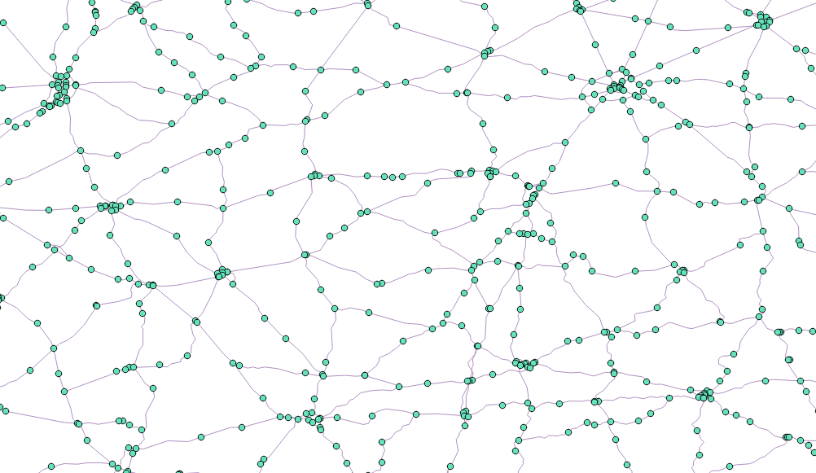
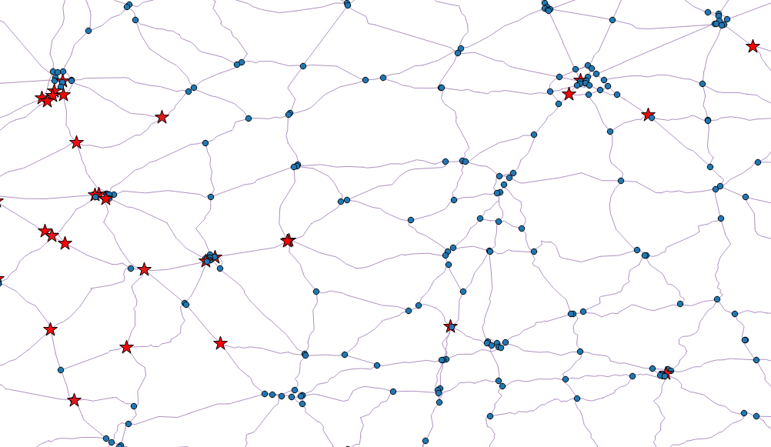
Generate the data
Simplification
Before:
After:

Slide 5



Generate the data
Simplification
Database backup.
Add Eij, electrical energy coefficient for each road arc.
Add Tij, time coefficient for each road arc (traffic, speed…)
Add charge time at each station.
Update database
Tij
Eij

