Slide 1

Optimized route for electric vehicles from 25/03/2018 to 23/04/2018
LIU Jixiong | MANGEARD Benoît | OBAME EDOU Yves William
XUAN Yuang | MAILLY Charles
Advisor:
BERRADIA Tahar
TROJET Wassim

Slide 2
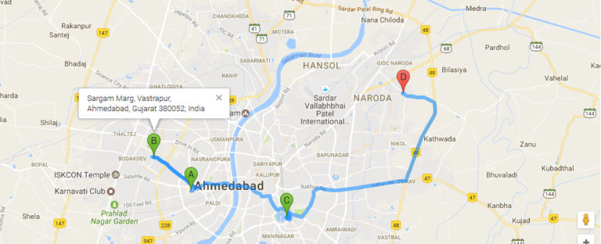
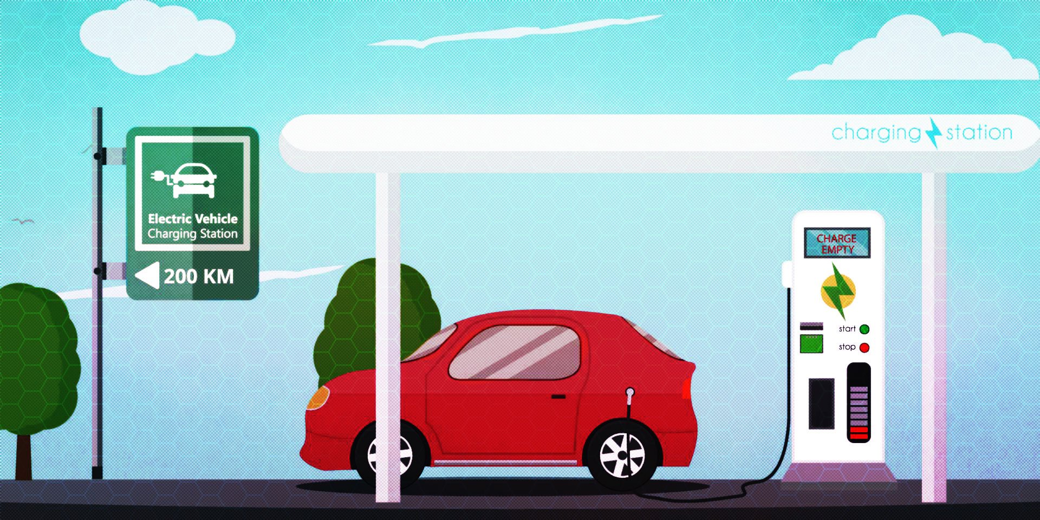
INTRODUCTION
Searching the optimized route for electric vehicles.
Charging time
Range anxiety

Slide 3
PLAN
I) Generate the data
Simplification
Generate the database
II) Find the most optimal path
Parameters
Calculation method
III) Display the map in a site
IV) Results
V) Conclusion

Slide 4
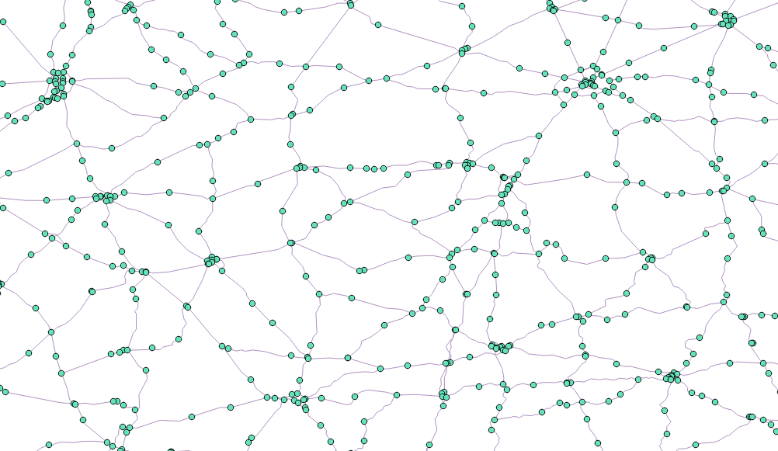
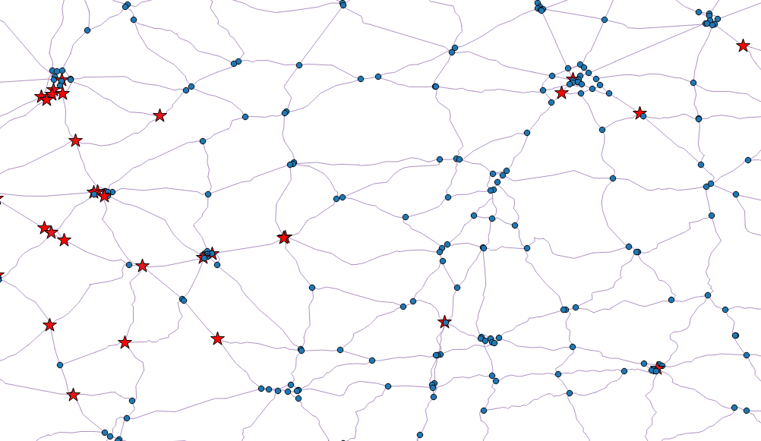
Generate the data
Simplification
Before:
After:

Slide 5



Generate the data
Generate the database
Database backup.
Electrical energy coefficient for each road arc.
Time coefficient for each road arc (traffic, speed…)
Charge time at each station
Database update

Slide 6

Finding the most optimal path
Parameters
Starting and arriving points
Starting and arriving energy
Vehicles battery capacity
Travel time and energy consumption of the roads
Number of stations

Slide 7

Finding the most optimal path
Calculation method
Find the best stations
Determine the best itineraries going through these stations
Choose the itinerary with the lowest travel time

Slide 8
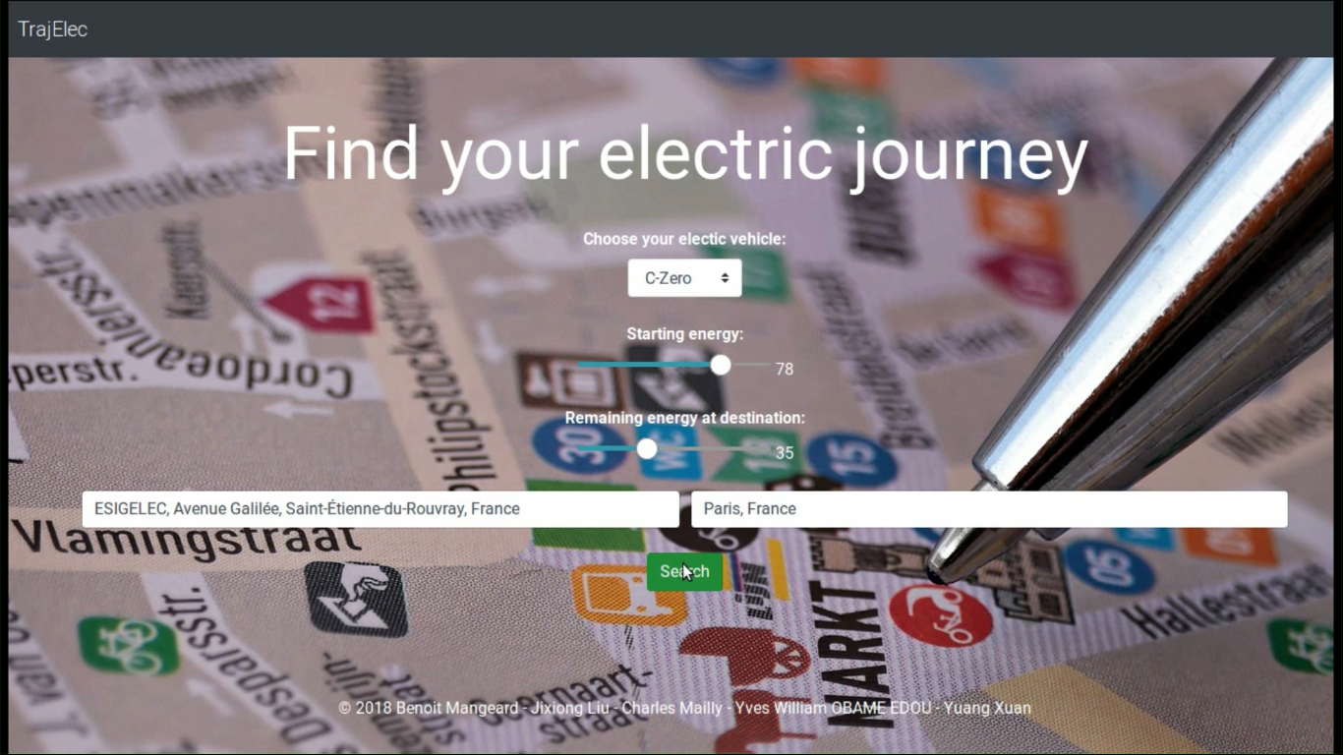
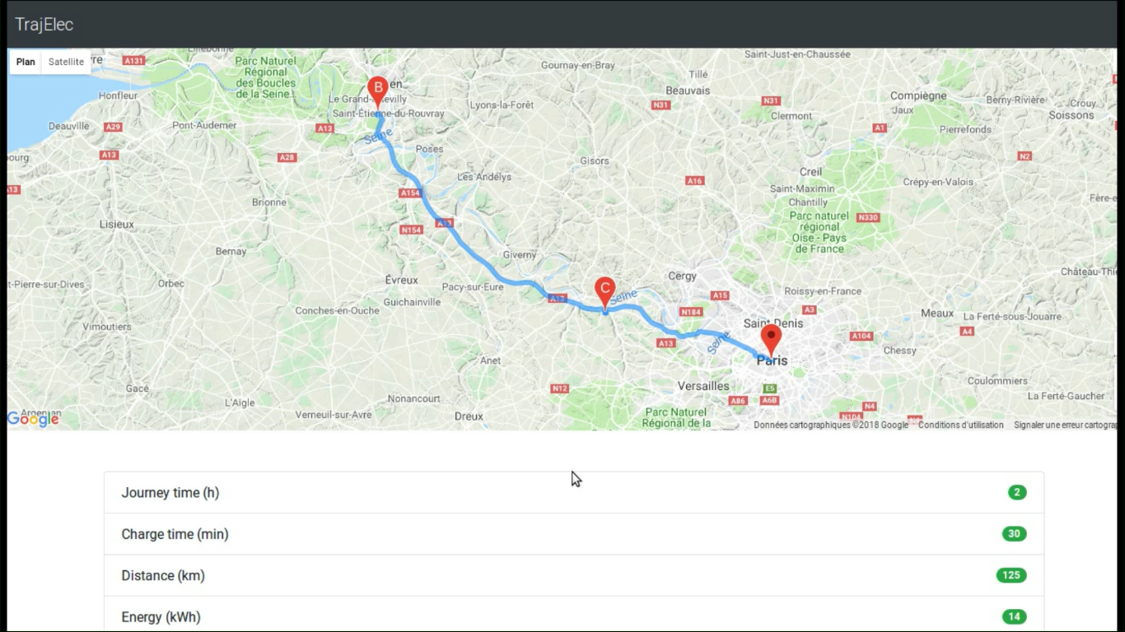
Display the map in a site

Slide 9

Results
High response time due to the:
Implementation method used in the program
Huge amount of data to treat

Slide 10


CONCLUSION

