Slide 1

Optimized route for electric vehicles from 25/03/2018 to 23/04/2018
LIU Jixiong | MANGEARD Benoît | OBAME EDOU Yves William
XUAN Yuang | MAILLY Charles
Advisor:
BERRADIA Tahar
TROJET Wassim

Slide 2
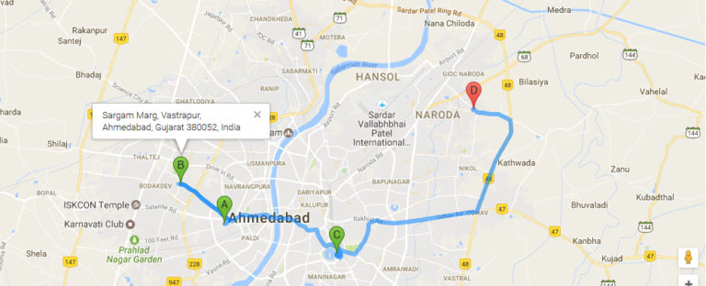
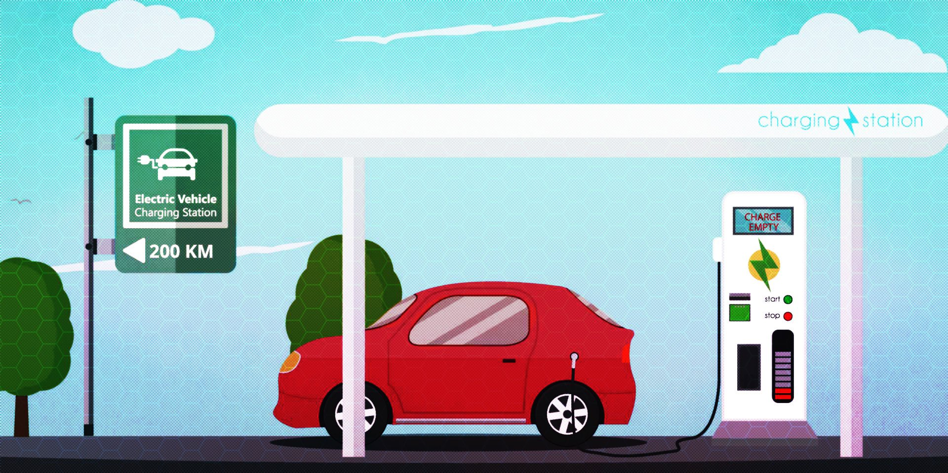
INTRODUCTION
Electric vehicles can reach it’s destination by this optimized route
Recharging time

Slide 3
PLAN
I) Generate the data
Simplification
Generate the database
II) Find the most optimal path
III) Display the map in a site
IV)Results

Slide 4
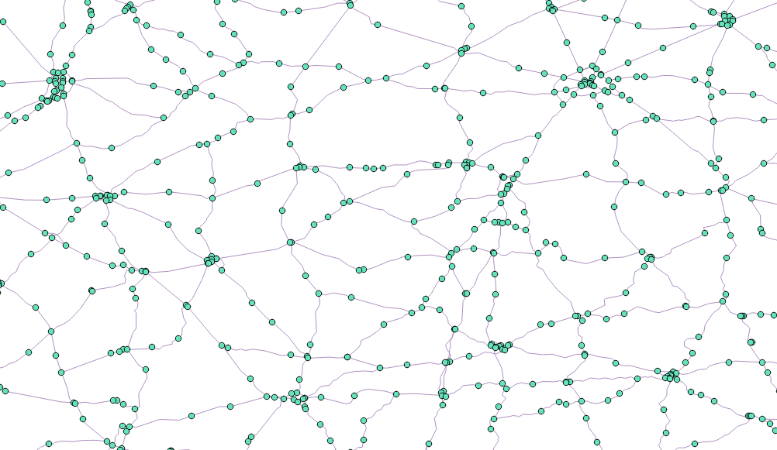
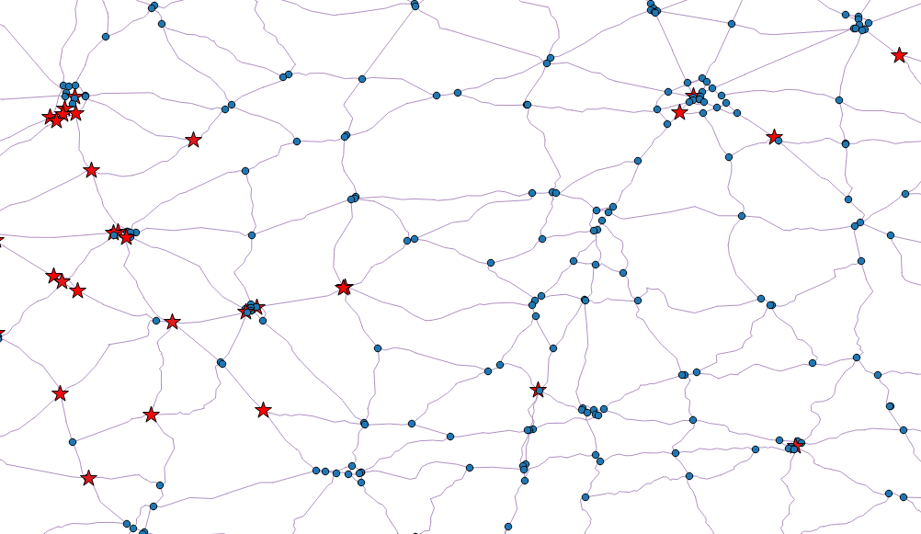
Generate the data
Simplification
Before:
After:

Slide 5



Generate the data
Simplification
Database backup.
Add Eij, electrical energy coefficient for each road arc.
Add Tij, time coefficient for each road arc (traffic, speed…)
Add charge time at each station.
Update database
Tij
Eij

Slide 6

Finding the most optimal path
Parameters
Starting and arriving points
Starting and arriving energy
Vehicule’s battery capacity
Travel time and energy consumption of the roads
Number of stations

Slide 7

Finding the most optimal path
Calculation method
Find the best stations
Determine the best itineraries going through these stations
Choose the itinerary with the lowest travel time

Slide 8
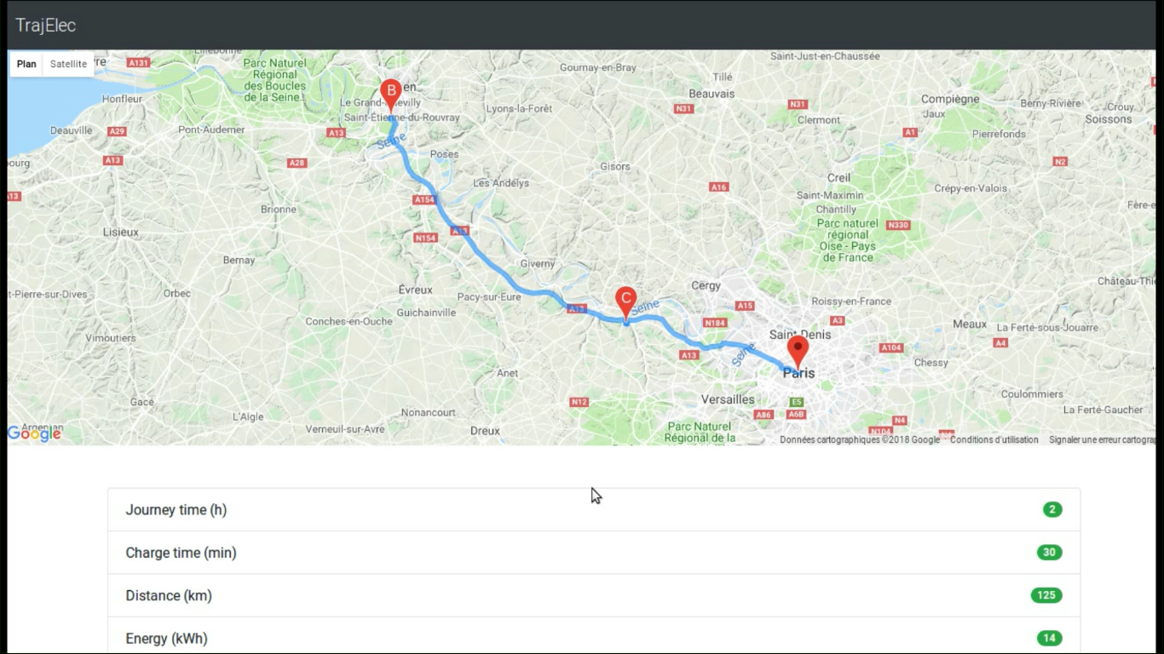

RESULTS
High response time due to the:
Implementation method used in the program
Huge amount of data to treat

Slide 9


CONCLUSION

