Slide 1
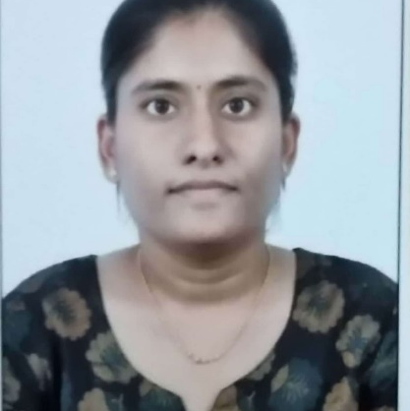


Parnapalli Sahithya
Analyst/Software Engineer
Master of Technlogy, Electrical and Electronics Engineering : 2019 - 2021
Skills
Mumbai
Java​ | Java Basics, OOPS, Generics, Collections, Arrays, Loops, Lambda Exp, Stream API Junit, Mockito
Spring Core | IOC & Dependency Injection, Autowire
Spring Rest | REST controllers, Implementation of GET, POST, PUT & DELETE, Bean Validation & Exception Handling, Testing Services, Controller & Repository layer
Spring Boot Microservices | Spring Boot Starters, annotations, Swagger API specifications
Spring Cloud | Eureka, Spring Cloud API
React​ | Components, Hooks, Event handling, Redux, Reducers
Database​ | Postgre SQL, MongoDB
UI Tech​ | HTML 5 & CSS 3,JavaScript
Tools | Eclipse, STS, GitHub, Postman, Swagger, Sonarlint, Visual Studio Code, Pg Admin 4, SQL Shell, Mongo Atlas & Compass
Add On skills​ ​ | Communications, Team management. Peer learning
Parnapalli.sahithya@capgemini.com
9948897142
A4
Full Stack Developer
Hands on experience in creating microservices with Springboot, Spring Security, Spring Cloud API Gateway, Eureka server, load balancing, rest template
Proficient in creating Single page Web Application in React redux with Authentication with route guards, axios, react router
Hands on experience in implementing polyglot architecture with ReactJs & spring boot
Experience in creating documentation with Java docs and swagger and in unit testing using Junit, Mockito including code quality compliance using Sonar lint
Hands on experience in developing web pages using HTML5, CSS3, Object Oriented Java script, JSON, XML. Good understanding of Document Object Model (DOM) and DOM Functions.
Online Hotel Management System Application
Completed end to end case study of Online Hotel Management using Microservices and MongoDB as a database along with JWT authentication, Swagger and payment using RazorPay. Implemented unit testing in middle ware.
All the Microservices are registered with Eureka Server. Used Spring Cloud API Gateway
E-Vehicle Showroom Admin and Dealer page
Case study of e- Vehicle showroom for admin and dealer pages along with API Gateway, Swagger, responsive UI with HTML5, CSS, Bootstrap and React used as User Interface.
Check out my work on GitHub

