Slide 1

Making Accessibility Accessible
Josh Dean
Mary Monroe-Ellis
Susan Mosteller
In Chrome web browser, open the following website.
PSCCMATH.github.io

Slide 2
Important Notes
We don’t know all the answers or even all the questions.
There will be 2 times today that you will need to do EXACTLY what we tell you in the order we tell you to do it. Yes, we know this is hard, but it’s the only way we will get through this.

Slide 3
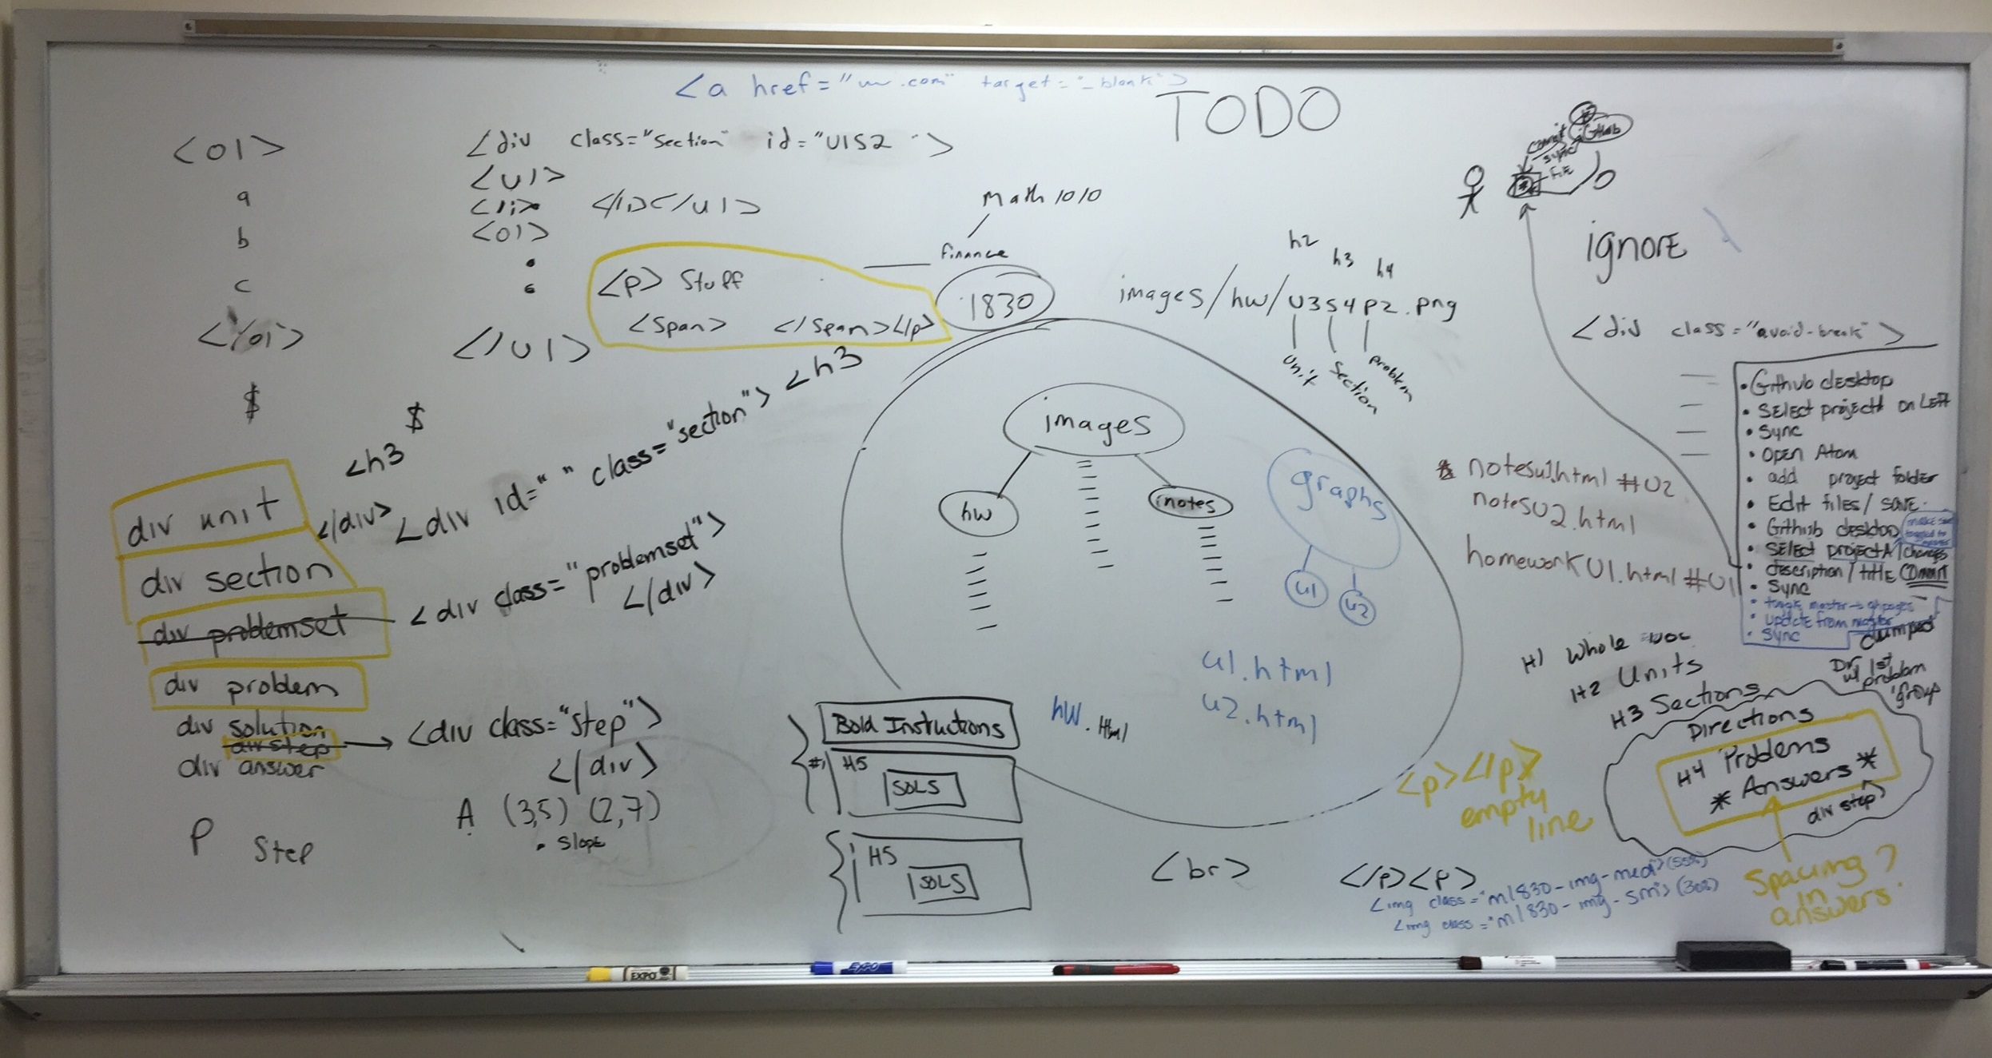
How We Got Here: From Word to HTML

Slide 4
Our Journey Through the 5 Stages of Grieving
Denial – Our Word documents look really nice.
Anger – We have over 250 pages of material to make accessible.
Bargaining – Hey! MathType in Word will publish to HTML. Problem solved!
Depression – Why did MathPlayer not read that equation….how many steps does it take to fix one typo…and where in the hell are my graphs?
Acceptance – Using MarkDown to create HTML documents gives us a truly accessible course. It can be navigated with JAWS. And we’ve found our graphs!!!

Slide 5
All HTML Documents Are Not The Same
HTML documents created using Word and MathType
In Word, convert equations and publish to MathPage.
Reliability is dependent on versions of software used by the instructor and student.
HTML documents created/edited in D2L
Equations are objects and are not visible in the editor
HTML documents created using Markdown
Easy work flow that can begin with your existing Word documents.
Forfeit some ability to customize
HTML documents created/edited directly in an HTML editor
More robust than Markdown – document can be fully customized.

Slide 6
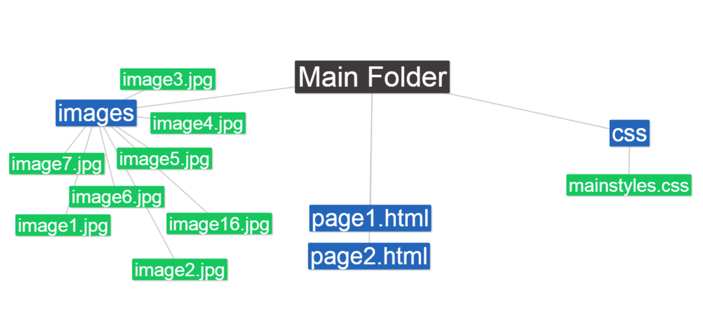
File Directory Tree

Slide 7
Our Word Document For This Workshop
Headers
Basic Text
Unordered List
Ordered List
Links
Images
Tables
Formulas

Slide 8
In Chrome web browser, open the following website.
PSCCMATH.github.io

Slide 9
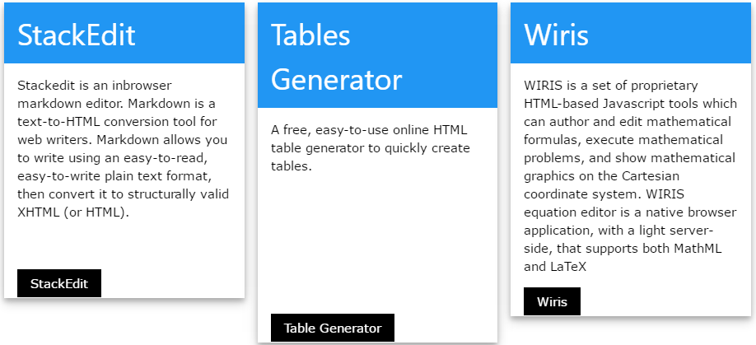
This is the first time you should do EXACTLY what we tell you!
Click on the Three Links
This will open each in a different tab.
We will use each of these as we work through converting our Word doc to Markdown.

Slide 10
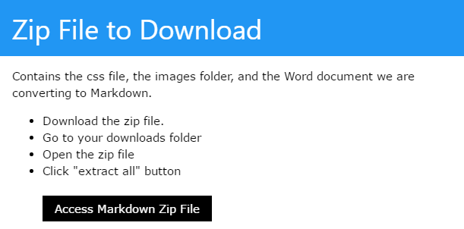
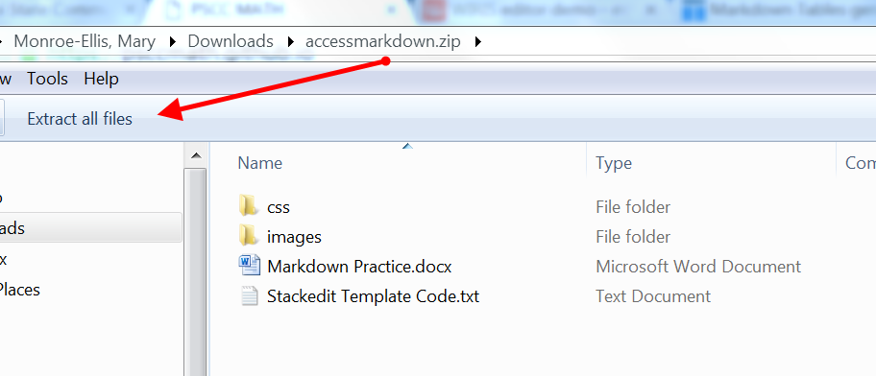

Steps to Download and Unzip the Folder
The files you will use today are zipped in a folder named: accessmarkdown.zip
We now have everything we need in the DOWNLOADS folder on our computer.

Slide 11
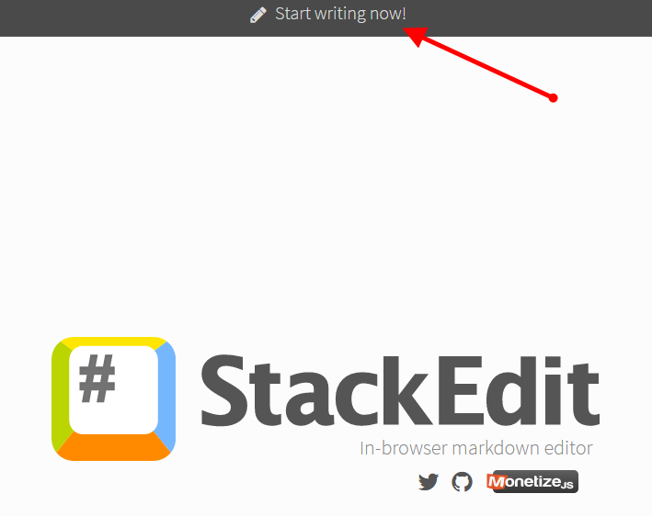
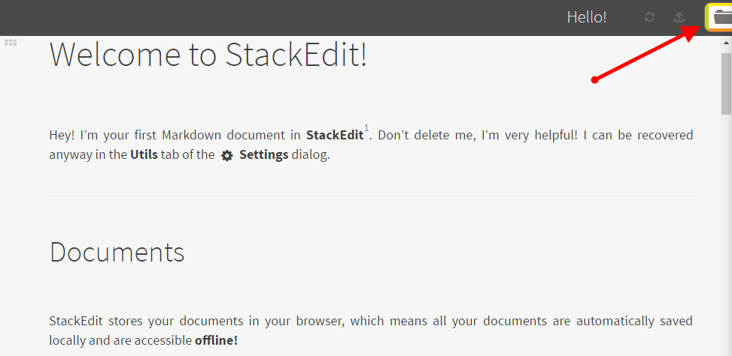
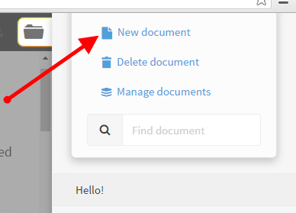
Click on your StackEdit tab
Click Start writing now!
Click on the folder icon on the top right.
Click on New Document.

Slide 12
Converting Word Document to Markdown
Go back to your downloads folder
Open the Markdown Practice Document
Ctrl A (to highlight the entire document)
Ctrl C (to copy the entire document)
Click on your Stackedit Tab
Ctrl V to paste the Word doc into a new Stackedit document

Slide 13
Editing in StackEdit
Headings
# (space) for Heading 1
## (space) for Heading 2
### (space) for Heading 3
…
Bold
Highlight the text you want to bold and click on the B on the top toolbar.
Italics
Highlight the text you want to bold and click on the B on the top toolbar.

Slide 14
Editing in StackEdit
LISTS: For all lists, make sure to hit enter BEFORE the first item in the list.
Unordered Lists (bullets)
Use the unordered list icon on the toolbar
OR
Use hyphen (-) and a space
Ordered Lists (numbered lists)
Use the ordered list icon on the toolbar

Slide 15
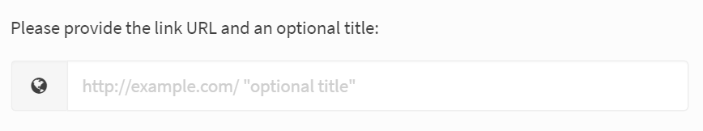
Editing in StackEdit
LINKS
Type in or highlight the words you want to describe the link.
Click on the link icon on the top toolbar.
Paste the URL into the box.
Click OK.

Slide 16
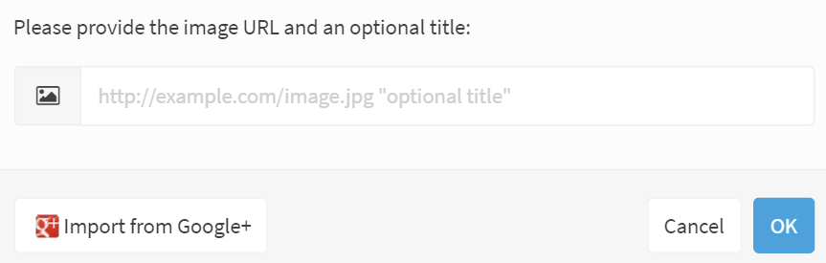
Images in StackEdit ***All images must be saved in your images folder.***
Click on the images icon on the top toolbar.
Type in the path to the image: images/nameoftheimage.jpg
Click OK.

Slide 17
Images in StackEdit (cont.)
Alternate Text
After you hit OK to insert the image, you have the option for alternate text.
[enter image description here](images/supplyanddemand.jpg)
If you already have alternate text in your Word document, copy and paste it into the brackets.
If you do not already have alternate text, then type the alt text in.

Slide 18
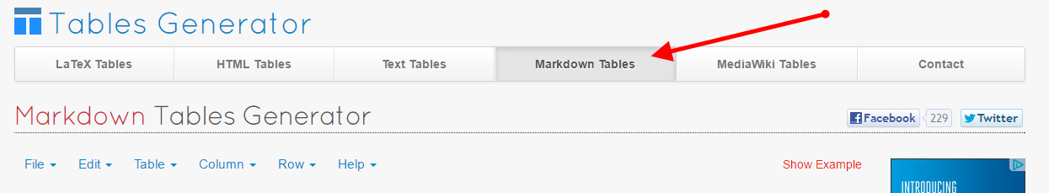
Tables in StackEdit
Copy a table from your Word document
Go to the Tables Generator website.
http://www.tablesgenerator.com/markdown_tables
Make sure you are on the Markdown Tables Tab.

Slide 19
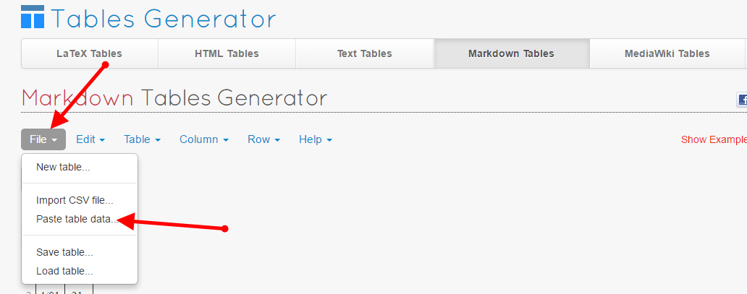
Tables in StackEdit (cont.)
4. Click on the arrow by File and choose Paste Table Data.
5. Ctrl V to paste your data in and click LOAD.

Slide 20
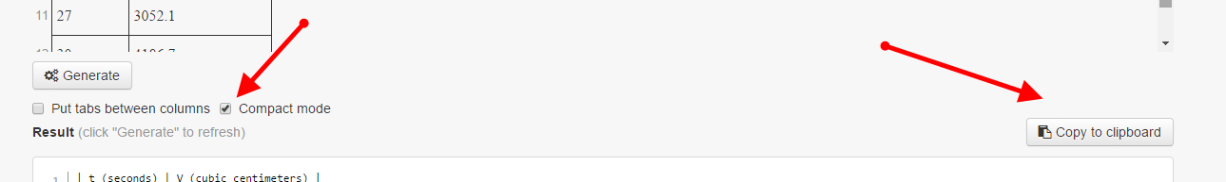
Tables in StackEdit (cont.)
6. Click on Compact Mode on the bottom left.
7. Click on Copy to Clipboard on the bottom right.
8. Go back to your document in StackEdit.
9. Ctrl V to paste the table into StackEdit.

Slide 21
Formulas in StackEdit
Easy Formulas
Formulas that can be typed from a standard keyboard can be typed directly into your StackEdit document.
Enclose the formula in $ signs
Example: $y=mx+b$
Double dollar signs $$y=mx+b$$ will center the formula on the page.

Slide 22

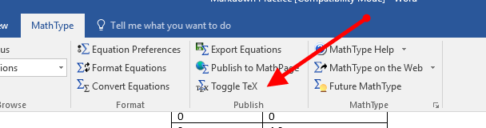
Formulas in StackEdit: MathType
Formulas in MathType
Click on the formula.
Click on the MathType tab.
Click on Toggle TeX.
Copy the LaTeX code into StackEdit.
$N\left( t \right)=~\frac{178t}{t+5}$

Slide 23
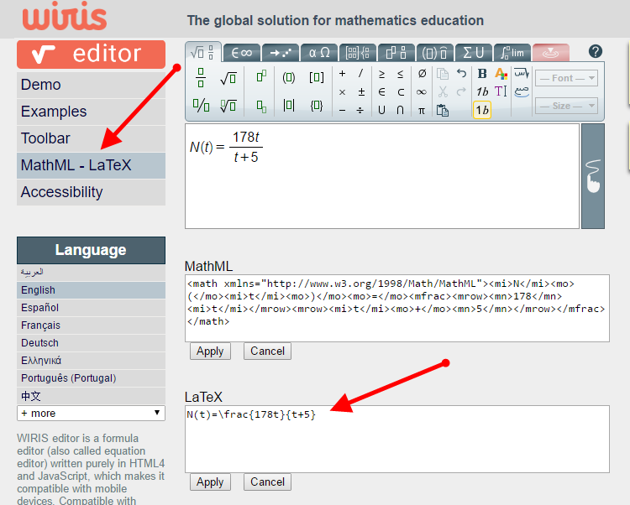
Formulas in StackEdit: Wiris
Wiris Equation Editor
http://www.wiris.com/editor/demo/en/mathml-latex
Open the Wiris Equation Editor.
(make sure you are on MathML-LaTeX)
Type the equation in.
Copy the LaTex formula into StackEdit.
(Remember to enclose it in $ signs.)

Slide 24
CSS Template
This is the 2nd time that you need to do EXACTLY what we say!
(The good news is that you only have to do this once for any computer you are working on.)
Go back to your zip file in the Downloads folder
Open Stackedit Template Code.txt
Ctrl A (to highlight the entire document)
Ctrl C (to copy the entire document)
Go back to StackEdit
Click on the #
Settings—Advanced
Delete everything in the Default Template box
Ctrl V (to paste in the css template)

Slide 25
Export Markdown from StackEdit
Click on the # on the left side of StackEdit
Export to disk Using Template
(The file will automatically go to your downloads folder but will not be placed in the unzipped accessmarkdown folder.)
Go to downloads folder
Move the html file to the unzipped accessmarkdown folder
Click on the html file to see the finished product

