Slide 1
EVENT MANAGEMENT SYSTEM
Project Report
Batch Members :
ALAGURAJA.U
MARUTHIRAJA
JAGADEESHKUMAR.C
SARAVANAKUMAR.N

Slide 2
Layers of webpage
HTML
Contains:
Content of a web page
CSS
Contains:
Style of a web page
JAVA
SCRIPT
Contain:
Behavior
Of a web page

Slide 3
Why java script used?
Light weight scripting language.
Interpreted language(inbuilt in all browser) It is otherwise known as java script engine.
Embedded directly into html code.
No need of purchase of license.
Validations in web page.

Slide 4
Working of java script
Browser server
Java script is a client side scripting language.
The client can validate by using JS.
But php, nod.js, asp are server side scripting language
WEB SERVER
HTML
CSS
JS
REQUEST
RESPONSE

Slide 5
Syntax of JS
JS uses <script>…..</script> in html page.
Two important attributes
-Language—it specified script language.
-type— optional since supports all browsers.
<script language=“javascript” type=“text/javascript”>…</script>

Slide 6
Where to place a script tag
HEAD
BODY
HEAD
BODY

Slide 7
DHTML(dynamic html)
HTML
This combination
Is known as
DHTML
DHTML
DOM
CSS
SCRIPTING LANGUAGE

Slide 8
Creating object, class, date conversion date, string, math methods
OBJECT:
Object in js are created with the help of constructor
The object constructor use new keyword to create a dynamically and generic object .
Syntax:
Var student=new Object(arg1,arg2,….argn);

Slide 9
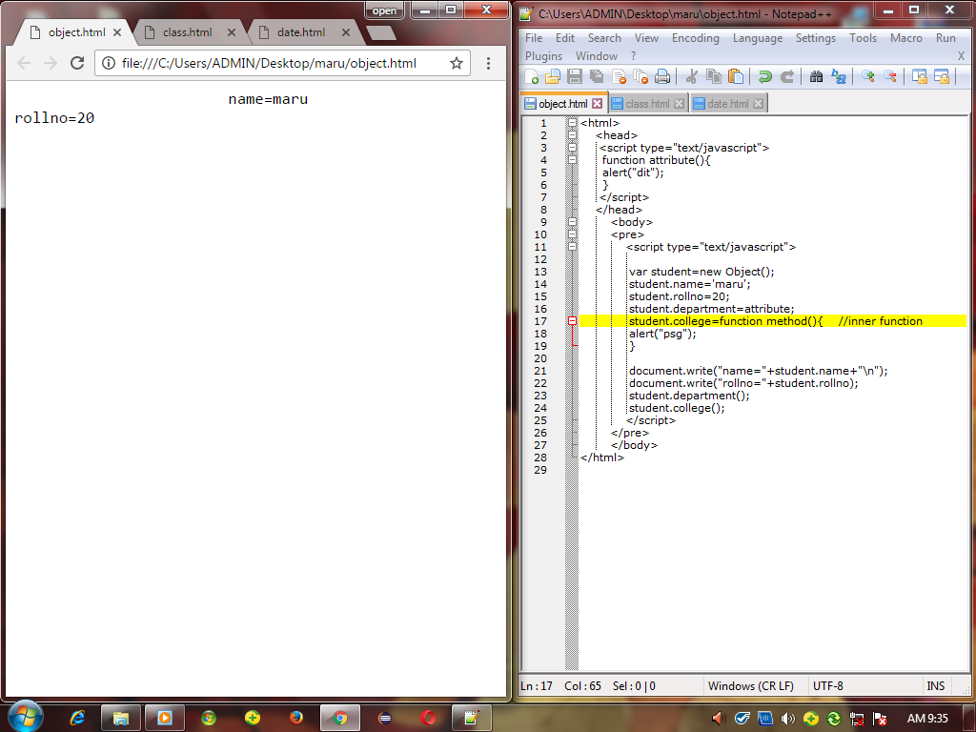
Example program for creating object in JS

Slide 10
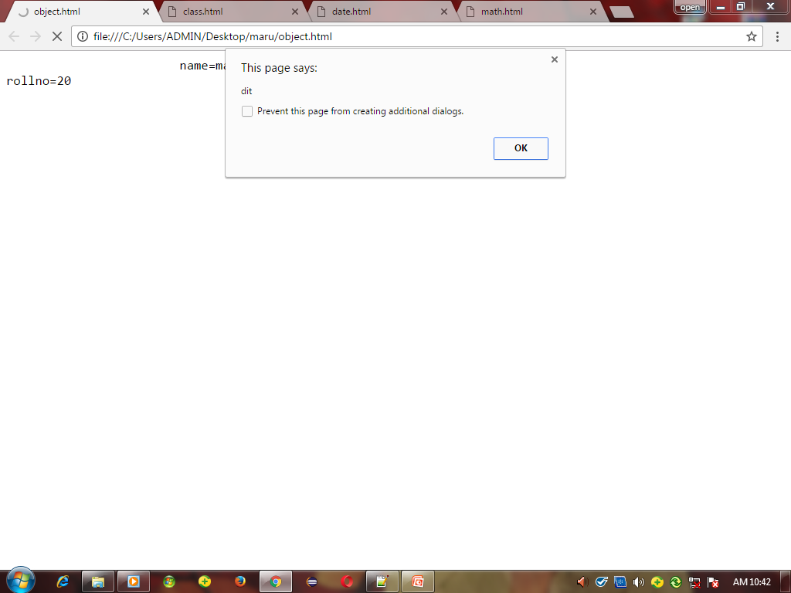
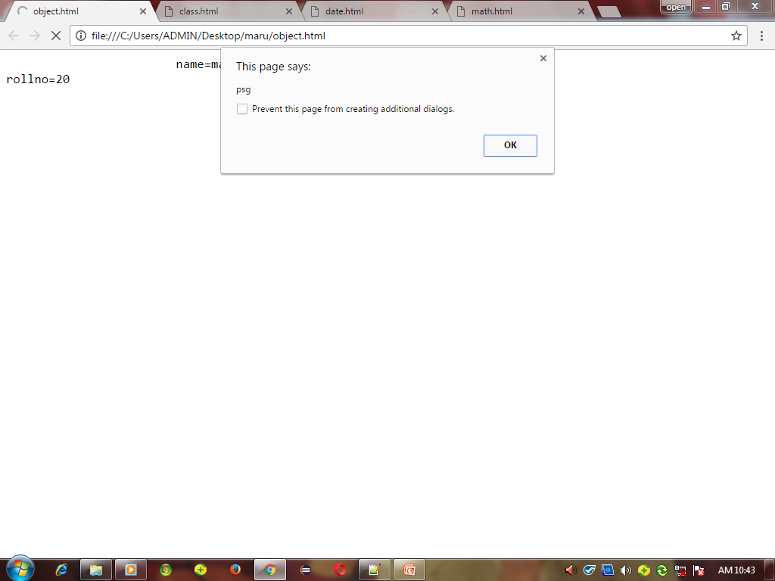

Slide 11
Create Classes
A class is created by using by just defining a function
‘this’ keyword is used refer the current object.
Syntax
function student(){
This.name=“srikanth”;
}
Var college=new student();

Slide 12
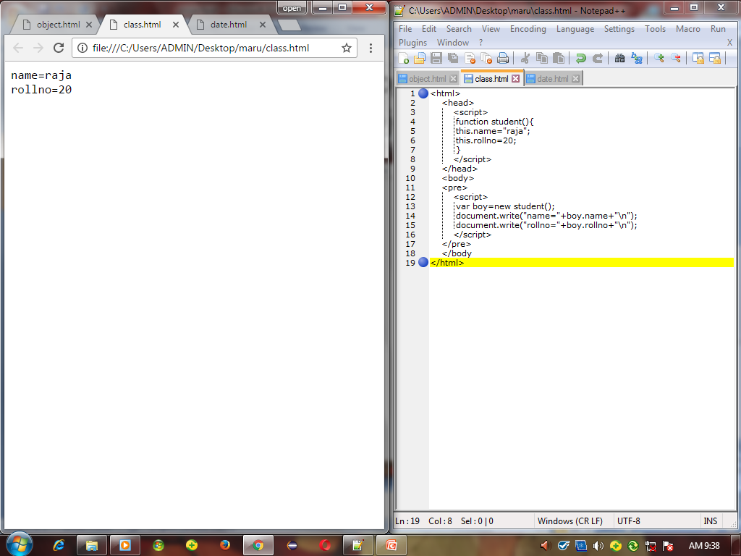
Example program for creating class in JS

Slide 13
Date method
Used to store date as well as time.
Syntax:
The most of the code is JS are in camal case.
Var myobj=new Date();
Methods:
getDate() setDate()
getMonth() setMonth() toLocaleString()
getFullyear() setFullyear() toDateString()
getHours() setHours()
getMinutes() setMinutes()
getSeconds() setSeconds()

Slide 14
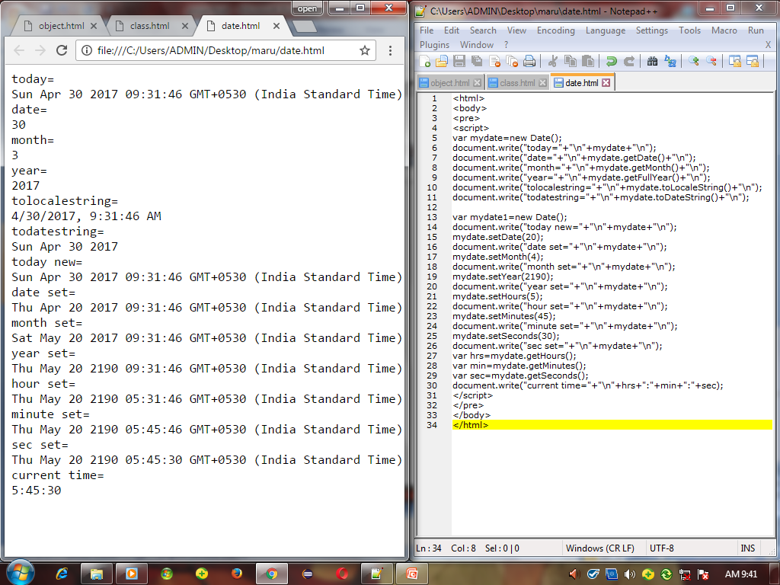
Example program for date method in JS

Slide 15
Math methods
Mathamatical operations are used in the java script.
To calculate in the JS the math keyword is used.
Examples:
math.sin(90);//0.89 math.round(230.54);//230
math.cos(90);//-0.44 math.PI;//3.14
math.tan(45);//1 math.pow(2,3);//8
math.abs(-20);//20 math.log(1);//0
math.ceil(2.5);//3 math.sqrt(16);//4
math.floor(2.5);//2

Slide 16
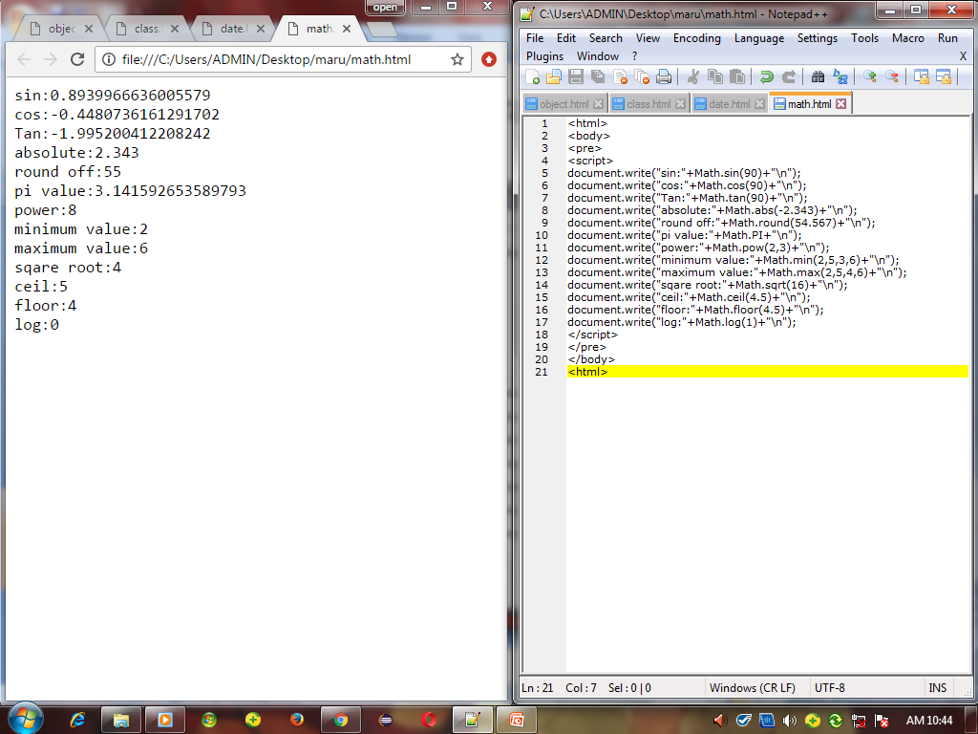
Example program for math methods in JS

Slide 17
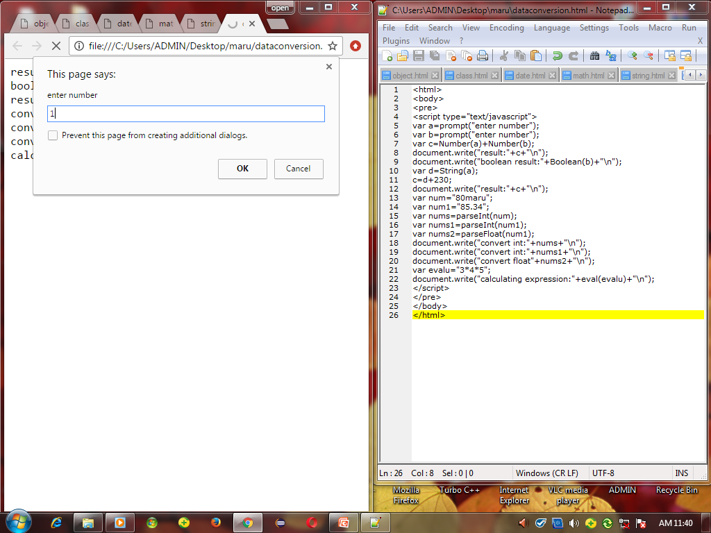
Data conversion

Slide 18
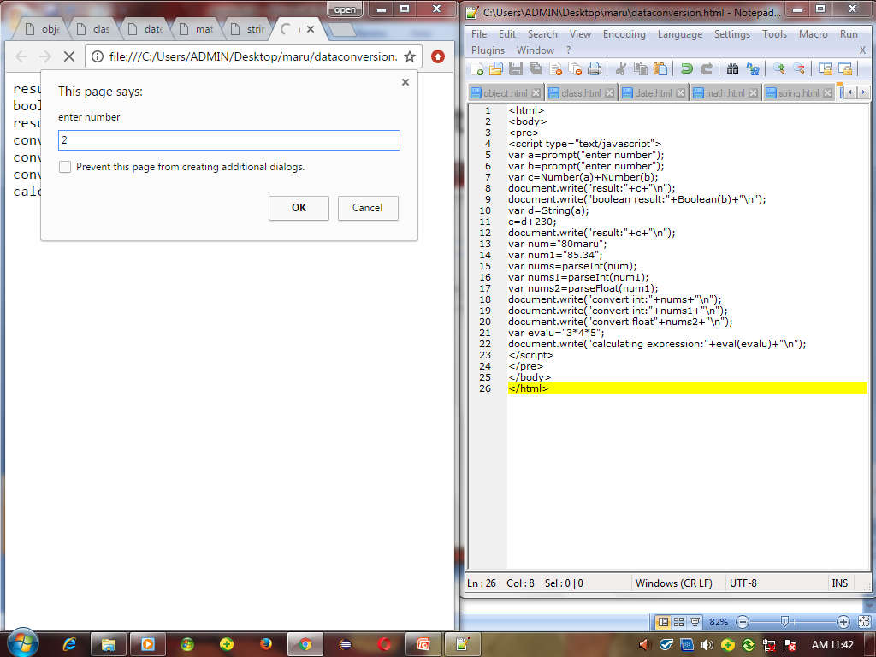

Slide 19
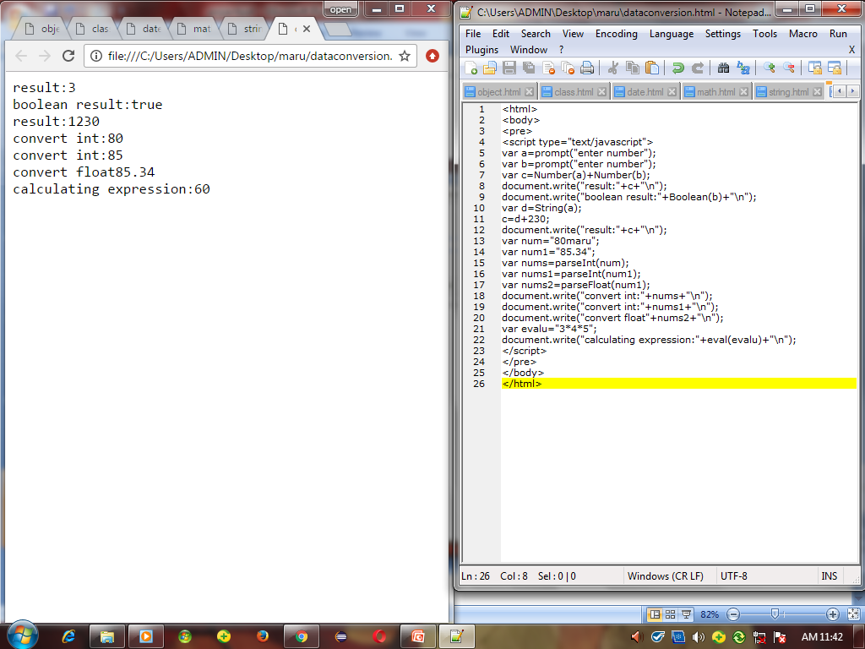

Slide 20
Applications :
Html+css
Ajax
JavaScript
Php

Slide 21
Process of login
faculty
Visit website
login
View event entry
Prepares proposal
Registered info

Slide 22
Login Page
User ID :
Faculty Adviser /Secretary
Password :
Faculty Adviser
Student Secretary

Slide 23
Club Inauguration
Clubs | Program meeting details | Hall Booking
Music club Dance club Women Development club Quiz Club | Venue : A block Venue : Y block Venue : K block Venue : D block
websites

Slide 24
Event Registration
Name of the Association/club :
Name of the Event :
Date of the Event :
Invitation :
Email to Principal/HOD/Tutor/Faculty
submit
cancel

Slide 25

Gallery
Photography :
Choose images
upload
submit
cancel

Slide 26
Thank you

