Slide 1

SharePoint Online PowerShell is confusing, let fix that…
By B.J. Fentress
Senior Systems Engineer CareSource

Slide 2
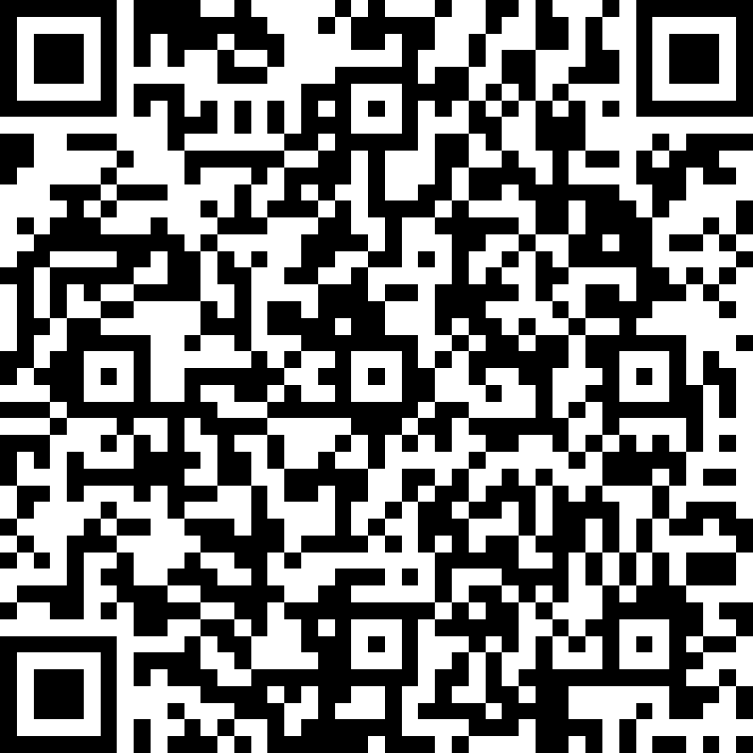
About ME
Currently a Senior Systems Engineer with CareSource in Dayton, OH
Live and work in Cleveland, TN
11 years of experience working with SharePoint and SQL
More cloud focused each day
Becoming more developeree
DevOps noob
Blogger about 5-6 years

Slide 3







How Can we work with SharePoint Online? (Feel free to clap or boo below)
Web browser
Admin portal
SharePoint Destroyer (Designer)
InfoPath
CSOM
PowerShell
PnP PowerShell

Slide 4
Why is SharePoint Online PS confusing?
First of all, you need the admin role for SharePoint Online given to you by a global admin
Permissions
Roles
Multifactor auth? (MFA)
Take heart, not too different from Get-SPSite and others

Slide 5
Connecting to SPOnline
Download latest version of SharePoint Online Management Shell
https://go.microsoft.com/fwlink/p/?LinkId=255251
Can install multiple versions with –Force
Hint: uninstall one version before updating to a new one
List of commands:
https://go.microsoft.com/fwlink/?linkid=869060

Slide 6
Demo
Connecting
Listing
Isolating certain sites
Now lets kick it up a notch

Slide 7
What is PnP PowerShell
Community Project – GitHub
https://github.com/SharePoint/PnP-PowerShell
https://docs.microsoft.com/en-us/powershell/sharepoint/sharepoint-pnp/sharepoint-pnp-cmdlets?view=sharepoint-ps
Updated each month ongoing basis
Different Modules for different versions of SharePoint
Online, 2019, 2016, 2013
Can install multiple versions (ie. SharePoint Hybrid setup)
Updating versions much easier than SPOnline

Slide 8
Connecting with PnP to Sponline and Demo
Installing
Connecting
Listing
Easier?

Slide 9
CSOM Online
Office 365 Developer Blog
https://developer.Microsoft.com/en-us/sharepoint
https://developer.microsoft.com/en-us/office/blogs/new-sharepoint-csom-version-released-for-sharepoint-online-june-2019/
Updated each month to go along with feature updates

Slide 10
SharePoint Framework - SPFx
Way to develop features and apps in SharePoint Online, SharePoint 2019, and SharePoint 2016 with Feature Pack 2
Requires a bit of config to get configured correctly
Create an app catalog site
Then create a site collection to test with
Can use workbench to test with (https://your-sharepoint-site/_layouts/workbench.aspx)
Then configure development environment locally
Install Node JS
A code editor (VS Code?)
Install Yeoman and gulp
Then install the Yeoman generator

Slide 11
How to get started
Desktop through windows 10
VSCode
Visual Studio Community Edition
Set up a developer tenant with Office 365
https://social.technet.microsoft.com/wiki/contents/articles/37830.office-365-how-to-set-up-a-developer-subscription.aspx
https://developer.microsoft.com/en-us/office/dev-program

Slide 12
Demo - tips
Figuring out what we have in SPOnline
Cool Tools
https://github.com/Zerg00s/productivity-tools

Slide 13

Questions?
https://github.com/PSHChatt/PowerShell-On-The-River-2019
https://bjfentress.wordpress.com
https://twitter.com/bjfentress

