Slide 1

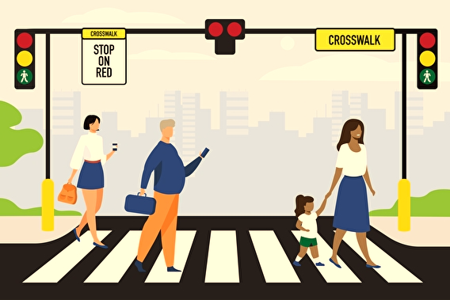
June – September
2023
IEEE ITSS Student Competition in Pedestrian Behavior Prediction

