Slide 1





CAMIS
Comparing
Analysis
Method
Implementations in
Software

Slide 2
Disclaimer
This presentation reflects the view of the PHUSE CAMIS Working Group and does not necessarily represent the position of PAREXEL or GSK

Slide 3

Why Document Comparisons
Lyn
Has been in industry for 20+ years
Prefers SAS
Christina
Newer to industry
Learned object oriented programming in school and prefers R

Slide 4
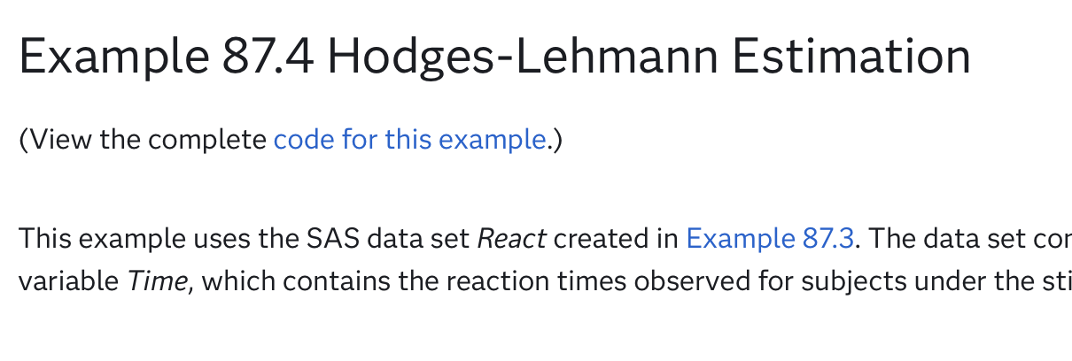


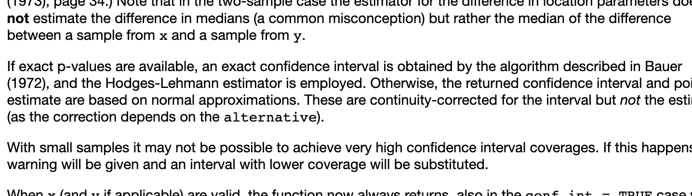
Why Document Comparisons
Lyn
SAS®
Christina
P-value = 0.049, CI = -1.72 to -0.024
P-value = 0.051,
CI = -1.65 to 0.036
Notes:
Even the best documentation focuses on what that software did not how the choices in software might differ from other software
CAMIS was born from a desire to consolidate these differences
Transitions:
What can you do to make sure that you don’t run into this issue at a critical time?

Slide 5
How to Avoid Finding Differences at Critical Times
Make sure to have clear requirements
Check CAMIS
Consider defining tolerances rather than looking for exact match between prod and QC

Slide 6
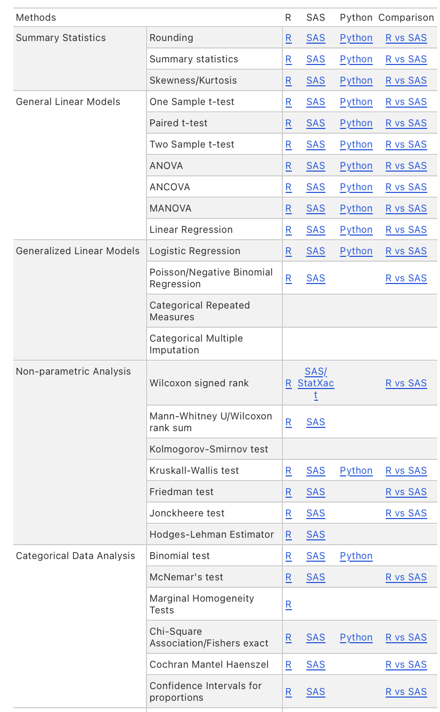
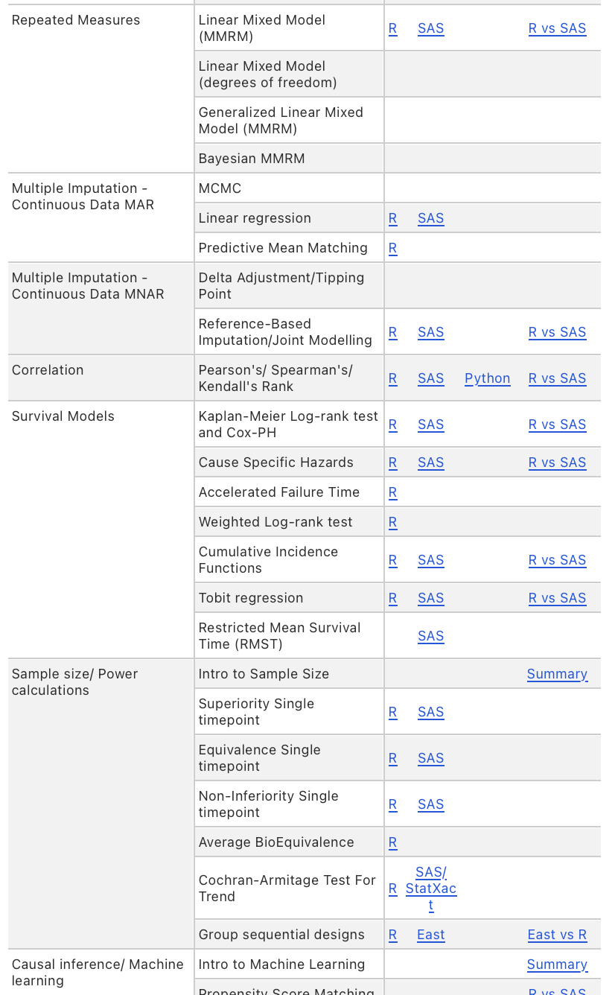
What does CAMIS Cover?

Slide 7
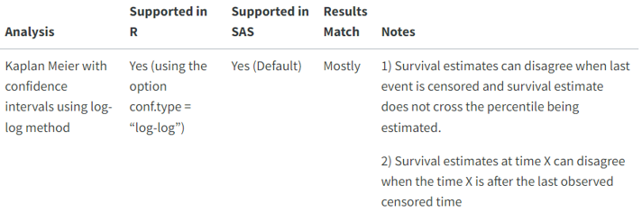

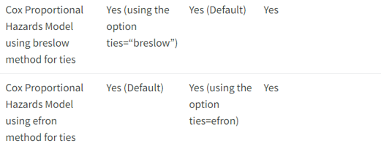
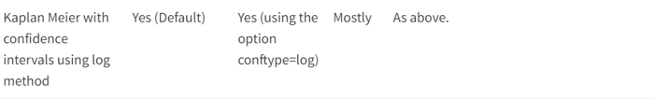
Differing Defaults
Kaplan Meier Cox – PH regression

Slide 8
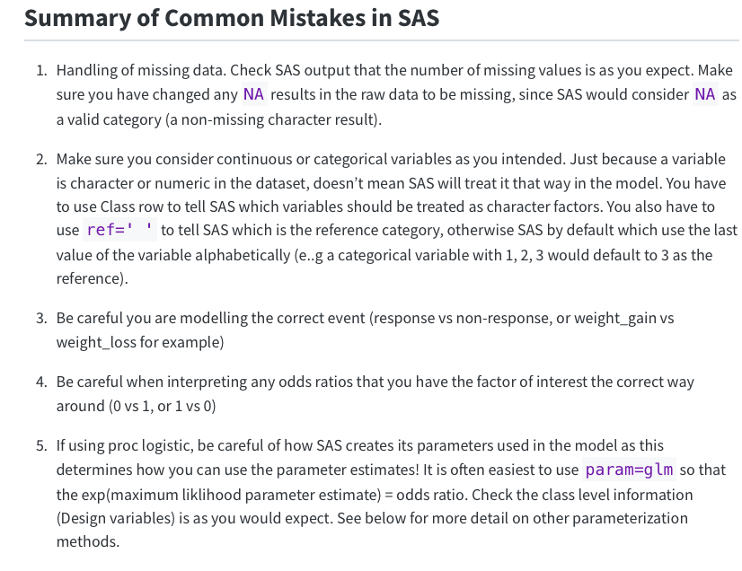
Identifying Common Coding Mistakes
Logistic Regression

Slide 9
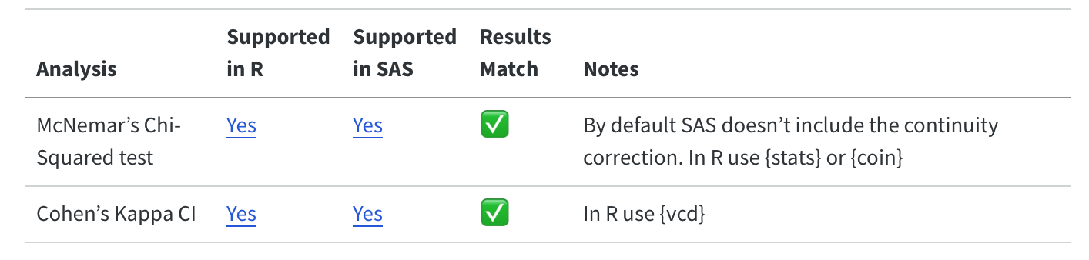
Identifying Packages Not Being Maintained
McNemar’s Chi Squared
{epibasix} package
Categorised as ‘High Risk’ by {riskmetrics} package
Unknown by the author what equation they used to calculated the CIs

Slide 10
Finding Bugs and Getting them Corrected
{RBesT} produces Clopper Pearson CIs
Matched {cardx} and {Hmisc} except 2 cases
Authors informed
Package updated & re-released on CRAN as v1.8-0
CAMIS Improves reliability & confidence in R packages
x = 0 (0% responders), in which case the lower limit does not match.
x = n (100% responders), in which case the upper limit does not match.

Slide 11
Key Impacts
Documentation of Differences due to Methodology use
Continuity corrections
Different Defaults
Methods / Options not available in both software
Common implementation mistakes and any unclear software documentation explained
Bugs identified (and R packages updated & fixed!)
CAMIS Is a Trusted Resource for Industry Guidance
Notes:
Can just go through this slide only….. Or go through each point individually below.

Slide 12

How You Can Help the CAMIS Project
Be a
Contributor
To the
Repository !
Use it as a key resource
Contribute !
We are happy to receive any contribution (big or small!):
Help to grow the repository with
New methodologies
More software comparisons
Improve the content by review & revision

Slide 13
Example
For a study comparing treatments A and B in patients. Apply the Wilcoxon rank-sum test to analyse the change from baseline FEV1 post-mannitol challenge 2. Report the Hodges-Lehmann estimate of the median difference between treatments (B vs A), corresponding 95% CI and the associated p-value
Notes:
While this is pretty clear language, it is actually missing some information. It doesn’t explain how ties and 0 differences should be handled

Slide 14

How to Compare
Is this method possible in both software?
Are there multiple ways to do this in each software?
Are considerations we need to make when choosing a dataset?

Slide 15
Example
Is this method possible in both software?
stats
pairwiseCI
coin
Are there multiple ways to do this in each software?

Slide 16
Comparing Packages
Is this package being actively maintained?
Is the author known in this field?
Does one of the packages have better documentation?
Look at community adoption?
Can the packages handle different edge cases?
Notes:
We don’t want to do a full GxP evaluation of the packages, but also we don’t want to do a many to one comparison. So, we need to chose a package

Slide 17
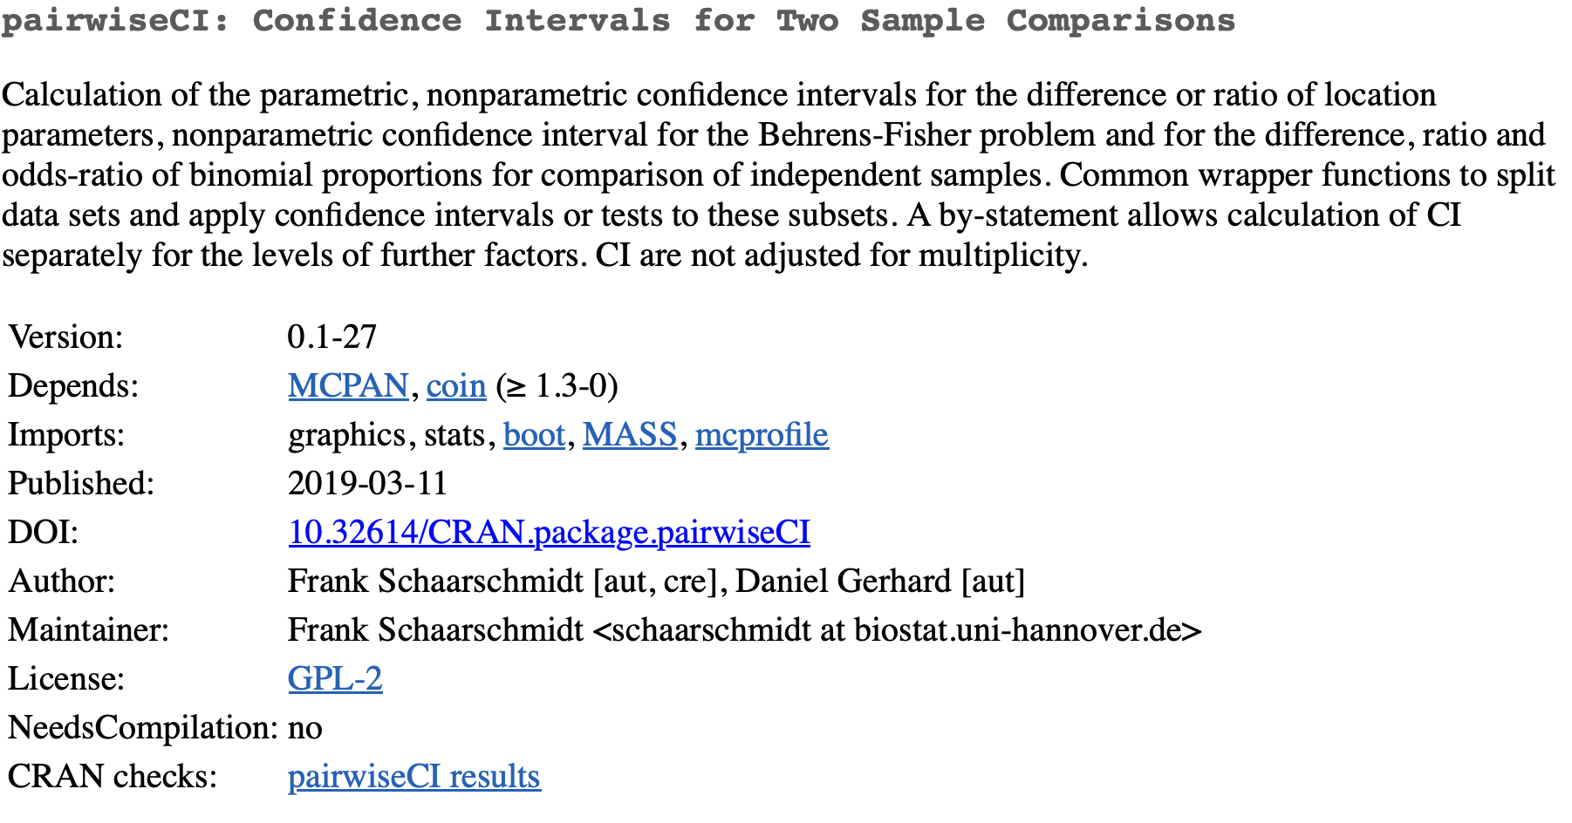
Example

Slide 18
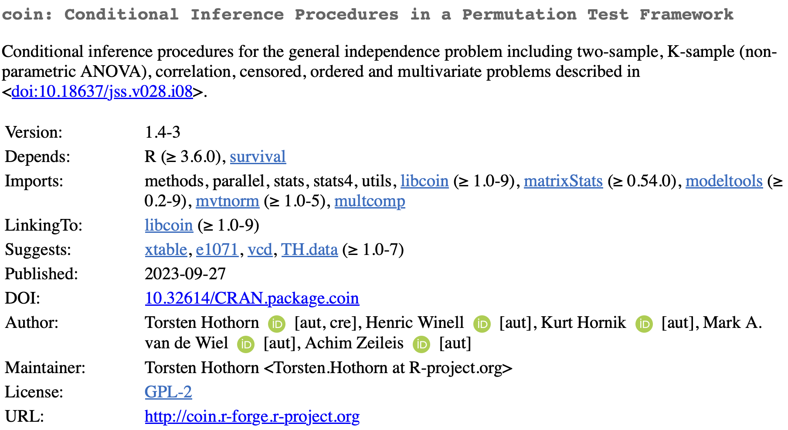
Example

Slide 19
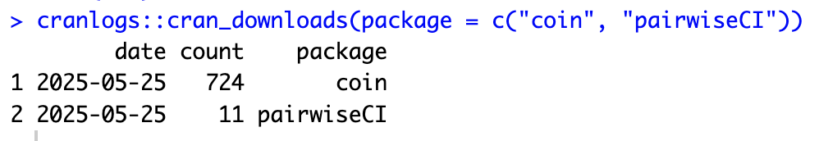
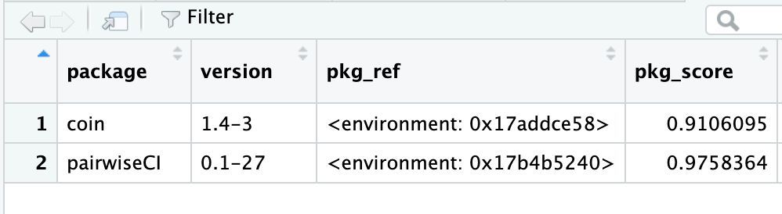
Example

Slide 20


Example
Is this method possible in both software?
Are there multiple ways to do this in each software?
Are considerations we need to make when choosing a dataset?
Because we have known issues with ties, we want to make sure to have a dataset that includes them

Slide 21
Example
 | R {coin} | SAS
P-value | 0.009392 | 0.0094
CI | -0.76 – -0.1 | -0.77 – -0.0900
 | R {coin} | SAS
P-value (asymptotic) | 0.009392 | 0.0094
CI (exact) | -0.76 – -0.1 | -0.7600 - -0.1000
P-values (exact) | 0.008181 | 0.0082
CI (asymptotic) | NA | -0.77 – -0.0900

Slide 22
Example
For a study comparing treatments A and B in patients. Apply the Wilcoxon rank-sum test to analyse the change from baseline FEV1 post-mannitol challenge 2. Report the Hodges-Lehmann estimate of the median difference between treatments (B vs A), corresponding 95% exact CI and the associated exact p-value (without continuity correction)
Notes:
If this is a small study, we can’t use the normal approximation, but we still want to use asymptotic (moses) ci

Slide 23
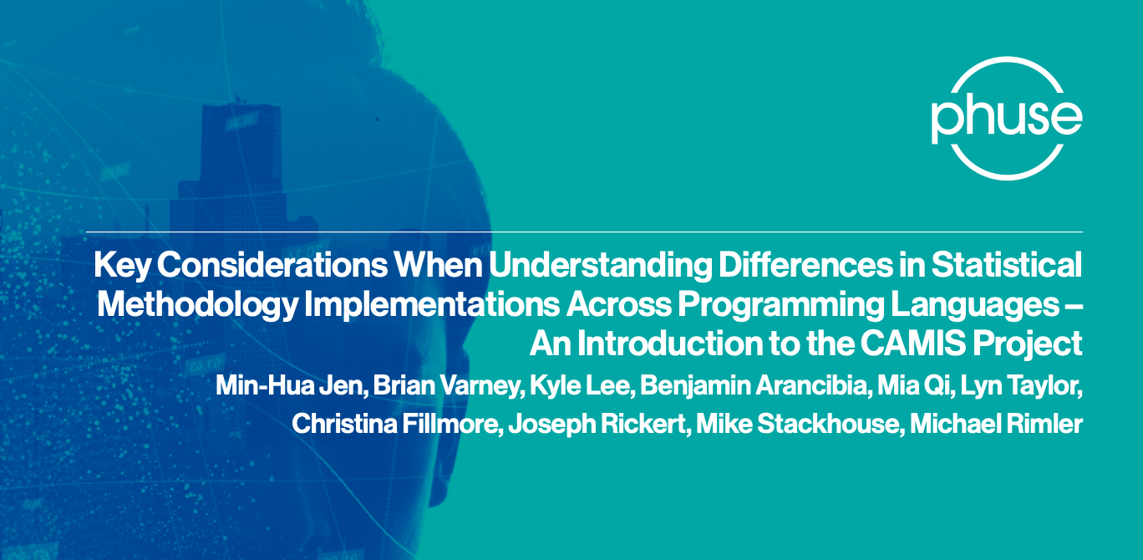
CAMIS Objectives
Understand and Document analysis result discrepancies across software
Demonstrate the methodology through examples
Document in open GitHub repository
Grow the repository, increasing quality and quantity of information
Notes:
So to address this need, CAMIS started up.

Slide 24

Questions ?
CAMIS website: https://psiaims.github.io/CAMIS/
GitHub Repo: https://github.com/PSIAIMS/CAMIS/
Open issues: https://github.com/PSIAIMS/CAMIS/issues

