Slide 1

Version Control with Git & RStudio
Christina Fillmore (GSK)
Lyn Taylor (PAREXEL)
Irene Vassallo (Incyte)
Alexandra Lauer (Merck KGaA, Darmstadt, Germany)
1

Slide 2



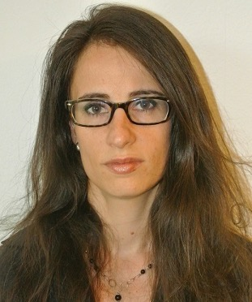
Introductions
Who are we?
What do we do?
Alexandra Lauer
Christina Fillmore
Lyn Taylor
Irene Vassallo

Slide 3
Introduction Agenda
Intro to git and GitHub
Git in Theory
Git in Practice
3
Notes:
This will be an interactive course
Questions in the chat box

Slide 4
Our Environment
Shiny app for theoretical exercises
https://camis.shinyapps.io/git-app/
Posit Cloud for practical exercise
https://posit.cloud/

Slide 5








What is Git?
Git is a version control system
Created by the maker of Linux (Linus Torvalds) to help make Linux
Git is the system that manages the versioning, but GitHub is the cloud-based service to manage Git repositories. Other hosting services do exist like Gitlab or Bitbucket

Slide 6







Some basic terminology
Repository (aka repo): a collection of code you want to track together
Commit: a saved version of your file/project
Only track change
One commit can have changes to multiple files
Notes:
Repository: Group of code to track together, it can be as big or as small as you want. If you are using RStudio projects, then typically one project has one git repo.
Commits similar to checking out and checking your code back in with Trial Master Files VCS system. Each commit is often presented as a dot, with multiple commits connected by a line. But there are two important differences
commits only track changes
Commits can have changes to multiple files

Slide 7

Case Study: Camille
Week 1
Day 1: Analyses data and makes a graph
Day 2: Submits to journal A
Day 3: Continues to explore other analyses
Day 4: Modifies her graph
Day 5: Submits to journal B
Work icons created by Eucalyp - Flaticon
Notes:
This is Camille, she has her coffee, and laptop ready for a week of programming analysis for a publications.
On Day 1 she does some great analyses and writes the results up.
On Day 2 she submits this to a journal - hopeful of getting published,.
On Day 3 she explores more analysis, adding new variables to her dataset and putting them into her model to see if it finds anything else interesting
On Day 4 She modifies the graphs a bit more
On Day 5, she does more analysis, graphs and tables and writes this up to submit to journal B
She’s thrilled with the great week she’s had, shuts down her lap top and heads off to enjoy her weekend.

Slide 8

Case Study: Camille
Week 2
Day 1: Journal A has questions. Camille goes back to her program but it’s all changed
“My code has changed”
“What did I call that version?”
“Where did I store it?”
“I don’t want to have to undo the work I have for Journal B”
Work icons created by Eucalyp - Flaticon
Notes:
On Monday she comes back to find an email from journal A. They would like her to re-run the analysis but this time including Variable A in the model.

Slide 9
Exercise 1: Committing
Go to the App and work through Q1, Q2, and Q3 in the committing section
We will be available for help if you need it, just ask your questions in the chat box
We will resume in 10 min
Notes:
Raise your hand when you are done

Slide 10
What we did in the exercise
Made a commit
Created a git network graph
“checked-out” different commits
Tagged a commit
Notes:
Talk about checking out different commits
Also mention that bad commit messages makes it hard to find things
The commit that is being actively check-out is called the HEAD

Slide 11
Checking-out
The checkout command in git is used to move around
The commit that is currently checkout is referred to as the “HEAD”

Slide 12


Tags
Often used for package releases
Any commit can be tagged
But only one commit can be tagged
Notes:
Tag can be super helpful in identifying things, such as what commit was used to create the plot for Journal A. But, Camille needs to update that plot. A single commit is tagged, so if Camille updated the code that tag wouldn’t travel to the latest. Plus, Camille doesn’t want to undo any of the work she has done on the graph for Journal B

Slide 13
Branching
Branch 1
Main
Branch 2
Notes:
Branching allows us to make non-linear changes to the code.
By making changes to branch 1 we will leave the main branch unaffected
By convention, the primary branch where most branches originate will be called main
Any commit can have a branch off of it
There is no limit to the number of branches that can be made, you can even have multiple branches off the same commit

Slide 14
Exercise 2: Branching
Go to the App and work through Q1 and Q2 in the branching section
We will be available for help if you need it, just ask your questions in the chat box
We will resume in 10 min

Slide 15
What we did in the exercise
Made a branch
Committed to the new branch
“checked-out” different branches
Notes:
Talk about checking out different commits
The commit that is being actively check-out is called the HEAD

Slide 16
Merging
Branch 1
Main
Notes:
The thing that makes branching super powerful is our ability to combine everything back together. In git there is called merging
To merge all we need to do is combine the changes from branch 1 into main this can be done through a pull request on github or via the git merge command.
In order

Slide 17

Merging
– Conflict!
Branch 1
Main
Notes:
Sometimes when you are trying to merge two branches together you can get a merge conflict. This conflict arises because git is dumb! It is only tracking differences and not when you make those changes. So, if two branches are changing the cam line in the same same file git won’t know which one to keep.

Slide 18
Merging – Conflict!
library(dplyr)
<<<<<<< HEAD
library(lme4)
=======
library(MMRM)
>>>>>>> Branch1
Notes:
But, don’t worry merge conflicts are pretty easy to fix. When you try to merge the branches, you will get a merge conflict error and then it will tell you which files you need to fix. To fix the files you look at the code looking for >>>>, ====, and <<<<. These are the places where there are issues. If you want to keep all the code you can just delete the >>>, ====, <<<, but if you only want to keep stuff from branch one then you are only going to keep the top bit and everything else you are going to delete

Slide 19
Exercise 3: Merging
Go to the App and work through Q1 and Q2 in the merging section
We will be available for help if you need it, just ask your questions in the chat box
We will resume after 15 min

Slide 20
What we did in the exercise
Merged a branch into main
Resolved a merge conflict
Notes:
Talk about checking out different commits
The commit that is being actively check-out is called the HEAD

Slide 21
A branching rule of thumb
Branches are cheap, make lots of them!
The longer branches grow away from main, the harder it will be to merge them back.
If you want to change something, branch - update - commit - merge back to main

Slide 22

Case Study: Camille & Sylvie
Work icons created by Eucalyp - Flaticon
Notes:
Now everything is going great for Camille, she has been able to to pull everything together for Journal A and Journal B. But she needs some help finishing up things up, so Sylvie is going to join the team. But, Camille wants to share all the wonderful work she has been doing with git!

Slide 23
Collaboration
Local
Remote
Notes:
Camille now wants to share her code with Sylvie, but it is only on her computer. To share the code she is going to need to put it online so Sylvie can pick it up.
This is where the cloud-based services like github, bitbucket, and gitlabs come in. They work by mirroring your local git network in the cloud. The cloud is generally referred to as the remote. The exact location in the cloud where the repo is is called the remote

Slide 24
Let’s walk through how this works
Push
Clone
Notes:
The first thing Camille is going to do in order to share the code with Sylvia is to make a repository somewhere on either github, gitlab, or bitbucket
Now she is going to set the origin in her local repository to be the repo she setup and then she is going to push the code to the remote
Finally Sylvie can pull those changes to her local computer which will allow her to work

Slide 25
Let’s walk through how this works
Pull
Push
Notes:
Sylvie has made her own branch based off the tagged Journal A plot commit. She wants to share this back to Camille
To do this she pushes her code back to the origin. Now her branch is in the remote as well as Camille’s main branch
Camille wants to be able have some of Sylvie’s code she pulls the repository and it adds Sylvie’s branch to her local working area
Note: Camille is only pulling the branch down cause she already have the repo locally, you only need to clone for the first action

Slide 26
Exercise 4: Remotes
Go to the App and work through Q1 and Q2 in the remotes section
We will be available for help if you need it, just ask your questions in the chat box
We will resume in 10 min

Slide 27
What we did in the exercise
Located different branches
Cloned a repo, created a branch, and pushed changes back to the remote
Push
Pull
Notes:
Talk about checking out different commits
The commit that is being actively check-out is called the HEAD

Slide 28

Case Study: Camille & Edward
Work icons created by Eucalyp - Flaticon
Notes:
Now let’s imagine Edward, some person on the internet unrelated to Camille’s project wants to contribute.
As Camille wants to retain control of her original project, she could protect it from outside changes and thus prohibit Edward from branching off of it. In order to still be able to use Camille’s work as a starting point, Edward might want to fork Camille’s repo. This creates a direct copy of the remote where Edward enjoys full ownership. He can apply changes as he wishes.
At a later point in time Edward can decide to open a pull request (PR) and propose his changes to the original project. This gives Camille the option to review changes to her code in the PR and decide which parts of the fork to merge into her original project.

Slide 29


Let’s walk through how this works
Clone
Notes:
Edward would like to pull from Camille’s repository but does not have enough access rights to do so.
He cannot pull and is unable to create the local copy of Camille’s project.
Edward needs to create a remote copy of Camille’s repo, where he enjoys full control and from where he can pull stuff to his local computer.

Slide 30
Let’s walk through how this works
Fork
Clone
Notes:
The first thing Edward needs to do to work on the project, is create a fork. The fork is a remote copy of Camille’s repo owned by Edward.
Edward pulls the repo to his local computer.
He can now continue working.

Slide 31
Let’s walk through how this works
?
Pull Request
Push
Notes:
Now Edward made changes on his local computer.
He pushes the changes to his fork, which, as we remember, is a remote where Edward has full ownership over the project.
For these changes to be reflected in the original, protected repo, he opens a pull request, asking the owner (Camille) to approve his changes.
After Camille has reviewed and approved Edward’s changes they are merged into the repo.

Slide 32


Coffee Break
20 min
Notes:
As a summary, forks allow for controlled collaboration outside of a designated project team. Users can create a fork, which is a remote copy of the protected repo where they are the owners and can hence do what they want. To promote their changes to the original project, they open a pull request, or PR, and the project maintainers can then decide whether to approve the PR and merge the changes, or reject it.
This is a case you will likely encounter in the development areas of R packages. Write access is granted only to the designated team of core developers. If users want to collaborate, because they wrote code to fix a certain bug in the package, they would create a fork, add the code for the bug fix and open a PR. The package author would then review the code and either reject or approve it.
This concludes the theoretical section. We have learned how to read a network graph, are now familiar with the concepts of commits, branches, merging, push and pulls and know how to differentiate between our local repo and the remote. Finally, we learned about forks. We’ll now have a 20 minutes break.

Slide 33
Git in Practice
Hands-on posit Cloud demo

Slide 34
What we will cover
How to navigate GitHub
How to fork a project and clone it
How to set up your Git identity and safely connect your local environment to your GitHub account
How to navigate the RStudio Git GUI to:
Make commits
Push commits
Create branches
Perform merges
How to perform pull requests (PRs)
34

Slide 35
Pre-requisites for the practical session
Have access to Posit Cloud
Have a GitHub account
If you do not have a GitHub account you can follow along the live presentation.

Slide 36
GitHub Interface (I)
We will use the following repo to perform all the different steps: https://github.com/PSIAIMS/git-training
The repository is public and you are able to read the code
Since you are not part of the project, you will have to fork the repository rather than clone it to be able to make any modification

Slide 37
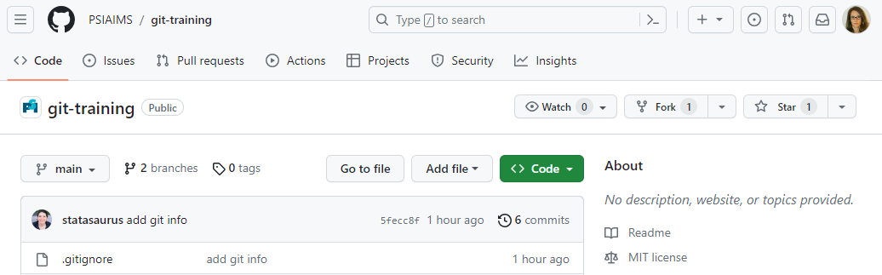
GitHub Interface (II)
In Network graph you can have a snapshot of all the development that has occurred so far
You can see where the repo is located
It can be public or private
To get the code you will have to fork from here

Slide 38
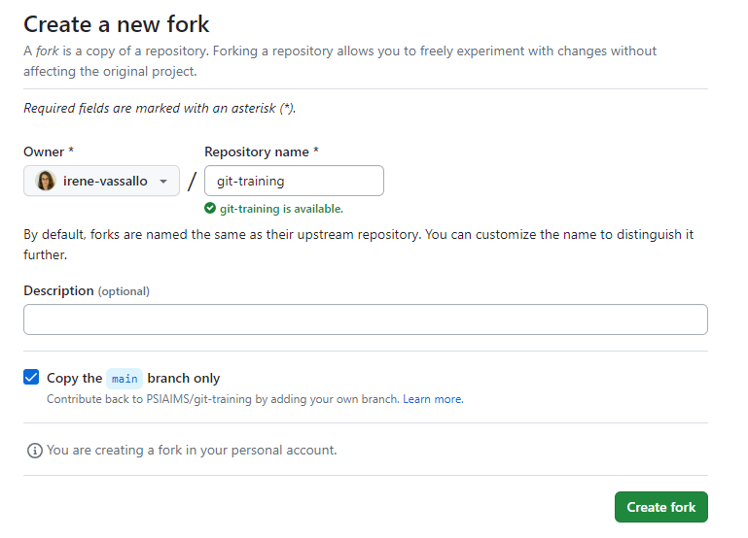
How to fork the project (I)
Click on the fork option and create a new fork
You will be the owner of a copy of the project
You will now be able to make changes

Slide 39
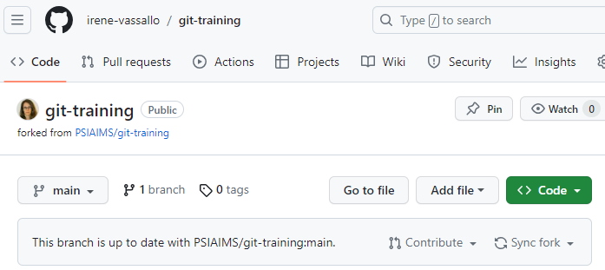
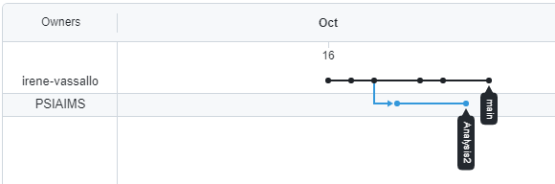
How to fork the project (II)

Slide 40
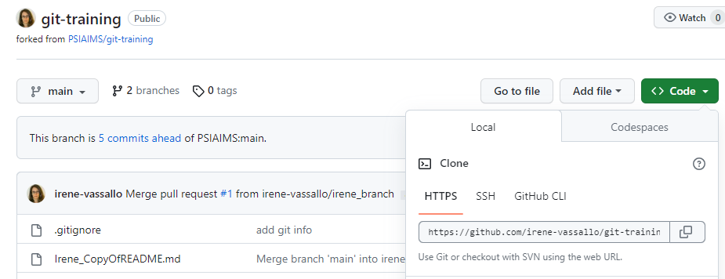
How to fork the project (III)
To get the URL to your fork, click on ‘<> Code’
Copy the URL from the text box

Slide 41
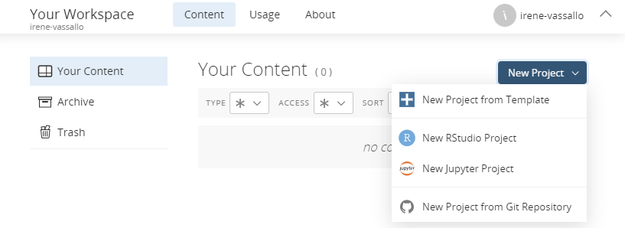
Set up your posit Cloud session
Log into your posit cloud account: https://login.posit.cloud
In ‘Your Workspace’ create a new project from the Git repository
Add the URL from your forked project: https://github.com/irene-vassallo/git-training.git

Slide 42

RStudio IDE and Git GUI
Using Posit Cloud you can copy the project called ‘’
In your session you will see an R project with several files associated
You can see in the Git tab that you have a few changes that have been committed previously
To explore what has happened so far you can use the history tab. You will be able to follow the evolution of each change, as well as see where the tags have been placed
You can now perform additional changes and commit (with a meaningful message ☺ )
To check on which branch you are you can use the branch tools, they will allow to create new branches and switch between them

Slide 43
Set your identity
Open the file called ‘git-cred.R’ -> all steps are available there
Install two packages that will help with the setup:
install.packages(c("usethis", "credentials"))
Use the ‘use_git_config()’ function to set up your user.name and email associated with your GitHub account:
usethis::use_git_config(user.name = "YourUserName",
user.email = "your@email.com")

Slide 44
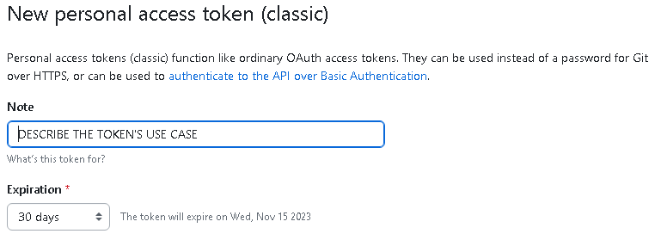

Set your Personal Access Token (I)
To set up the PAT execute the following code:
usethis::create_github_token()
The GitHub sign-in page will open, and after sign-in you should see:
Click on at the end of the page

Slide 45
Set your Personal Access Token (II)
You should copy the newly generated token. You will not be able to see it twice!
It should be a long string of number and characters starting with: ghp….
In the R console execute the following line:
credentials::set_github_pat()
A window should pop up asking you to copy your new token.

Slide 46
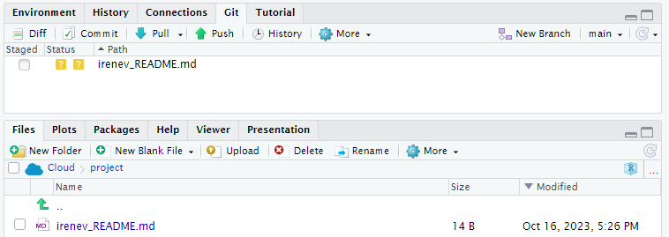
Making a commit
Copy the README.md file and name it yourname_README.md (this will avoid too many conflicts in the next steps)
You will see the newly performed change appear in the Git Tab
You can ‘stage’ the file you want to commit, click on commit and add a message and finally push to remote
You will find your new change in the history graph

Slide 47

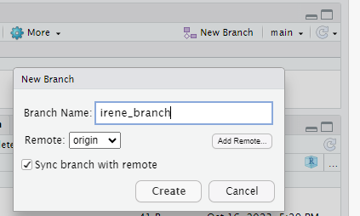
Create a new branch
You can now perform changes in the branch, and when you push to remote it will stay separate from main

Slide 48
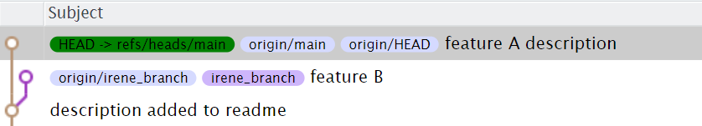
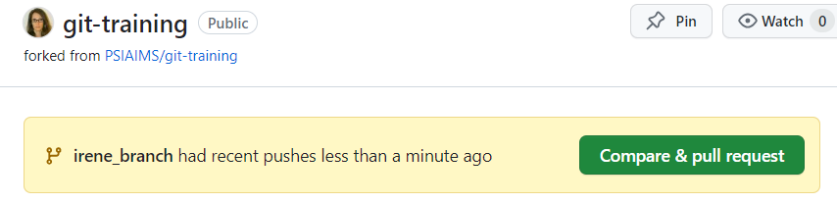
Merge your new branch into main
If you want to merge your branch into main you can go to GitHub and you should see the following:

Slide 49
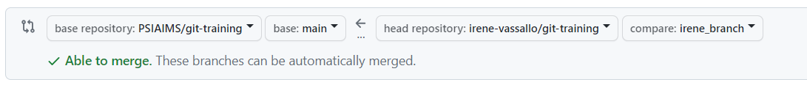
Setting up the pull request to merge the branch
Change to your own project: in my case irene-vassallo/git-training
Click on create pull request

Slide 50
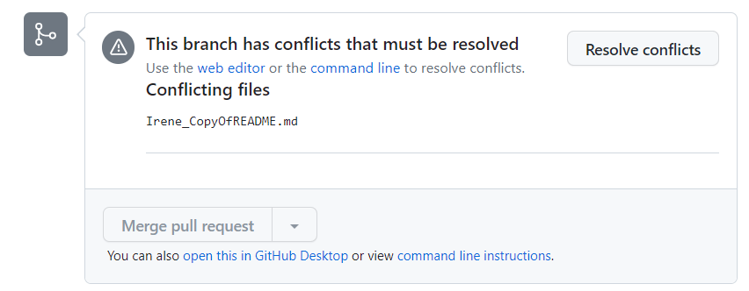
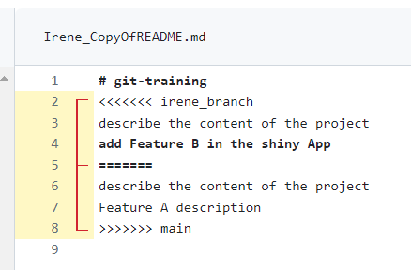
Solve the merge conflict
After deciding what to keep you can confirm and commit the merge

Slide 51
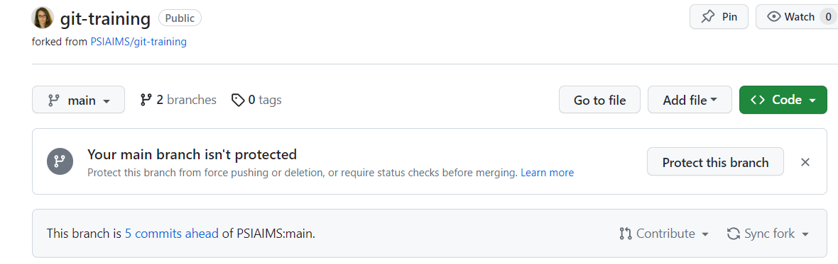
Setting up a pull request to merge into the original project
When you are ready to propose your updates to the ‘original’ project you can go back to GitHub:
Sync fork is to get all the updates that might have happened in the project since the fork was created (or synched lastly). We will follow up with this case later.
Contribute is to create the pull request -> go ahead here!

Slide 52
What if the original project changed?
You will have to synch the fork
Pull the updates locally
Merge if needed
Push back your final work
Open a new pull request

Slide 53
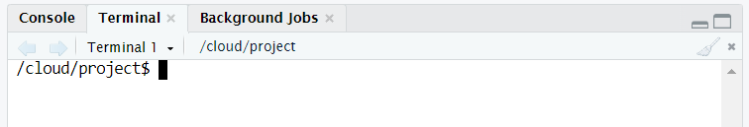
Tips with the Terminal
Some actions are impossible or just difficult to perform via the Git GUI:
Delete local branches: git branch –d ‘name of the branch’
Perform local merges (see next slide)
To delete all local branches but the one you are on use:
git branch | grep -v $(git rev-parse --abbrev-ref HEAD) | xargs git branch -D

Slide 54
Tips with the Terminal (merge)
The same operation can be achieved via the Terminal by:
Checking out to the branch you want to merge into
Typing in the Terminal: git merge ‘name of your branch you want to merge’
When an automatic merge cannot happen, a file with the merge conflict will appear
You should select what you want to keep, save the file and commit the changes

Slide 55
Github in Practice
GitHub Issues

Slide 56
My own Issue with dplyr
I love dplyr
I tend to struggle with dplyr::filter() due to its tendency to drop missing values
I would like to open an issue in the dplyr GitHub repo
Work icons created by Eucalyp - Flaticon
Notes:
On Monday she comes back to find an email from journal A. They would like her to re-run the analysis but this time including Variable A in the model.

Slide 57
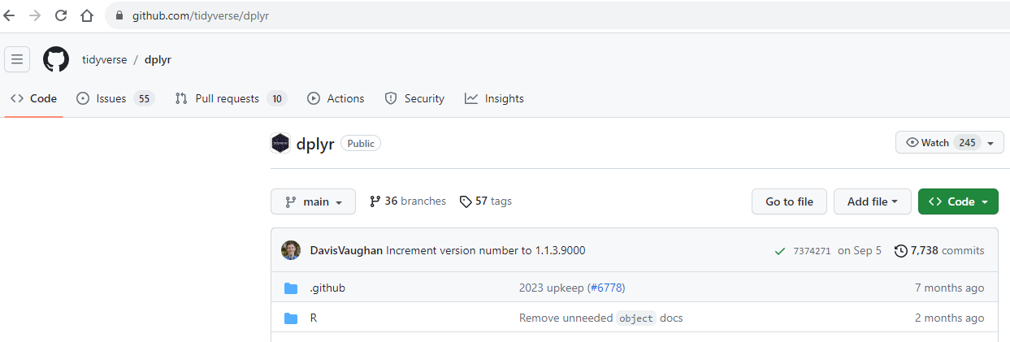
GitHub Issues (I)
The first step is to navigate to the dplyr repo on Github:
https://github.com/tidyverse/dplyr
Now, click on Issues and check if something similar has already been submitted.

Slide 58
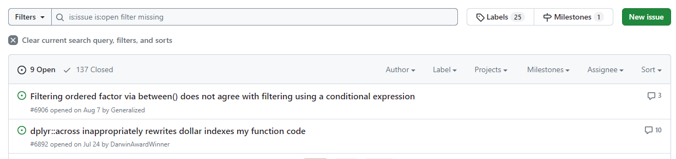
GitHub Issues (II)
We can use the search bar to check if there is an issue related to dplyr::filter()’s behaviour for missing values.
There are 9 open issues in scope of our search.
We can now browse through the issues and see if one of them matches our problem.
If not, we can open an issue of our own under New issue.

Slide 59
GitHub Issues (II)
We can use the search bar to check if there is an issue related to dplyr::filter()’s behaviour for missing values.
There are 9 open issues in scope of our search.
We can now browse through the issues and see if one of them matches our problem.
If not, we can open an issue of our own under New issue.
If it does exist, we might want to leave a comment that we’re encountering the same issue.

Slide 60
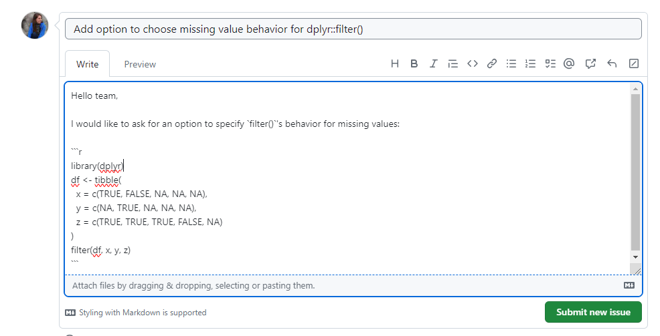
Authoring GitHub Issues (I)
Choose a meaningful title
Describe your problem
Use code blocks to provide reproducible example for the author

Slide 61
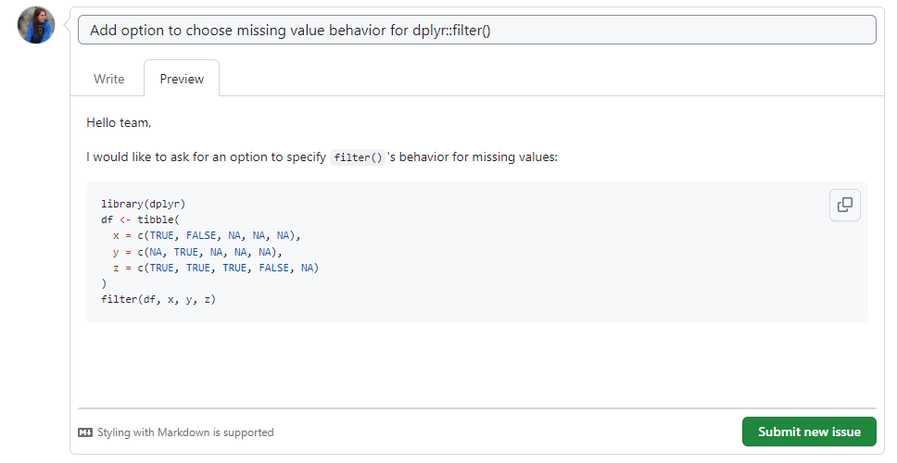
Authoring GitHub Issues (II)
Navigate to Preview to see the properly rendered version of your Issue

Slide 62
Summary - What we covered today
In Theory: Git vs GitHub Committing Tagging Branching Merging (and dealing with conflicts) Remotes Forking | In Practice: Forking Creating a project in RStudio How to connect RStudio to GitHub Committing in RStudio Staging/Working Directory/Local Repo Pull requests Merge conflicts Checking/ Authoring Issues

Slide 63
Additional resources
git --fast-version-control
Pro Git (by Scott Chacon and Ben Straub)
GitHub Docs: Help for wherever you are on your GitHub journey.
Git Cheat Sheet
Happy Git and GitHub for the useR (by Jenny Bryan)

