Slide 1
Solr PSICQUIC Webservice

Slide 2
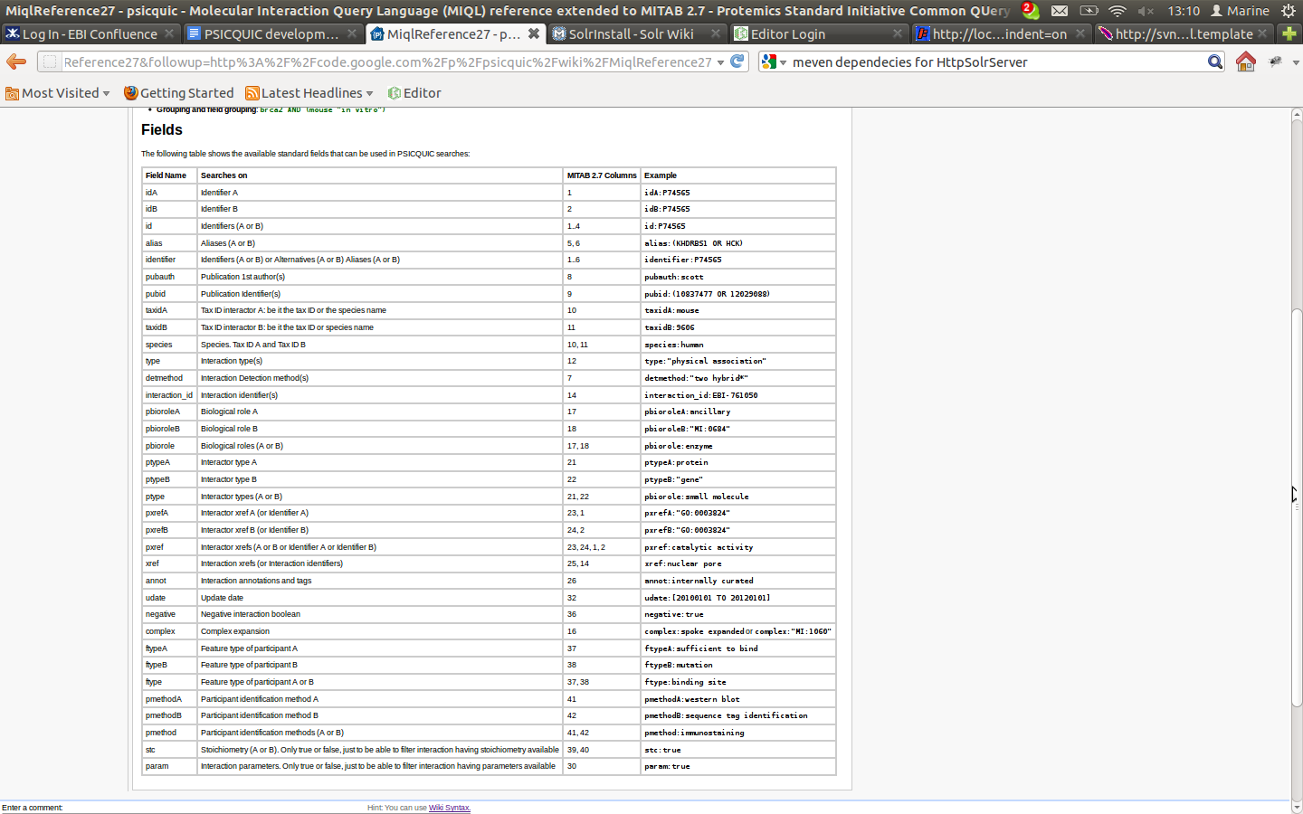
35 fields

Slide 3
Indexing Component
Lucene 2.3.2 to 3.6.0
New Schema
  resolved issue with previous text analyzer (split between ‘:’ + duplicate terms) <miql_field>, we store the unique set of store db, value, txt, db:value
  added copy fields (indexed, unstored) to generate composite fields (id, identifier, species)
  added indexed string fields (unstored) for faceting and sorting (<db>:<value>) <miql_field>_s
  added stored fields (not-indexed) to flexibly retrieve original fields <mitab_field>_o using the solr option fl=x,y,z
  UUID for distributed searching

Slide 4
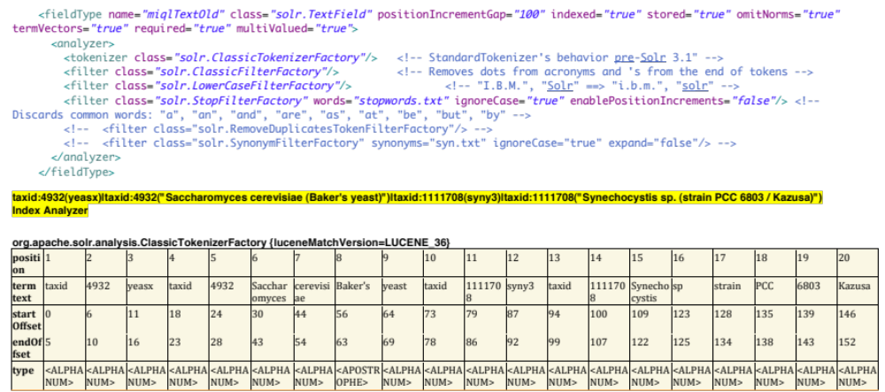

Slide 5
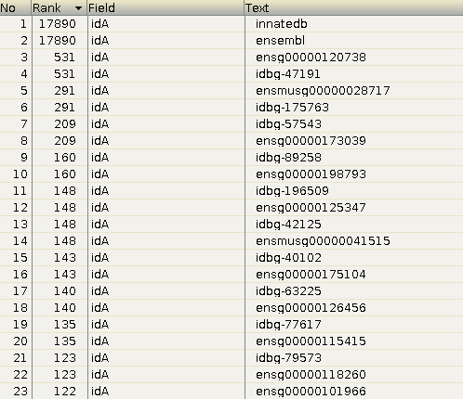
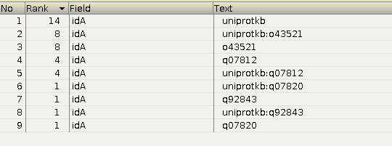
Indexing Component
idA old
idA new

Slide 6
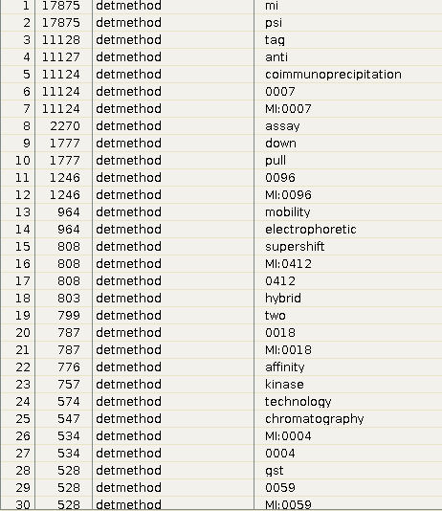
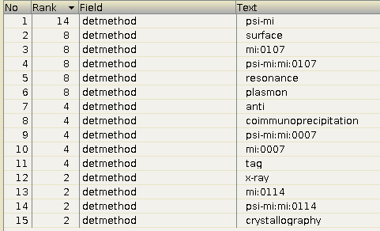
Indexing Component
old detection method
new detection method

Slide 7
SOLR indexing
Read MITAB 2.5, MITAB 2.6 or MITAB 2.7 (calimocho)
Spring batch 2.1.8.RELEASE : chunk processing
Indexing : solrj 3.0.6
Same SOLR schema based on MIQL 2.7 (http://code.google.com/p/psicquic/wiki/MiqlReference27)
Source code : http://psicquic.googlecode.com/svn/trunk/psicquic-solr

Slide 8
How to start process
Start SOLR server
./indexMitab27.sh ${mitab_file} "http://localhost:8983/solr"
Start PSICQUIC webservice (not done yet)

Slide 9
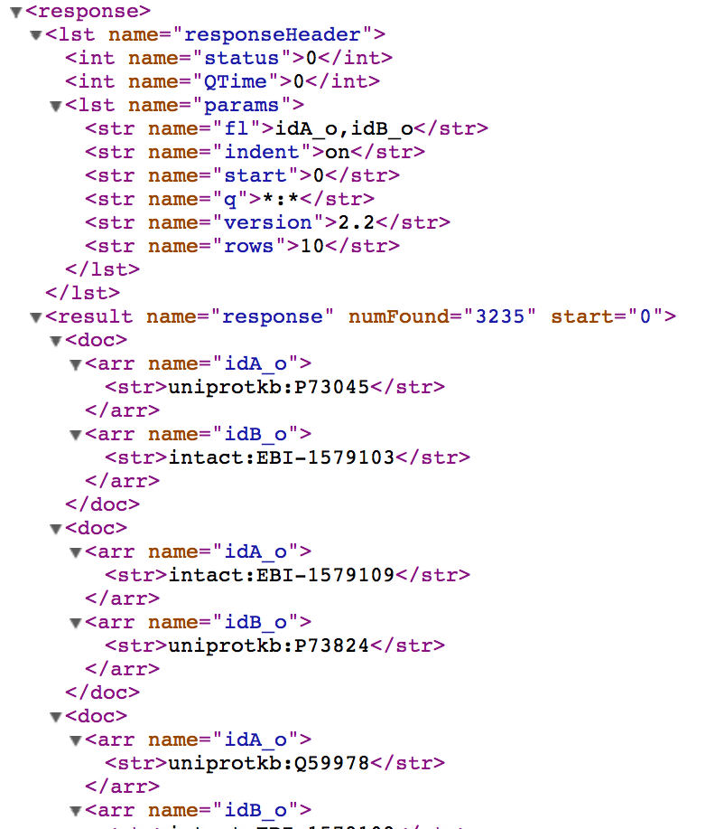
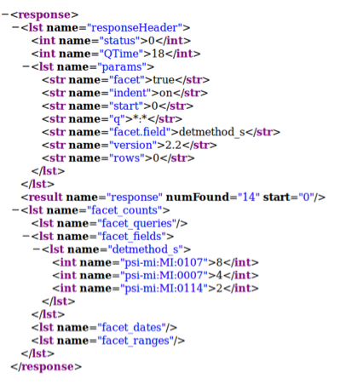
http://localhost:8983/solr/select/?q=*%3A*&version=2.2&start=0&rows=10&indent=on&fl=idA_o,idB_o
http://localhost:8983/solr/select/?q=*%3A*&version=2.2&start=0&rows=0&indent=on&facet=true&facet.field=detmethod_s

Slide 10
Next steps
Test indexing with larger files
Update PSICQUIC webservice source code
(https://psicquic.googlecode.com/svn/trunk/psicquic-solr)
  SOLR behind the scene
  Support MITAB 2.6 and MITAB 2.7 + current formats
  Update methods to allow faceting (group by)
Update PSICQUIC-view and IMEX-view
Export data in MITAB 2.7!

