Slide 1

SaQshi
Digital quality assessment, continuous improvement and monitoring for public health facilities
Client presentation
Open-source platform maintained by Tech4Gov, Piramal Swasthya
Notes:
Source: SaQshi About page and Project Overview. Cover image generated for this presentation; illustrative only.

Slide 2
Quality work needs one connected workflow
SaQshi replaces disconnected assessment records with an accountable improvement cycle
1
Assessment evidence
Checklist responses, department scope and assessor details remain connected to each facility assessment.
2
Improvement follow-through
Gaps become assigned action plans with target dates, evidence and closure updates.
3
Programme visibility
Monitoring users can review progress across block, district, division and state scope.
Designed for facility-level quality data. Patient-level clinical records do not belong in SaQshi.
SaQshi | Client presentation
02
Notes:
Source: docs/architecture/project_overview.md and docs/user/user_guide.md.

Slide 3
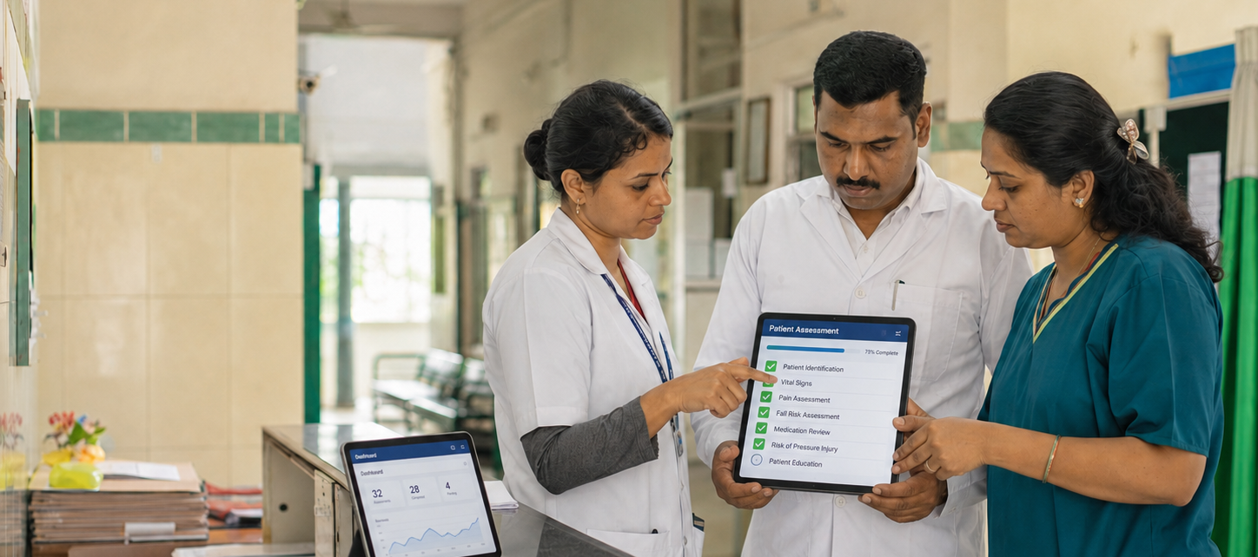
Assessment to continuous quality improvement
A single record connects baseline findings with corrective action and monitoring
1
2
3
4
5
6
Start or continue assessment
Activate applicable departments
Capture checklist responses
Review gaps and assign actions
Close gaps with evidence and revised score
Monitor reports, KPIs and certification
Scores support the workflow: 0 = non-compliance, 1 = partial compliance, 2 = full compliance
SaQshi | Client presentation
03
Notes:
Source: docs/architecture/project_overview.md and docs/user/user_guide.md. Product image is from the workspace.

Slide 4
Role-based experience for every level
Each role sees the workflow and geography that match its responsibility
Facility team
Assessor
Create assessments, complete checklists, manage CQI actions, enter KPI and outcome data.
Work only on assigned facilities and allocated departments or classes.
Block, district and division
State administration
Monitor facilities within the assigned administrative area.
Monitor statewide data, manage assessors and users, track certification and export reports.
SaQshi | Client presentation
04
Notes:
Source: docs/user/user_guide.md, “Main User Types” and “State Monitoring”.

Slide 5
Core capabilities
The platform brings quality assessment and programme monitoring into the same operating model
Structured assessment
CQI management
Configurable frameworks, department activation, assessor information and checkpoint-level scoring.
Gap analysis, action plans, responsible person, target date, closure remarks and evidence.
Performance monitoring
Certification tracking
Configurable KPI and outcome indicators, monthly entry, formula-based results and trends.
State or national certification status, history, validity, expiry tracking and map view.
Reports and exports
Scorecards, progress reports, CQI reports, performance downloads and state reports.
SaQshi | Client presentation
05
Notes:
Source: docs/architecture/project_overview.md, “Current Functional Scope”.

Slide 6
Monitoring that supports action
Programme teams can move from an overview to the facility and checkpoint that require follow-up
Assessment progress
Track started, in-progress and completed assessments within the user’s scope.
State Facility Insights Map
View facility presence, certification coverage or the latest assessment result by Area of Concern and subtype.
CQI action tracking
Identify high-priority, unassigned, overdue and soon-due actions.
Critical
0–25%
Needs improvement
26–60%
Risk analysis
Satisfactory
Above 60%
Find the quality concerns affecting the most facilities and drill down by location, facility type and department.
SaQshi | Client presentation
06
Notes:
Source: docs/user/user_guide.md and ui/help/state-risk-analysis.html; score bands from ui/help/state-facility-insights-map.html.

Slide 7
Designed for deployment and governance
Saqshi keeps the platform adaptable while making its data boundary explicit
Configurable by design
Facility-level data boundary
Frameworks, departments, performance indicators, certification rules and map settings use configuration files.
The platform supports facility observations, scores, CQI activity, KPI/outcome numbers and monitoring reports.
Protected administration
Open-source foundation
Role-based scopes restrict monitoring views. Administrative identity fields receive field encryption where implemented.
The platform is maintained by the Tech4Gov team at Piramal Swasthya.
SaQshi | Client presentation
07
Notes:
Source: docs/architecture/project_overview.md and ui/help/about.html.

Slide 8
A practical path to a SaQshi rollout
1
Confirm programme scope
Agree facility types, assessment framework, indicators and reporting needs.
2
Configure and validate
Set up masters, role mapping, geography, checklists and acceptance checks.
3
Pilot with real teams
Run a controlled facility pilot and refine workflow, reports and support.
4
Scale with oversight
Use dashboards, CQI tracking and certification views to guide follow-up.
For partnership, implementation or technical support: tech4gov@piramalswasthya.org
SaQshi | Client presentation
08
Notes:
Contact source: ui/help/about.html. Rollout steps are a proposed implementation approach, not a product claim.

