Slide 1

OPEN SOURCE • CONFIGURABLE • CROSS-SECTOR
Education
SaQshi
Health
Open Digital Quality
Improvement Platform
ONE
PLATFORM
From assessment → action → outcomes → certification — across health, education and other public-service quality programs.
Analytics
Feedback
Your Saathi for Quality Assessment — evolved into a reusable digital public quality platform.

Slide 2
EXECUTIVE PROPOSITION
SaQshi is not another checklist application
It is a configurable quality-improvement operating layer that turns standards into repeatable digital workflows.
Standards become digital
Assessments become workflows
Data becomes improvement
Frameworks, domains, checkpoints, scoring rules and facility/entity types become configuration — not hard-coded forms.
Pause/resume, evidence, scoring, gaps, action plans, responsibility, target dates, closure and reassessment stay connected.
Dashboards, KPI/outcome trends, certification status and comparative analysis show whether quality is actually changing.
THE PLATFORM IDEA → Configure once. Reuse across frameworks, facilities, schools, departments, classes and geographies.

Slide 3
PROBLEM
Quality assurance is still fragmented between paper, Excel and isolated applications
The original SaQshi concept note identifies manual assessment, limited digital functionality, weak action planning and poor comparative analysis.
Paper → Excel → manual scoring
Digital forms without workflow
Action plans disconnected from evidence
Printing, re-entry and score collation consume time and introduce avoidable errors.
Capturing answers alone does not create real-time gap visibility or accountability for closure.
Owner, due date, closure evidence and revised score are often managed outside the assessment.
No continuous improvement memory
Framework silos
Vendor & customization dependency
Baseline, reassessment and current status are difficult to compare consistently over time.
Every program, facility type or sector tends to create a new workflow and a new technology stack.
Closed or hard-coded systems make adaptation, integration and long-term ownership expensive.

Slide 4
STRATEGIC SHIFT
The shift: from digitizing a checklist to operating a quality-improvement system
SaQshi connects the full improvement loop instead of stopping after data capture.
01
02
03
04
05
06
Configure
Assess
Improve
Monitor
Certify
Learn
Framework, entity types, domains, checkpoints, scoring
Digital response, evidence, progress, pause/resume
Gap analysis, action plan, owner, target date, closure
KPI / outcome entry, formulas, validation and trends
Certification type, validity, renewal and history
Dashboards, drill-down, reports and resource feedback
Continuous Quality Improvement (CQI) loop: each reassessment creates a new evidence-backed improvement history instead of replacing the past.

Slide 5
PLATFORM
One core engine, many sectors and frameworks
The reusable platform separates common capabilities from sector-specific configuration.
Health
SaQshi Core Platform
Framework Pack
NQAS • MusQan • LaQshya
JSON configuration
Identity & RBAC
Framework Engine
Education
Geography & Hierarchy
School • Class • Domain
Assessment & Scoring
CQI / Action Plan
State → district → entity
KPI / Outcomes
Analytics & Export
Beneficiary Experience
Deployment Profile
Feedback • Social audit
Cloud / on-prem / tenant

Slide 6
CROSS-SECTOR
Health → Education → any structured quality program
SaQshi works because the underlying quality-assurance pattern is the same even when the vocabulary changes.
Quality concept
HEALTH
EDUCATION
SAQSHI CONFIGURATION
Quality entity
Health facility
School / institution
Facility types / entity types
Operational unit
Department
Class / grade / unit
Departments / sub-entities
Quality dimension
Area of concern / standard
Domain / theme
Framework domains
Assessment item
Checkpoint
Observation / indicator
Configurable checkpoint
Evidence
Document / observation
Classroom evidence / records
File / note / score
Improvement
Gap + action plan
Low domain + improvement action
Generic CQI workflow
Performance
KPI / outcome indicator
Class / school performance
Indicator engine + analytics
Result: the platform can absorb new frameworks without rebuilding authentication, assessment workflow, CQI, analytics and governance every time.

Slide 7
HEALTH
Health quality assurance: from facility assessment to certification readiness
Designed around facility types, departments, checkpoints, gaps, indicators and improvement cycles.
Multiple frameworks
NQAS, MusQan, LaQshya and future framework packs
Facility hierarchy
DH, SDH, CHC, PHC, APHC, HWC and configurable types
Department activation
Enable only the departments relevant to a facility / assessment period
Assessment cycles
Baseline, self-assessment, reassessment and multiple cycles
Outcome monitoring
Monthly KPI / outcome entry with validation and trend visualization
Certification tracking
State, national, conditional certification, validity and renewal history
Health workflow: FACILITY → DEPARTMENT → CHECKPOINT → GAP → ACTION PLAN → REASSESSMENT → KPI/OUTCOME → CERTIFICATION

Slide 8
EDUCATION
Education quality improvement uses the same platform primitives
Schools, classes and quality domains can be assessed, compared and improved without creating a separate product.
School
Class / Grade
Domain
Assessment
Improvement
Entity
Operational unit
Quality dimension
Latest per class
Lowest-domain action
Latest-assessment logic
Domain diagnostics
District / state view
When a class is assessed multiple times, analytics can use only the latest completed assessment.
Identify the lowest-performing domain for each class and focus the improvement conversation.
Class-wise completion, top/low schools, district comparisons and trend reporting.
The sector changes. The platform workflow does not.

Slide 9
WORKFLOW
End-to-end functional workflow
A single transaction chain connects configuration, assessment, improvement, performance and governance.
1
2
3
4
Onboard
Activate
Assess
Score
Users • roles • hierarchy
Framework • entity • department
Checkpoint response • evidence
Auto score • compliance • gaps
5
6
7
8
Act
Close
Monitor
Govern
Owner • target • action plan
Evidence • status • revised score
KPI • outcomes • trend
Certification • dashboard • export
Every step writes to a traceable digital record — making the improvement story visible, auditable and reportable.

Slide 10
ASSESSMENT ENGINE
Digital assessment designed for real field conditions
The objective is not only paper elimination; it is better adoption, continuity and data quality.
Pause & resume
Evidence-ready
Assessment Workspace
Stagger long assessments without losing progress.
Attach documents / notes and keep them with the checkpoint.
Department: Patient Rights • Cycle 2
Checkpoint 4.2 | Is informed consent documented?
Multiple cycles
Contextual scoring
Baseline, reassessment and repeated improvement cycles.
Configurable scoring and completion rules by framework.
Fully
Partially
Non-compliant
Progress tracking
Validation
Evidence / notes / attachment
Department / class / entity completion status in real time.
Prevent duplicate or invalid entries using workflow rules.
SAVE & NEXT
68% complete

Slide 11
CQI
Gap closure is a workflow, not a spreadsheet column
SaQshi carries each non-compliance from identification to accountable closure and reassessment.
Gap detected
Action created
Responsibility
Target date
Closure evidence
Reassessment
Checkpoint is partially / non-compliant
Corrective / preventive action recorded
Owner and team assigned
Due date & status become visible
Proof and comments attached
Score revised; history retained
Accountability
Time-bound closure
Audit trail
Improvement history
This is the core difference between “assessment digitization” and “continuous quality improvement.”

Slide 12
PERFORMANCE
Move from periodic assessment to continuous performance monitoring
Monthly KPI and outcome indicators show whether process improvement is translating into results.
Monthly entry
Illustrative outcome trend
Indicator values captured against the entity and reporting month.
Baseline period
Improvement period
Formula engine
47
Derived KPI / rate calculations can be automated.
39
34
28
27
Validation rules
22
Duplicate-month and invalid-value controls improve data quality.
Trend intelligence
Apr
May
Jun
Jul
Aug
Sep
State, district and entity views show movement over time.
Assessments tell us “where we are.” Indicators tell us “whether the system is improving.”

Slide 13
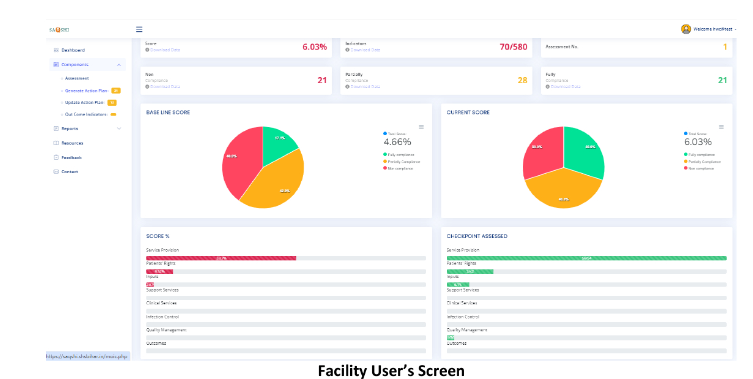
PLATFORM PROOF
Unified dashboard: baseline, current score, compliance and progress in one view
The reference SaQshi concept already demonstrates baseline/current comparison, checkpoint completion, resources and feedback modules.
Baseline vs current
Visual evidence of improvement
Checkpoint progress
Track assessment completeness
Compliance mix
Fully / partially / non-compliant
Role-specific access
Dashboard + modules by responsibility

Slide 14
CERTIFICATION
Certification becomes a managed lifecycle, not a static field
Track status, validity, renewal and history while connecting certification readiness to actual assessment progress.
Ready?
Apply
Certified
Validity
Renew
Gap status + score
Certification workflow
State / national / conditional
Expiry monitoring
Reassessment + evidence
Governance benefit: administrators can see which entities are certified, expiring, due for renewal or blocked by unresolved gaps — without rebuilding the status manually.

Slide 15
GOVERNANCE
Role-based access mirrors how public programs are actually managed
Access is controlled by hierarchy, responsibility and functional privilege rather than a single “admin/user” split.
State / Program Admin
Scope
State / district / entity / department
Configuration • users • dashboard • certification
District / Division
View • create • edit • approve • export • administer
Monitor entities • review progress • analytics
Privileges
Facility / School Admin
Activate departments/classes • assign work • action plans
Assignment
User linked to facility / school and allowed units
Assessor / Department User
Assess • save evidence • close gaps • enter indicators
Auditability
Security events and change history retained
Security is part of the platform contract — not a feature added later for each framework.

Slide 16
CAPABILITIES
What the platform provides today — and what every framework can reuse
A shared capability stack prevents the same features being rebuilt for each sector or program.
CONFIGURE
ASSESS
IMPROVE
MONITOR
Framework & facility/entity types
Digital forms + progress tracking
Gap analysis
KPI / outcome indicators
Departments / domains / concerns
Pause / resume / multiple cycles
Action plan + responsibility
Formula & validation engine
Checkpoint & scoring configuration
Evidence and validation
Target dates + closure evidence
Trend analytics
Assessment methods / cycle rules
Automated score calculation
Revised score + history
Baseline vs current
GOVERN
ANALYZE
ENABLE
INTEGRATE
RBAC + hierarchy
State / district / entity dashboards
Resources / guidelines / videos
API-first services
User / entity assignment
Drill-down & completion status
User feedback
JSON configuration
Certification tracking
Comparative analysis
Admin-managed content
External data exchange
Audit / access controls
Excel / PDF exports
Low-bandwidth aware UX
Portable deployment

Slide 17
OPEN SOURCE
Open source by design — not simply “built with open-source tools”
The strategic value is government / implementer ownership, configurability, portability and a contribution model that reduces lock-in.
Open codebase
Open configuration
Open interfaces
Auditable, reviewable and extensible source structure.
Framework packs are data-driven (JSON), reducing custom code.
API-first services allow integration with surrounding systems.
Deployment freedom
Reusable sector packs
Transparent improvement
Run on government cloud, private cloud or on-prem environments.
Health / education / future domains can share one core engine.
Issues, releases, documentation and QA can follow an open contribution process.
OPEN SOURCE OUTCOME → Local ownership + faster adaptation + lower duplication + easier integration + ecosystem innovation

Slide 18
WHY OPEN
Replace framework-by-framework software projects with a shared public quality platform
The biggest cost is often not the first build — it is repeated customization, migrations and dependency over many programs.
Silo / closed implementation
SaQshi open platform approach
New application for each framework
New framework = configuration pack
Hard-coded workflow and scoring
Shared workflow + configurable scoring
Custom reports for every geography
Reusable dashboards + filters + exports
Vendor change becomes a migration project
Code/config ownership can transfer locally
Integration added after deployment
APIs are a core platform layer
Knowledge remains with implementation team
Documentation + versioned contribution model
Strategic principle: invest once in platform capability; spend future effort on quality content and implementation — not rebuilding software plumbing.

Slide 19
ARCHITECTURE
Open-source architecture: modular, configuration-driven and API-first
Current refactor separates core services, framework configuration and assessment APIs so the same engine can serve multiple programs.
Experience Layer
Responsive Web UI • Admin Console • Test UI • Reports & Exports
Platform API Layer
Auth / RBAC • Framework APIs • Assessment APIs • CQI • KPI / Outcomes • Certification
Reusable Services
FrameworkEngine • DepartmentStatusService • DynamicAssessmentService • Security / Session / CSRF
Configuration Layer
frameworks/*.json • masters/*.json • facility types • domains • checkpoints • methods
Data & Deployment
MySQL / relational data • file storage • APIs • container / VM / government cloud / on-prem options
Key design decision: framework knowledge lives in configuration; common quality-improvement behavior lives in reusable services.

Slide 20
PLATFORM ENGINEERING
Interoperable, portable and secure by default
A quality platform has to coexist with existing government systems, not become another isolated data island.
INTEROPERABILITY
SECURITY
PORTABILITY
Documented REST-style APIs
Role-based access & scoped assignment
Open relational database foundation
JSON-based framework/config exchange
CSRF and session security controls
Deployable on VM / cloud / on-prem
Excel / PDF exports for operational use
Login lockout / failed-attempt controls
Configuration separated from application code
Integration-ready master and reporting services
Audit-oriented workflow and privilege separation
Sector packs can evolve independently
This engineering foundation is what allows SaQshi to become infrastructure, rather than a one-time application.

Slide 21
OPEN ECOSYSTEM
A practical open-source operating model for SaQshi
Open-source sustainability needs product governance as much as it needs a repository.
1. Core platform
2. Framework packs
3. State / tenant config
Stable authentication, workflow, services, reporting and database contracts.
Versioned health, education and future sector configurations.
Local hierarchy, masters, roles, labels, active modules and deployment settings.
4. Contribution flow
5. Documentation
6. Release governance
Issue → design review → code/config change → test → release notes.
User manual, API docs, deployment guide, configuration guide and testing playbook.
Versioning, security review, compatibility checks and upgrade path.
Goal: let multiple implementers contribute without fragmenting the product into incompatible forks.

Slide 22
ROADMAP
Evolution roadmap: from legacy assessment to open digital quality infrastructure
The roadmap shows how functionality matures from digitization into an interoperable, reusable platform.
0
1
2
3
4
5
6
7
8
Legacy
Digital
Framework
CQI
Performance
Certification
Dashboards
Analytics
Open ecosystem
Paper / Excel
Assessment engine
JSON-driven configuration
Gap → action → closure
KPI / outcomes
Validity & renewal
Monitoring & drill-down
Trends & exports
APIs • sector packs • contributions
What makes Phase 8 different?
The platform is no longer “a SaQshi deployment.” It becomes a reusable ecosystem where new frameworks, sectors, states and implementers can extend a stable common core.
CONFIGURATION OVER CUSTOM CODE
OPEN APIS
REUSABLE SECTOR PACKS

Slide 23
QUALITY IMPROVEMENT INFRASTRUCTURE
SaQshi connects standards, people, evidence and outcomes in one continuous digital loop.
ASSESS → IMPROVE → MONITOR → LEARN
Cross-sector
Health today. Education now. More sectors without rebuilding the core.
Repeat across every framework and every service-delivery system.
Open by design
Configurable, auditable, portable and extendable — reducing long-term lock-in.
Improvement-first
Assessment is the starting point; action, outcomes and learning are the destination.
SaQshi — Your Saathi for Quality Assessment. Built to become the open platform for quality improvement.

Slide 24
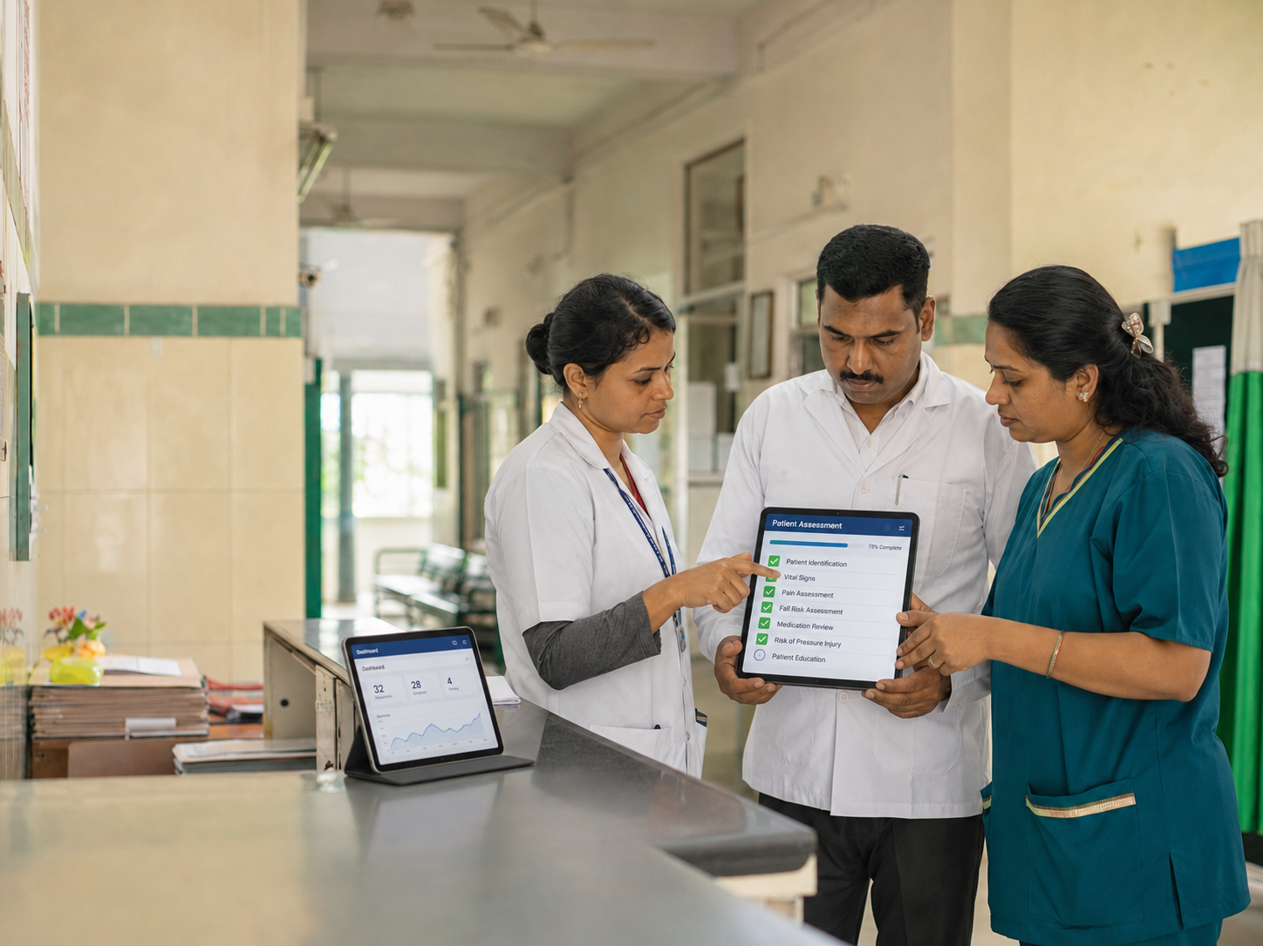
HEALTHCARE PLATFORM
SaQshi connects assessment, action and oversight
The health deployment brings assessment, CQI, performance monitoring, certification and reporting into one platform.
Structured assessment
CQI action management
Create or resume assessments, activate applicable departments and capture checkpoint responses.
Turn gaps into action plans with ownership, target dates, evidence and closure updates.
Performance monitoring
Certification and reports
Record monthly KPI and outcome data, calculate results and review trends.
Track certification status and history, then use reports to support follow-up.
SaQshi | Open Digital Quality Improvement Platform
24
Notes:
Source: docs/architecture/project_overview.md.

Slide 25
ROLE-BASED OPERATIONS
The right view for each person
SaQshi separates facility work from supervisory monitoring while keeping every assessment traceable to its scope.
Facility team
Assessor
Assessment entry, CQI actions, evidence, KPI/outcome entry and facility reports.
Assigned facility assessments and allocated department or class work.
District and division
State administration
Progress, CQI and performance monitoring for assigned geography.
Statewide dashboards, certification views, assessor management, exports and reports.
SaQshi | Open Digital Quality Improvement Platform
25
Notes:
Source: docs/user/user_guide.md.

Slide 26
CONTINUOUS QUALITY IMPROVEMENT
A score creates a clear next action
SaQshi keeps the corrective-action trail connected to the assessment result rather than separating it into files.
1
2
3
4
Score checklist
Set action plan
Add evidence
Review revised score
Non-compliance and partial-compliance checkpoints become gaps.
Assign responsible person and target date for each gap.
Attach supporting evidence and record closure remarks.
Use closure status and revised score in progress reports and monitoring.
Monitoring teams can identify open, overdue and high-priority actions without changing the facility’s underlying action plan.
SaQshi | Open Digital Quality Improvement Platform
26
Notes:
Source: docs/architecture/project_overview.md and docs/user/user_guide.md.

Slide 27
IMPLEMENTATION
A practical path to a SaQshi rollout
The platform supports local programme configuration. A client rollout begins by aligning its scope and operating model.
1
Confirm scope
Agree facility types, geography, framework, indicators and reporting needs.
2
Configure platform
Set up masters, roles, workflow rules, checklist and monitoring views.
3
Pilot with users
Run a controlled pilot with facility teams and monitoring users, then refine.
4
Scale with governance
Use adoption support, dashboards and CQI follow-up to guide expansion.
Client discussion: select the first programme, facilities and users for a focused pilot.
SaQshi | Open Digital Quality Improvement Platform
27
Notes:
Rollout structure is a proposed approach based on SaQshi configuration and role workflows.

