Slide 1

SaQshi
A digital platform for facility quality assessment, continuous improvement and programme monitoring
Client proposal | Public health facilities
Assess. Improve. Monitor. Report.
Notes:
Source: SaQshi documentation. Cover image is illustrative.

Slide 2
CLIENT CONTEXT
Quality work loses momentum when the workflow breaks
Facility teams, assessors and programme managers often work across disconnected registers, spreadsheets and follow-up calls.
1
2
3
Assessments are hard to track
Gaps do not become action
Leaders lack a single view
Teams need to know what started, what is incomplete and where evidence sits.
A weak checkpoint needs a named action, owner, target date and closure evidence.
Programme teams need to see progress and risk at facility, district and state levels.
SaQshi keeps the assessment, the improvement action and the monitoring view in the same platform.
SaQshi | Client proposal
02

Slide 3
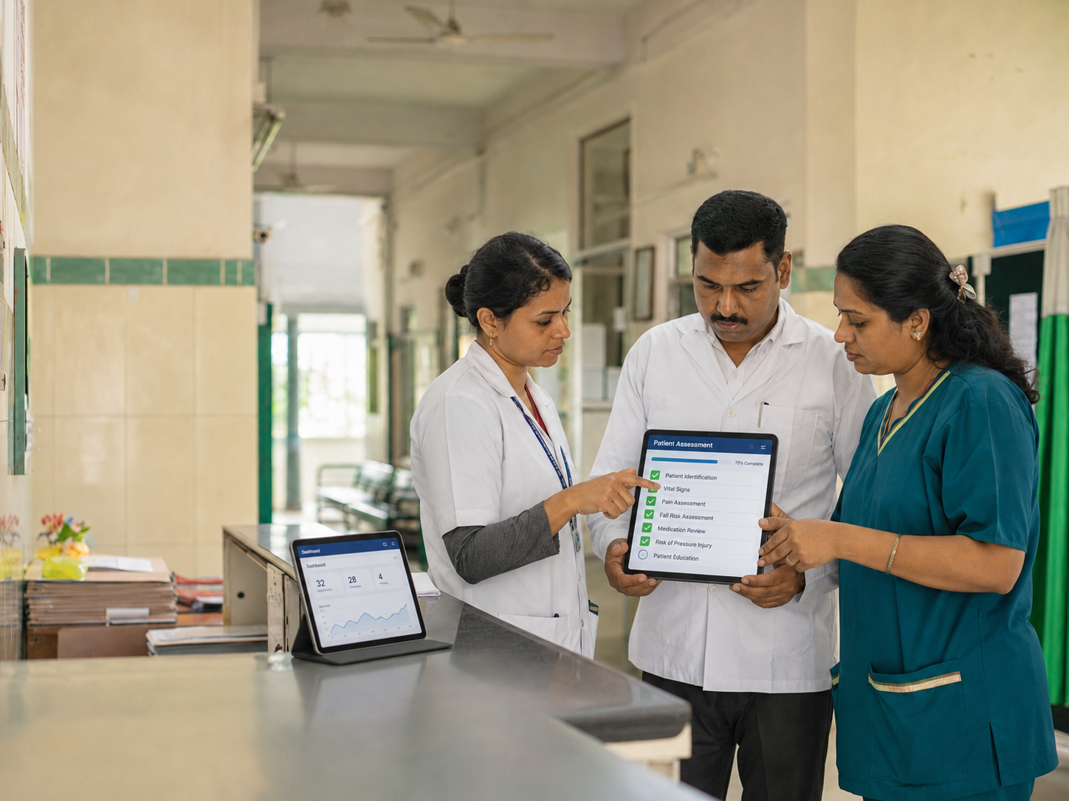
THE PLATFORM
SaQshi turns quality assessment into an operating cycle
It gives each role the right workflow and connects field-level action with programme-level oversight.
ASSESS
Use configurable checklists to capture facility evidence and checkpoint scores.
IMPROVE
Convert gaps into action plans, assign ownership and record closure evidence.
MONITOR
Track assessment progress, overdue actions, performance and certification across geography.
SaQshi | Client proposal
03

Slide 4
FACILITY WORKFLOW
One assessment record carries the team from baseline to follow-up
Each step uses the same facility and assessment context, so teams can resume work and managers can trace progress.
1
2
3
4
5
6
Create assessment
Activate departments
Record checklist scores
Review gaps
Assign actions
Close gaps with evidence
The reported score and progress reflect the assessment responses and the CQI closure record.
SaQshi | Client proposal
04

Slide 5
ASSESSMENT
Structured assessment for real facility work
SaQshi supports configurable frameworks and department-aware checklist entry for a disciplined, auditable assessment process.
1
Framework and facility scope
2
Checkpoint-level response
Select the framework and activate only the departments that apply.
Record compliance at each checkpoint. In the NQAS profile: 0 non-compliance, 1 partial, 2 full.
3
Pause and continue
4
Evidence and validation
Teams can resume an active assessment instead of re-entering completed work.
Attach approved evidence and apply workflow rules to prevent incomplete or duplicate entry.
SaQshi | Client proposal
05

Slide 6
CONTINUOUS QUALITY IMPROVEMENT
Every weak checkpoint becomes a managed improvement action
SaQshi maintains the corrective-action trail with the score that created it.
1
2
3
4
Gap analysis
Action plan
Closure
Follow-up
Non-compliance and partial-compliance checkpoints appear for review.
Capture the responsible person, target date and the corrective action.
Add closure remarks, evidence and revised score where applicable.
Monitoring users can identify overdue, unassigned and high-priority actions.
SaQshi | Client proposal
06

Slide 7
MONITORING
Programme teams see where follow-up is needed
Role-based monitoring moves from an overview to the facility, department or checkpoint that needs attention.
Assessment coverage
CQI action tracking
Started, in-progress and completed assessment counts for the user’s geography.
Open, overdue, unassigned and soon-due actions for practical follow-up.
Risk analysis
Facility insights
Identify quality concerns affecting the greatest number of facilities, then drill down.
View facility presence, certification coverage and latest assessment risk by Area of Concern.
SaQshi | Client proposal
07

Slide 8
ROLE-BASED EXPERIENCE
Every user works at the right level
The platform separates facility data entry from monitoring responsibilities while preserving one connected record.
Facility team
Assessor
Create assessments, complete checklists, manage CQI actions, enter KPI/outcome data and use facility reports.
Work only on assigned facilities and allocated departments or classes.
Block, district and division
State administration
Monitor facility progress, CQI and performance within the assigned geography.
Monitor statewide data, certification and reports; manage assessors and users.
SaQshi | Client proposal
08

Slide 9
REPORTING AND PERFORMANCE
A client can monitor both quality activity and outcomes
SaQshi combines assessment reporting with monthly performance monitoring and certification tracking.
1
2
3
Reports
KPI and outcomes
Certification
Scorecards, progress reports, CQI reports, performance downloads and state reports.
Department-aware monthly entry, formula-based results and trend views.
State or national certification status, history, validity, expiry tracking and map view.
SaQshi | Client proposal
09

Slide 10
GOVERNANCE
Designed for facility-level quality data
The deployment scope focuses on facility observations, assessment scores, CQI actions, evidence, KPI/outcome numbers and monitoring reports.
1
2
3
No patient records required
Configurable by design
Controlled visibility
SaQshi is not an electronic medical record or patient registry. It should not hold patient-level clinical information.
Frameworks, departments, indicators, certification rules and map settings can be configured for an approved programme.
Role-based scope limits monitoring by geography and responsibility. Administrative identity fields receive protection where implemented.
SaQshi | Client proposal
10

Slide 11
CLIENT VALUE
What changes when SaQshi becomes the operating platform
The value is practical: clearer work for teams, faster follow-up for managers and better visibility for programme leadership.
1
For facility teams
One guided workflow replaces separate records for assessment, action planning and closure.
2
For programme managers
Dashboard and report views show where coverage, action follow-up or performance needs attention.
3
For leadership
A consistent digital record supports accountability, reporting and future scale across facilities.
SaQshi | Client proposal
11

Slide 12
IMPLEMENTATION
A controlled rollout proves the model before scale
The first implementation should focus on one agreed programme scope, a prepared user group and measurable operating outcomes.
1
Confirm programme scope
Agree facility types, geography, framework, indicators and client reporting needs.
2
Configure and validate
Set up master data, role mapping, workflow rules, checklists and monitoring views.
3
Pilot with real users
Run a controlled pilot with facility teams and monitoring users; refine support and reports.
4
Scale with governance
Use dashboards and CQI follow-up to guide adoption and staged expansion.
SaQshi | Client proposal
12

Slide 13
Let’s define the first SaQshi pilot
1
Programme and facility scope
Which facilities and framework should form the first cohort?
2
Client roles and reporting
Who will assess, act, monitor and receive programme reports?
3
Success measures
Which quality, process and adoption measures will define a successful pilot?
tech4gov@piramalswasthya.org
Notes:
Contact source: ui/help/about.html.

