Slide 1
HACK4HACK CREW HIRING CHALLENGE 2026 · PROBLEM STATEMENT 1
CrewForge
Race-proof team formation at scale
A database-enforced membership workflow designed for the last-seat race.
50-CONTENDER TEST
71 LOCAL TESTS PASS
100 VU BENCH
Repository: github.com/PSP-YN/Race-proof-team-formation
NOV 2026

Slide 2
01 / PROBLEM
The failure mode is a race, not a button
Last seat contention
Duplicate membership
Retry ambiguity
Many participants can request the same final slot at nearly the same instant.
One person must never become a member of two teams in the same hackathon.
A double-click or flaky network must not create duplicate requests or teams.
Correctness invariant
The database—not the browser—decides who owns a seat. Capacity, membership, request status and audit history must commit together.
Target scale: 10,000 participants · 2,000 teams · 100 concurrent board users
CREWFORGE / HACK4HACK CREW HIRING CHALLENGE · PS1
02

Slide 3
02 / PRODUCT
A moderated workflow keeps team ownership explicit
01
02
03
04
Discover
Request
Approve
Maintain
Searchable team board with skill-fit recommendations and clear open-seat counts.
→
Participant submits an idempotent pending request; no seat is reserved.
→
Only the current leader can accept or decline a request.
→
Leader can remove a member; leadership passes when the leader leaves.
Invite lifecycle · Expiring, single-use hashed tokens · Final-member exit closes the team · Every mutation is audited
CREWFORGE / HACK4HACK CREW HIRING CHALLENGE · PS1
03

Slide 4
03 / ARCHITECTURE
Correctness is enforced at the transaction boundary
Next.js API
→
MongoDB txn
→
Unique indexes
→
Audit + SSE
Auth · validation · rate limits
Conditional capacity update
One member / hackathon
Commit event · live refresh
Atomic approval transaction
Verify leader + pending request → insert membership → increment memberCount only below maxSize → mark request accepted → append audit event
MongoDB replica-set transactions and change streams are required. Unique compound indexes remain the final guard against duplicate membership.
CREWFORGE / HACK4HACK CREW HIRING CHALLENGE · PS1
04

Slide 5
04 / CONCURRENCY PROOF
50 contenders. One remaining seat. Exactly one approval.
50
50
1
49
→
→
pending join requests
concurrent leader approvals
accepted
rejected
Assertions from the MongoDB replica-set integration test
2 total memberships (leader + winner) · memberCount = 2 · exactly 1 JOIN_REQUEST_ACCEPTED audit event
Test exercises production requestJoinTransaction and decideJoinRequestTransaction helpers—not a mock race-only helper.
CREWFORGE / HACK4HACK CREW HIRING CHALLENGE · PS1
05

Slide 6
06 / VERIFICATION
CI and local verification are reproducible—and scoped
The release checks cover database races, process-failure rollback, production build integrity and HTTP behavior.
71 / 71
49
11
11
automated tests passed
API route-contract tests
MongoDB integration tests
unit tests
CI LOAD TEST · 100 VIRTUAL USERS · 30 SECONDS
3,000 requests 98.43 req/s 10.23 ms p95 0% HTTP failures
CI seed: 10k users · 2k teams · 6k memberships · 4k unassigned participants · 4k open seats. All 6,000 board checks passed.
CI + local: typecheck, 71 tests, transaction-kill rollback, production build, 0 audit findings and 5 smoke checks passed.
CI 42057405278 · CodeQL 42057405246 · commit 274feac
06

Slide 7
07 / OPERATIONAL DESIGN
Security and lifecycle controls
Identity & authorization
Abuse resistance
Auditability
HttpOnly session cookies; server-side leader checks; same-origin mutation checks.
Persistent rate limits; high-entropy invite tokens stored as hashes; input validation.
Transactional audit events; hashed single-use auth tokens; security telemetry.
Realtime and lifecycle
MongoDB change streams → bounded Server-Sent Events · leader succession · invite revocation · last-member team closure
Verified in code and automated tests: server-side role checks · idempotent requests · hashed invites · transactional audit events · reconnectable live updates.
CREWFORGE / HACK4HACK CREW HIRING CHALLENGE · PS1
07

Slide 8
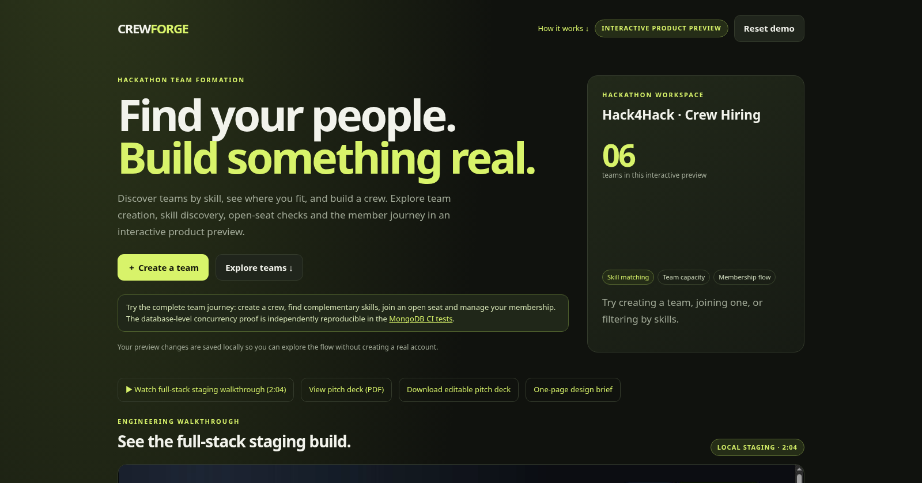
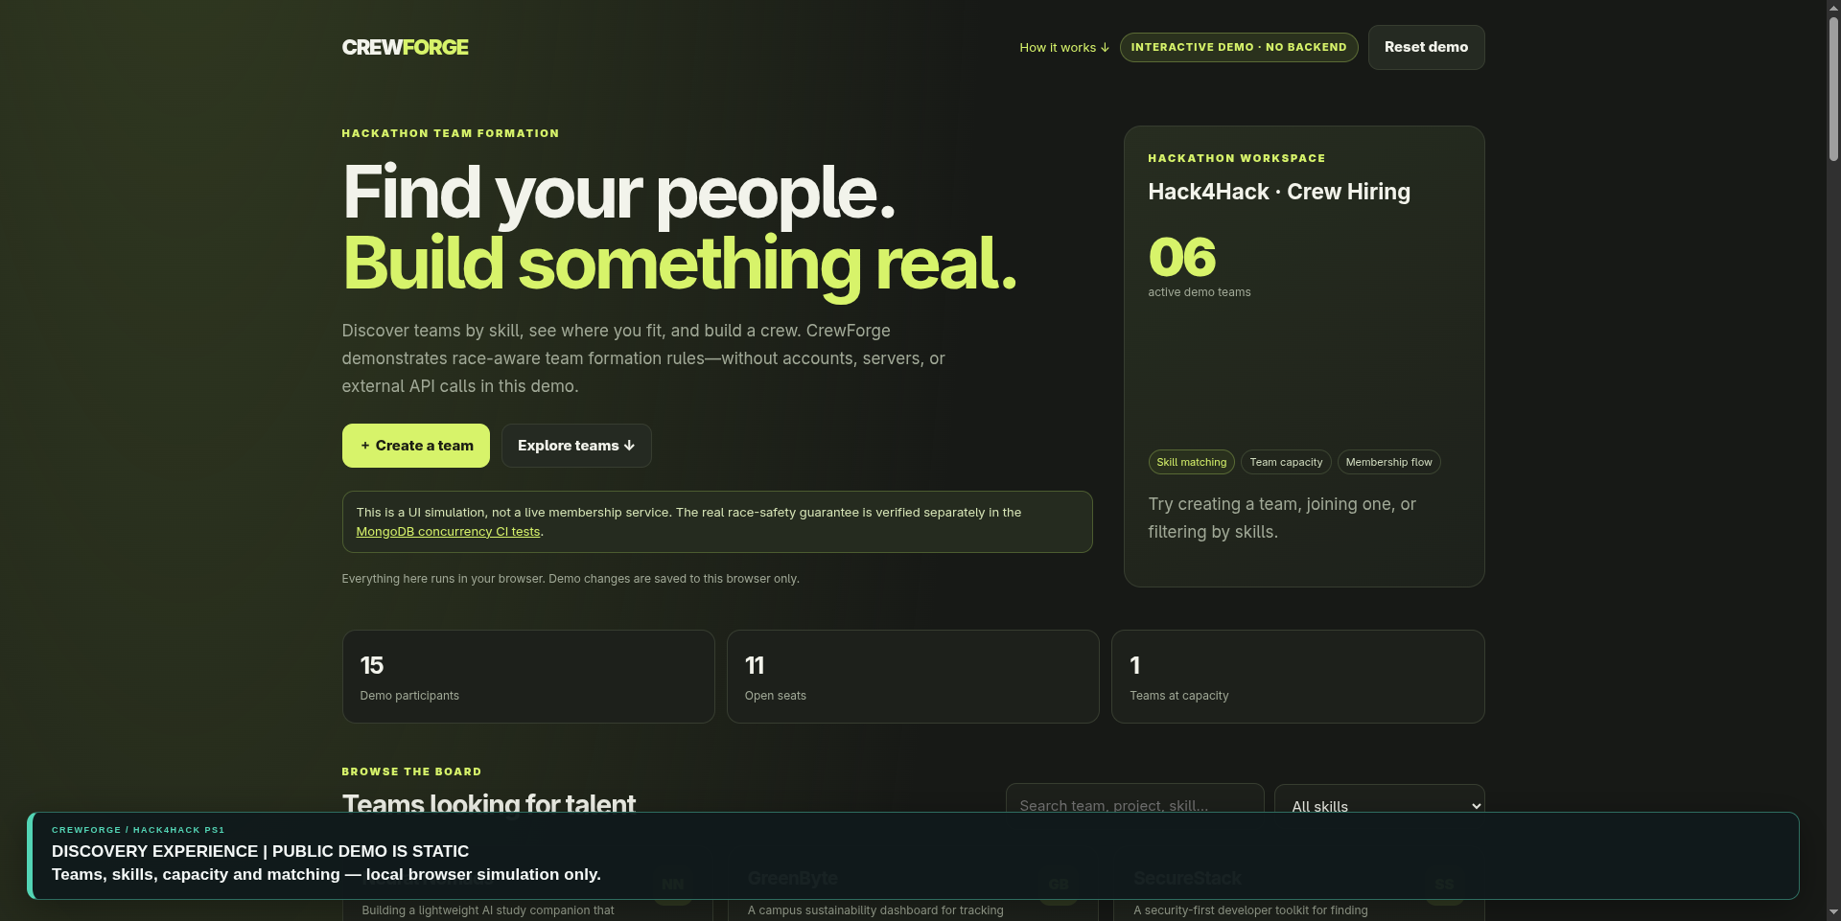
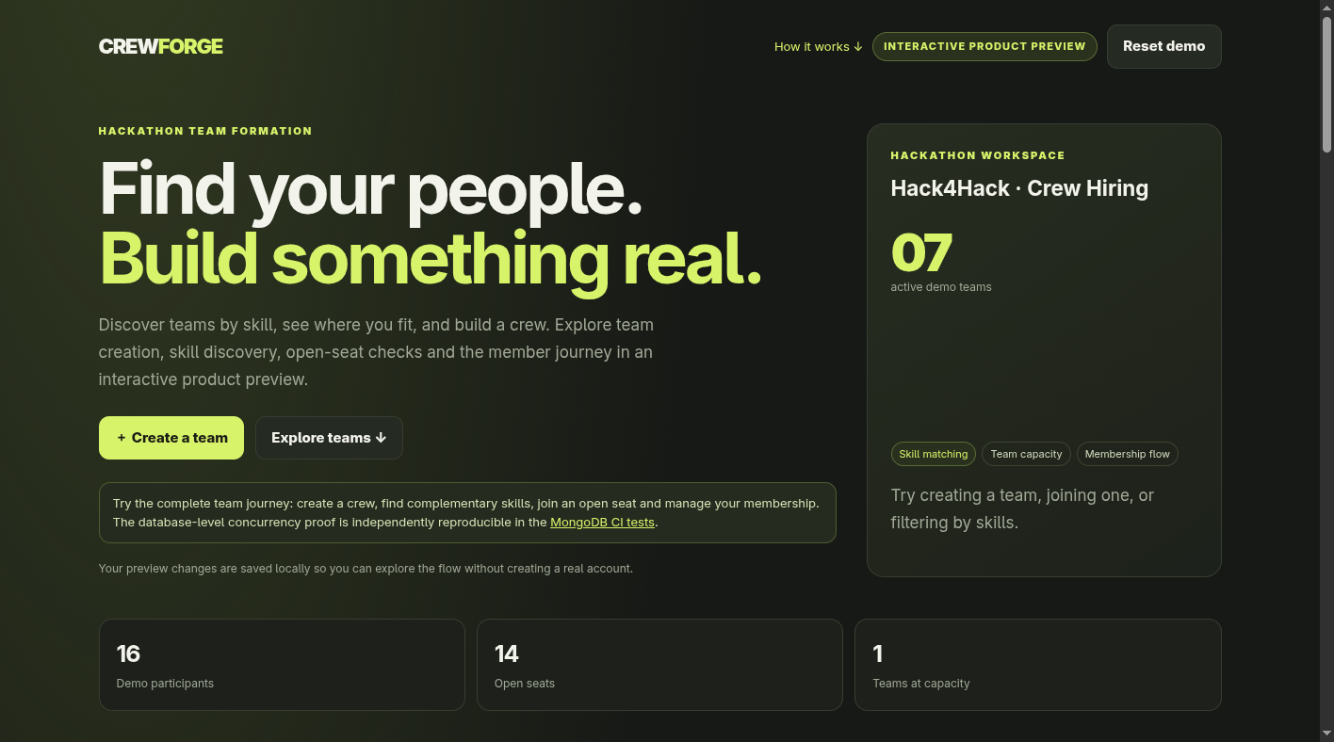
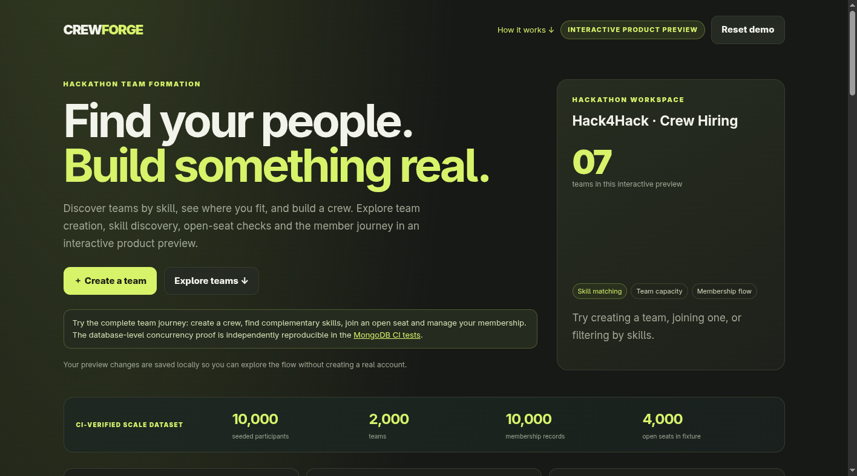
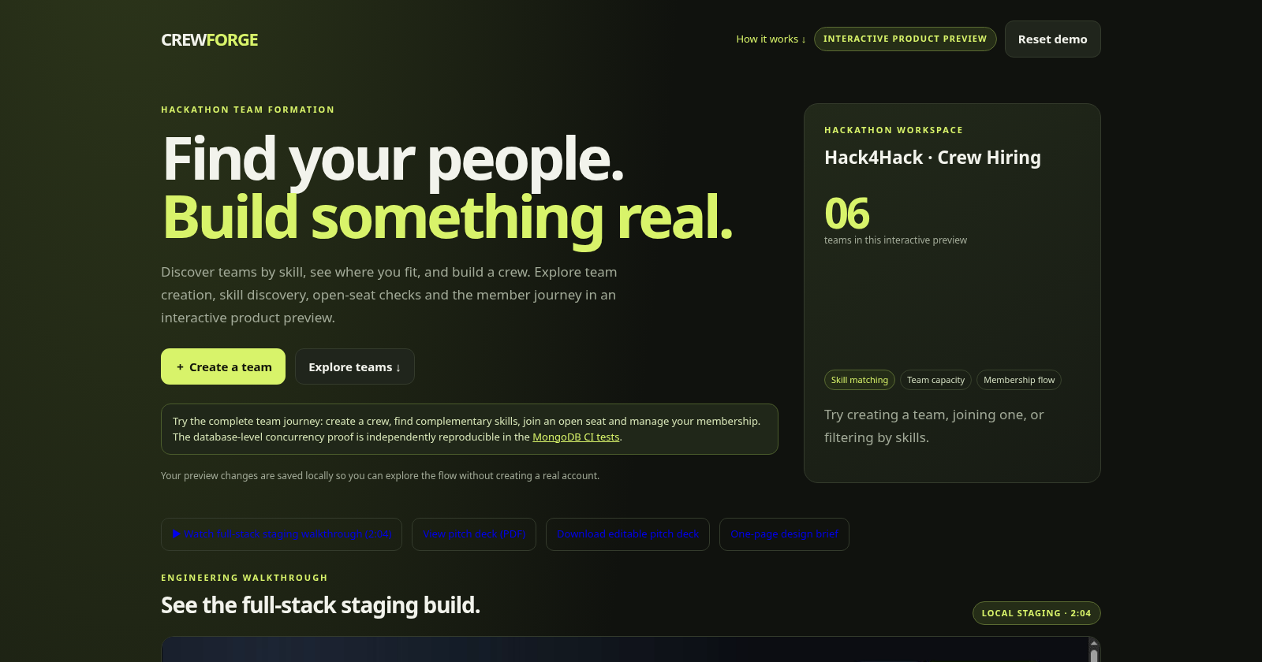
08 / EVIDENCE
What judges can inspect and verify
A working product journey backed by transaction-level correctness and local verification.
WORKING PRODUCT FLOWS
01 Create teams and define skill needs
02 Discover teams by skills and open seats
03 Submit idempotent join requests
04 Leader approval reserves the final seat atomically
05 Manage members, invites and team lifecycle
10,000
2,000
6,000
50 → 1
seeded participants
teams
membership records
concurrent final-seat race
CI + local: 71/71 tests · rollback fault injection · build · 0 audit findings · 5 smoke checks. 100-VU load: 98.43 req/s, 10.23 ms p95, 0% failures.
Repository: github.com/PSP-YN/Race-proof-team-formation · CI 42057405278 · CodeQL 42057405246

