Slide 1
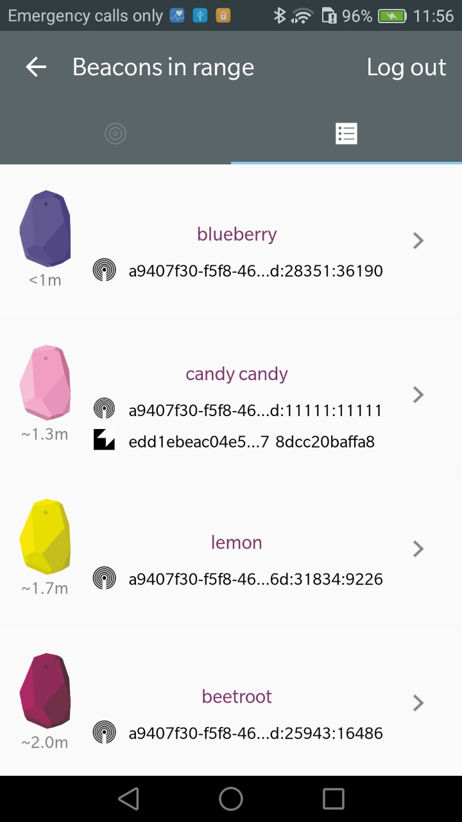
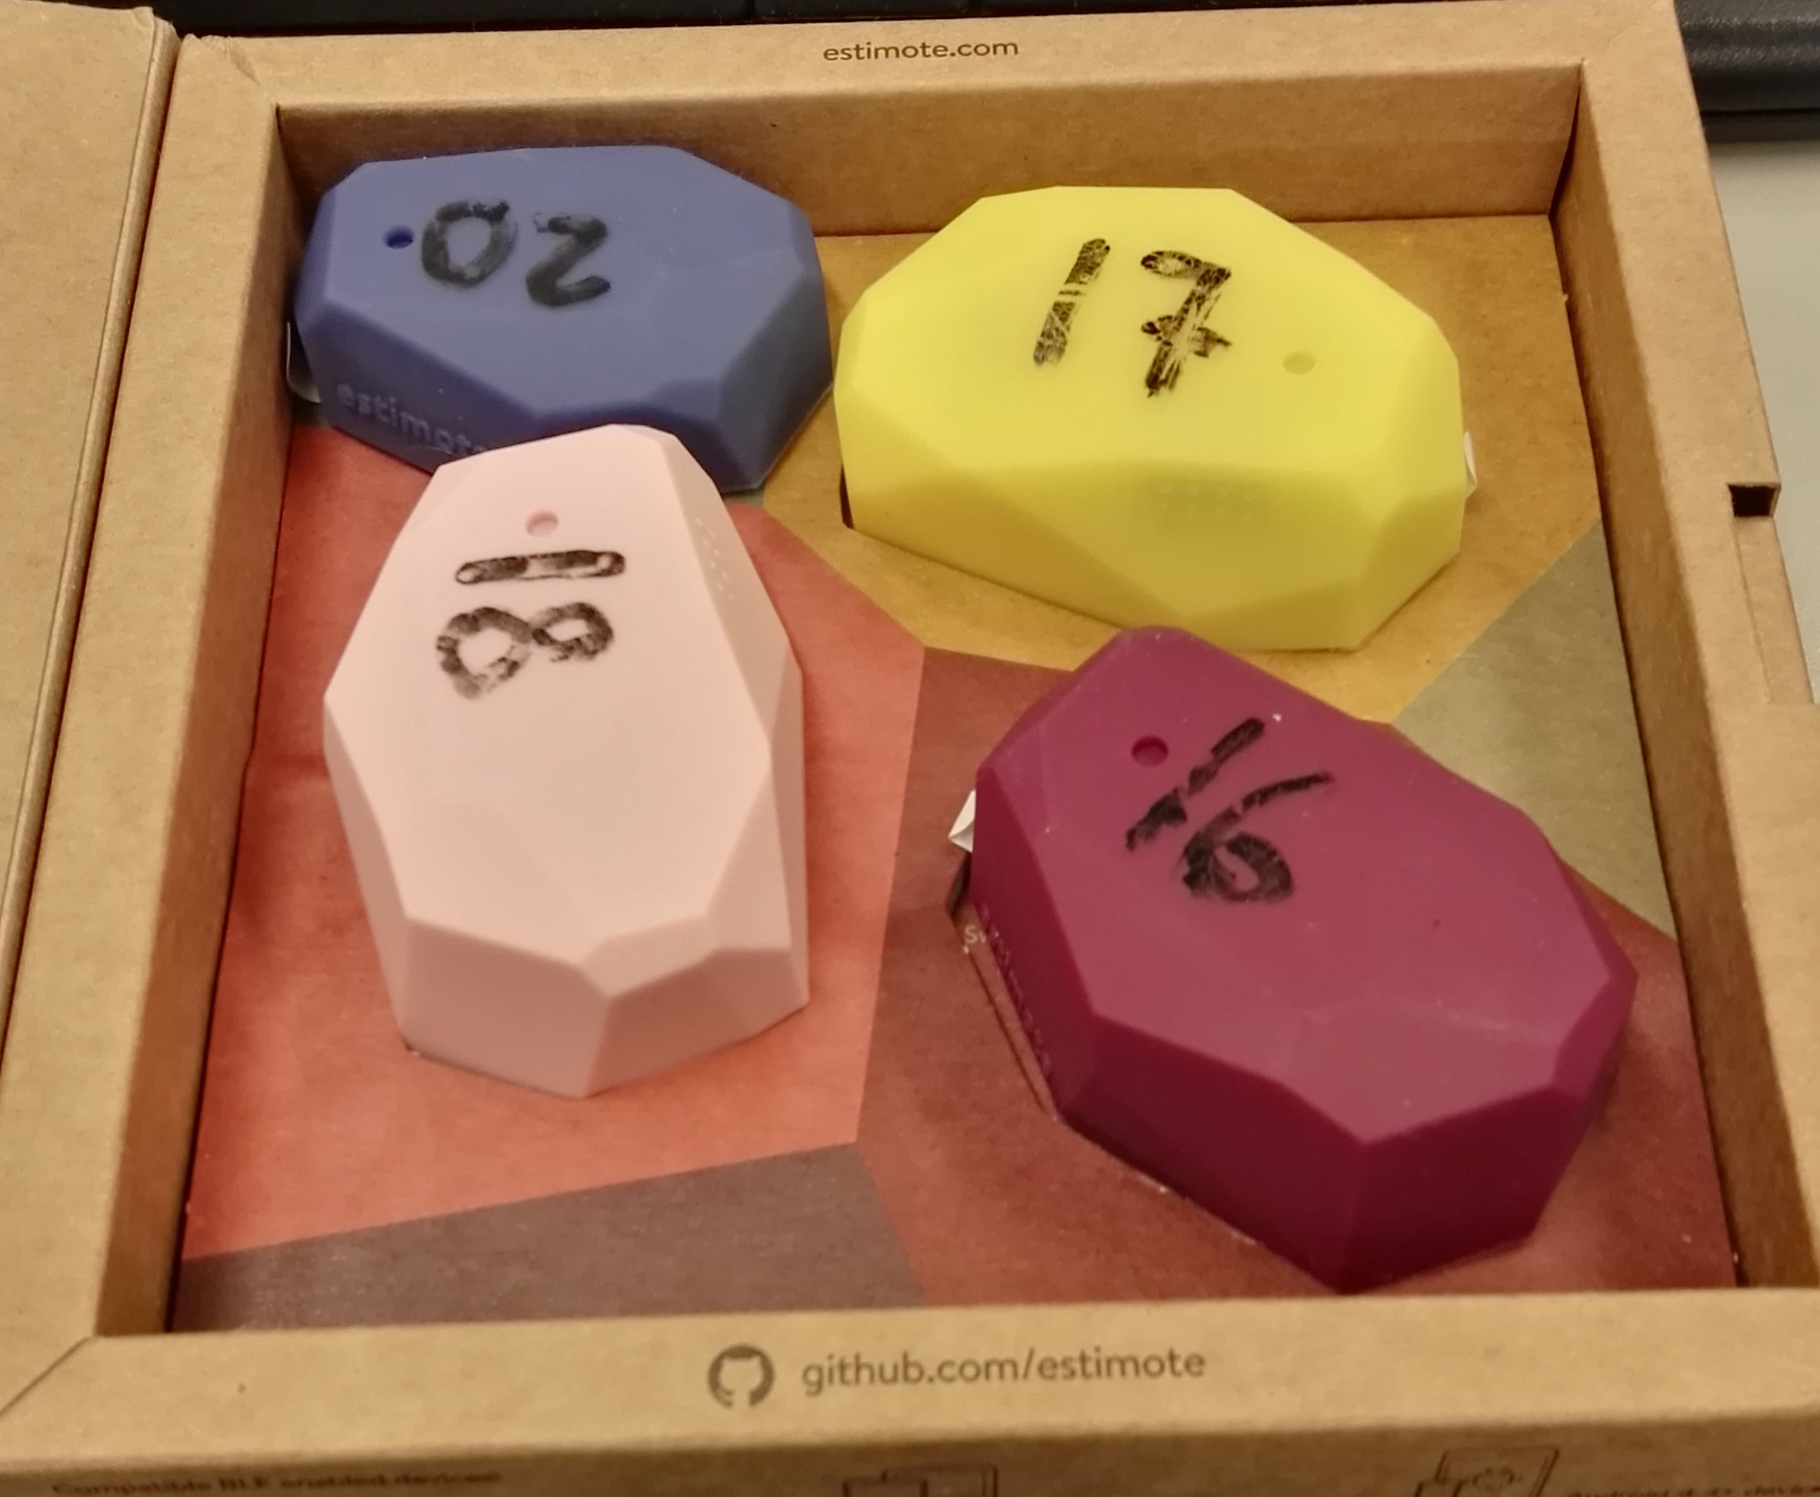
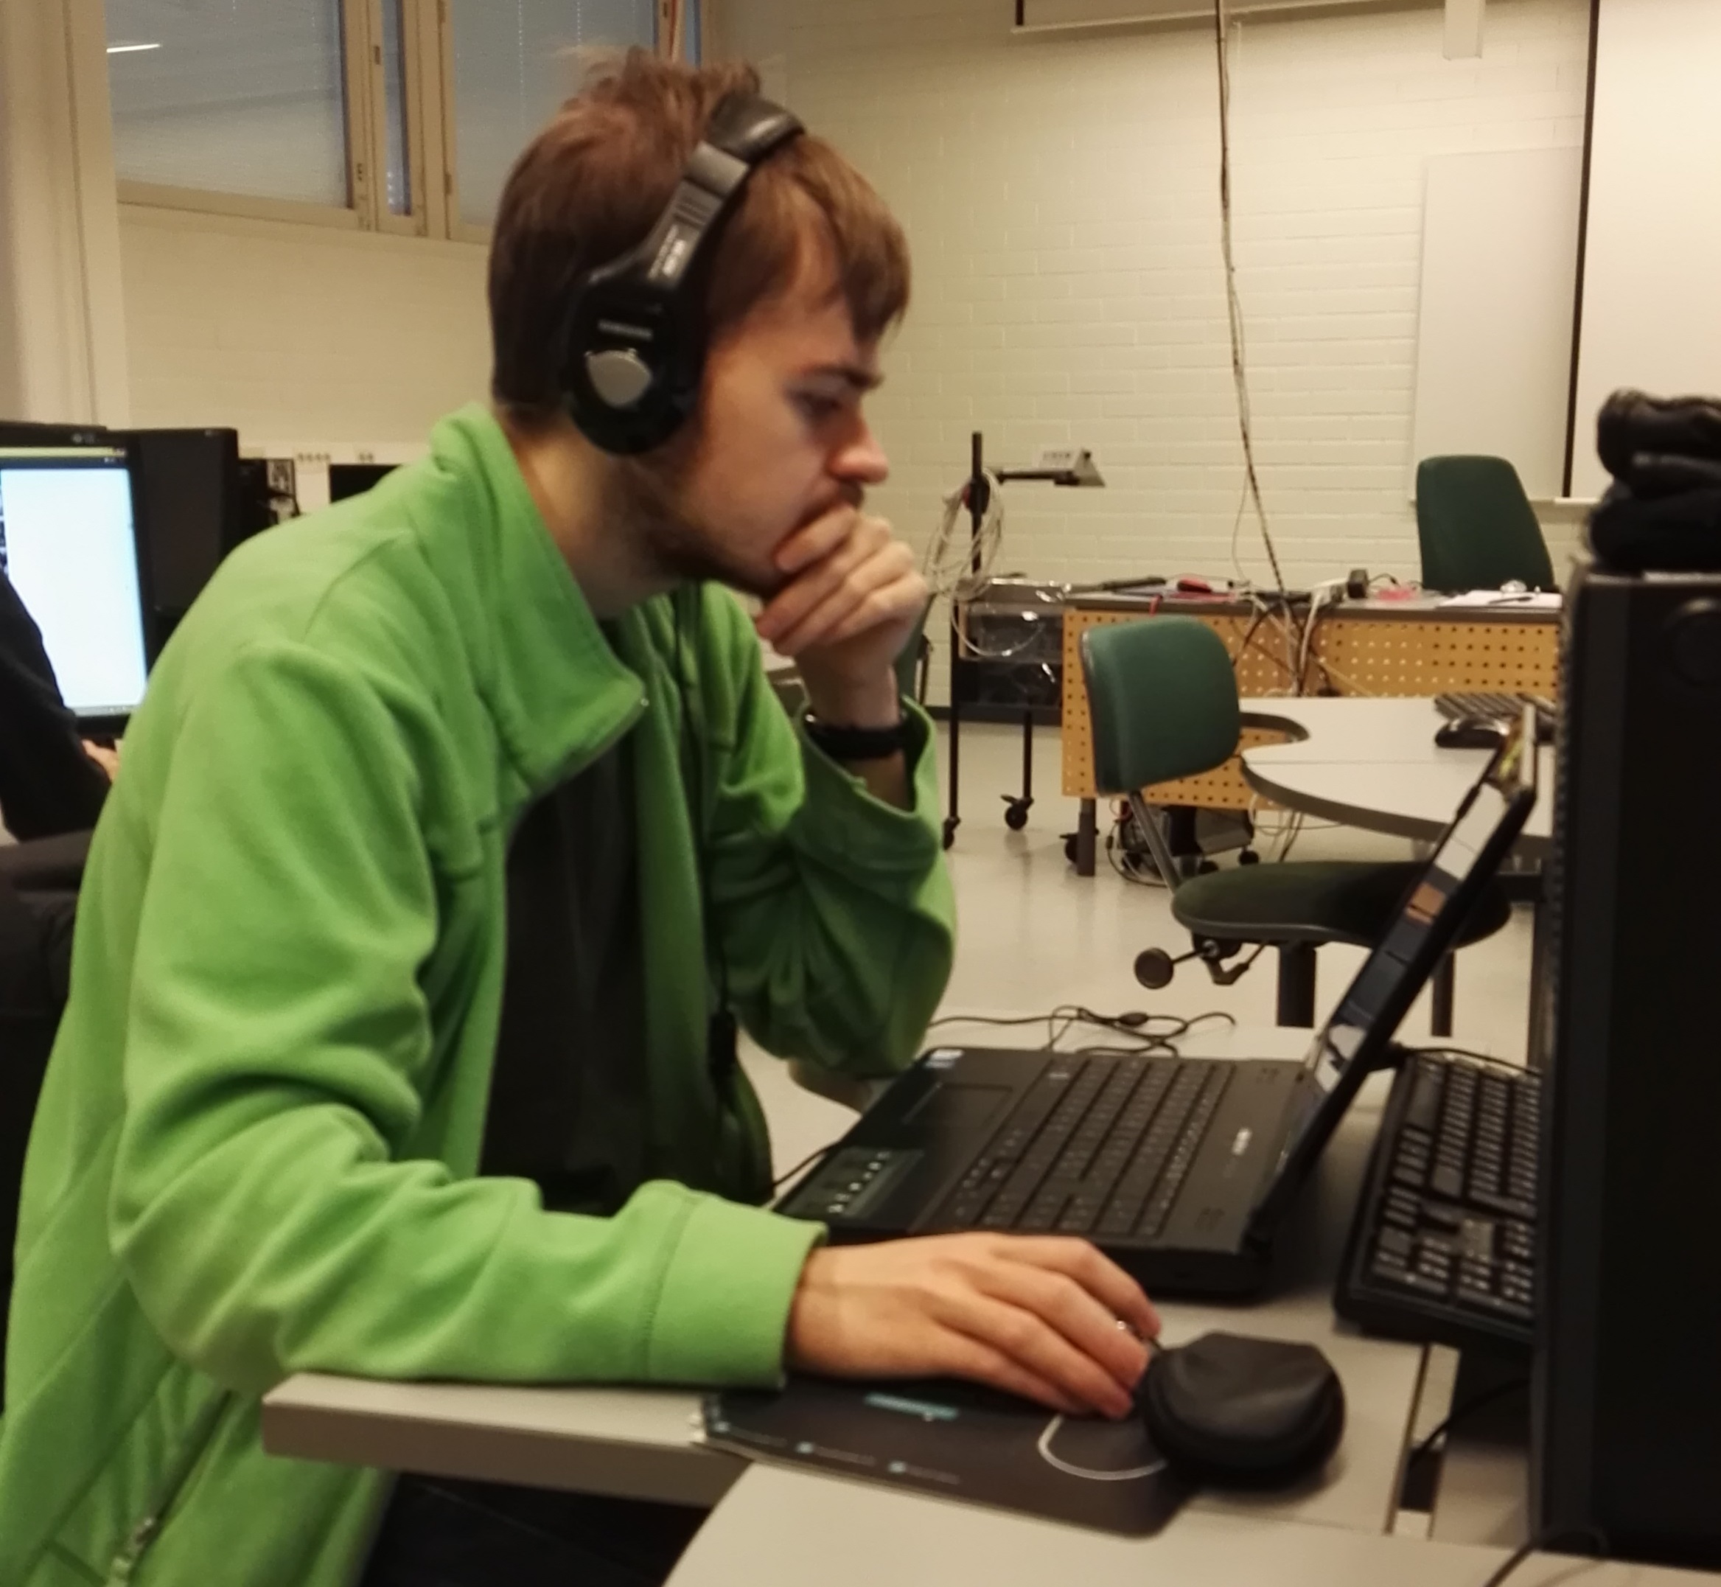
Shitty beacon project
Tatu Piippo, Jiska Parrila, Petri Virkkunen, Pauli Huttunen
School of Engineering and Natural Recources, Information Technology, Software Engineering
Introduction
The subject of this project was to create a IoT-system using estimotes.
Estimotes are fairly small Bluetooth devices that can send telemetry data or an url. We decided to make a system that changes the contents of a web page depending on what beacon is currently closest to our android device.
FIGURE 1. Estimote beacons
Estimote beacons
Estimote beacons can measure temperature, brightness, pressure and received signal strength. This data can be sent to Bluetooth compatible devices like Android or iOS phones. You can’t program the estimote to send any data you want except the url. So instead you need to use an app or a webpage that has that shows specific data depending which beacon is currently the closest one.
Methods
We used an Android device to read the data off the estimote beacons. The android device then sends the data to a database using PHP. Our webpage then reads the database and determines what beacon is currently the closest and changes it’s content accordingly.
FIGURE 2. Leadcoder Jiska Parrila thinking about the meaning of life
Results
The estimote beacons worked really well. The estimotes were easy to use as a developer there are great libraries already done by the estimote company that have the necessery functions for automatic data reading. Also the estimotes are fairly easy to configure using the estimote app.
FIGURE 3. Estimote beacon configuration app
Conclusions
Our project members don’t think the estimote beacons will become popular because of the app requirement. For example users need to download an app for each different company seperately. So if the beacons were available in several different store chains you would need to have an app for each one. It is very unlikely that common consumers would bother to download an app for each store they go to.
References
http://www.estimote.com/
Date of publication: 2016, Fall
Supervisor Pertti Heikkilä

