Slide 1

NETFLIX STOCK PRICE PREDICTION

Slide 2

AGENDA
OBJECTIVE
DATASET
TRAINING AND TESTING
METHODOLOGY
RESULTS AND DISCUSSION

Slide 3
OBJECTIVE
TO BUILD A MODEL WHICH WILL PREDICT THE STOCK PRICE OF THE COMPANY

Slide 4

DATASET
STOCK PRICES FROM 2013 – 2017
ALL COMPANIES ON S&P 500 INDEX
61900 OBSERVATIONS ACROSS 7 ATTRIBUTES
2016-17 TESTING SET
2013-16 TRAINING SET
619,000
OBSERVATIONS

Slide 5
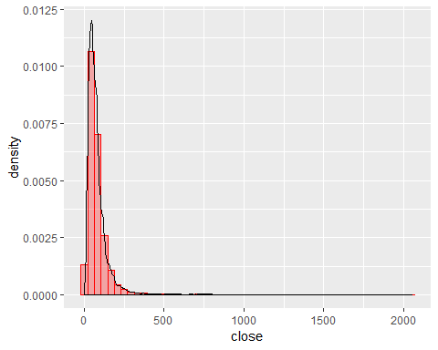
EXPLORING THE DATASET
Distribution of Closing Prices
Maximum Stock Prices around USD 100

Slide 6

DATA CLEANING
Checking for NA values
Removing the columns for opening, high and low
Remove Stock data of Companies other Than ‘NFLX’

Slide 7
TRAINING AND TESTING
2016-17 TESTING SET
2013-16 TRAINING SET
To make a prediction, at first we need to split our database on train and test datasets. To check if model built on one set of data will predict correctly data that were not used to built one. We split data with proportion 20% test, 80% train.
Now we build model with the same variables that we’ve got, but using train data.
Actual vs prediction of forecast for all models.
Confusion Matrix of all models.

Slide 8
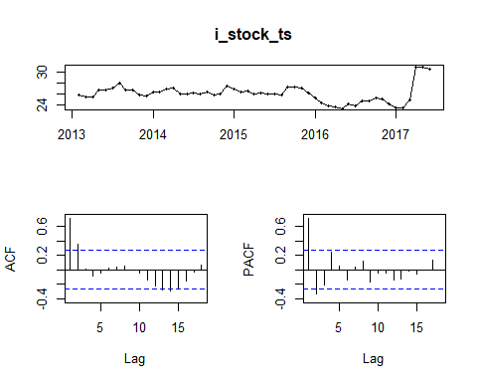
EXPLORATORY DATA ANALYSIS
Data Visualization
Looks stationary but actually has components
We Use KPSS and ADF

Slide 9
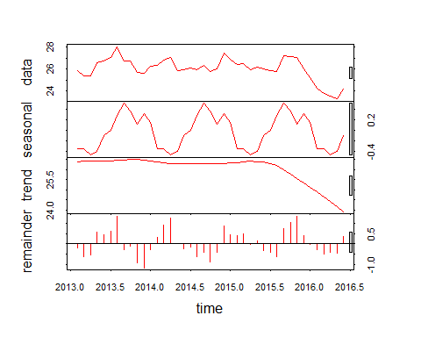
DECOMPOSITION
Seasonality is present
Trend is present
Needs First Order Differencing

Slide 10
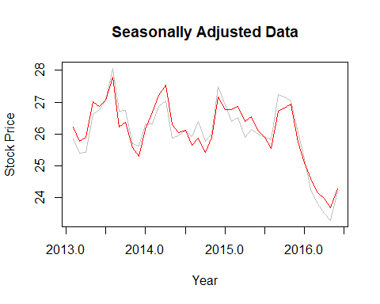
METHODOLOGY
DIFFERENCING
FIRST MODEL
First model after all transformations and most of used variables are relevant.
Nevertheless, there are still many ways to improve it.

Slide 11
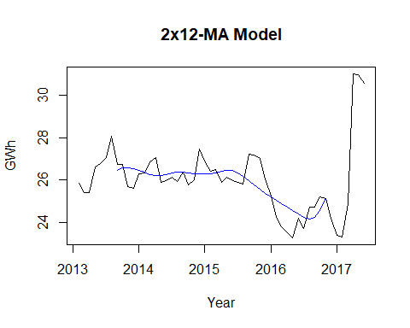
METHODOLOGY
DIFFERENCING
SECOND MODEL
For yearly variations we use 2X12 Moving Average Model

Slide 12
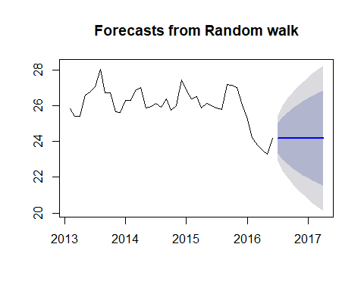
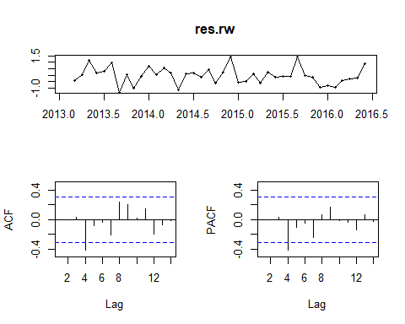
METHODOLOGY
RANDOM WALK
We apply the random walk model just to get a base line for accuracy
No seasonality and trend Noise & stationary time series.
RMSE of the training set is 0.66

Slide 13
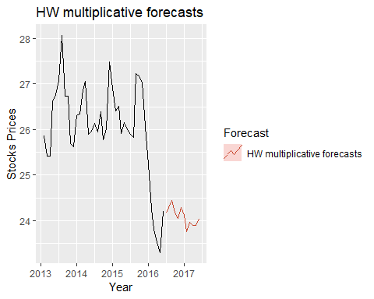
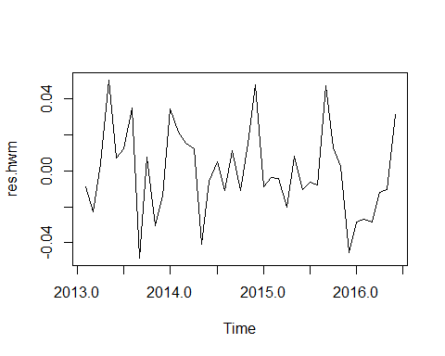
METHODOLOGY
HOLT’S FORECASTING
Use both additive and multiplicative, with and without damping
HW MULTIPLICATIVE FORECAST
RMSE of the training set is 0.63
Some cyclic behaviour

Slide 14
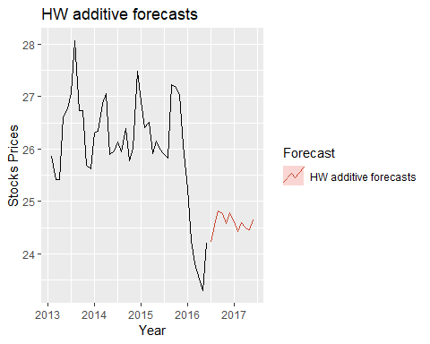
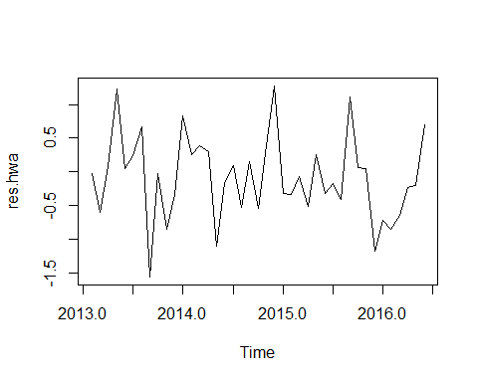
METHODOLOGY
HOLT’S FORECASTING
HW ADDITIVE FORECAST
RMSE of the training set is 0.63
Cyclic Behaviour & Stationary TS

Slide 15
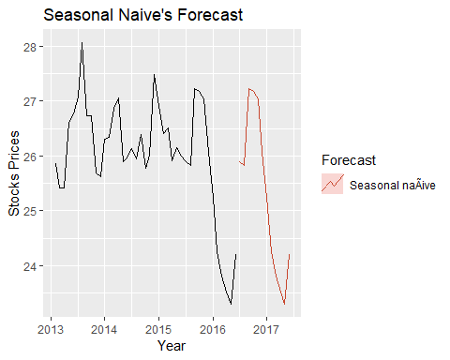
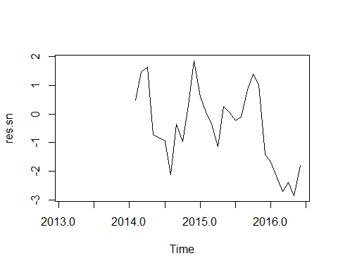
METHODOLOGY
SEASONAL NAIVE
Perform poorly given the variation in the data
RMSE of the training set is 1.32

Slide 16
METHODOLOGY
SELECTING PARAMETER FOR ARIMA MODEL
ADJUSTED BY AIC CRITERIA
One of the metrics that determines quality of econometric model is AIC criteria.
We use auto.arima algorithm to gain model with the lowest possible AIC score which gives us best possible model
We do not need to difference time series
Auto ARIMA give us AIC of 79.64 for ARIMA(0,1,0)(0,0,1)[12]

Slide 17
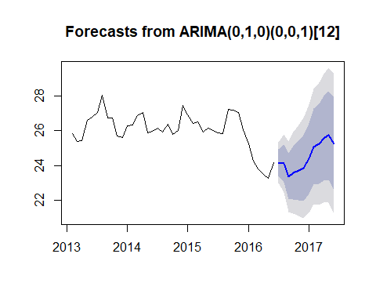
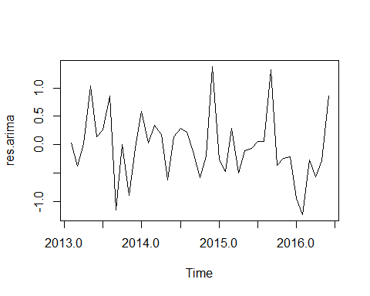
METHODOLOGY
FITTING ARIMA MODEL
Checking Accuracy of the model
Non-Seasonal component - first order difference
Moving Average - first order
Seasonal component 12 seasons

Slide 18
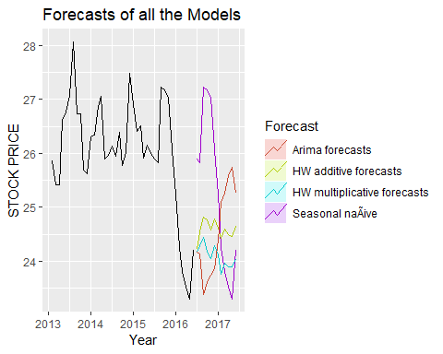
ACCURACY OF THE MODEL
Plot all the models to view the performance

Slide 19
CONCLUSION & CHALLENGES
CONCLUSION
Using Auto ARIMA we got the model with a low RMSE compared to other models
Can be used for good enough predictions
This model can be improved with more data which includes a larger proportion of training set
CHALLENGES
Other methods could be used for comprehensive comparison of Advantages and Disadvantages of varied models
Overall calculation is huge amount of work

Slide 20
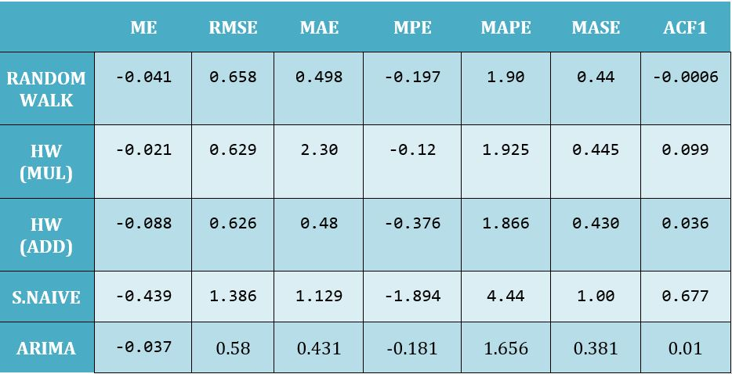
ACCURACY OF THE MODEL
Use ERROR values to compare the accuracy of all models

Slide 21
THANK YOU!

