Slide 1
MULTI-CLASS NLP CLASSIFICATION • PROJECT DEMO
Reddit Mental Health
Topic Classification
Comparing 5 NLP approaches — from TF-IDF to zero-shot transformers
depression · anxiety · crisis · neutral · loneliness

Slide 2
THE PROBLEM
Reading Mental-Health Signal in Reddit Posts
Use Case
Dataset
Automatically route a post into a mental-health topic — depression, anxiety, crisis, neutral, or loneliness — the moment it's written.
Reddit posts scraped 2019–2022 from r/depression, r/Anxiety, r/SuicideWatch, r/mentalhealth, r/lonely — cleaned, labeled, and stratified into train / val / test.
Early-signal triage for moderation queues
Content routing to the right peer-support community
Foundation for a crisis-response alerting layer
17,501
3,751
3,751
train
validation
test
5 source subreddits → 5 label classes → 5 candidate models
Not a diagnostic tool — a topic-classification exercise on public data.
Reddit Mental Health — Multi-Class Topic Classification
2

Slide 3
METHODOLOGY
Project Management & Workflow
Version Control
Task Tracking
Iteration Model
GitHub repository — notebook, app, and model artifacts tracked with a clean, gitignored history.
Jira Kanban board — Backlog → In Progress → Review → Done, one card per modeling milestone.
Each model (TF-IDF → RNN → BiLSTM → DistilBERT → Zero-Shot) shipped as its own tracked increment.
[ Insert Jira Kanban board screenshot here ]
Backlog
In Progress
Review
Done
Reddit Mental Health — Multi-Class Topic Classification
3

Slide 4
SYSTEM DESIGN
End-to-End Architecture
Raw Reddit
Data
→
Streaming
Clean & Label
→
Train / Val / Test
Split
5 candidate models trained / evaluated in parallel
TF-IDF +
LogReg
RNN
BiLSTM
DistilBERT
(fine-tuned)
Zero-Shot
BART
↓
Evaluation & Comparison
(accuracy, macro-F1, latency)
→
Streamlit App
user text in → all 5 model predictions out
Reddit Mental Health — Multi-Class Topic Classification
4

Slide 5
THE MODELS
Five Approaches, One Task
Model | Family | Description
TF-IDF + Logistic Regression | Classical ML | Sparse n-gram features, linear classifier — fast, interpretable baseline
RNN (Elman) | Deep Learning | Single-direction recurrence over word embeddings
BiLSTM | Deep Learning | Bidirectional LSTM — reads context forward and backward
DistilBERT | Transformer (fine-tuned) | Pretrained transformer, fine-tuned on the labeled training set
Zero-Shot (BART-large-mnli) | Transformer (zero-shot) | No training — NLI entailment against the label names at inference time
Reddit Mental Health — Multi-Class Topic Classification
5

Slide 6
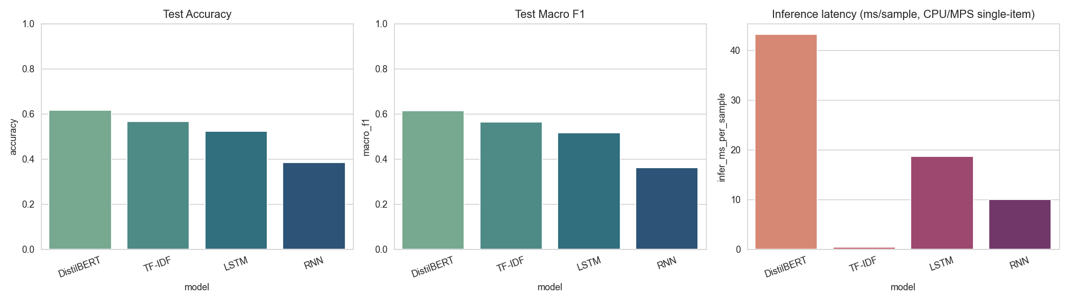
RESULTS
Model Comparison — Test Set
Model | Accuracy | Macro F1 | Train Time | Infer. ms/sample
DistilBERT | 0.617 | 0.613 | ~20 min | ~43 ms
TF-IDF + LogReg | 0.565 | 0.563 | ~2 s | ~0.4 ms
BiLSTM | 0.522 | 0.515 | ~4 min | ~19 ms
RNN | 0.384 | 0.361 | ~1.6 min | ~10 ms
Zero-Shot (BART) | not yet measured | — | 0 (no training) | slow, CPU-bound
Zero-shot cell was added to the notebook but not yet re-run — see docs note.
Reddit Mental Health — Multi-Class Topic Classification
6

Slide 7
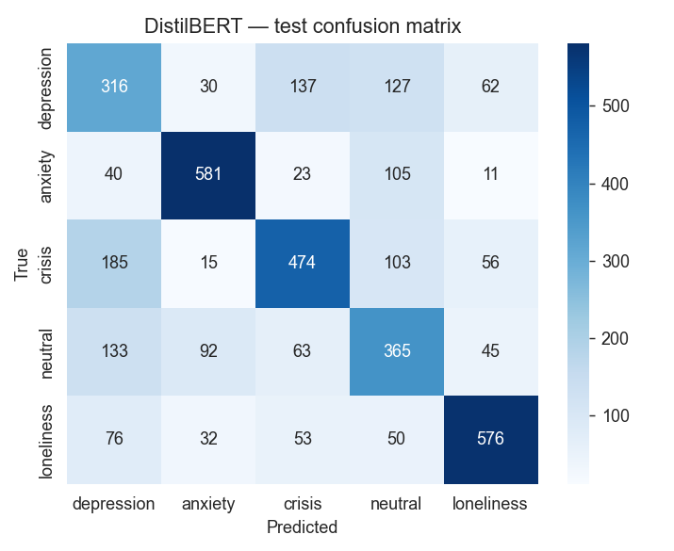
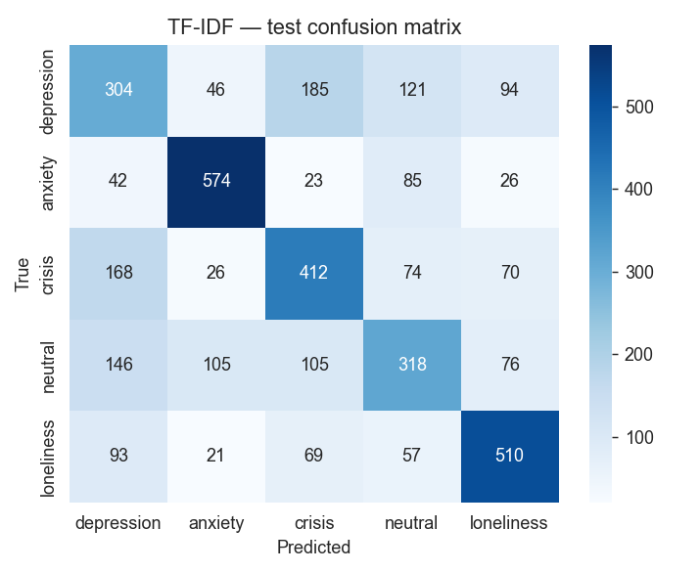
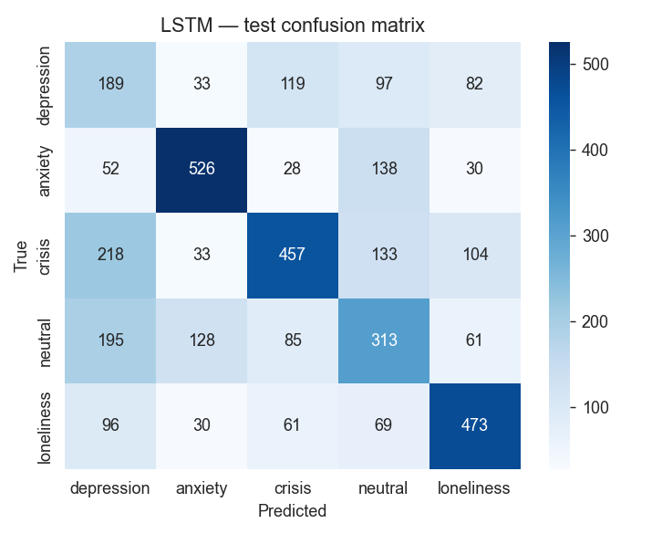
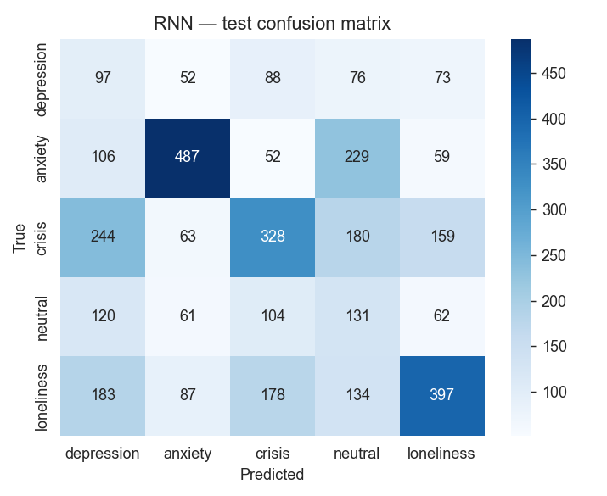
ERROR ANALYSIS
Confusion Matrices — Test Set
DistilBERT
TF-IDF + LogReg
BiLSTM
RNN
Reddit Mental Health — Multi-Class Topic Classification
7

Slide 8
ANALYSIS
Why DistilBERT / TF-IDF Win
TF-IDF wins accuracy-per-second
Near-zero latency, fully interpretable (inspect top n-gram weights), trains in seconds — the right default baseline.
DistilBERT wins raw accuracy
Best macro-F1 overall, at ~100x TF-IDF's inference cost and a GPU-bound training run.
RNN underperforms BiLSTM
Single-direction memory loses earlier context over a ~120-word post; bidirectional reading largely fixes it.
Zero-shot trades accuracy for flexibility
Zero labeled data, instant adaptation to new label sets — valuable when categories change faster than you can re-annotate.
Reddit Mental Health — Multi-Class Topic Classification
8

Slide 9
LIVE DEMO
The Streamlit Application
🎤 Try It Yourself
📡 Live Audience Wall
Single text box — anyone types a post
All 5 models predict side by side
Confidence % and latency (ms) per model
QR code generated to open the deployed app on a phone
Automatic crisis warning banner if any model flags "crisis"
Audience submits via a Google Form
App polls the published Google Sheet CSV — no login/API key
Every new response classified live, on the presenter's screen
Same crisis-flag banner surfaces for the whole room
Reddit Mental Health — Multi-Class Topic Classification
9

Slide 10
WRAP-UP
Conclusion & Next Steps
5 models compared end-to-end — TF-IDF is the production default, DistilBERT is the accuracy ceiling.
1
Re-run the zero-shot evaluation cell to complete the 5-model comparison table
2
Expand labeled data for the "crisis" class — likely the smallest, highest-stakes class
3
Evaluate distillation / quantization for lighter deployment
4
Add production monitoring specifically on "crisis" predictions
Thank you
Reddit Mental Health — Multi-Class Topic Classification
10

