Slide 1

Maze
Team CBBA-6890

Slide 2
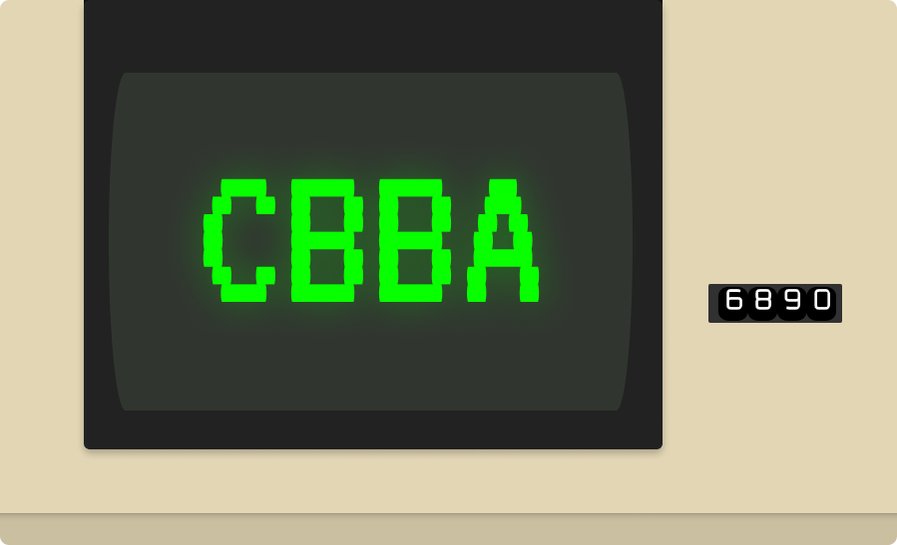

Participants
Ivan Burzev- Back -end developer
Presiyan Stefanov - Front-end developer
Presiyan Stefanov - QA engineer
Veleka Kostova - Scrum trainer

Slide 3






Used technologies

Slide 4

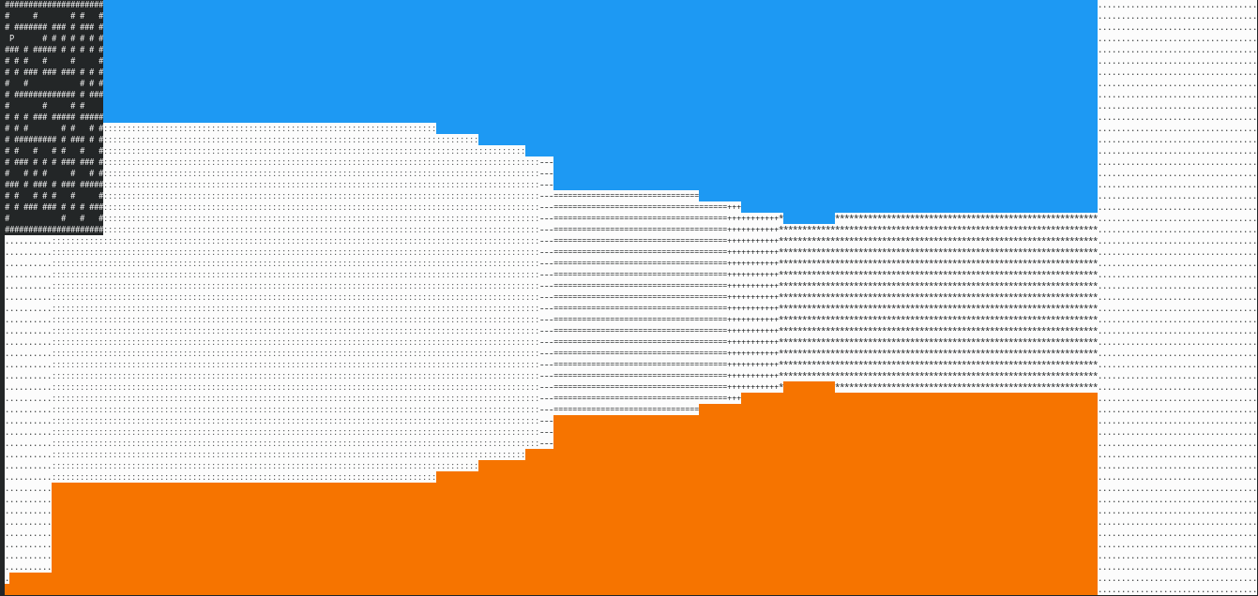
About the game
The code was written by Ivan Burzev and Presiyan Stefanov. They used C++, Makefile and ncurses library.

Slide 5
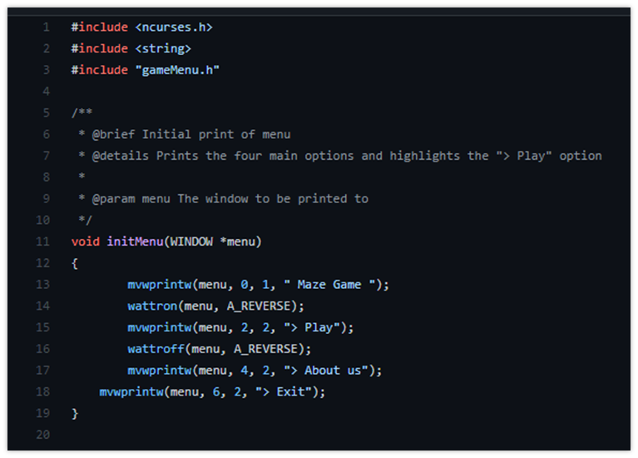
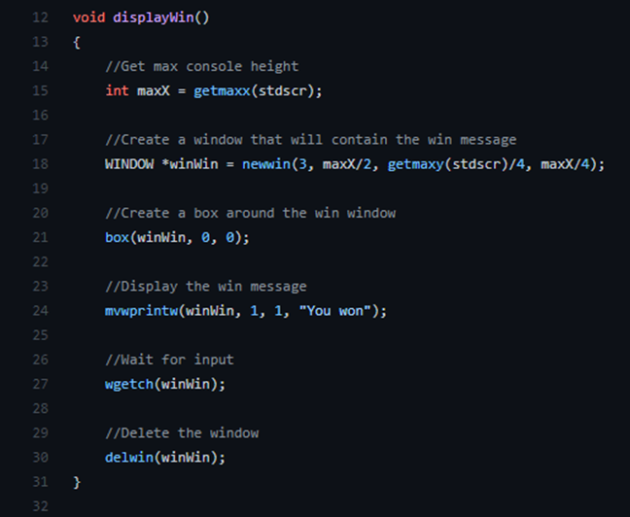

Slide 6
Thank you for your attention!
MENU
ANALYSIS
CONTACT
Data ANALYSIS

