Slide 1
PRESENTATION TITLE
SUBTITLE HERE
MindShow.fun
2023-12-04

Slide 2
CONTENTS
Card Transaction Fraud Dataset Introduction
XGBoost introduction

Slide 3
01
Introduction to Dataset

Slide 4
Dataset Introduction
1000000 transactions, 8.74% fraud rate
Binary classification problem, Unbalanced data
We will try stratified sampling and upsampling when dividing the dataset

Slide 5
Dataset Introduction
Feature Explanation:
distance_from_home: the distance from home where the transaction happened
distance_from_last_transaction: the distance from last transaction happened
ratio_to_median_purchase_price: ratio of transaction prive to median purchase price
repeat_retailer: Is the transaction happened from same retailer
used_chip: Is the transaction through credit card?
used_pin_number - Is the transaction happened by using PIN number?
online_order - Is the transaction an online order?
fraud - Is the transaction fraudulent.

Slide 6
Gradient boosting
In Gradient boosted decision tree(GBDT), the k-th tree is used to fit the negative derivative of the loss function with respect to the current model’s prediction.
The current model’s prediction for each observation is the weighted sum of the first k-1 trees.
If we use MSE as the loss function in a regression task, the derivative for each observation is simply the residual between true label value and predicted value.

Slide 7
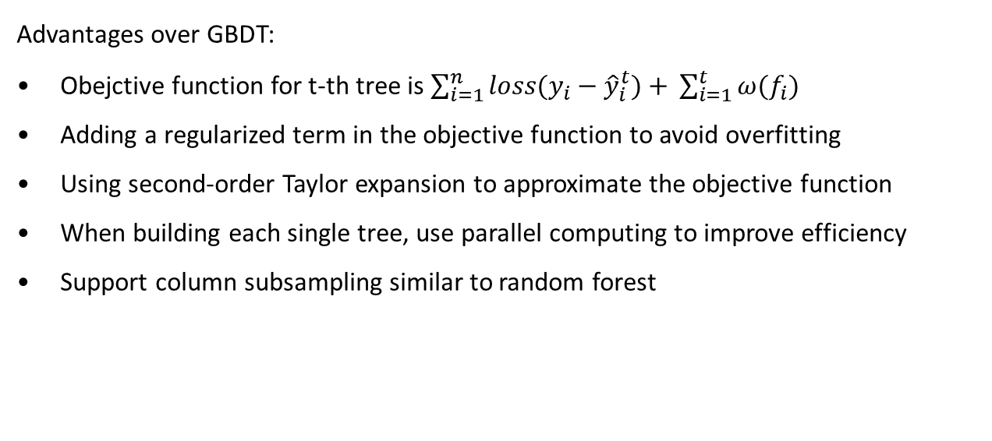
XGBoost
Advantages over GBDT:
Obejctive function for t-th tree is $\sum_{i=1}^{n}{loss(y_{i}−{\hat{y}}_{i}^{t})+} \sum_{i=1}^{t}{ω(f_{i})}$
Adding a regularized term in the objective function to avoid overfitting
Using second-order Taylor expansion to approximate the objective function
When building each single tree, use parallel computing to improve efficiency
Support column subsampling similar to random forest

Slide 8
XGBoost in R
Install required package
install.packages(‘xgboost’)
require(xgboost)
Save the dataset in Dmatrix format provided by XGBoost package to ensure efficiency
E.x
train.x <- data.matrix(training(data.split) %>% select(-fraud))
xgb.train <- xgb.DMatrix(data = train.x, label = train.y)

Slide 9
XGBoost in R
Model parameters and training example
model <- xgb.train(data = xgb.train, max_depth = 3, objective = “binary:logistic”, eta = 0.3, nrounds = 100, nthread = 2, early_stopping_rounds = 50, verbose = 0)
Max_depth

Slide 10
XGBoost offers several advantages that make it a preferred choice for machine learning enthusiasts and practitioners. These advantages include:
High Performance: XGBoost has a proven track record of winning numerous machine learning competitions due to its superior performance.
Flexibility: It supports custom optimization objectives and evaluation criteria, providing flexibility in model development.
Cross-Platform Compatibility: XGBoost is compatible with various programming languages, including Python, R, Java, and more, making it accessible to a wide range of users.

Slide 11
02
Card Transaction Fraud Dataset Introduction

Slide 12
Card Transaction Fraud Dataset Introduction
Understanding Card Transaction Fraud
Importance of Fraud Detection
Characteristics of Fraudulent Transactions

Slide 13
03
Enhanced Fraud Detection using XGBoost

Slide 14
THE END
THANKS

