Slide 1
PRESENTATION TITLE
David Lin, Amber Wang, Mu Niu,
Qifei Cui, Yixin Xue
MindShow.fun
2023-12-04

Slide 2
CONTENTS
Card Transaction Fraud Dataset Introduction
XGBoost introduction

Slide 3
01
Introduction to Dataset

Slide 4
Dataset Introduction
Simulated credit card transaction fraud data on Kaggle
Credit Card Fraud (kaggle.com)
Binary classification problem, each transaction is either fraudulent or not.
1000000 transactions, only 87403 transactions are fraudulent. 8.74% fraud rate, very unbalanced data
We will try stratified sampling and upsampling when dividing the dataset

Slide 5
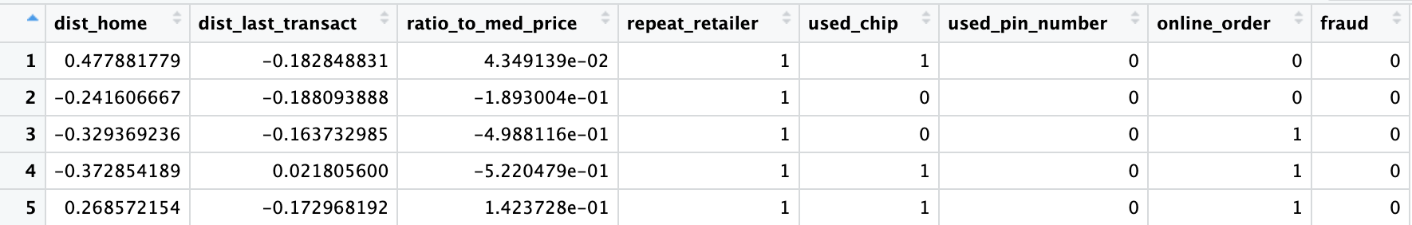
Dataset description
dist_home: the distance from home where the transaction happened
dist_last_transact: the distance from last transaction happened
ratio_to_med_price: ratio of transaction prie to median purchase price
repeat_retailer: Is the transaction happened from same retailer

Slide 6
Dataset description (continue)
used_chip: Is the transaction through credit card?
used_pin_number - Is the transaction happened by using PIN number?
online_order - Is the transaction an online order?
fraud - Is the transaction fraudulent.

Slide 7
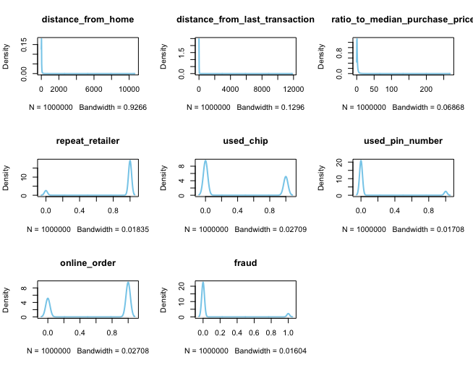
EDA
> dim(data)
[1] 1000000 8
> sum(is.na(data))
[1] 0
# distribution and outliers in each feature

Slide 8
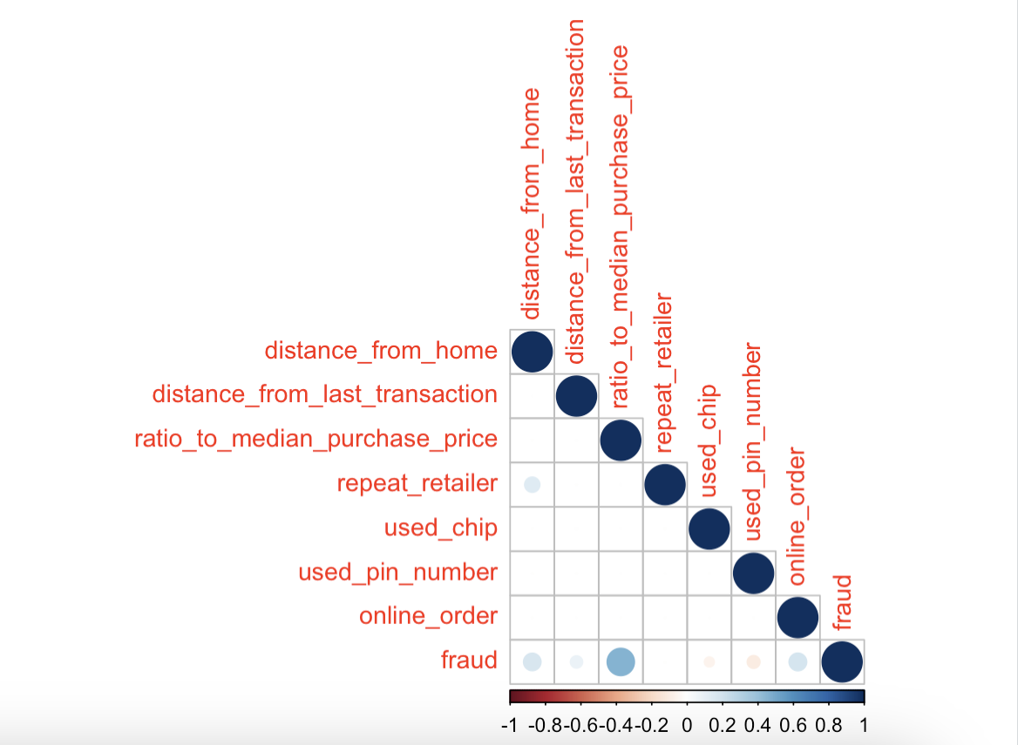
EDA：Correlation
There is a positive correlation with respect to the response variable "fraud" in the variables:
ratio_to_median_purchase_price
distance_from_home
online_order
And a negative relationship with:
used_pin_number

Slide 9
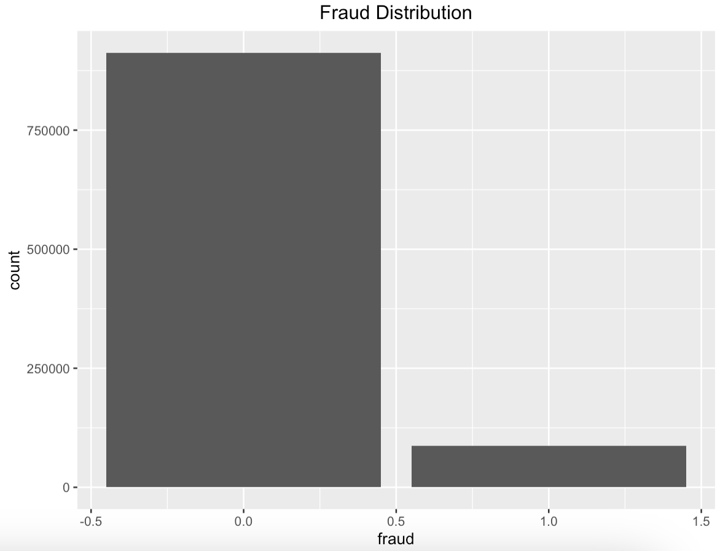
EDA：Imbalance
Around 91% of the transactions are not fraud and 9% are fraud.
There imbalance suggests adapting performance metrics like "true positive rate", "precision" instead of "accurary" to assess the ML model.

Slide 10
Gradient boosting
In Gradient boosted decision tree(GBDT), the k-th tree is used to fit the negative derivative of the loss function with respect to the current model’s prediction.
The current model’s prediction for each observation is the weighted sum of the first k-1 trees.
If we use MSE as the loss function in a regression task, the derivative for each observation is simply the residual between true label value and predicted value.

Slide 11
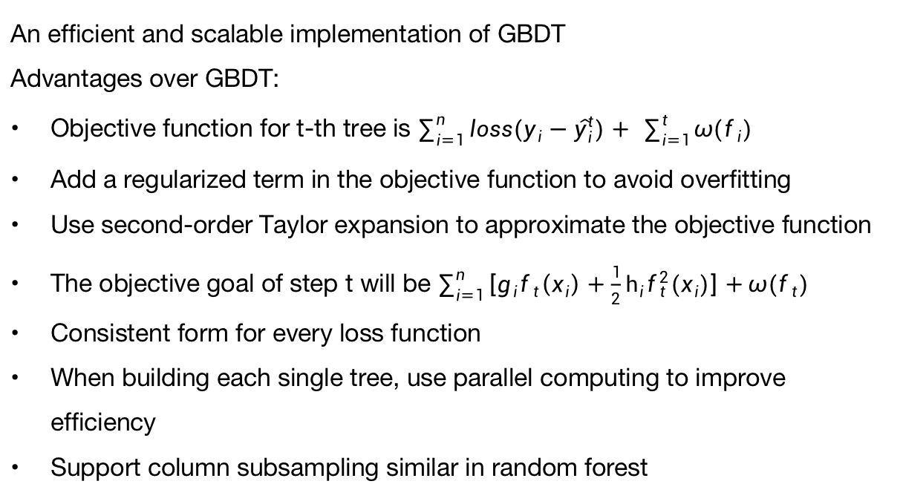
XGBoost
An efficient and scalable implementation of GBDT
Advantages over GBDT:
Objective function for t-th tree is $\sum_{i=1}^{n}{loss(y_{i}−{\hat{y}}_{i}^{t})+} \sum_{i=1}^{t}{ω(f_{i})}$
Add a regularized term in the objective function to avoid overfitting
Use second-order Taylor expansion to approximate the objective function
The objective goal of step t will be $\sum_{i=1}^{n}{\left[g_{i}f_{t}\left(x_{i}\right)+\frac{1}{2}h_{i}f_{t}^{2}(x_{i})\right]+ω(f_{t})}$
Consistent form for every loss function
When building each single tree, use parallel computing to improve efficiency
Support column subsampling similar in random forest

Slide 12
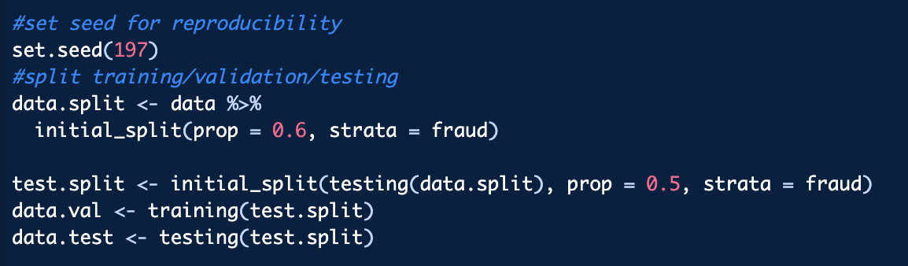
XGBoost in R: Preparation
The first step involves installing and loading the 'xgboost' package in R.
Subsequently, we split the data into 3 parts: training (60%), validation (20%), and testing (20%).
These segments are then transformed into DMatrix objects, an efficient data structure for the xgboost algorithm, by using xgb.DMatrix() function.

Slide 13
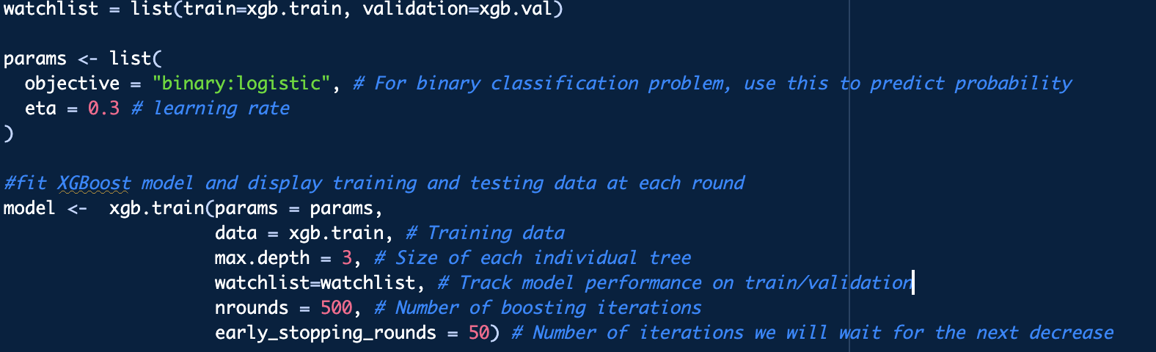
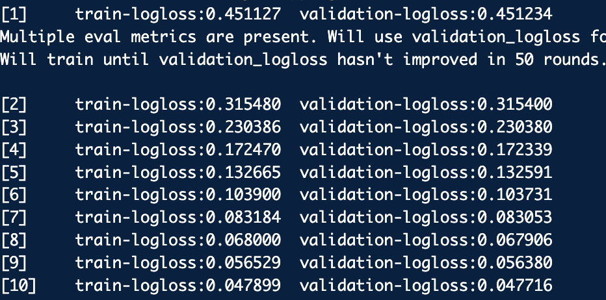
XGBoost in R: Model Training
objective: What’s your goal? In this case, we use ‘binary:logistic’ to predict the probability of having a fraud based on the predictor variables
eta: How fast to learn? default value 0.3
data: Training data in DMatrix structure
max.depth: The size of each tree and a rule of thumb is to use 2 or 3 to prevent overfitting
watchlist: Track model performance on training and validation data during the training process to prevent overfitting
nrounds: number of boosting rounds
early_stopping_rounds: Stop the training process if the model's accuracy on validation set hasn't improved for the specified number of rounds
How watchlist works

Slide 14
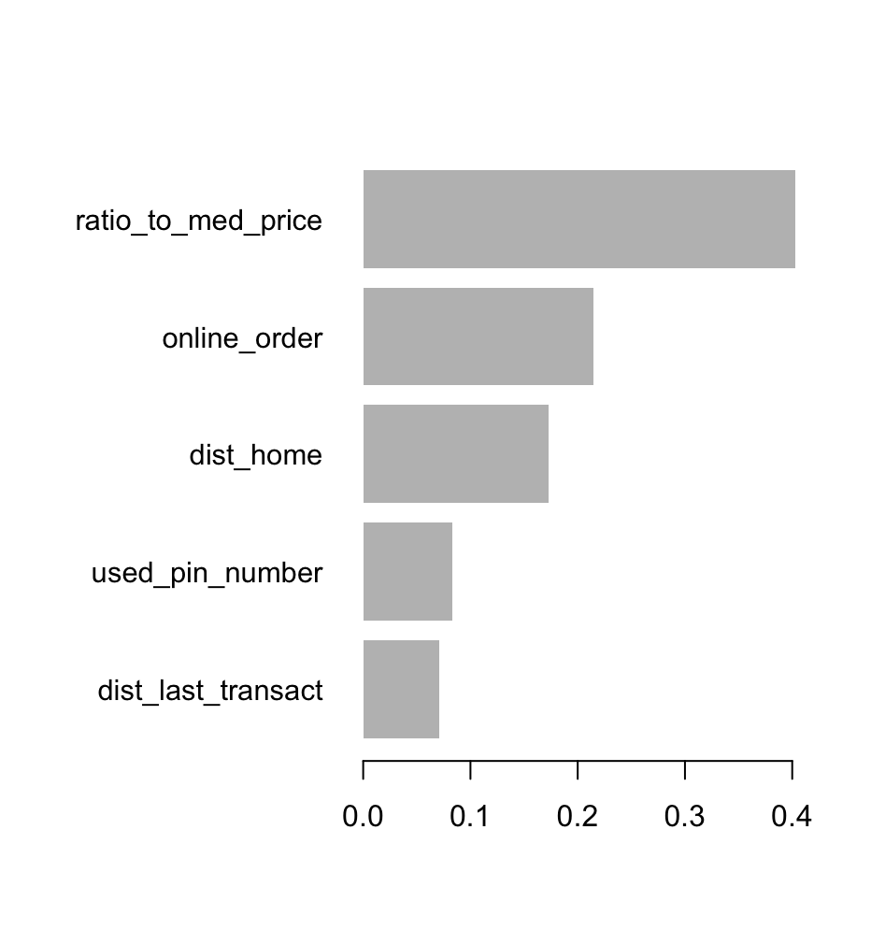
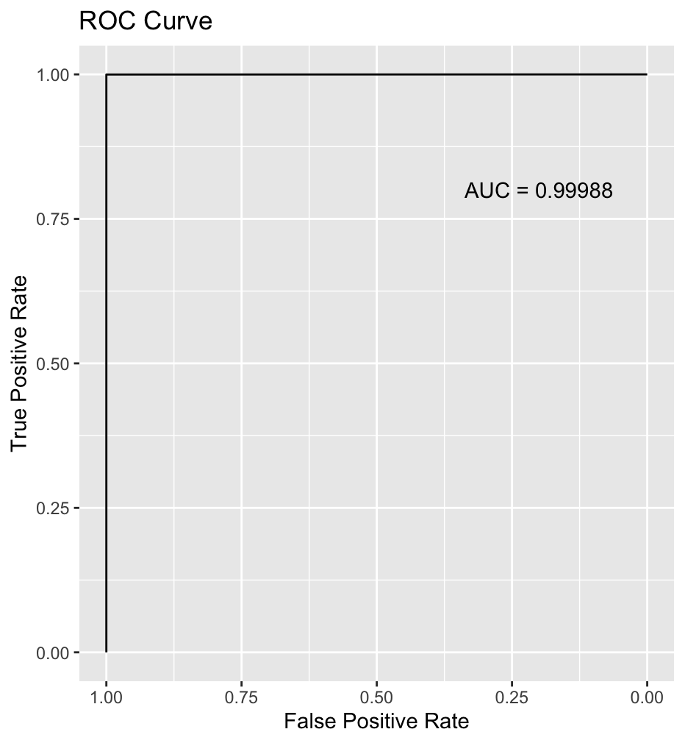
XGBoost in R: Result
Our model stops boosting at #261 round, which means the model accuracy decreases in the next 50 rounds. So we know that overfitting occurs after that. Hence, we changed parameter nrounds to 261 and trained our final model.
The first plot shows the 5 most important features identified by our final XGBoost model
The ROC-AUC plot illustrates the model's performance on the test set. The exceptionally high AUC score of 0.99988, suggests an almost perfect classification. It’s likely that the nature of the simulated dataset leads to such unusual result since the simulated dataset is designed for practice purposes and thus may be simpler to classify.

Slide 15
THE END
THANKS

