Slide 1
PRESENTATION TITLE
SUBTITLE HERE
MindShow.fun
2023-12-04

Slide 2
CONTENTS
Introduction to XGBoost
Card Transaction Fraud Dataset Introduction
Enhanced Fraud Detection using XGBoost

Slide 3
Dataset Introduction
1000000 transactions, 8.74% fraud rate
Feature Explanation:
distance_from_home: the distance from home where the transaction happened
distance_from_last_transaction: the distance from last transaction happened
ratio_to_median_purchase_price: ratio of transaction prive to median purchase price
repeat_retailer: Is the transaction happened from same retailer
used_chip: Is the transaction through credit card?
used_pin_number - Is the transaction happened by using PIN number?
online_order - Is the transaction an online order?
fraud - Is the transaction fraudulent.

Slide 4
01
Introduction to XGBoost

Slide 5
Gradient boosting
In Gradient boosted decision tree(GBDT), the k-th tree is used to fit the negative derivative of the loss function with respect to the current model’s prediction.
The current model’s prediction for each observation is the weighted sum of the first k-1 trees.
If we use MSE as the loss function in a regression task, the derivative for each observation is simply the residual between true label value and predicted value.

Slide 6
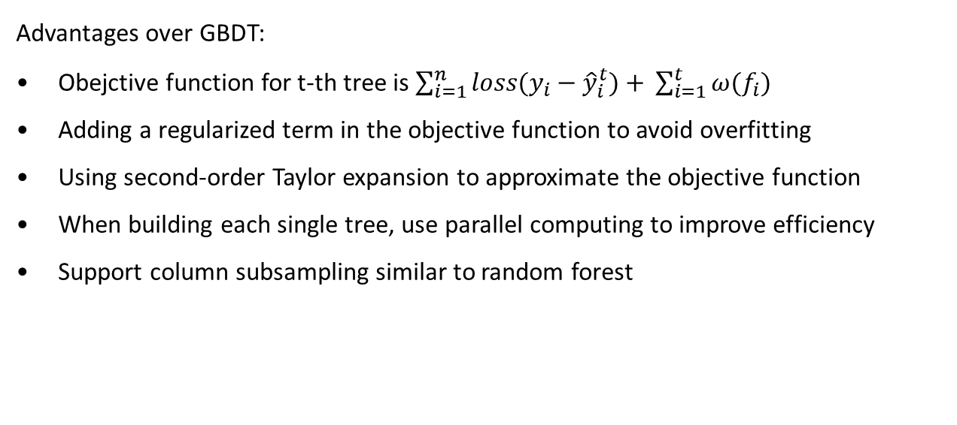
XGBoost
Advantages over GBDT:
Obejctive function for t-th tree is $\sum_{i=1}^{n}{loss(y_{i}−{\hat{y}}_{i}^{t})+} \sum_{i=1}^{t}{ω(f_{i})}$
Adding a regularized term in the objective function to avoid overfitting
Using second-order Taylor expansion to approximate the objective function
When building each single tree, use parallel computing to improve efficiency
Support column subsampling similar to random forest

Slide 7
XGBoost in R
xgb.train <- xgb.DMatrix(data = train.x, label = train.y)
Parallel Computing: It features parallelization capabilities, enabling faster model training.
Tree Pruning: XGBoost employs a technique called tree pruning to improve its efficiency and overall performance.

Slide 8
Advantages of XGBoost
XGBoost offers several advantages that make it a preferred choice for machine learning enthusiasts and practitioners. These advantages include:
Chapter 2

Slide 9
XGBoost offers several advantages that make it a preferred choice for machine learning enthusiasts and practitioners. These advantages include:
High Performance: XGBoost has a proven track record of winning numerous machine learning competitions due to its superior performance.
Flexibility: It supports custom optimization objectives and evaluation criteria, providing flexibility in model development.
Cross-Platform Compatibility: XGBoost is compatible with various programming languages, including Python, R, Java, and more, making it accessible to a wide range of users.

Slide 10
02
Card Transaction Fraud Dataset Introduction

Slide 11
Card Transaction Fraud Dataset Introduction
Understanding Card Transaction Fraud
Importance of Fraud Detection
Characteristics of Fraudulent Transactions

Slide 12
Understanding Card Transaction Fraud
Credit card fraud has become a prevalent issue in the financial industry, posing a significant threat to both cardholders and financial institutions. Detecting fraudulent transactions is crucial for preventing financial losses and maintaining trust in the payment ecosystem.

Slide 13
Importance of Fraud Detection
The ability to identify and prevent fraudulent activities is paramount for safeguarding the integrity of financial transactions. With the advancement of machine learning techniques, such as XGBoost, the detection of fraudulent card transactions has become more efficient and accurate, leading to enhanced security measures and reduced financial losses for both consumers and businesses.

Slide 14
Characteristics of Fraudulent Transactions
Fraudulent card transactions often exhibit distinct patterns and anomalies that can be detected through sophisticated machine learning models. By leveraging advanced algorithms and feature engineering, it is possible to uncover hidden insights within card transaction data, enabling the identification of fraudulent activities with high precision.
Chapter 3

Slide 15
03
Enhanced Fraud Detection using XGBoost

Slide 16
Enhanced Fraud Detection using XGBoost
Leveraging XGBoost for Fraud Detection
Feature Engineering in Fraud Detection
Real-time Monitoring and Response

Slide 17
Leveraging XGBoost for Fraud Detection
XGBoost has emerged as a powerful tool for fraud detection in card transactions due to its ability to handle large volumes of data and effectively capture intricate patterns indicative of fraudulent behavior. By harnessing the strengths of XGBoost, financial institutions can enhance their fraud detection mechanisms and mitigate potential risks associated with unauthorized transactions.

Slide 18
Feature Engineering in Fraud Detection
Incorporating advanced feature engineering techniques in conjunction with XGBoost provides a comprehensive approach to detecting fraudulent transactions. By extracting relevant features from transaction data and leveraging the predictive capabilities of XGBoost, financial organizations can achieve greater accuracy in identifying potential fraud instances, thereby fortifying their security measures.

Slide 19
Real-time Monitoring and Response
Another compelling aspect of utilizing XGBoost for fraud detection lies in its capability to facilitate real-time monitoring and response. By continuously analyzing incoming transaction data using XGBoost-powered models, organizations can swiftly detect anomalies and take immediate action to prevent financial losses, thereby elevating the overall security posture within the payment ecosystem.

Slide 20
THE END
THANKS

Slide 21
Copyright:
The copyright of this template belongs to MindShow.fun.
Personal commercial use requires Premium Account, Basic Account can only be used for personal study.
If you need enterprise commercial authorization, please contact MindShow.fun to purchase the enterprise version.
Download font in PPT:"Noto Sans SC", "Noto Sans KR"
https://github.com/huansixie6rj/MindShow.fun/releases

