Slide 1
PRESENTATION TITLE
David Lin, Amber Wang, Niu Mu, Qifei Cui, Yixin Xue
MindShow.fun
2023-12-04

Slide 2
CONTENTS
Card Transaction Fraud Dataset Introduction
XGBoost introduction

Slide 3
01
Introduction to Dataset

Slide 4
Dataset Introduction
Simulated credit card transaction fraud data on Kaggle
Credit Card Fraud (kaggle.com)
Binary classification problem, each transaction is either fraudulent or not.
1000000 transactions, only 87403 transactions are fraudulent. 8.74% fraud rate, very unbalanced data
We will try stratified sampling and upsampling when dividing the dataset

Slide 5
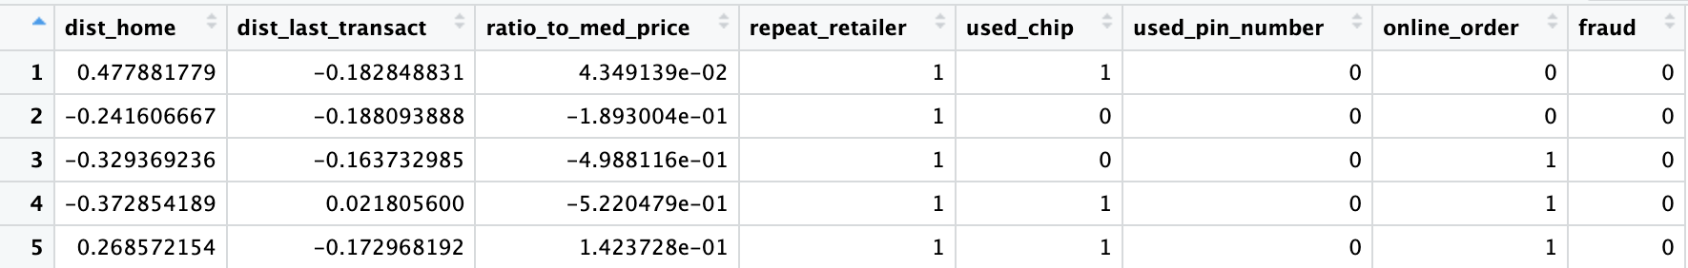
Dataset description
dist_home: the distance from home where the transaction happened
dist_last_transact: the distance from last transaction happened
ratio_to_med_price: ratio of transaction prive to median purchase price
repeat_retailer: Is the transaction happened from same retailer

Slide 6
Dataset description (continue)
used_chip: Is the transaction through credit card?
used_pin_number - Is the transaction happened by using PIN number?
online_order - Is the transaction an online order?
fraud - Is the transaction fraudulent.

Slide 7
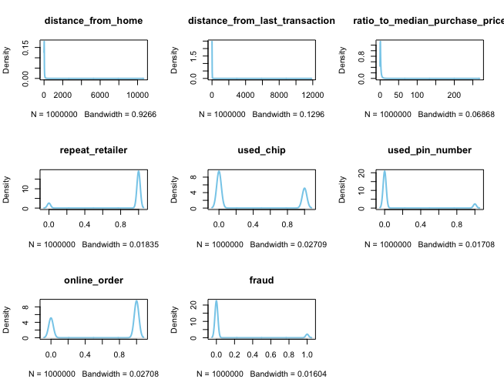
EDA
> dim(data)
[1] 1000000 8
> sum(is.na(data))
[1] 0
# distribution and outliers in each feature

Slide 8
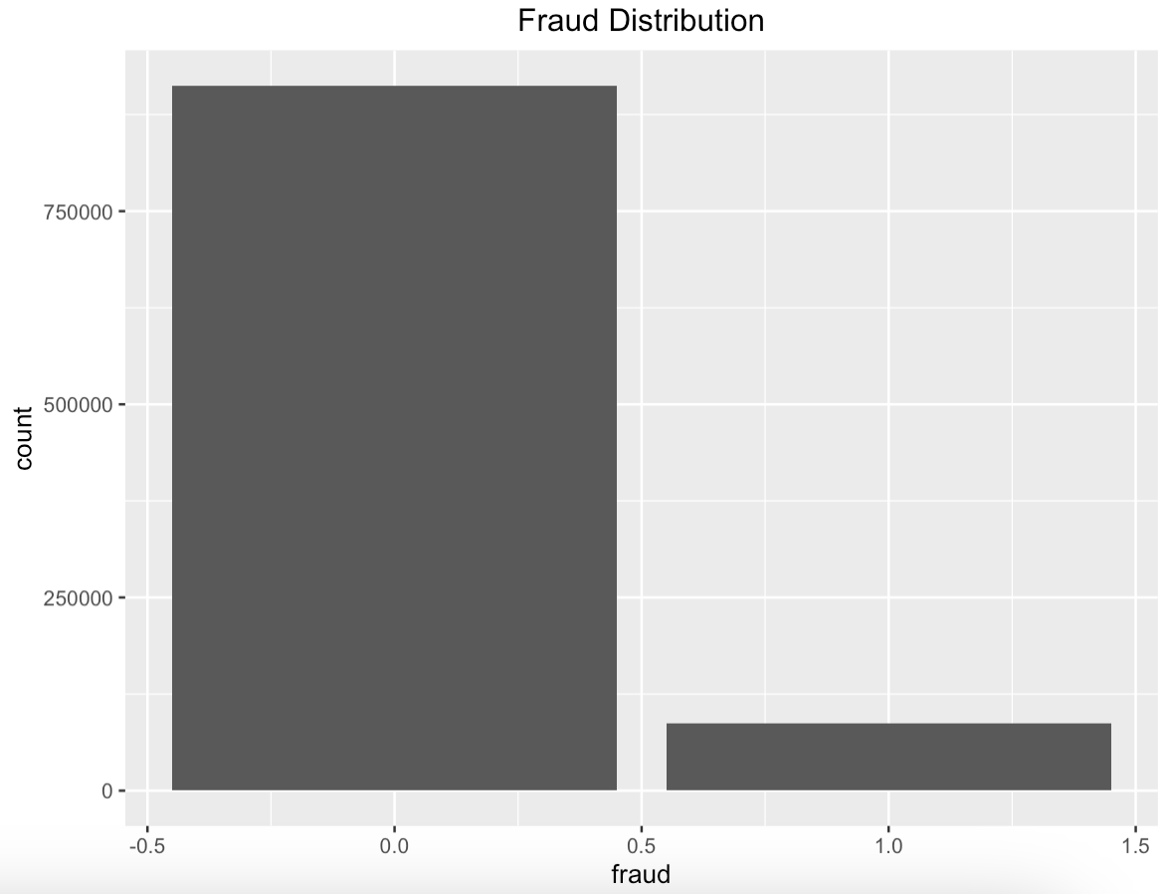
More on EDA
Around 91% of the transactions are not fraud and 9% are fraud.
There imbalance suggests adapting performance metrics like "true positive rate", "precision" and "f1 score" instead of "accurary" to assess the ML model.

Slide 9
Gradient boosting
In Gradient boosted decision tree(GBDT), the k-th tree is used to fit the negative derivative of the loss function with respect to the current model’s prediction.
The current model’s prediction for each observation is the weighted sum of the first k-1 trees.
If we use MSE as the loss function in a regression task, the derivative for each observation is simply the residual between true label value and predicted value.

Slide 10
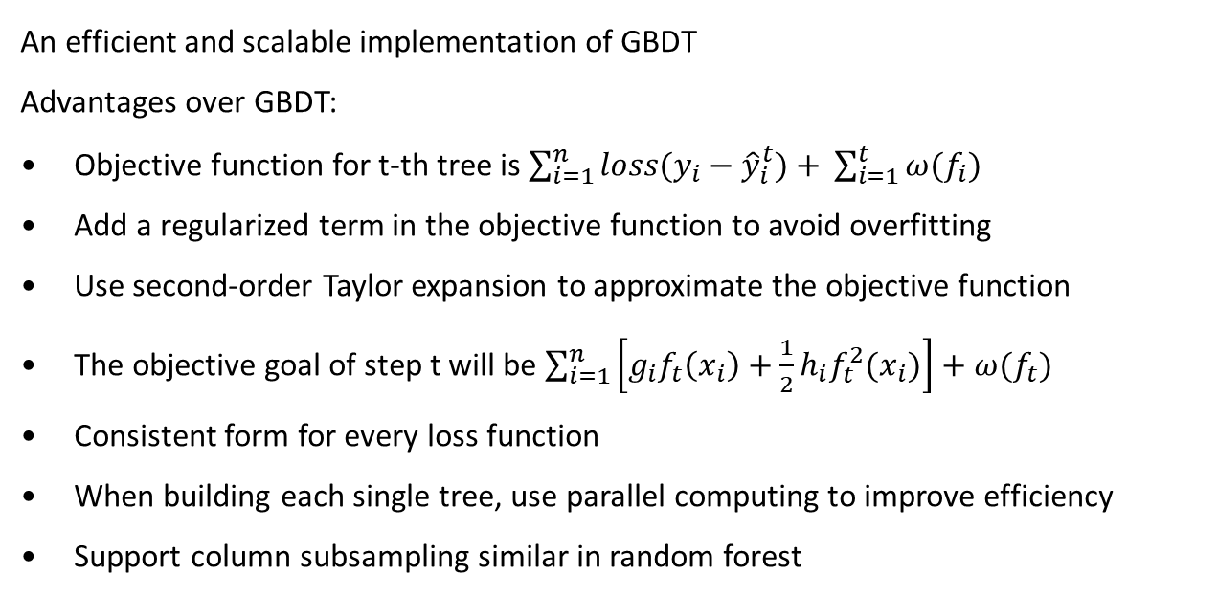
XGBoost
An efficient and scalable implementation of GBDT
Advantages over GBDT:
Objective function for t-th tree is $\sum_{i=1}^{n}{loss(y_{i}−{\hat{y}}_{i}^{t})+} \sum_{i=1}^{t}{ω(f_{i})}$
Add a regularized term in the objective function to avoid overfitting
Use second-order Taylor expansion to approximate the objective function
The objective goal of step t will be $\sum_{i=1}^{n}{\left[g_{i}f_{t}\left(x_{i}\right)+\frac{1}{2}h_{i}f_{t}^{2}(x_{i})\right]+ω(f_{t})}$
Consistent form for every loss function
When building each single tree, use parallel computing to improve efficiency
Support column subsampling similar in random forest

Slide 11
XGBoost in R
Install required package
install.packages(‘xgboost’)
require(xgboost)
Save the dataset in Dmatrix format provided by XGBoost package to ensure efficiency
E.x
train.x <- data.matrix(training(data.split) %>% select(-fraud))
xgb.train <- xgb.DMatrix(data = train.x, label = train.y)

Slide 12
XGBoost in R
Model parameters and training example
watchlist = list(train=dtrain, validation=dval)
model <- xgb.train(data = dtrain, max_depth = 3, objective = “binary:logistic”, eta = 0.3, nrounds = 100, nthread = 2, early_stopping_rounds = 50, verbose = 0, watchlist = watchlist)

Slide 13
XGBoost in R
watchlist = list(train=dtrain, validation=dval)
model <- xgb.train(data = dtrain, max_depth = 3, objective = “binary:logistic”, eta = 0.3, nrounds = 100, nthread = 2, early_stopping_rounds = 50, verbose = 0, watchlist = watchlist)
max_depth: depth of each decision tree
nrounds: max number of trees built
eta: learning rate used to control the weight of each tree, default 0.3
use watchlist to monitor model performance on validation dataset in each round
early_stopping_rounds = 10 means that if the model’s performance on validset doesn’t decrease for 10 rounds, stop training

Slide 14
02

Slide 15
Card

Slide 16
THE END
THANKS

